Slide 1
MA/CSSE 473 Day 21
AVL Tree
Maximum height
2-3 Trees
Heap Review: intro
Student questions?

Slide 2
Review: Representation change:
AVL Trees (what you should remember…)
Named for authors of original paper, Adelson-Velskii and Landis (1962).
An AVL tree is a height-balanced Binary Search Tree.
A BST T is height balanced if T is empty, or if
  | height( T_{L} ) - height( T_{R} ) | ≤ 1, and
  T_{L} and T_{R} are both height-balanced.
Show: Maximum height of an AVL tree with N nodes is Θ(log N)
How do we maintain balance after insertion?
Exercise for later: Given a pointer to the root of an AVL tree with N nodes, find the height of the tree in log N time
Details on balance codes and various rotations are
in the CSSE 230 slides that are linked from the
schedule page.
Let's review that together
Notes:
Extra data to make this more efficient. Balance code in each node.
This is an essential part of the AVL data structure.

Slide 3
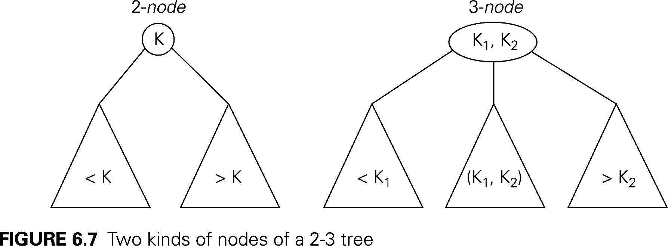
Representation change: 2-3 trees
Another approach to balanced trees
Keeps all leaves on the same level
Some non-leaf nodes have 2 keys and 3 subtrees
Others are regular binary nodes.
Notes:
Easy to balance

Slide 4
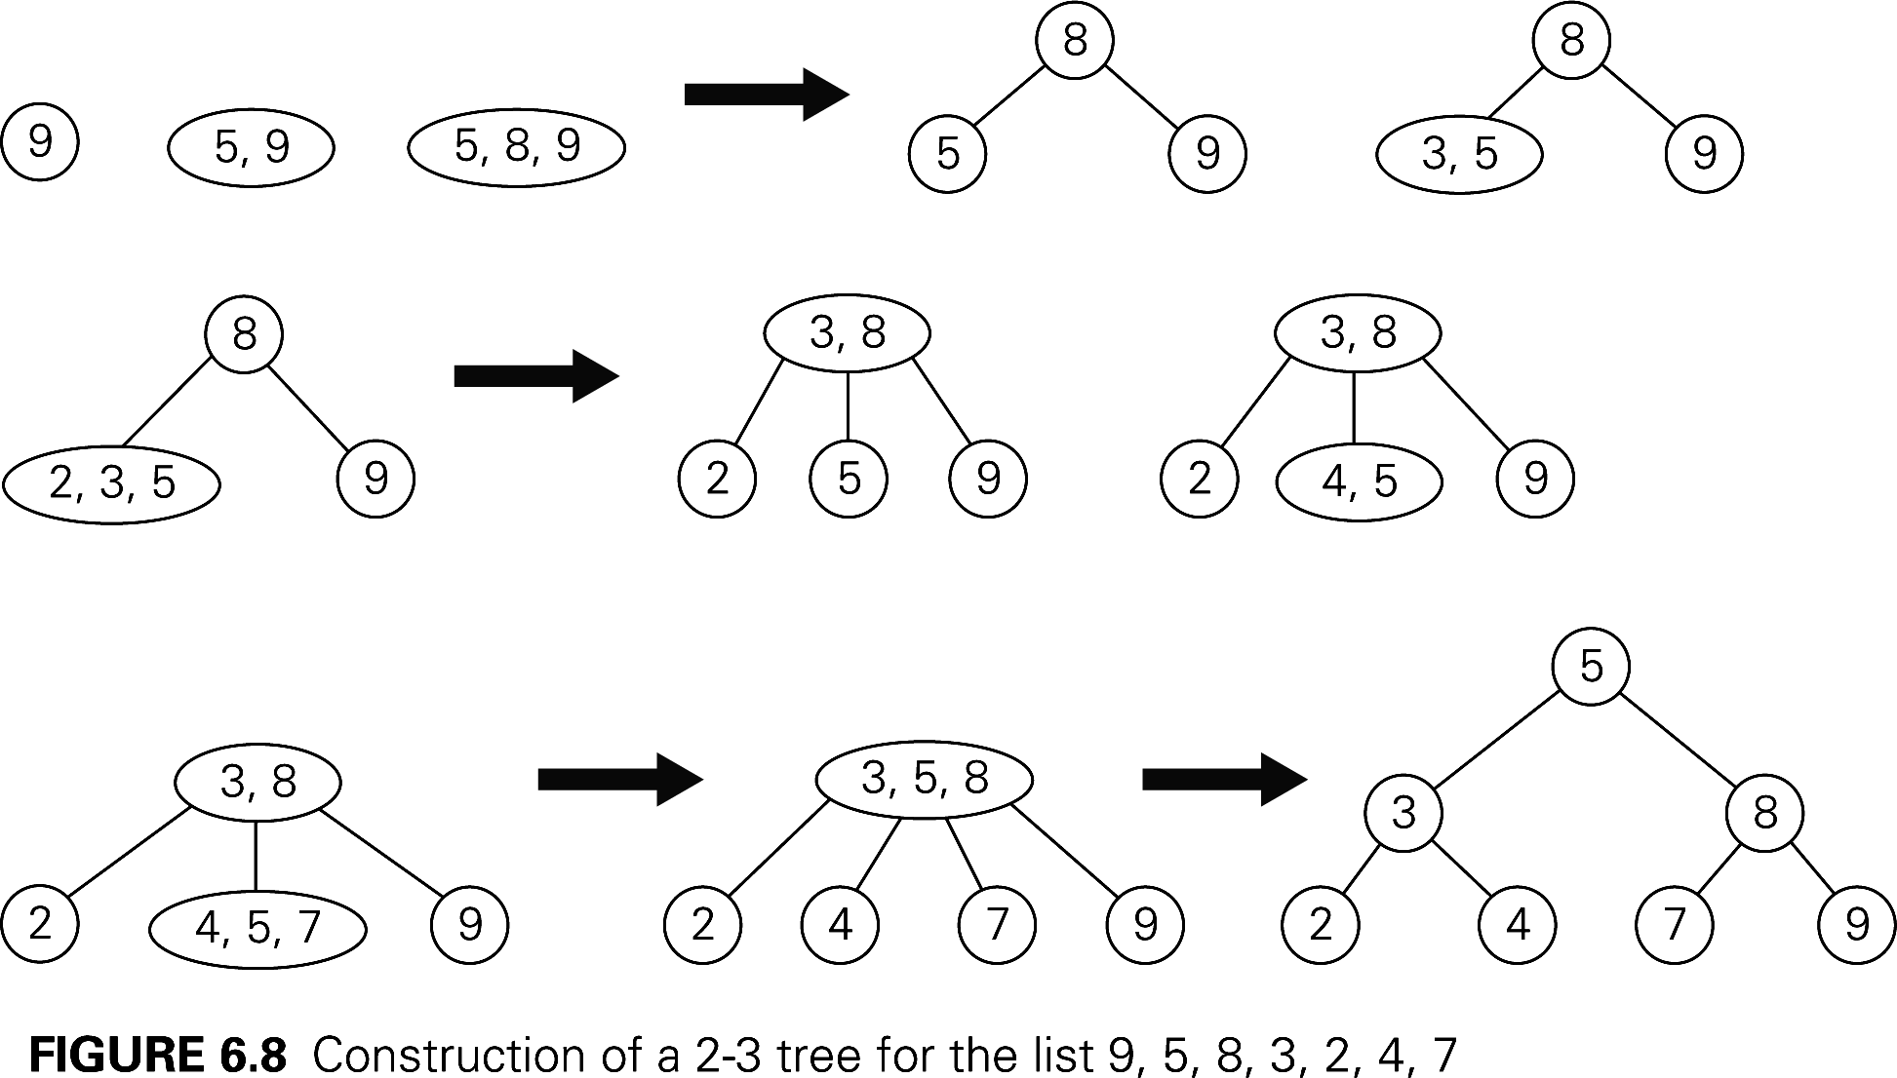
2-3 tree insertion example
More examples of insertion:
http://www.cs.ucr.edu/cs14/cs14_06win/slides/2-3_trees_covered.pdf
http://slady.net/java/bt/view.php?w=450&h=300
Add 10, 11, 12, … to the last tree

Slide 5
Efficiency of 2-3 tree insertion
Upper and lower bounds on height of a tree with n elements?
Worst case insertion and lookup times is proportional to the height of the tree.
Notes:
Upper bound: A full binary tree. So N ≥ 2^{h+1} -1. h ≤ lg(N+1) -1.
Lower bound. Full ternary tree. Two items in each node
N <= 2(1 + 3 + 3² + … + 3^{h}) = 3^{h+1} -1. So h ≥ log₃(N+1) -1

Slide 6
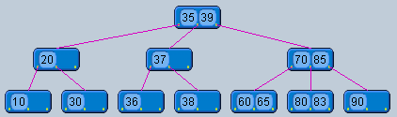
2-3 Tree insertion practice
Insert 84 into this tree and show the resulting tree

Slide 7
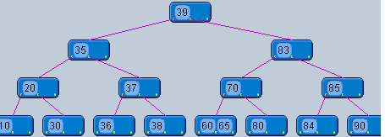
2-3 Tree insertion practice
Insert 84 into this tree and show the resulting tree

Slide 8
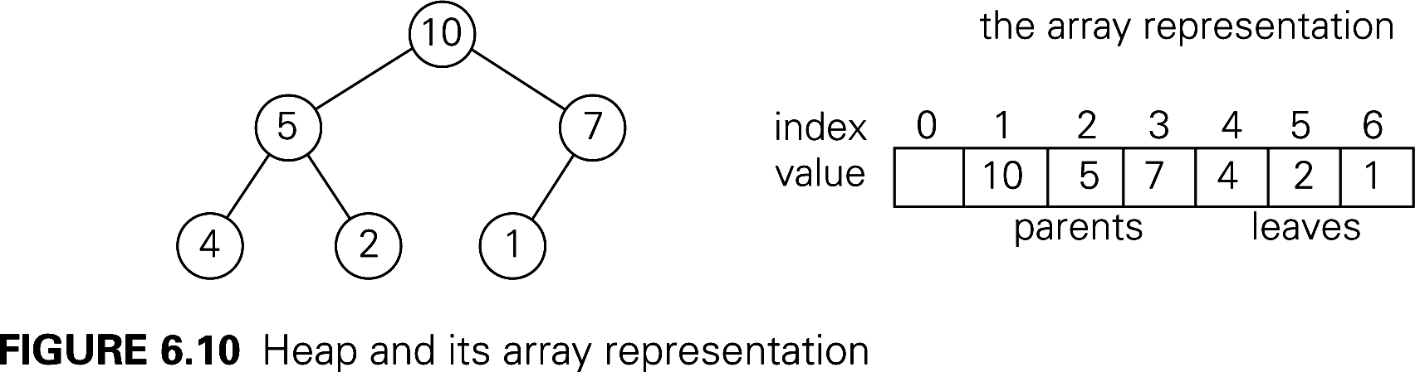
Binary (max) Heap Quick Review
Representation change example
See also Weiss, Chapter 21 (Weiss does min heaps)
An almost-complete Binary Tree
  All levels, except possibly the last, are full
  On the last level all nodes are as far left as possible
  No parent is smaller than either of its children
  A great way to represent a Priority Queue
Representing a binary heap as an array:
Notes:
My guess is that for most of you, you only need a quick refresher on the heap insert and removeMax algorithms, but that a subtle issue relating to heapSort analysis may have gone over your head.

Slide 9
Insertion and RemoveMax
Insertion:
  Insert at the next position (end of the array) to maintain an almost-complete tree, then "percolate up" within the tree to restore heap property.
RemoveMax:
  Move last element of the heap to replace the root, then "percolate down" to restore heap property.
Both operations are Ѳ(log n).
Many more details (done for min-heaps):
  http://www.rose-hulman.edu/class/csse/csse230/201230/Slides/18-Heaps.pdf
Notes:
Draw the heap rom previous slide on the board, insert 8, then 11; removeMax a couple of times.
Then show code on next slide

Slide 10
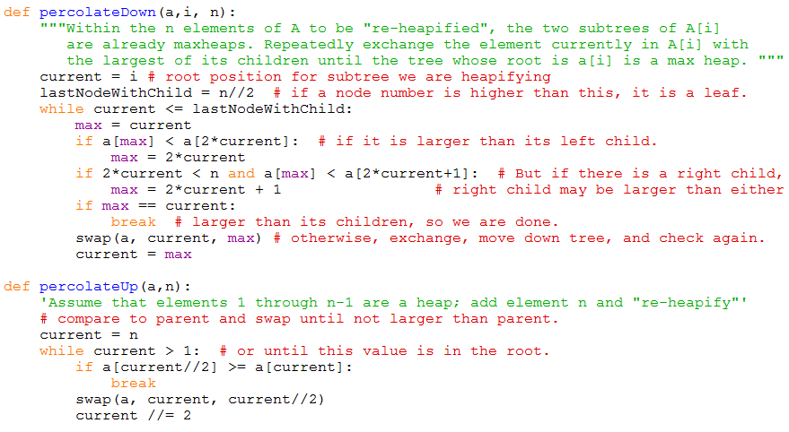
Heap utilitiy functions
Code is on-line, linked from the schedule page

Slide 11
HeapSort
Arrange array into a heap. (details next slide)
for i = n downto 2:
a[1]↔a[i], then "reheapify" a[1]..a[i-1]

Slide 12
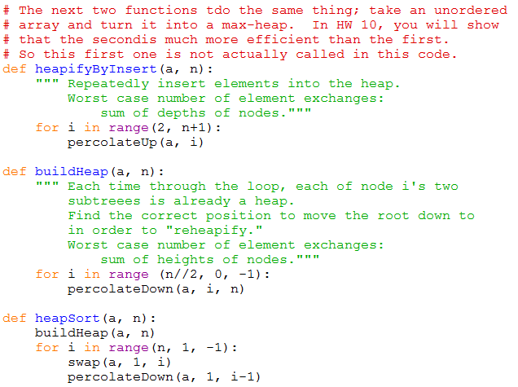
HeapSort Code

Slide 13
Recap: HeapSort: Build Initial Heap
Two approaches:
  for i = 2 to n
  percolateUp(i)
  for j = n/2 downto 1
  percolateDown(j)
Which is faster, and why?
What does this say about overall big-theta running time for HeapSort?
Notes:
What is the depth of the node in position a[i]? Answer: floor(lg i)
In a full tree, what is the relationship between Height(node[i]) and depth(node[i])?

