Slide 1
MA/CSSE 473 Day 20
Finish Josephus
Transform and conquer
Gaussian Elimination
LU-decomposition
AVL Tree
Maximum height
2-3 Trees
Student questions?

Slide 2
Recap: Josephus Problem
n people, numbered 1-n, are in a circle
Count starts with 1
Every 2nd person is eliminated
The last person left, J(n), is the winner
Examples: n=8, n=7
J(1) = 1
Solution if n is even: J(2k) = 2*J(k) - 1
Solution if n is odd: J(2k+1) = 2*J(k) + 1
Use it to find J(2) … J(8)
Clever solution: cyclic bit shift left
Notes:
n=8: First pass eliminates positions 2, 4, 6, 8. Second pass eliminates 3, 7. Third pass 5. 1 left
n=7. First pass 2, 4, 6, 1. Then 5, 3 . 7 is left
If n is even: We eliminate 2, 4, 6, … n on first round.
This leaves us with the same problem for n/2 (except for renumbering)
1→ 1, 2→ 3, 3→5, etc. i→2*i-1.
Thus J(2k) = 2∙J(k)-1
If n is odd: We eliminate 2, 4, 6, … n-1, 1 on first round.
This leaves us with the same problem for (n-1)/2 items (except for renumbering)
1→ 3, 2→ 5, 3→7, etc. i→2*i+1.
Thus J(2k+1) = 2∙J(k)+1
Cyclic bit shift: 1→1, 10→01, 11→11, 100→001, 101→011, 110→101, 111→111, 100→001

Slide 3
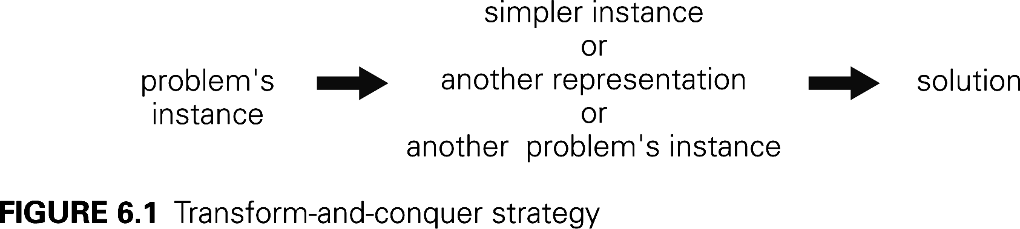
Transform and Conquer Algorithms
Transform a problem to a simpler instance of the same problem – instance simplification
Transformation to a different representation of the same instance – representation change
Transformation to an instance of a different problem that we know how to solve – problem reduction

Slide 4
Instance simplification:
Presorting an Array
The following problems are simplified by pre-sorting the array:
  Search (can do Binary or Interpolation search)
  Determine whether the array contains duplicates
  Find the median of the array
  Find the mode of the elements of the array
    The most frequently-occurring element
  A related problem: Anagrams
    In a large collection of words, find words that are anagrams of each other
    How can pre-sorting help?
    Sort the letters of each word
  Interval union problem from early part of PLC course
Notes:
Why are these "transform and conquer"?

Slide 5
Instance Simplification: Gaussian Elimination
(hopefully you saw basics in a DE or lin. Alg. course)
Solve a system of n linear equations in n unknowns
  Represent the system by an augmented coefficient matrix
  Transform the matrix to triangular matrix by a combination of the following solution-preserving elementary operations:
    exchange two rows
    multiply a row by a nonzero constant
    replace a row by that row plus or minus a constant multiple of a different row
  Look at the algorithm and analysis on pp 207-208; if you can't understand them, ask in my office.
  Ѳ(n³) [previous HW problem]
Notes:
Why is this "transform and conquer"?

Slide 6
Other Applications of G.E.
Matrix inverse
  Augment a square matrix by the identity matrix
  Perform elementary operations until the original matrix is the identity.
  The "augmented part" will be the inverse
  More details and an example at
  http://en.wikipedia.org/wiki/Gauss-Jordan_elimination

Slide 7
Other Applications of G.E.
Determinant calculation
  Calculation of the determinant of a triangular matrix is easy
What effect does each of the elementary operations have on the determinant value?
  exchange two rows
  multiply a row by a nonzero constant
  replace a row by that row plus or minus a constant multiple of a different row
Do these operations until you get a triangular matrix
Keep track of the operations' cumulative effect on the determinant
Notes:
Multiples determinant by -1
Multiplies determinant by that constant
No effect.

Slide 8
LU Decomposition
This can speed up all three applications of Gaussian Elimination
Write the matrix A as a product of a Lower Triangular matrix L and an upper Triangular matrix U.
Example:
Splitting A up into L and U is an n³ operation. https://rosettacode.org/wiki/LU_decomposition
Notes:
Example, solving Ax = B is the same as solving LUx = B.
let y = Ux. Solve Ly = B, easy because L is triangular.
Then solve Ux = y, also easy because U is triangular.
We won't do the details. It turns out that finding L and U are theta(n^3) – like G.E..
But once we have done it, doing the multiplication is theta(n^2)
Helpful in situation where we want to solve several different equations: Ax = b, Ax = c, Ax=d, etc. The L and U are the same for all of the cases.

Slide 9
Review: Representation change:
AVL Trees (what you should remember…)
Named for authors of original paper, Adelson-Velskii and Landis (1962).
An AVL tree is a height-balanced Binary Search Tree.
A BST T is height balanced if T is empty, or if
  | height( T_{L} ) - height( T_{R} ) | ≤ 1, and
  T_{L} and T_{R} are both height-balanced.
Show: Maximum height of an AVL tree with N nodes is Θ(log N)
How do we maintain balance after insertion?
Exercise for later: Given a pointer to the root of an AVL tree with N nodes, find the height of the tree in log N time
Details on balance codes and various rotations are
in the CSSE 230 slides that are linked from the
schedule page.
Let's review that together
Notes:
Extra data to make this more efficient. Balance code in each node.
This is an essential part of the AVL data structure.

Slide 10
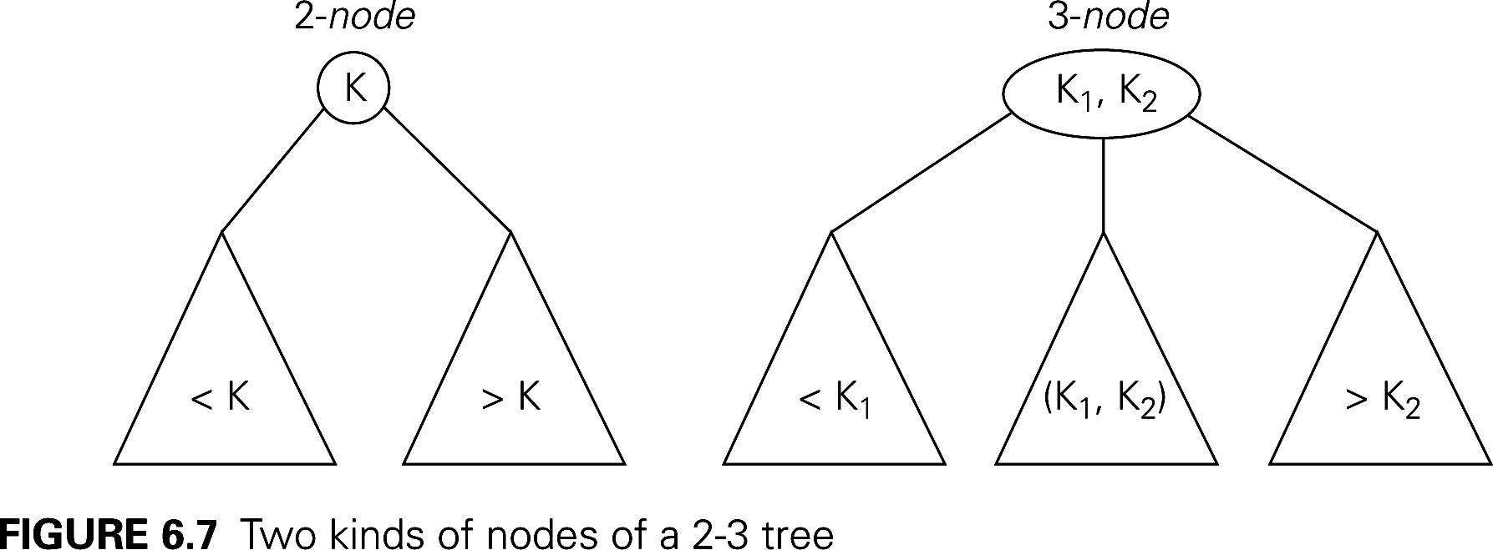
Representation change: 2-3 trees
Another approach to balanced trees
Keeps all leaves on the same level
Some non-leaf nodes have 2 keys and 3 subtrees
Others are regular binary nodes.
Notes:
Easy to balance

Slide 11
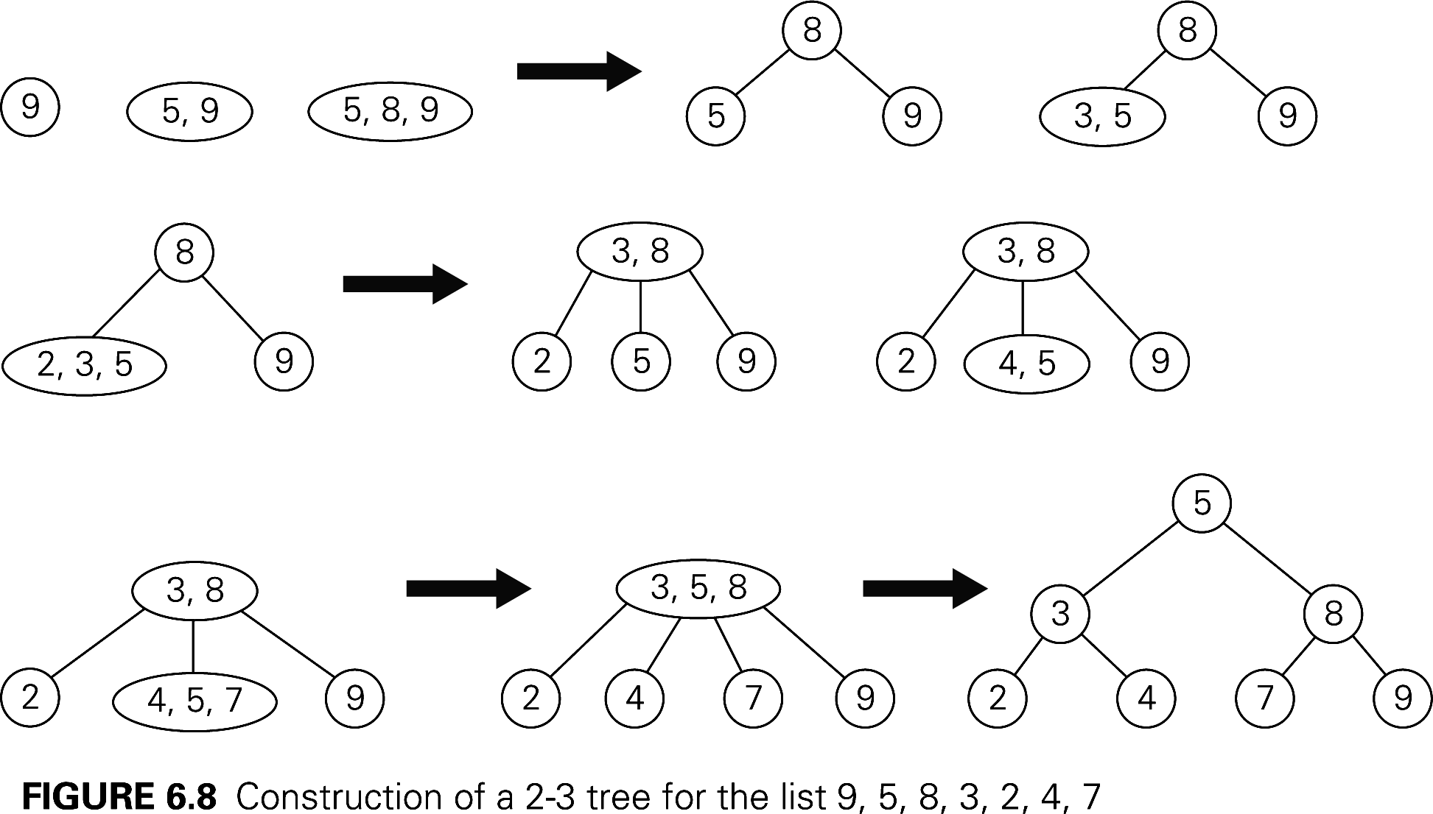
2-3 tree insertion example
More examples of insertion:
http://www.cs.ucr.edu/cs14/cs14_06win/slides/2-3_trees_covered.pdf
http://slady.net/java/bt/view.php?w=450&h=300
Add 10, 11, 12, … to the last tree

Slide 12
Efficiency of 2-3 tree insertion
Upper and lower bounds on height of a tree with n elements?
Worst case insertion and lookup times is proportional to the height of the tree.
Notes:
Upper bound: A full binary tree. So N ≥ 2^{h+1} -1. h ≤ lg(N+1) -1.
Lower bound. Full ternary tree. Two items in each node
N <= 2(1 + 3 + 3² + … + 3^{h}) = 3^{h+1} -1. So h ≥ log₃(N+1) -1

Slide 13
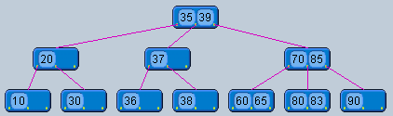
2-3 Tree insertion practice
Insert 84 into this tree and show the resulting tree

Slide 14
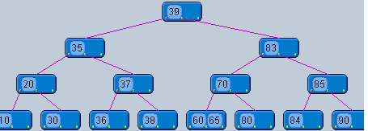
2-3 Tree insertion practice
Insert 84 into this tree and show the resulting tree

