Slide 1
Some more Decrease-and-conquer Algorithms
What questions do you have?
Decrease by a constant factor
Decrease by a variable amount

Slide 2
Shell's sort – A quick recap
Insertion Sort on Steroids

Slide 3
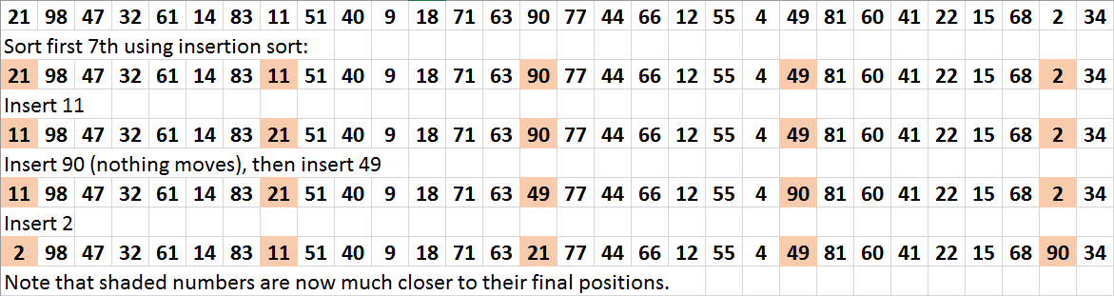
Shell's Sort
We use the following gaps: 7, then 3, then 1 (last gap must always be 1):
Next, do the same thing for the next group of 7ths

Slide 4
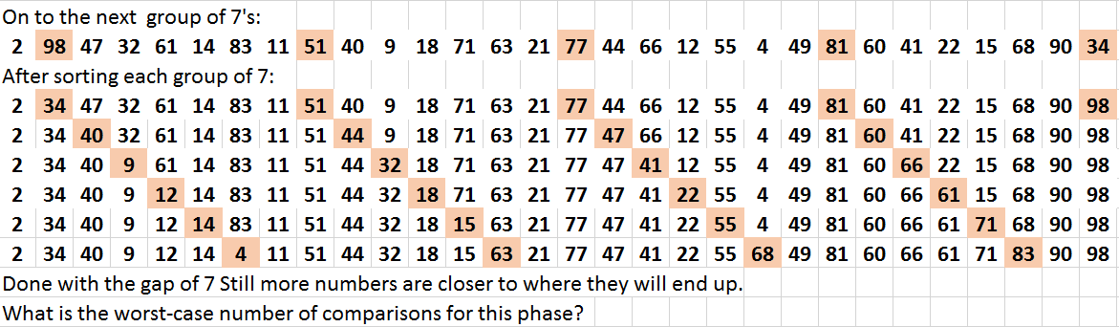
Shell's sort 2

Slide 5
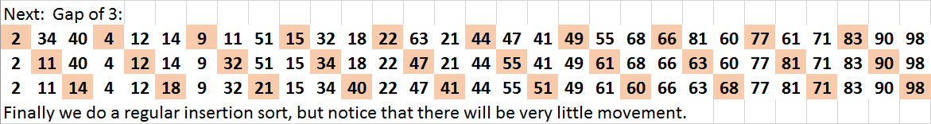
Shell's sort 3
Why bother, if we are going to do a regular insertion sort at the end anyway?
Analysis?
Why would this be an inferior gap sequence?
36, 12, 3, 1
https://www.youtube.com/watch?v=CmPA7zE8mx0
Notes:
No one has been able to analyze it yet, thought it works fast in practice if gap sequence is chosen well.

Slide 6
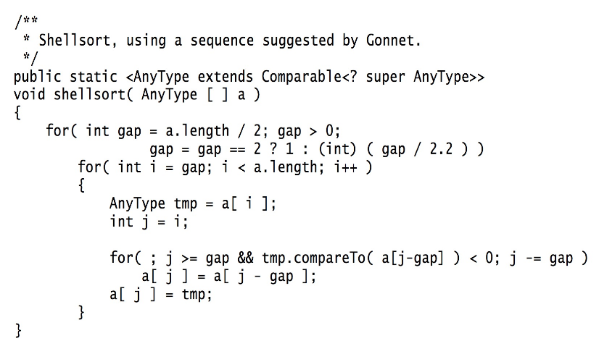
Code from Weiss book

Slide 7
More Decrease and Conquer examples

Slide 8
Decrease by a constant factor
Examples that we have already seen:
  Binary Search
  Exponentiation (ordinary and modular) by repeated squaring
  Multiplication à la Russe (The Dasgupta book that I often used for the first part of the course calls it "European" instead of "Russian")
    Example
    11 13
    5 26
    2 52
    1 104
    143
Then strike out any rows whose first number is even, and add up the remaining numbers in the second column.

Slide 9
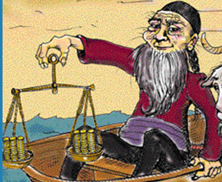
Fake Coin Problem
We have n coins
All but one have the
same weight
One is lighter
We have a balance scale with two pans.
All it will tell us is whether the two sides have equal weight, or which side is heavier
What is the minimum number of weighings that will guarantee that we find the fake coin?
Decrease by factor of two?

Slide 10
Decrease by a variable amount
Search in a Binary Search Tree
Interpolation Search
  See Levitin, pp190-191
  Also Weiss, Section 5.6.3
  And class slides from Session 12 (Winter, 2017)
Notes:
Mention the Wilkes-Barre phone book.

Slide 11
Median finding
Find the k^{th} smallest element of an (unordered) list of n elements
Start with quicksort's partition method
Informal analysis
Notes:
QuickSelect(A[l..r], k):
pos = partition(A) // use A[l] as pivot
If pos == k, return A[k]
Else if pos > k return QuickSelect(A[l, pos-1], k)
Else return QuickSelect(A[pos+1, r], k-pos-1)
Analysis: Best, constant, worst N^2. Average turns out to be linear, but analysis is complicated.

Slide 12
One Pile Nim
There is a pile of n chips.
Two players take turns by removing from the pile at least 1 and at most m chips. (The number of chips taken can vary from move to move.)
The winner is the player that takes the last chip.
Who wins the game – the player moving first or second, if both players make the best moves possible?
It’s a good idea to analyze this and similar games “backwards”, i.e., starting with n = 0, 1, 2, …
Notes:
If it's your turn and there are zero chips left, you have already lost.
If 1, 2, 3, … m, you can take them all and win.
What about m+1?
m+2?

Slide 13
Graph of One-Pile Nim with m = 4
Vertex numbers indicate n, the number of chips in the pile.
  The losing positions for the current player are circled.
  Only winning moves from a winning position are shown.
Generalization: The player who moves first wins iff n is not a multiple of 5 (more generally, m+1);
  The winning move is to take n mod 5 (n mod (m+1)) chips.

Slide 14
Multi-Pile Nim
There are multiple piles of chips. Two players take turns by removing from any single pile at least one and at most all of that pile's chips. (The number of chips taken can vary from move to move)
The winner is the player who takes the last chip.
What is the winning strategy for 2-pile Nim?
For the general case, consider the "Nim sum",
x ⊕ y, which is the integer obtained by bitwise XOR of corresponding bits of two non-negative integers x and y.
What is 6 ⊕ 3?
Notes:
2-piles: Take enough chips form larger pile so that n₁ = n₂.
6 ⊕ 3:
1 1 0
0 1 1
------
1 0 1 = 5

Slide 15
Multi-Pile Nim Strategy
Solution by C.L. Bouton:
The first player has a winning strategy iff the nim sum of the "pile counts" is not zero.
Let's prove it. Note that ⊕ is commutative and associative.
Also note that for any non-negative integer k, k⊕k is zero.

Slide 16
Multi-Pile Nim Proof
Notation:
  Let x₁, … ,x_{n} be the sizes of the piles before a move, and y₁, … ,y_{n} be the sizes of the piles after that move.
  Let s = x₁ ⊕ … ⊕ x_{n}, and t = y₁ ⊕ … ⊕ y_{n}.
Observe: If the chips were removed from pile k, then x_{i} = y_{i} for all i≠k, and x_{k} > y_{k} .
Lemma 1: t = s ⊕ x_{k} ⊕ y_{k} .
Lemma 2: If s = 0, then t ≠ 0.
Lemma 3: If s ≠ 0, it is possible to make a move such that t=0. [after proof, do an example].
Proof of the strategy is then a simple induction.
(It's a HW problem)
Example: 3 piles, containing 7, 13, and 8 chips.
Notes:
Lemma 1 proof:
t = 0 ⊕ t
= s ⊕ s ⊕ t
= s ⊕ (x₁ ⊕ ... ⊕ x_{n}) ⊕ (y₁ ⊕ ... ⊕ y_{n})
= s ⊕ (x₁ ⊕ y₁) ⊕ ... ⊕ (x_{n} ⊕ y_{n})
= s ⊕ 0 ⊕ ... ⊕ 0 ⊕ (x_{k} ⊕ y_{k}) ⊕ 0 ⊕ ... ⊕ 0 =
= s ⊕ x_{k} ⊕ y_{k}
Lemma 2 proof:
If there is no possible move, then the lemma is vacuously true (and the first player loses the normal play game by definition).
Otherwise, any move in heap k will produce t = x_{k} ⊕ y_{k} from (*). This number is nonzero, since x_{k} ≠ y_{k}.
Lemma 3 proof:
Let d be the position of the leftmost (most significant) nonzero bit in the binary representation of s, and choose k such that the dth bit of x_{k} is also nonzero. (Such a k must exist, since otherwise the dth bit of s would be 0.)
Then letting y_{k} = s ⊕ x_{k}, we claim that y_{k} < x_{k}:
all bits to the left of d are the same in x_{k} and y_{k}, bit d decreases from 1 to 0 (decreasing the value by 2^{d}), and
any change in the remaining bits will amount to at most 2^{d}−1.
The first player can thus make a move by taking x_{k} − y_{k} objects from heap k,
then
t = s ⊕ x_{k} ⊕ y_{k} (by (Lemma 1)) = s ⊕ x_{k} ⊕ (s ⊕ x_{k}) = 0.

