Slide 1
MA/CSSE 473 Day 17
Divide-and-conquer Convex Hull
Strassen's Algorithm: Matrix Multiplication
(if time, Shell's Sort)

Slide 2
MA/CSSE 473 Day 17
Student Questions
Exam 2 specification
Levitin 3rd Edition Closest Pairs algorithm
Convex Hull (Divide and Conquer)
Matrix Multiplication (Strassen)
Shell's Sort (a.k.a. shellsort)
Notes:
Pass around attendance sheet.

Slide 3
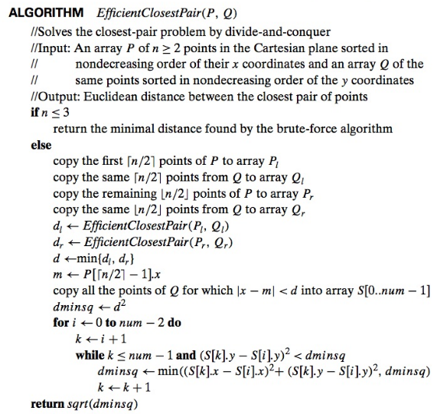

Levitin 3rd edition Closest Pair Algorithm
Sorting by both X and Y coordinates happens once, before the recursive calls are made.
When doing the comparisons in the inner loop, we compare all points that are in "y within d" range, not just those on opposite sides of the median line.
Simpler but more distances to calculate than in what I presented on Friday.
Notes:
This is here for reference again

Slide 4
QuickHuLL
A fast algorithm for solving the Convex Hull problem

Slide 5
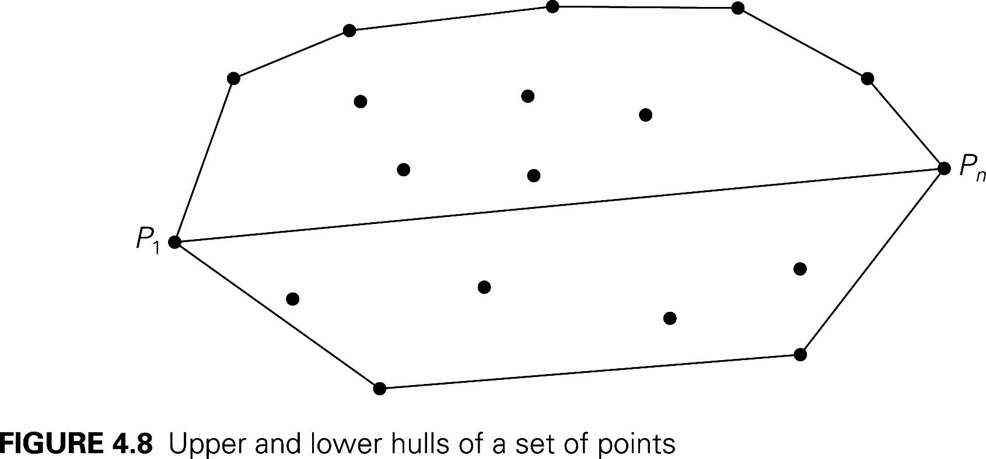
Convex Hull Problem
Again, sort by x-coordinate, with tie going to larger y-coordinate.
Notes:
Define the upper hull and lower hull.
S₁ is set of points above the P₁P_{n} line
To construct Upper Hull:
If S1 is empty, the upper hull is simply the P₁P_{n} line. Otherwise …
Find P_{max}, a point in S1 furthest away from the line. If there is a tie, select the point that maximizes the angle P_{max} P₁P_{n}.
Next slide.

Slide 6
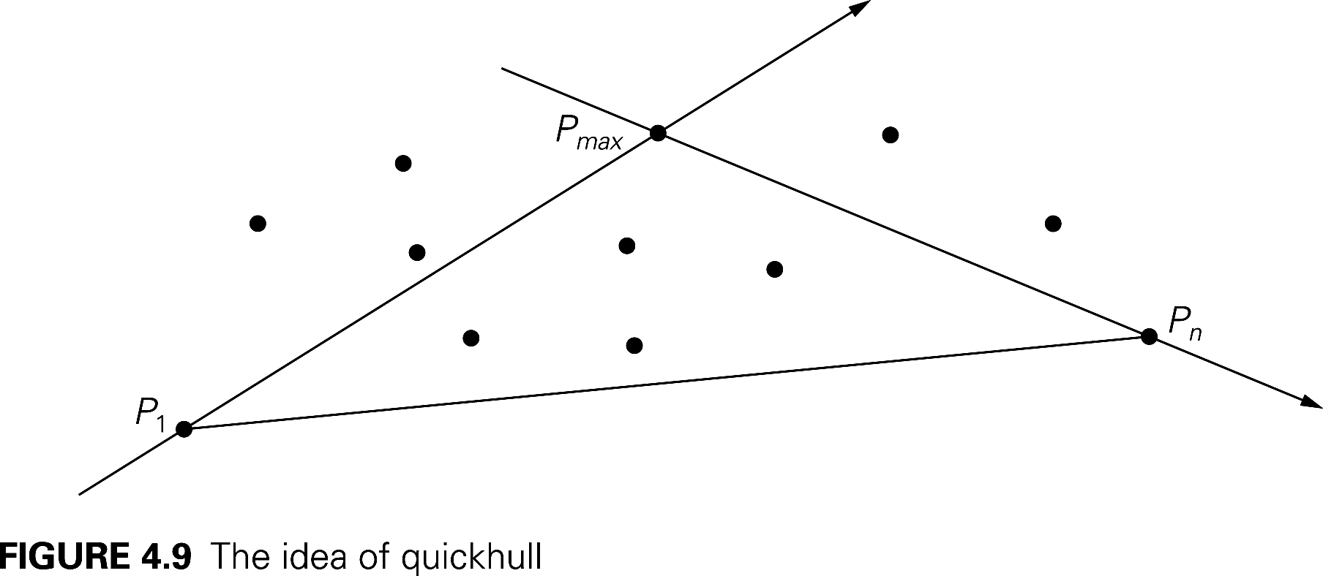
Recursive calculation of Upper Hull
Notes:
S_{1,1} is the set of points from S1 that are to the left of line P₁P_{max}.
S_{1,2} is the set of points from S1 that are to the left of line P_{max}P_{n}.
Note that
these sets must be disjoint (or else we did not choose P_{max} correctly)
P_{max} must be in the upper hull.
No points inside the triangle can be in the upper hull.
Recursively construct upper hulls of P₁ U S_{1,1} U P_{max} and of P_{max} U S_{1,2} U P_{n}.

Slide 7
Simplifying the Calculations
We can simplify two things at once:
Finding the distance of P from line P₁P_{2, and}
Determining whether P is "to the left" of P₁P₂
  The area of the triangle through P₁=(x₁,y₁), P₂=(x₂,y₂), and P₃=(x₃,y_{e}) is ½ of the absolute value of the determinant
    For a proof of this property, see http://mathforum.org/library/drmath/view/55063.html
    How do we use this to calculate distance from P to the line?
  The sign of the determinant is positive if the order of the three points is clockwise, and negative if it is counter-clockwise
    Clockwise means that P₃ is "to the left" of directed line segment P₁P₂
Speeding up the calculation
Notes:
Speeding up he calculation of the determinant
Note that the first and 5th terms of the determinant are the same for all points P3,
so for each point we only have to do 4 multiplications and 4 additions each time.

Slide 8
Efficiency of quickhull algorithm
What arrangements of points give us worst case behavior?
Average case is much better. Why?
Notes:
Worst Case is O(n²). What is the worst case (none of the points are inside the triangle).
Average turns out to be O(N), where N = number of points.

Slide 9
Faster Matrix multiplication
Strassen's Divide-and-conquer algorithm

Slide 10
Ordinary Matrix Multiplication
How many additions and multiplications are needed to compute the product of two 2x2 matrices?
    C₀₀ C₀₁ A₀₀ A₀₁ B₀₀ B₀₁
    = *
    C₁₀ C₁₁ A₁₀ A₁₁ B₁₀ B₁₁
[ ]
[ ]
[ ]

Slide 11
Strassen’s Matrix Multiplication
Strassen observed [1969] that the product of two matrices can be computed as follows:
    C₀₀ C₀₁ A₀₀ A₀₁ B₀₀ B₀₁
    = *
    C₁₀ C₁₁ A₁₀ A₁₁ B₁₀ B₁₁
    M₁ + M₄ - M₅ + M₇ M₃ + M₅
    =
    M₂ + M₄ M₁ + M₃ - M₂ + M₆
[ ]
[ ]
[ ]
[ ]
Values of M₁, M₂, … , M₇ are on the next slide

Slide 12
Formulas for Strassen’s Algorithm
M₁ = (A₀₀ + A₁₁) ∗ (B₀₀ + B₁₁)
M₂ = (A₁₀ + A₁₁) ∗ B₀₀
M₃ = A₀₀ ∗ (B₀₁ - B₁₁)
M₄ = A₁₁ ∗ (B₁₀ - B₀₀)
M₅ = (A₀₀ + A₀₁) ∗ B₁₁
M₆ = (A₁₀ - A₀₀) ∗ (B₀₀ + B₀₁)
M₇ = (A₀₁ - A₁₁) ∗ (B₁₀ + B₁₁)
How many additions and multiplications?

Slide 13
The Recursive Algorithm
We multiply square matrices whose size is a power of 2 (if not, pad with zeroes)
Break up each matrix into four
N/2 x N/2 submatrices.
Recursively multiply the parts.
How many additions and multiplications?
  If we do "normal matrix multiplication" recursively using divide and conquer?
  If we use Strassen's formulas?
Notes:
First analysis: T(n) = 8T(n/2) + 1. a = 8, b = 2, k = 0. Third case of master theorem.
So T(n) = n^3
Second analysis (is on a later slide)

Slide 14
Analysis of Strassen’s Algorithm
If N is not a power of 2, matrices can be padded with zeros.
Number of multiplications:
M(N) = 7M(N/2) + C, M(1) = 1
Solution: M(N) = Θ(N^{log} 2⁷) ≈ N^{2.807}
vs. N³ of brute-force algorithm.
What if we also count the additions?
Algorithms with better asymptotic efficiency are known but they are even more complex.
Notes:
BEFORE ANIMATION: Analysis M(N) = 7 M(N/2) = 49 M(N/4) ….
How do we know that x^(log y) =y^(log x)?
A(N) = 7A(N/2) + 18(N/2)²
We are doing 7 multiplications of smaller matrices, and 18 additions of smaller matrices.
Use Master Theorem

Slide 15
Shell's sort (a.k.a. ShellSort)
This is not a divide-and-conquer algorithm.
Today just seemed like a time when we might have a few minutes in which to discuss this interesting sorting technique
Insertion Sort on Steroids

Slide 16
Insertion sort
For what kind of arrays is insertion sort reasonably fast?
What is the main speed problem with insertion sort in general?
Shell's Sort is an attempt to improve that.

Slide 17
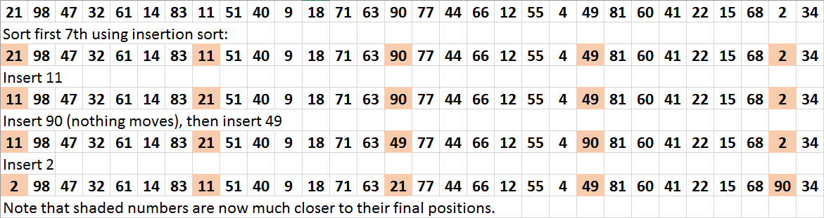
Shell's Sort
We use the following gaps: 7, then 3, then 1 (last one must always be 1):
Next, do the same thing for the next group of 7ths

Slide 18
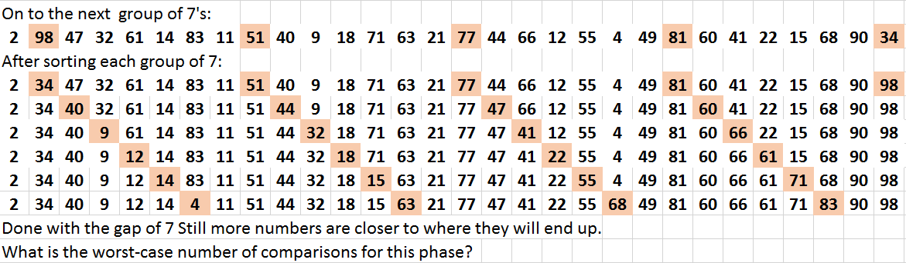
Shell's sort 2

Slide 19
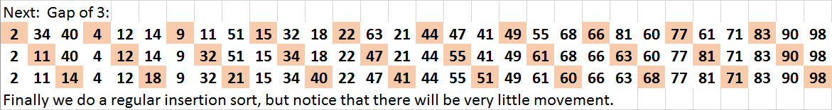
Shell's sort 3
Why bother if we are going to do a regular insertion sort at the end anyway?
Analysis?
Notes:
No one has been able to analyze it yet, thought it works fast in practice if gap sequence is chosen well.

Slide 20
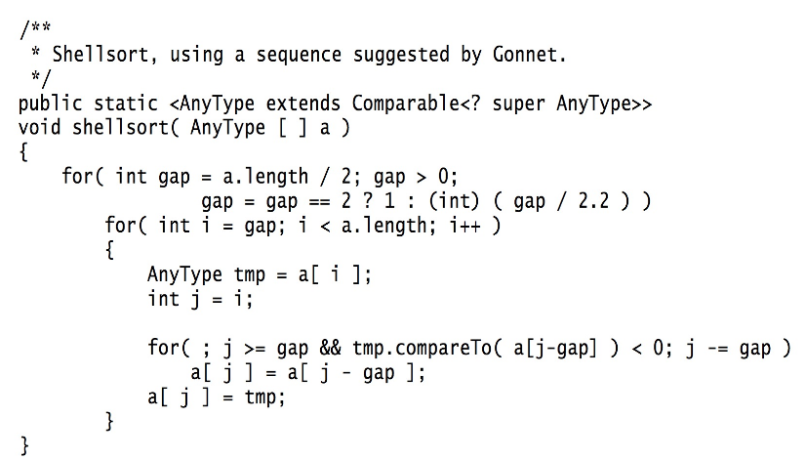
Code from Weiss book

