Slide 1
MA/CSSE 473 Day 16
Answers to your questions
Divide and Conquer
Closest Points
Convex Hull intro

Slide 2
Exercise from last time
Which permutation follows each of these in lexicographic order?
  183647520 471638520
  Try to write an algorithm for generating the next permutation, with only the current permutation as input.
If the lexicographic permutations of the numbers [0, 1, 2, 3, 4, 5] are numbered starting with 0, what is the number of the permutation 14032?
  General form? How to calculate efficiency?
In the lexicographic ordering of permutations of [0, 1, 2, 3, 4, 5], which permutation is number 541?
  How to calculate efficiently?
Notes:
After 183647520: 183650247 After 471638520: 471650238
Algorithm: Scan from right, find first place where p[i] < p[i+1].
find j, position of smallest among numbers in p[i+1]…p[n-1] that are greater than p[i].
exchange p[i] and p[j], then reverse p[i+1] ..p[n-1]

Slide 3
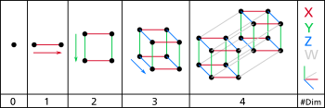
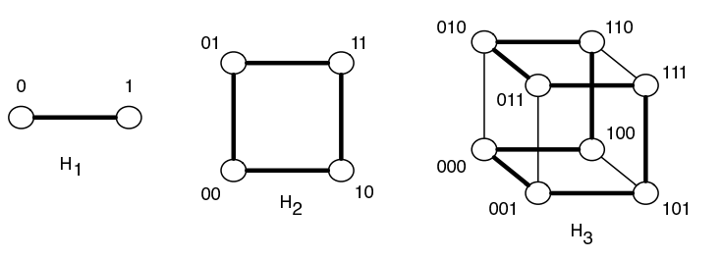
Gray Code and Hamiltonian Cycles
A Hamiltonian cycle in an undirected graph is …
Hypercubes
(picture is from
Wikipedia):
Binary-reflected
Gray Code is a
Hamiltonian
Cycle of a
Hypercube:

Slide 4
Divide and Conquer

Slide 5
Divide-and-conquer algorithms
Definition
List examples seen in prior courses or so far in this course
Notes:
Have students list some examples of divide-and-conquer algorithms

Slide 6
Divide and Conquer Algorithms
Today: Closest Points, Convex Hull

Slide 7
Divide-and-conquer algorithms
Definition
Examples seen prior to this course or so far in this course
Q1
Notes:
Have students list some examples of divide-and-conquer algorithms

Slide 8
Closest Points problem
Given a set, S, of N points in the xy-plane, find the minimum distance between two points in S.
Running time for brute force algorithm?
Next we examine a divide-and-conquer approach.

Slide 9
Closest Points "divide" phase
S is a set of N points in the xy-plane
For simplicity, we assume N = 2^{k} for some k.
(Otherwise use floor and ceiling functions)
Sort the points by x-coordinate
  If two points have the same x-coordinate, order them by y-coordinate
  If we use merge sort, the worst case is Ѳ(N log N)
Let c be the median x-value of the points
Let S₁ be {(x, y): x ≤ c}, and S₂ be {(x, y): x ≥ c}
  adjust so we get exactly N/2 points
  in each subset

Slide 10
Closest Points "conquer" phase
Assume that the points of S are sorted by x-coordinate, then by y-coordinate if x's are equal
Let d₁ be the minimum distance between two points in S₁ (the set of "left half" points)
Let d₂ be the minimum distance between two points in S₂ (the set of "right half" points)
Let d = min(d₁, d₂). Is d the minimum distance for S?
What else do we have to consider?
Suppose we needed to compare every point in S₁ to every point in S₂. What would the running time be?
How can we avoid doing so many comparisons?
Notes:
Next-to-last bullet:
T(N) = 2T(N/2) + theta(N²).
This is the first case of the Master Theorem. And so T(N) is theta(N²).
MASTER THEOREM IS ON NEXT SLIDE

Slide 11
Reference: The Master Theorem
The Master Theorem for Divide and Conquer recurrence relations:
Consider the recurrence
T(n) = aT(n/b) +f(n), T(1)=c,
where f(n) = Ѳ(n^{k}) and k≥0 ,
The solution is
  Ѳ(n^{k}) if a < b^{k}
  Ѳ(n^{k} log n) if a = b^{k}
  Ѳ(n^{logba}) if a > b^{k}
For details, see Levitin pages 483-485 or Weiss section 7.5.3.
Grimaldi's Theorem 10.1 is a special case of the Master Theorem.
We will use this theorem often. You should review its proof soon (Weiss's proof is a bit easier than Levitin's).

Slide 12
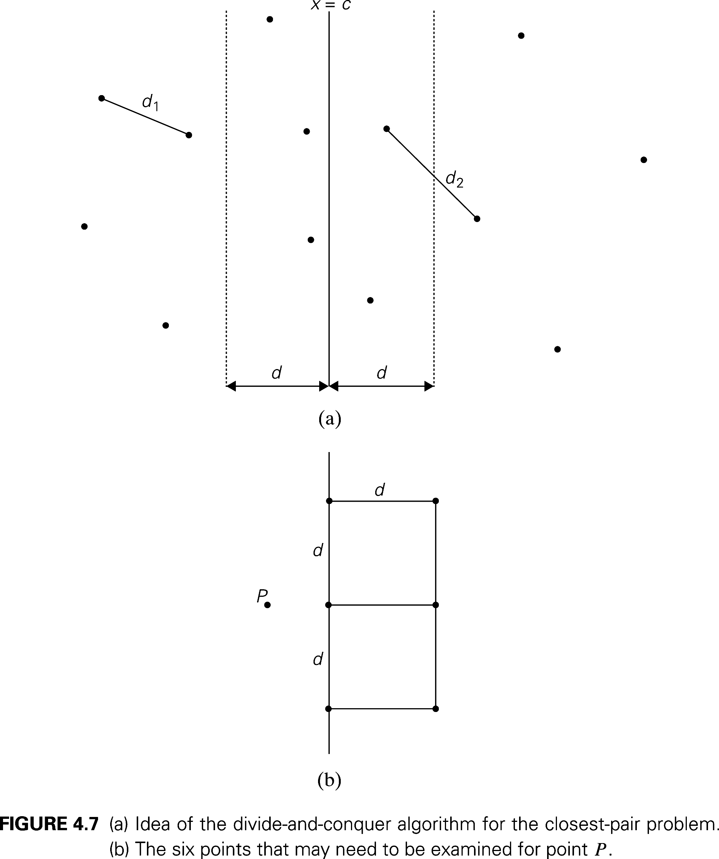
After recursive calls on S₁ and S₂
d = min(d₁, d₂).
Notes:
We only need to check points in sets C1 and C2, whose x coordinates are within d of c.
And it turns out that for each point in C1, we need to check at most 6 points of C2 (see bottom picture).
Assume that the recursive calls have left the two halves of S1 and S2 sorted by Y coordinate. Merge them O(N) so that S1 and S2 are sorted by Y coordinate. Pick out the points that are in C1 and C2. All of this is O(N).
Now, we can scan from top to bottom in C1 and C2. For each point in C1, find the (up to 6) points in C2 that are in the rectangle, check the distances.
T(N) = 2T(N/2) + Ѳ(N). Solution, according to the Master Theorem, is Ѳ(N log N)

Slide 13
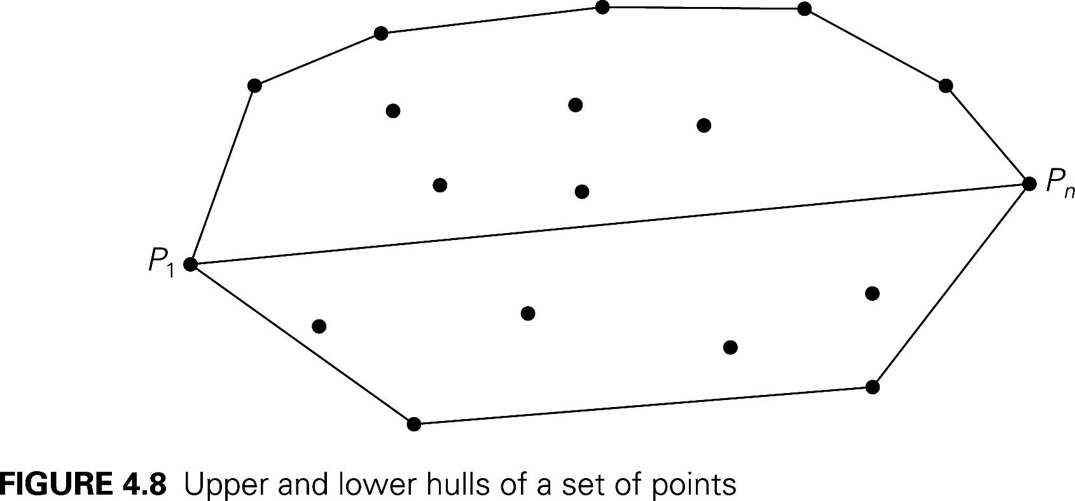
Convex Hull Problem
Again, sort by x-coordinate, with tie going to larger y-coordinate.
Notes:
Define the upper hull and lower hull.
S₁ is set of points above the P₁P_{n} line
To construct Upper Hull:
If S1 is empty, the upper hull is simply the P₁P_{n} line. Otherwise …
Find P_{max}, a point in S1 furthest away from the line. If there is a tie, select the point that maximizes the angle P_{max} P₁P_{n}.
Next slide.

Slide 14
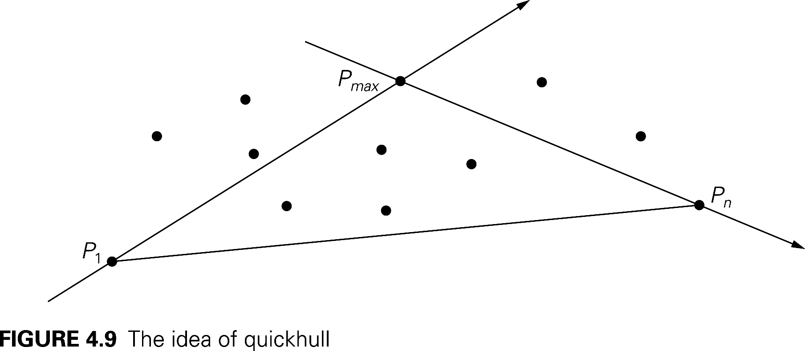
Recursive calculation of Upper Hull
Notes:
S_{1,1} is the set of points from S1 that are to the left of line P₁P_{max}.
S_{1,2} is the set of points from S1 that are to the left of line P_{max}P_{n}.
Note that
these sets must be disjoint (or else we did not choose P_{max} correctly)
P_{max} must be in the upper hull.
No points inside the triangle can be in the upper hull.
Recursively construct upper hulls of P₁ U S_{1,1} U P_{max} and of P_{max} U S_{1,2} U P_{n}.

Slide 15
Simplifying the Calculations
We can simplify two things at once:
Finding the distance of P from line P₁P_{2, and}
Determining whether P is "to the left" of P₁P₂
  The area of the triangle through P₁=(x₁,y₁), P₂=(x₂,y₂), and P₃=(x₃,y_{e}) is ½ of the absolute value of the determinant
    For a proof of this property, see http://mathforum.org/library/drmath/view/55063.html
    How do we use this to calculate distance from P to the line?
  The sign of the determinant is positive if the order of the three points is clockwise, and negative if it is counter-clockwise
    Clockwise means that P₃ is "to the left" of directed line segment P₁P₂
Speeding up the calculation
Notes:
Speeding up he calculation of the determinant
Note that the first two terms of the determinant are the same for all P3,
so for each point we only have to do 4 multiplications and 4 additions.

Slide 16
Efficiency of quickhull algorithm
What arrangements of points give us worst case behavior?
Average case is much better. Why?
Notes:
Worst Case is O(n²). What is the worst case (none of the points are inside the triangle).
Average turns out to be O(N), where N = number of points.

