Slide 1
MA/CSSE 473 Day 15
Return Exam
Student questions
Towers of Hanoi
Subsets
Ordered Permutations
Notes:
Take Knuth Fascicle to class.

Slide 2
MA/CSSE 473 Day 13
Student Questions on exam or anything else
Towers of Hanoi
Subset generation – Gray code
Permutations and order
Notes:
Pass around attendance sheet.

Slide 3
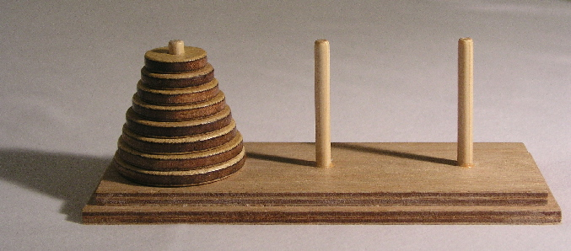
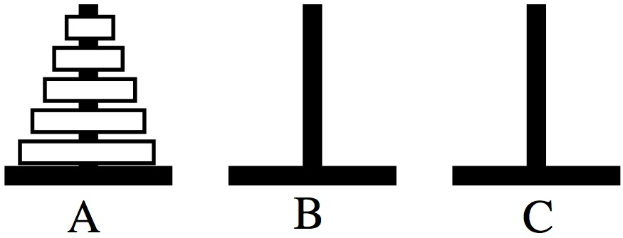
Towers of Hanoi
Move all disks from
peg A to peg B
One at a time
Never place larger disk
on top of a smaller disk
Demo
Code
Recurrence and solution

Slide 4
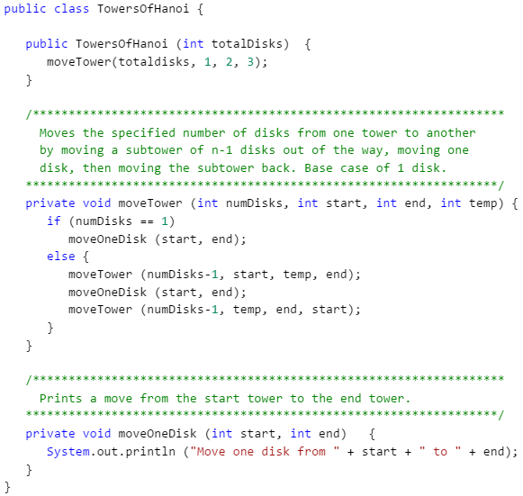
Towers of Hanoi code
Recurrence
for number of moves,
and its
solution?

Slide 5
Subset generation
Goal: generate all subsets of
{0, 1, 2, …, N-1}
Bottom-up (decrease-by-one) approach
First generate S_{n-1}, the collection of all subsets of {0, …, N-2}
Then S_{n} = S_{n-1} ∪ { s ∪ {N-1} : s∈S_{n-1}}

Slide 6
Subset generation
Numeric approach: Each subset of
{0, …, N-1} corresponds to an bit string of length N where the i^{th} bit is 1 iff i is in the subset.
So each subset can be represented by N bits.
A simple loop generates them all in "numeric" order.

Slide 7
Subset generation
Minimal change algorithm:
flip exactly one bit each time we generate the next subset.
Most common minimal-change approach:
Binary-reflected Gray code.
See the links in the announcements page and the schedule page.
Transition sequences: which bit to flip
0
010
0102010
010201030102010

Slide 8
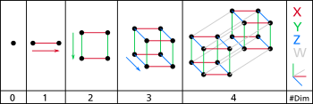
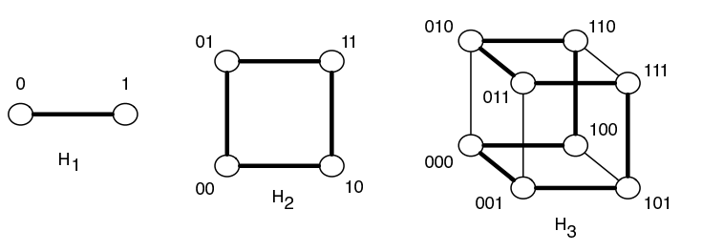
Gray Code and Hamiltonian Cycles
A Hamiltonian cycle in an undirected graph is …
Hypercubes
(from
Wikipedia):
Binary-reflected
Gray Code is a
Hamiltonian
Cycle of a
Hypercube:

Slide 9
Recap: Permutations and Order
number | permutation |  | number | permutation
0 | 0123 |  | 12 | 2013
1 | 0132 |  | 13 | 2031
2 | 0213 |  | 14 | 2103
3 | 0231 |  | 15 | 2130
4 | 0312 |  | 16 | 2301
5 | 0321 |  | 17 | 2310
6 | 1023 |  | 18 | 3012
7 | 1032 |  | 19 | 3021
8 | 1203 |  | 20 | 3102
9 | 1230 |  | 21 | 3120
10 | 1302 |  | 22 | 3201
11 | 1320 |  | 23 | 3210
Given a permutation of 0, 1, …, n-1, can we directly find the next permutation in the lexicographic sequence?
Given a permutation of 0..n-1, can we determine its permutation sequence number?
Given n and i, can we directly generate
the i^{th} permutation of 0, …, n-1?
Notes:
Discuss these, with examples:

Slide 10
Discovery time (with two partners)
Which permutation follows each of these in lexicographic order?
  183647520 471638520
  Try to write an algorithm for generating the next permutation, with only the current permutation as input.
If the lexicographic permutations of the numbers [0, 1, 2, 3, 4, 5] are numbered starting with 0, what is the number of the permutation 14032?
  General form? How to calculate efficiency?
In the lexicographic ordering of permutations of [0, 1, 2, 3, 4, 5], which permutation is number 541?
  How to calculate efficiently?
Notes:
After 183647520: 183650247 After 471638520: 471650238
Algorithm: Scan from right, find first place where p[i] < p[i+1].
find j, position of smallest among numbers in p[i+1]…p[n-1] that are greater than p[i].
exchange p[i] and p[j], then reverse p[i+1] ..p[n-1]

