Slide 1
MA/CSSE 473 Day 13
Finish
Topological Sort
Permutation Generation
Notes:
Take Knuth Fascicle to class.

Slide 2

MA/CSSE 473 Day 13
Student Questions
Finish Topological Sort
Permutation generation
Notes:
Pass around attendance sheet.

Slide 3
Recap: Topologically sort a DAG
DAG = Directed Aclyclic Graph
Linearly order the vertices of the DAG so that for every edge e, e's tail vertex precedes its head vertex in the ordering.

Slide 4
DFS-based Algorithm
DFS-based algorithm for topological sorting
  Perform DFS traversal, noting the order vertices are popped off the traversal stack
  Reversing order solves topological sorting problem
  Back edges encountered?→ NOT a dag!
Example:
Efficiency:
a
b
c
d
e
f
g
h
Notes:
Efficiency is the same as DFS algorithm

Slide 5
Source Removal Algorithm
  Repeatedly identify and remove a source (a vertex with no incoming edges) and all the edges incident to it until either no vertex is left (problem is solved) or there is no source among remaining vertices (not a dag)
Example:
Efficiency: same as efficiency of the DFS-based algorithm
a
b
c
d
e
f
g
h

Slide 6
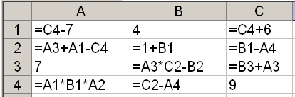
Application: Spreadsheet program
What is an allowable order of computation of the cells' values?
Notes:
Draw, or at least start a dependency graph.
An edge from each cell to cells that directly depend on it.
Go down the columns, from left to right,
Stop after B3.

Slide 7
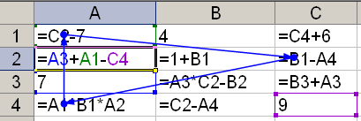
Cycles cause a problem!

Slide 8
Combinatorial object Generation
Permutations
Subsets

Slide 9
Combinatorial Object Generation
Generation of permutations, combinations, subsets.
This is a big topic in CS
We will just scratch the surface of this subject.
  Permutations of a list of elements (no duplicates)
  Subsets of a set
Notes:
Evidence: The book I received in 2008
The Art of Computer Programming, Volume 4, Fascicle 2
Generating All Tuples and Permutations
127 pages of very small print.

Slide 10
Permutations
We generate all permutations of the numbers 1..n.
  Permutations of any other collection of n distinct objects can be obtained from these by a simple mapping.
How would a "decrease by 1" approach work?
  Find all permutations of 1.. n-1
  Insert n into each position of each such permutation
  We'd like to do it in a way that minimizes the change from one permutation to the next.
  It turns out we can do it so that we always get the next permutation by swapping two adjacent elements.

Slide 11
First approach we might think of
for each permutation of 1..n-1
  for i=0..n-1
    insert n in position i
That is, we do the insertion of n into each smaller permutation from left to right each time
However, to get "minimal change", we alternate:
  Insert n L-to-R in one permutation of 1..n-1
  Insert n R-to-L in the next permutation of 1..n-1
  Etc.

Slide 12

Example
Bottom-up generation of permutations of 123
Example: Do the first few permutations for n=4

Slide 13
Johnson-Trotter Approach
integrates the insertion of n with the generation of permutations of 1..n-1
Does it by keeping track of which direction each number is currently moving
The number k is mobile if its arrow points to an adjacent element that is smaller than itself
In this example, 4 and 3 are mobile

Slide 14
Johnson-Trotter Approach
The number k is mobile if its arrow points to an adjacent element that is smaller than itself.
In this example, 4 and 3 are mobile
To get the next permutation, exchange the largest mobile number (call it k) with its neighbor.
Then reverse directions of all numbers that are larger than k.
Initialize: All arrows point left.
Notes:
Do the first few steps for n=4:
← ← ← ← ← ← ← ← ← ← ← ← ← ← ← ←
1 2 3 4 1 2 4 3 1 4 2 3 4 1 2 3
→ ← ← ← ← → ← ← ← ← → ← ← ← ← →
4 1 3 2 1 4 3 2 1 3 4 2 1 3 2 4
← ← ← ← ← ← ← ← ← ← ← ← ← ← ← ←
3 1 2 4 3 1 4 2 3 4 1 2 4 3 1 2
→ → ← ← → → ← ← → ← → ← → ← ← →
4 3 2 1 3 4 2 1 3 2 4 1 3 2 1 4

Slide 15
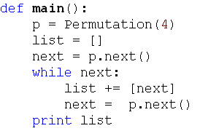
Johnson-Trotter Driver

Slide 16
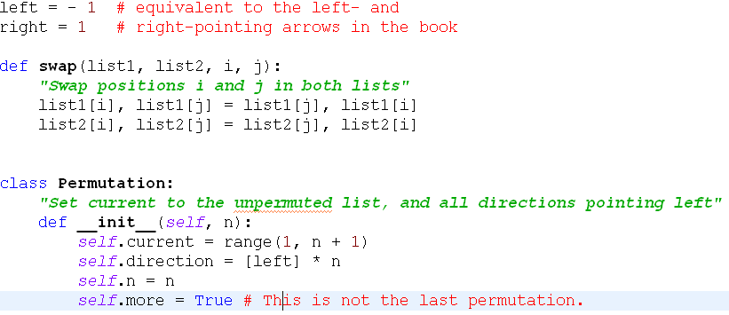
Johnson-Trotter background code

Slide 17
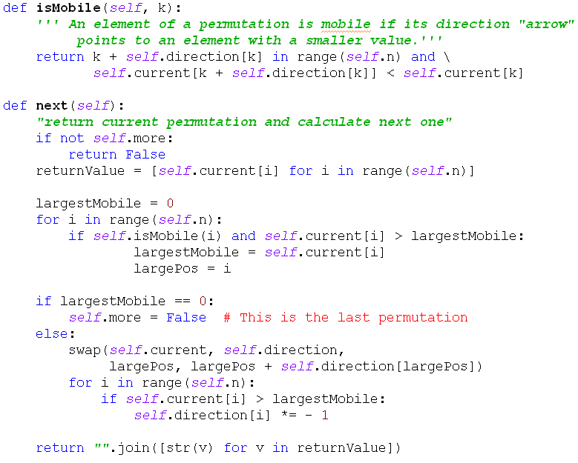
Johnson-Trotter major methods

Slide 18
Lexicographic Permutation Generation
Generate the permutations of 1..n in "natural" order.
Let's do it recursively.
Notes:
Solution on next Slide. Do not include it in the slides placed online before class.
Do this as a live coding exercise. Before class, copy PermutationStartingCode.py to PermutationSection1 and PermutationSection2 files.

Slide 19
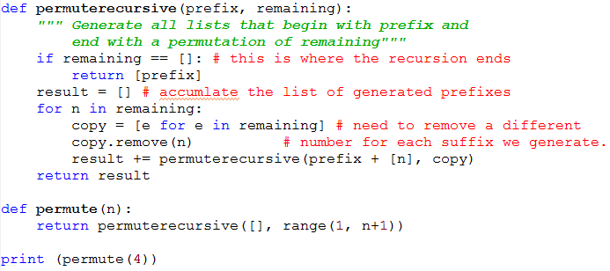
Lexicographic Permutation Code
Notes:
The book describes a "permute in place" algorithm.
We will look at that one later.

Slide 20
Permutations and order
number | permutation |  | number | permutation
0 | 0123 |  | 12 | 2013
1 | 0132 |  | 13 | 2031
2 | 0213 |  | 14 | 2103
3 | 0231 |  | 15 | 2130
4 | 0312 |  | 16 | 2301
5 | 0321 |  | 17 | 2310
6 | 1023 |  | 18 | 3012
7 | 1032 |  | 19 | 3021
8 | 1203 |  | 20 | 3102
9 | 1230 |  | 21 | 3120
10 | 1302 |  | 22 | 3201
11 | 1320 |  | 23 | 3210
Given a permutation of 0, 1, …, n-1, can we directly find the next permutation in the lexicographic sequence?
Given a permutation of 0..n-1, can we determine its permutation sequence number?
Given n and i, can we directly generate
the i^{th} permutation of 0, …, n-1?
Notes:
Discuss these, with examples:

Slide 21
Discovery time (with two partners)
Which permutation follows each of these in lexicographic order?
  183647520 471638520
  Try to write an algorithm for generating the next permutation, with only the current permutation as input.
If the lexicographic permutations of the numbers [0, 1, 2, 3, 4, 5] are numbered starting with 0, what is the number of the permutation 14032?
  General form? How to calculate efficiency?
In the lexicographic ordering of permutations of [0, 1, 2, 3, 4, 5], which permutation is number 541?
  How to calculate efficiently?
Notes:
After 183647520: 183650247 After 471638520: 471650238
Algorithm: Scan from right, find first place where p[i] < p[i+1].
find j, position of smallest among numbers in p[i+1]…p[n-1] that are greater than p[i].
exchange p[i] and p[j], then reverse p[i+1] ..p[n-1]

