Slide 1
MA/CSSE 473 Day 12
Interpolation Search
Insertion Sort
quick review
DFS, BFS
Topological Sort

Slide 2
MA/CSSE 473 Day 12
Questions?
Interpolation Search
Insertion sort analysis
Depth-first Search
Breadth-first Search
Topological Sort
(Introduce permutation and subset generation)

Slide 3
Decrease and Conquer Algorithms
Three variations. Decrease by
  constant amount
  constant factor
  variable amount
Notes:
Exploit the relationship between the solution to a given instance of a problem and a solution to a smaller instance of the same problem

Slide 4
Variable Decrease Examples
Euclid's algorithm
  b and a % b are smaller than a and b, but not by a constant amount or constant factor
Interpolation search
  Each of he two sides of the partitioning element are smaller than n, but can be anything from 0 to n-1.
Notes:
"Known" as in "students should already know Euclid"

Slide 5
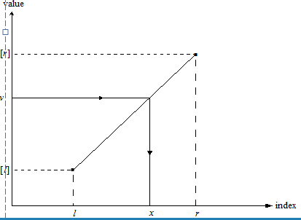
Interpolation Search
Searches a sorted array similar to binary search but estimates location of the search key in A[l..r] by using its value v.
Specifically, the values of the array’s elements are assumed to increase linearly from A[l] to A[r]
Location of v is estimated as the x-coordinate of the point on the straight line through (l, A[l]) and (r, A[r]) whose y-coordinate is v:
x = l + ⎣(v - A[l])(r - l)/(A[r] – A[l] )⎦
See Weiss, section 5.6.3
Levitin Section 4.5 [5.6]
Notes:
Take a phone book to class. Ask a student to the number for ABC Bail Bonds. Then ask them to tell me who has the number 812-299-3937 (It is Dr. Steven Black)
Make the point of how much of a difference sorting makes.
If you are looking me up in the phone book, using binary search, you would start in the middle. It would take several probes to get near me.

Slide 6
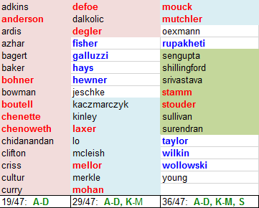
Interpolation Search Running time
Average case: Θ(log (log n)) Worst: Θ(n)
What can lead to worst-case behavior?
    Social Security numbers of US residents
    Phone book (Wilkes-Barre)
    CSSE department employees*, 1984-2017
*Red and blue are current employees
Notes:
If N is a billion, how big are lg n, lg lg N? (30, 5)
A lot of overhead in doing the calculations of where to probe, so we would only use this if the array is HUGE, or if each comparison takes a long time.
Note how many current profs are A-D, L-M, R=T (all but one)

Slide 7
Some "decrease by one" algorithms
Insertion sort
Selection Sort
Depth-first search of a graph
Breadth-first search of a graph

Slide 8
Review: Analysis of Insertion Sort
Time efficiency
C_{worst}(n) = n(n-1)/2 ∈ Θ(n²)
C_{avg}(n) ≈ n²/4 ∈ Θ(n²)
C_{best}(n) = n - 1 ∈ Θ(n)
(also fast on almost-sorted arrays)
Space efficiency: in-place
(constant extra storage)
Stable: yes
Binary insertion sort (HW 6)
  use Binary search, then move elements
  to make room for inserted element

Slide 9
Graph Traversal
Many problems require processing all graph vertices (and edges) in systematic fashion
Most common Graph traversal algorithms:
  Depth-first search (DFS)
  Breadth-first search (BFS)

Slide 10
Depth-First Search (DFS)
Visits a graph’s vertices by always moving away from last visited vertex to unvisited one, backtracks if no adjacent unvisited vertex is available
Uses a stack
  a vertex is pushed onto the stack when it’s reached for the first time
  a vertex is popped off the stack when it becomes a dead end, i.e., when there are no adjacent unvisited vertices
“Redraws” graph in tree-like fashion (with tree
edges and back edges for undirected graph)
  A back edge is an edge of the graph that goes from the current vertex to a previously visited vertex
  (other than the current vertex's parent).

Slide 11
Notes on DFS
DFS can be implemented with graphs represented as:
  adjacency matrix: Θ(V²)
  adjacency list: Θ(|V|+|E|)
Yields two distinct ordering of vertices:
  order in which vertices are first encountered (pushed onto stack)
  order in which vertices become dead-ends (popped off stack)
Applications:
  checking connectivity, finding connected components
  checking acyclicity
  finding articulation points
  searching state-space of problems for solution (AI)
Notes:
In a connected graph, an articulation point is a vertex whose removal would result in a disconnected graph.

Slide 12
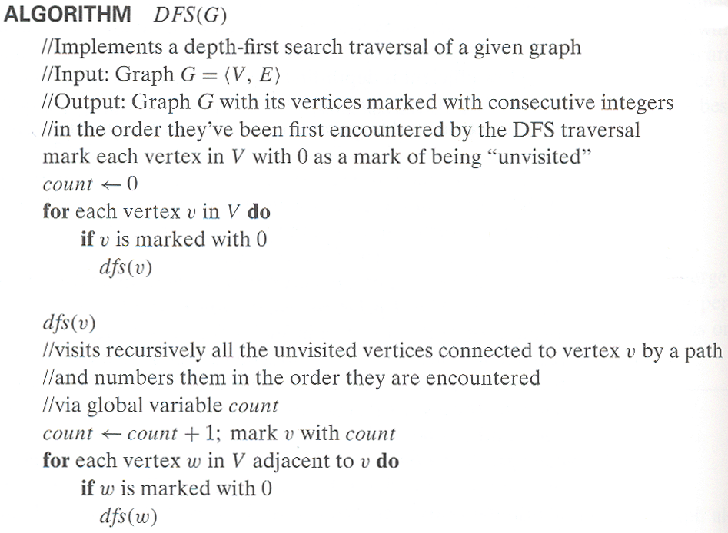
Pseudocode for DFS

Slide 13
Example: DFS traversal of undirected graph
a
b
c
d
e
f
g
h
DFS traversal stack:
DFS tree:
Notes:
Traversal using alphabetical order of vertices. Work through this example in detail, showing the traversal by highlighting edges on the graph and showing how the stack
evolves:
8 h 3
7 d 4 stack shown growing upwards
4 e 1 6 c 5 number on left is order that vertex was pushed onto stack
3 f 2 5 g 6 number on right is order that vertex was popped from stack
2 b 7 overlap is because after e, f are popped off stack, g and c
1 a 8 are pushed onto stack in their former locations.
order pushed onto stack: a b f e g c d h
order popped from stack: e f h d c g b a
* show dfs tree as it gets constructed, back edges

Slide 14
Breadth-first search (BFS)
Visits graph vertices in increasing order of length of path from initial vertex.
Vertices closer to the start are visited early
Instead of a stack, BFS uses a queue
Level-order traversal of a rooted tree is a special case of BFS
“Redraws” graph in tree-like fashion (with tree edges and cross edges for undirected graph)
Notes:
Note that if the graph is a binary tree and we start at the root, these two orders are preorder/postorder and levelorder traversals

Slide 15
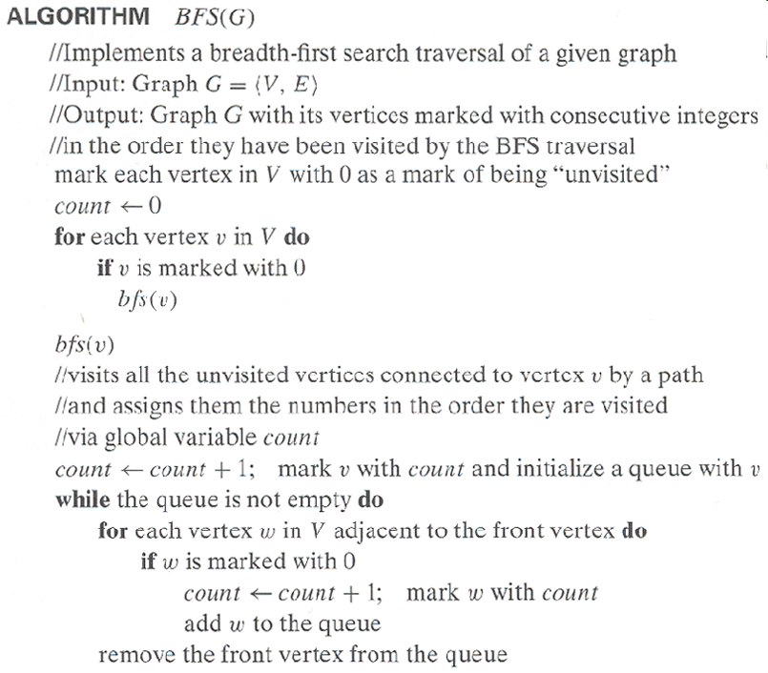
Pseudocode for BFS
Note that this code is like DFS, with the stack replaced by a queue

Slide 16
Example of BFS traversal of undirected graph
a
b
c
d
e
f
g
h
BFS traversal queue:
BFS tree:

Slide 17
Notes on BFS
BFS has same efficiency as DFS and can be implemented with graphs represented as:
  adjacency matrices: Θ(V²)
  adjacency lists: Θ(|V|+|E|)
Yields a single ordering of vertices (order added/deleted from the queue is the same)
Applications: same as DFS, but can also find shortest paths (smallest number of edges) from a vertex to all other vertices

Slide 18
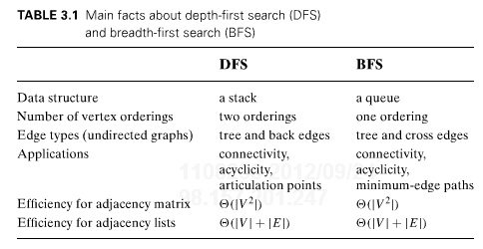
DFS and BFS

Slide 19
Directed graphs
In an undirected graph, each edge is a "two-way street".
  The adjacency matrix is symmetric
In an directed graph (digraph), each edge goes only one way.
  (a,b) and (b,a) are separate edges.
  One such edge can be in the graph without the other being there.

Slide 20
Dags and Topological Sorting
dag: a directed acyclic graph, i.e. a directed graph with no (directed) cycles
Dags arise in modeling many problems that involve prerequisite
constraints (construction projects, document version control, compilers)
The vertices of a dag can be linearly ordered so that every edge's
starting vertex is listed before its ending vertex (topological sort).
A graph must be a dag in order for a topological sort of its
vertices to be possible.
a
b
a
b
not a dag
a dag
c
d
c
d

Slide 21
Topological Sort Example
Order the following items in a food chain
tiger
human
fish
sheep
shrimp
plankton
wheat
Notes:
Show a possible sort order by hand.

Slide 22
DFS-based Algorithm
DFS-based algorithm for topological sorting
  Perform DFS traversal, noting the order vertices are popped off the traversal stack
  Reversing order solves topological sorting problem
  Back edges encountered?→ NOT a dag!
Example:
Efficiency:
a
b
c
d
e
f
g
h
Notes:
Efficiency is the same as DFS algorithm

Slide 23
Source Removal Algorithm
  Repeatedly identify and remove a source (a vertex with no incoming edges) and all the edges incident to it until either no vertex is left (problem is solved) or there is no source among remaining vertices (not a dag)
Example:
Efficiency: same as efficiency of the DFS-based algorithm
a
b
c
d
e
f
g
h

Slide 24
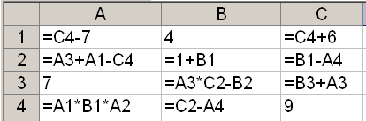
Application: Spreadsheet program
What is an allowable order of computation of the cells' values?
Notes:
Draw, or at least start a dependency graph.
An edge from each cell to cells that directly depend on it.
Go down the columns, from left to right,
Stop after B3.

Slide 25
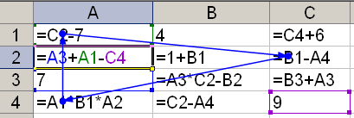
Cycles cause a problem!

Slide 26
Combinatorial object Generation
(We may not get to this today)
Permutations
Subsets

Slide 27
Combinatorial Object Generation
Generation of permutations, combinations, subsets.
This is a big topic in CS
We will just scratch the surface of this subject.
  Permutations of a list of elements (no duplicates)
  Subsets of a set
Notes:
Evidence: The book I received in 2008
The Art of Computer Programming, Volume 4, Fascicle 2
Generating All Tuples and Permutations
127 pages of very small print.

Slide 28
Permutations
We generate all permutations of the numbers 1..n.
  Permutations of any other collection of n distinct objects can be obtained from these by a simple mapping.
How would a "decrease by 1" approach work?
  Find all permutations of 1.. n-1
  Insert n into each position of each such permutation
  We'd like to do it in a way that minimizes the change from one permutation to the next.
  It turns out we can do it so that we always get the next permutation by swapping two adjacent elements.

Slide 29
First approach we might think of
for each permutation of 1..n-1
  for i=0..n-1
    insert n in position i
That is, we do the insertion of n into each smaller permutation from left to right each time
However, to get "minimal change", we alternate:
  Insert n L-to-R in one permutation of 1..n-1
  Insert n R-to-L in the next permutation of 1..n-1
  Etc.

Slide 30

Example
Bottom-up generation of permutations of 123
Example: Do the first few permutations for n=4

