Slide 1
MA/CSSE 473 Day 06
Euclid's Algorithm

Slide 2
MA/CSSE 473 Day 06
Student Questions
Odd Pie Fight
Modular exponentiation
Euclid's algorithm
(if there is time) extended Euclid's algorithm
Notes:
Pass around attendance sheet.

Slide 3
Review Thread
Quick look at review topics in textbook

Slide 4
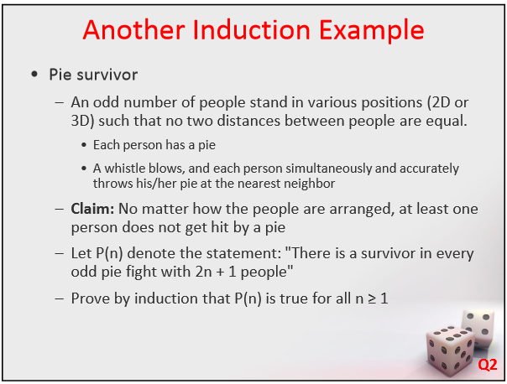

Slide 5
Odd Pie fight solution
The base case is easy: If n = 1 the two persons (A and B) with the smallest pairwise distance between them throw at each other, while the third person throws at one of them (whoever is closer). Therefore, this third person remains “unharmed”.
For the inductive step, assume that the assertion is true for odd k ≥ 1, and consider 2k+3 persons. Again, the two persons with the smallest pairwise distance between them (the closest pair) throw at each other.
Consider two possible cases as follows.
  If the remaining n persons all throw at one another, at least one of them survives, by the inductive assumption.
  If at least one of the remaining n persons throws at one of A or B, among the remaining 2k+1 persons, at most 2k are hit, so there must be a survivor because there is not enough pies to hit everybody. This completes the proof.

Slide 6
Arithmetic thread
Recap: Modular addition and multiplication
Euclid's Algorithm
Heading toward Primality Testing

Slide 7
Modular Addition and Multiplication
To add two integers x and y modulo N (where k = ⎡log N⎤), begin by doing regular addition.
  x and y are in the range 0 to N-1,
  so x + y is in range 0 to 2N-2
  If the sum is greater than N-1, subtract N, else return x + y
  Run time is Ѳ ( k )
To multiply x and y, begin with regular multiplication, which is quadratic in k.
  The result is in range 0 to (N-1)² so has at most 2k bits.
  Then compute the remainder when xy dividing by N, quadratic time in k. So entire operation is Ѳ( k²)

Slide 8
Modular Exponentiation
In some cryptosystems, we need to compute
x^{y} modulo N, where all three numbers are several hundred bits long. Can it be done quickly?
Can we simply take x^{y} and then figure out the remainder modulo N?
Suppose x and y are only 20 bits long.
  x^{y} is at least (2¹⁹)⁽²¹⁹⁾, which is about 10 million bits long.
  Imagine how big it will be if y is a 500-bit number!
To save space, we could repeatedly multiply by x, taking the remainder modulo N each time.
    If y is 500 bits, then there would be 2⁵⁰⁰ bit multiplications.
    This algorithm is exponential in the length of y.
    Ouch!
Notes:
To do better, we can use an algorithm like our previous recursive exponentiation algorithm

Slide 9
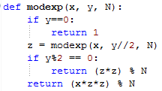
Modular Exponentiation Algorithm
Let k be the maximum number of bits in x, y, or N
The algorithm requires at most ___ recursive calls
Each call is Ѳ( )
So the overall algorithm is Ѳ( )
Notes:
Answers: k, k², k³

Slide 10
Modular Exponentiation Algorithm
Let n be the maximum number of bits in x, y, or N
The algorithm requires at most k recursive calls
Each call is Ѳ(k²)
So the overall algorithm is Ѳ(k³)

Slide 11
Euclid's Algorithm: the problem
One of the oldest known algorithms (about 2500 years old)
The problem: Find the greatest common divisor (gcd) of two non-negative integers a and b.
The approach you learned in elementary school:
  Completely factor each number
  find common factors (with multiplicity)
  multiply the common factors together to get the gcd
Finding factors of large numbers is hard!
A simpler approach is needed

Slide 12
Euclid's Algorithm: the basis
Based on the following rule:
  If x and y are positive integers with x ≥ y, then gcd(x, y) = gcd(y, x mod y)
Proof of Euclid's rule:
  It suffices to show the simpler rule
  gcd(x, y) = gcd(y, x - y)
  since x mod y can be obtained from x and y by repeated subtraction
  Any integer that divides both x and y must also
  divide x – y, so gcd(x, y) ≤ gcd(y, x – y)
  Any integer that divides both y and x - y must also
  divide x, so gcd(y, x-y) ≤ gcd(y, x)
  Putting these together: gcd(y, x-y) = gcd(y, x)
Notes:
Example x = 60, y=36. gcd(60, 36) = gcd(36, 60 – 36) = gcd (36, 24) = gcd(24, 12) = gcd(12, 0) = 12
In general, if a is a common divisor of x and y, y= ay’ and x = ax’, then x – y = a(x’ – y’).
What about the "less than part": Every common divisor of (x, y) is a common divisor of (y, x-y), so each is <= the gcd(y, x-y). Similarly for other direction.

Slide 13
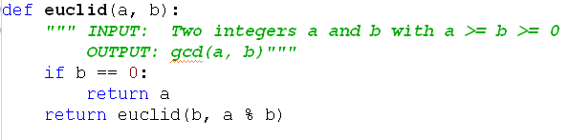
Euclid's Algorithm: the algorithm
Example: euclid(60, 36)
Does the algorithm work?
How efficient is it?
Notes:
Does it work? It's clear that it works when b is 0.
Is it clear that b will eventually be 0? Yes.
So by Euclid's rule, it works.
Efficiency? Each time, (a, b) gets replaced with (b, a mod b). How big of a reduction is that?

Slide 14
Euclid's Algorithm: the analysis
Lemma: If a ≥ b, then a % b < a/2
Proof
  If b ≤ a/2, then a % b < b ≤ a/2
  If b > a/2, then a % b = a – b < a/2
Application
  After two recursive euclid calls, both a and b are less than half of what they were, (i.e. reduced by at least 1 bit)
  Thus if a and b have k bits, at most 2k recursive calls are needed.
  Each recursive call involves a division, Ѳ(k²)
  Thus entire algorithm is at most k² * 2k, which is in O(k³)
  You can look up refinements of this.
Notes:
Do a number line showing 0, b, and a. then a second number line for the other case.
Case 1: "anything" mod b is less than b, and b <=a/2
Case 2: a/2 < b ➔ a < 2b, so a % b = a – b.
Since b > a/2, a – b < a/2.

Slide 15
Euclid's Algorithm: practical use
Divide 210 by 45, and get the result 4 with remainder 30, so 210=4·45+30.
Divide 45 by 30, and get the result 1 with remainder 15, so 45=1·30+15.
Divide 30 by 15, and get the result 2 with remainder 0, so 30=2·15+0.
The greatest common divisor of 210 and 45 is 15.

Slide 16
gcd and linear combinations
Lemma: If d is a common divisor of a and b,
and d = ax + by for some integers x and y, then
d = gcd(a,b)
Proof
  By the first of the two conditions, d divides both a and b. No common divisor can exceed their greatest common divisor, so
  d ≤ gcd(a, b)
  gcd(a, b) is a common divisor of a and b, so it must divide ax + by = d. Thus gcd(a, b) ≤ d
  Putting these together, gcd(a, b) = d
If we can, for any given a and b, find the x and y as in the lemma, we have found the gcd.
It turns out that a simple modification of Euclid's algorithm will allow us to calculate the x and y.

Slide 17
Forward-backward Example: gcd (33, 14)
33 = 2*14 + 5
14 = 2 * 5 + 4
5 = 1 * 4 + 1
4 = 4 * 1 + 0, so gcd(33, 14) = 1.
Now work backwards
1 = 5 - 4. Substitute 4 = 14 - 2*5.
1 = 5 – (14 - 2*5) = 3*5 - 14. Substitute 5 = 33 - 2*14
1 = 3(33 - 2*14) -14 = 3 * 33 – 7 * 14
Thus x = 3 and y = -7 Done!

Slide 18
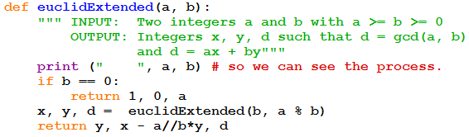
Extended Euclid Algorithm
Proof that it works
  I decided that it is a bit advanced for students who may have just seen Modular Arithmetic for the first time yesterday.
  If you are interested, look up “extended Euclid proof”
  We’ll do a couple of convincing examples.

Slide 19
Another example (same basic computation, different order): gcd (97, 20)
97 = 4·20+17
20 = 1·17+3
17 = 5·3+2
3 = 1·2+1 so GCD is 1.
Now figure out the x and y
17 = 1·97-4·20
20-1·17 = 3 so 3 = 1·20-1·17 = 1·20-(1·97-4·20) = -1·97+5·20
17=5·3+2 so 2 = 17-5·3 = (1·97-4·20)-5(-1·97+5·20) = 6·97-29·20
1 = 3-2 = (-1·97+5·20)-(6·97-29·20) = -7·97+34·20
Thus x = -7 and y = 34 Done!

