Slide 1
MA/CSSE 473 Day 05
Factors and Primes
Recursive division algorithm

Slide 2
MA/CSSE 473 Day 05
Student Questions
One more proof by strong induction
List of review topics I don’t plan to cover in class
Continue Arithmetic Algorithms
  Toward Integer Primality Testing and Factoring
  Efficient Integer Division Algorithm
  Modular Arithmetic intro
Notes:
Pass around attendance sheet.

Slide 3
Review Thread
Quick look at review topics in textbook

Slide 4
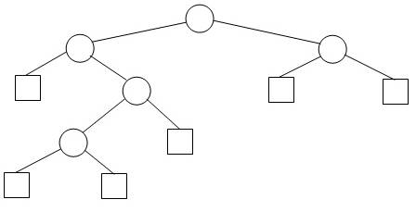
Another Induction Example
Extended Binary Tree (EBT)
An Extended Binary tree is either
  an external node, or
  an (internal) root node and two
  EBTs T_{L} and T_{R}.
We draw internal nodes as circles and external nodes as squares.
  Generic picture and detailed picture.
This is simply an alternative way of viewing binary trees, in which we view the null pointers as “places” where a search can end or an element can be inserted.

Slide 5
A property of EBTs
Property P(N): For any N>=0, any EBT with N internal nodes has _______ external nodes.
Proof by strong induction, based on the recursive definition.
  A notation for this problem: IN(T), EN(T)
  Note that, like some other simple examples, this one can also be done without induction.
  But the purpose of this exercise is practice with strong induction, especially on binary trees.
What is the crux of any induction proof?
  Finding a way to relate the properties for larger values (in this case larger trees) to the property for smaller values (smaller trees). Do the proof now.
Notes:
If time, ask students how we can do this without induction:
N nodes contain 2N pointers. N-1 of them point to other nodes, so N+1 must point to nothing.

Slide 6
Textbook Topics I Won't Cover in Class
Chapter 1 topics that I will not discuss in detail unless you have questions. They should be review For some of them, there will be review problems in the homework
  Sieve of Eratosthenes (all primes less than n)
  Algorithm Specification, Design, Proof, Coding
  Problem types : sorting, searching, string processing, graph problems, combinatorial problems, geometric problems, numerical problems
  Data Structures: ArrayLists, LinkedLists, trees, search trees, sets, dictionaries,

Slide 7
Textbook Topics I Won't Cover*
Chapter 2
  Empirical analysis of algorithms should be review
  I believe that we have covered everything else in the chapter except amortized algorithms and recurrence relations.
  We will discuss amortized algorithms later.
  Recurrence relations are covered in CSSE 230 and MA 375. We'll review particular types as we encounter them.
*Unless you ask me to

Slide 8
Textbook Topics I Won't Cover*
Chapter 3 - Review
  Bubble sort, selection sort, and their analysis
  Sequential search and simple string matching
*Unless you ask me to

Slide 9
Textbook Topics I Won't Cover*
Chapter 4 - Review
  Mergesort, quicksort, and their analysis
  Binary search
  Binary Tree Traversal Orders (pre, post, in, level)
*Unless you ask me to

Slide 10
Textbook Topics I Won't Cover*
Chapter 5 - Review
  Insertion Sort and its analysis
  Search, insert, delete in Binary Search treeTree
  AVL tree insertion and rebalance
    We will review the analysis of AVL trees.
*Unless you ask me to

Slide 11

Interlude

Slide 12
Arithmetic thread
Heading toward Primality Testing
Integer Division
Modular arithmetic
Euclid's Algorithm

Slide 13
FACTORING and PRIMALITY
Two important problems
  FACTORING: Given a number N, express it as a product of its prime factors
  PRIMALITY: Given a number N, determine whether it is prime
Where we will go with this eventually
  Factoring is hard
    The best algorithms known so far require time that is exponential in the number of bits of N
  Primality testing is comparatively easy
  A strange disparity for these closely-related problems
  Exploited by cryptographic systems
More on these problems later
  First, some more math and computational background…

Slide 14
Recap: Arithmetic Run-times
For operations on two k-bit numbers:
Addition: Ѳ(k)
Multiplication:
  Standard algorithm: Ѳ(k²)
  "Gauss-enhanced": Ѳ(k^{1.59}), but with a lot of overhead.
Division: We won't ponder it in detail, but see next slide: Ѳ(k²)

Slide 15
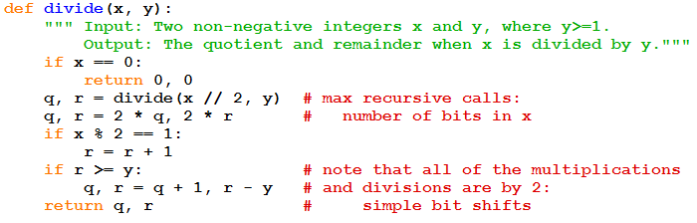
Algorithm for Integer Division
Let's work through divide(19, 4).
Analysis?
Notes:
divide(19, 4):
q, r = divide(9, 4)
q, r = divide (4, 4)
q, r = divide(2, 4)
q, r = divide(1, 4)
q, r = divide(0, 4) = 0, 0
x is odd, so
r = 1
return 0, 1
q, r, = 0, 2
return 0, 2
q, r = 0, 4
q, r = 1, 0
return 1, 0
q, r, = 2, 0
x is odd, so
q, r = 2, 1
return 2, 1
q, r = 4, 2
x is odd, so
q, r, = 4, 3
return 4, 3
Analysis: If k is max number of bits in x, y, each recursive call is O(k), and at most k calls, so altogether O( k^2).

Slide 16
Modular arithmetic
This idea has many uses
In this course we will use it for encryption and for primality testing

Slide 17
Modular arithmetic definitions
x modulo N (written as x % N in many programming languages) is the remainder when x is divided by N. I.e.,
  If x = qN + r, where 0 ≤ r < N (q and r are unique!),
  then x modulo N is equal to r.
x and y are congruent modulo N, which is written as x≡y (mod N), if and only if N divides (x-y).
  i.e., there is an integer k such that x-y = kN.
  In a context like this, a divides b means "divides with no remainder", i.e. "a is a factor of b."
Example: 253 ≡ 13 (mod 60),
253 ≡ 373 (mod 60)

Slide 18
Modular arithmetic properties
Substitution rule
  If x ≡ x' (mod N) and y ≡ y' (mod N),
  then x + y ≡ x' + y' (mod N), and xy ≡ x'y' (mod N)
Associativity
  x + (y + z) ≡ (x + y) + z (mod N)
Commutativity
  xy ≡ yx (mod N)
Distributivity
  x(y+z) ≡ xy +yz (mod N)

Slide 19
Modular Addition and Multiplication
To add two integers x and y modulo N (where k = ⎡log N⎤ ,the number of bits in N), begin with regular addition.
  Assume that x and y are in the range_____,
  so x + y is in range _______
  If the sum is greater than N-1, subtract N.
  Running time is Ѳ ( )
To multiply x and y modulo N, begin with regular multiplication, which is quadratic in k.
  The result is in range ______ and has at most ____ bits.
  Compute the remainder when dividing by N, quadratic time. So entire operation is Ѳ( )
Notes:
0 to N – 1, 0 to 2(N-1), Theta(k).
0 to (N-1)² , 2k Theta(k²)
More details on next slide

Slide 20
Modular Addition and Multiplication
To add two integers x and y modulo N (where k = ⎡log N⎤), begin by doing regular addition.
  x and y are in the range 0 to N-1,
  so x + y is in range 0 to 2N-2
  If the sum is greater than N-1, subtract N, else return x + y
  Run time is Ѳ ( k )
To multiply x and y, begin with regular multiplication, which is quadratic in k.
  The result is in range 0 to (N-1)² so has at most 2k bits.
  Then compute the remainder when xy dividing by N, quadratic time in k. So entire operation is Ѳ( k²)

Slide 21
Modular Exponentiation
In some cryptosystems, we need to compute
x^{y} modulo N, where all three numbers are several hundred bits long. Can it be done quickly?
Can we simply take x^{y} and then figure out the remainder modulo N?
Suppose x and y are only 20 bits long.
  x^{y} is at least (2¹⁹)⁽²¹⁹⁾, which is about 10 million bits long.
  Imagine how big it will be if y is a 500-bit number!
To save space, we could repeatedly multiply by x, taking the remainder modulo N each time.
    If y is 500 bits, then there would be 2⁵⁰⁰ bit multiplications.
    This algorithm is exponential in the length of y.
    Ouch!
Notes:
To do better, we can use an algorithm like our previous recursive exponentiation algorithm

Slide 22
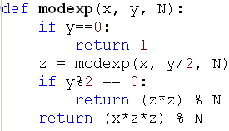
Modular Exponentiation Algorithm
Let k be the maximum number of bits in x, y, or N
The algorithm requires at most ___ recursive calls
Each call is Ѳ( )
So the overall algorithm is Ѳ( )
Notes:
Answers: k, k², k³

Slide 23
Modular Exponentiation Algorithm
Let n be the maximum number of bits in x, y, or N
The algorithm requires at most k recursive calls
Each call is Ѳ(k²)
So the overall algorithm is Ѳ(k³)

