Slide 1
MA/CSSE 473 Day 04
Multiplication runtime
Multiplication based on Gauss formula
Mathematical induction review

Slide 2
MA/CSSE 473 Day 04
Addition
MultiplicationDivide and Conquer Multiplication à la Gauss
Mathematical Induction review
Tiling with Trominoes (if there is time)
  http://www3.amherst.edu/~nstarr/trom/puzzle-8by8/
What questions do you have?
Notes:
Pass around attendance sheet.

Slide 3
Efficient integer Addition and multiplication

Slide 4
The catch!
Are addition and multiplication constant-time operations?
We take a closer look at the "basic operations"
First we look at Addition:
At most, how many digits are in the sum of three decimal one-digit numbers?
Is the same result true in binary and every other base?
Add two k-bit positive integers (53+35):
Carry:
So adding two k-bit integers is Θ( ).
1 1 1 1
1 1 0 1 0 1 (35)
1 0 0 0 1 1 (53)
1 0 1 1 0 0 0 (88)
Notes:
After Addition first, say,
"The next two bullets are prelminary info that we'll need in order to analyze
the runtime of integer addition."
Answers: 2, yes

Slide 5
"Ordinary" Multiplication of two k-bit numbers
Example: multiply 13 by 11
1 1 0 1
x 1 0 1 1
1 1 0 1 (1101 times 1)
1 1 0 1 (1101 times 1, shifted once)
0 0 0 0 (1101 times 0, shifted twice)
1 1 0 1 (1101 times 1, shifted thrice)
1 0 0 0 1 1 1 1 (binary 143)
There are k shift operations, followed by addition of k rows of 2k bits each, so
the whole multiplication is Θ( ) ?
Can we do better?
Notes:
The running time of the algorithm is O(k^2)

Slide 6
Multiplication by an Ancient Method
This approach was known to Al Khwarizimi
According to Dasgupta, et al, still used today in some European countries
Repeat until 1st number is 1, keeping all results:
  Divide 1st number by 2 (rounding down)
  double 2nd number
Example
11 13
5 26
2 52
1 104
143
Correct? Analysis
Then strike out any rows whose first number is even, and add up the remaining numbers in the second column.
Notes:
It is correct, because the same numbers get added as in the more "traditional" algorithm.
If we are multiplying k-bit numbers, the number of times through the loop is k.
And each time through the loop requires at most k steps.
And still we have to add up to k numbers of 2k bits each.
So O(k^2)

Slide 7
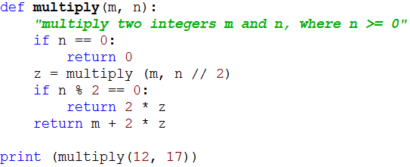
Recursive code: ancient multiply algorithm
If both m and n are k-bit numbers, what is the running time of this algorithm?
Notes:
k recursive calls. For each:
== 0: Theta(k)
//2: Theta(k)
%2: Theta(1)
2*z: Theta(k)
M+2*z: Theta k.

Slide 8
New Multiplication Approach
Divide and Conquer
To multiply two k-bit integers x and y:
  Split each into its left and right halves so that
  x = 2^{k/2}x_{L} + x_{R}, and y = 2^{k/2}y_{L} + y_{R}
  The straightforward calculation of xy would be
  (2^{k/2}x_{L} + x_{R})(2^{k/2}y_{L} + y_{R}) =
  2^{k}x_{L}y_{L} + 2^{k/2}(x_{L}y_{R} + x_{R}y_{L}) + x_{R}y_{R}
  Code on next slide
  Thus T(k) = . Solution?
Notes:
T(k) = 4T(k/2) +O(k). Solution?
When I write a, b, and k for the Master theorem, call the last one k_{MT}
Solution is case 3 of Master Theorem.
log[2] 4 is 2, so it is k^2.

Slide 9
For reference: The Master Theorem
The Master Theorem for Divide and Conquer recurrence relations:
Consider the recurrence
T(n) = aT(n/b) +f(n), T(1)=c,
where f(n) = Ѳ(n^{k}) and k≥0 ,
The solution is
  Ѳ(n^{k}) if a < b^{k}
  Ѳ(n^{k} log n) if a = b^{k}
  Ѳ(n^{logba}) if a > b^{k}
For details, see Levitin pages 483-485 or Weiss section 7.5.3.
Grimaldi's Theorem 10.1 is a special case of the Master Theorem.
We will use this theorem often. You should review its proof soon (Weiss's proof is a bit easier than Levitin's).

Slide 10
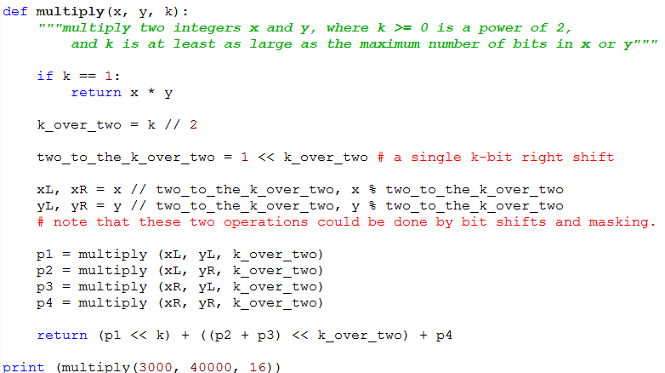
Code for divide-and-conquer multiplication

Slide 11
Can we do better than O(k²)?
Is there an algorithm for multiplying two k-bit numbers in time that is less than O(k²)?
Basis: A discovery of Carl Gauss (1777-1855)
  Multiplying complex numbers:
  (a + bi)*(c+di) = ac – bd + (bc + ad)i
  Could also be expressed as ordered pairs
  [a, b]*[c,d] =[ac-bd, bc+ad]

Slide 12
Gauss's Algorithm
[a, b]*[c,d] = [ac-bd, bc+ad] (complex number multiplication)
  Needs 4 real-number multiplications and 3 additions
But bc + ad = (a+b)(c+d) – ac –bd
  And we have already computed ac and bd when we computed the real part of the product!
Thus we can do the complex product with 3 multiplications and 5 additions
Additions are so much faster than multiplications that this is a good trade-off.
A little savings, but not a big deal until applied recursively!
We apply the same general idea to recursive
divide-and-conquer multiplication
(next slide – first 2/3 of the code is unchanged)

Slide 13
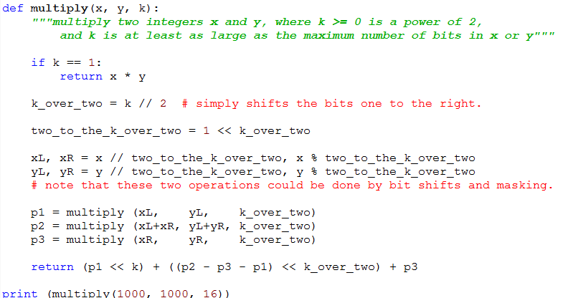
Code for Gauss-based Algorithm
Recurrence relation: solution:
Notes:
DO and solve the recurrence:
T(n) = 3 T(n/2) + Θ(n)
In Master theorem, a = 3, b = 2, k = 1.
So we have the third case: T(N) = Θ(n ^ log[2]3),
Which is approximately n ^ 1.59.

Slide 14
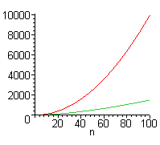
Is this really a lot faster?
Standard multiplication: Ѳ(k²)
Divide and conquer with Gauss trick: Ѳ(k^{1.59})
But there is a lot of additional overhead with Gauss, so standard multiplication is faster for small values of k.
In Maple,
In reality we would not let the
recursion go down to the
single bit level, but only down
to the number of bits that our
machine can multiply in
hardware without overflow.
Notes:
DO and solve the recurrence:
T(n) = 3 T(n/2) + Θ(n)
In Master theorem, a = 3, b = 2, k = 1.
So we have the third case: T(N) = Θ(n ^ log[2]3),
Which is approximately n ^ 1.59.

Slide 15
Quick review of mathematical induction
Back to the "review thread"

Slide 16
Induction Review
To show that property* P(n) is true for all integers n≥n₀, it suffices to show:
  Ordinary Induction
    P(n₀) is true
    For all k≥n₀ , if P (k) is true, then P(k+1) is also true.
  or
  Strong Induction
    P(n₀) is true (sometimes you need multiple base cases)
    For all k>n₀ , if P(j) is true for all j with n₀ ≤ j < k, then P(k) is also true.
* In this context, a property is a function whose domain is a subset of the non-negative integers and whose range is {true, false}
Notes:
Can someone remind me of how we know ordinary induction works?
Well-ordering principle.

Slide 17
Proof by Induction
On Liquor Production by David M. Smith
A friend who's in liquor production
Owns a still of astounding construction.
The alcohol boils
Through old magnetic coils…
She says that it's "proof by induction."
Disclaimer: The presentation of this multiple pun should not be taken as an implied endorsement on the part of the instructor of the production and/or consumption of liquor. For example, according to the National Institutes of Health (https://www.niaaa.nih.gov/alcohol-health/overview-alcohol-consumption/alcohol-facts-and-statistics), 31% of traffic deaths involve alcohol. NIH studies revealed that young people who began drinking before age 15 are four times more likely to develop alcohol dependence during their lifetime than those who began drinking at age 21 or later. Those that drank before age 15 are also seven times more likely to report having been in a traffic crash because of drinking both during adolescence and adulthood. Alcohol also plays a significant role in risky sexual behavior and increases the risk of physical and sexual assault. Among college students under age 21, 50,000 experience alcohol-related date rape, and 43,000 are injured by another student who has been drinking. Each year, approximately 5,000 persons under the age of 21 die from causes related to underage drinking. These deaths include about 1,600 homicides and 300 suicides.

Slide 18
Induction examples
For all N≥0,
  This is formula 7 on P 470
Show that any postage amount of 24 cents or more can be achieved using only 5-cent stamps and 7-cent stamps.
Notes:
Stamps: Proof is by strong induction.
Five base cases: 24 = 7*2+5*2, 25=5*5, 26=7*3 + 5, 27=7 + 4*5, 28 = 4*7
Induction step: Let k be any number that is > 28. Show that if for all j<k, we achieve
j cents using 5 and 7 cent stamps, then we can achieve k cents using 5 and 7 cent stamps.
In particular (by the induction assumption) j=k-5 can be achieved with 5 and 7-cent stamps. Add one more 5-cent stamp to get k cents.

Slide 19

Another Induction Example
Tiling with Trominoes
We saw that a 2^{n}×2^{n} checkerboard can be tiled with dominoes.
What about trominoes?
Clearly, we can't tile an entire board!
Definition: A deficient rectangular grid of squares has one square missing.
It's easy to see that we can tile any 2×2 deficient rectangle! (We can rotate the tromino)
Note: HW 4 is mainly about tiling with trominoes.

Slide 20
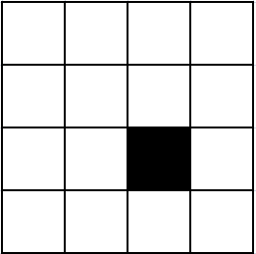
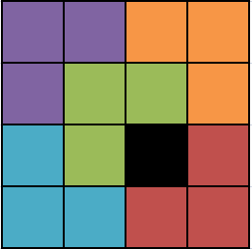
Trominoes Continued
What about a 4 x 4 deficient rectangle?
Can we tile this?
  Fun with Tromino tiling:
  http://www3.amherst.edu/~nstarr/trom/puzzle-8by8/

Slide 21
Trominoes Continued
Prove by induction that we can tile any 2^{n}×2^{n} deficient rectangle with trominoes
Base case: n=1 Done
Assume that we can do it for n=k
Show that we can do it for n=k+1
Assume WLOG that the missing square is in the lower right quadrant of the rectangle
  If it is somewhere else, we could simply rotate the board.
  Can we place one tromino in a way that allows us to use the induction assumption?
  Draw the picture
Notes:
Place the first tromino so that it covers 3 of the 4 center squares, the three that are not in the lower-right quadrant. Now all of the four quadrants are deficient rectangles of size 2^{k} by 2^{k}.

Slide 22
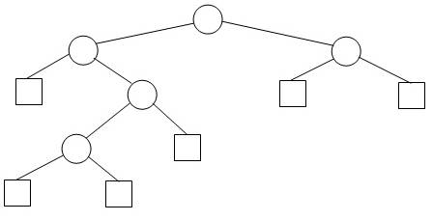
Another Induction Example
Extended Binary Tree (EBT)
An Extended Binary tree is either
  an external node, or
  an (internal) root node and two
  EBTs T_{L} and T_{R}.
We draw internal nodes as circles and external nodes as squares.
  Generic picture and detailed picture.
This is simply an alternative way of viewing binary trees, in which we view the null pointers as “places” where a search can end or an element can be inserted.

Slide 23
A property of EBTs
Property P(N): For any N>=0, any EBT with N internal nodes has _______ external nodes.
Proof by strong induction, based on the recursive definition.
  A notation for this problem: IN(T), EN(T)
  Note that, like some other simple examples, this one can be done without induction.
  But the purpose of this exercise is practice with strong induction, especially on binary trees.
What is the crux of any induction proof?
  Finding a way to relate the properties for larger values (in this case larger trees) to the property for smaller values (smaller trees). Do the proof now.
Notes:
If time, ask students how we can do this without induction:
N nodes contain 2N pointers. N-1 of them point to other nodes, so N+1 must point to nothing.

