Slide 1
MA/CSSE 473 Day 03
Asymptotics
A Closer Look at Arithmetic
With another student,
try to write a precise,
formal definition of
“t(n) is in O(g(n))”

Slide 2
Day 3
Student questions
  Course policies?
  HW assignments?
  Anything else?
The two “early course” threads (review, arithmetic)
Review of asymptotic notation
Finish the Fibonacci discussion
(efficiently compute powers of a matrix)
Addition and multiplication algorithms

Slide 3
Two threads in lectures
Each day at the beginning of the course
Some review
Continue with discussion of efficiency of Fibonacci and arithmetic.
Review thread for today:
Asymptotics (O, Ѳ, Ω)
Mostly a recap of my 230 lecture on same topic.
I

Slide 4
Rapid-fire Review:
Definitions of O, Ѳ, Ω
I will re-use many of my slides from CSSE 230
  Some of the pictures are from the Weiss book.
And some pictures are Levitin's.
A very similar presentation appears in Levitin, section 2.2
Since this is review, we will move much faster than in 230
Notes:
Q1

Slide 5
Asymptotic Analysis
We usually only care what happens when N (the size of a problem's input) gets to be large
Is the runtime linear? quadratic? exponential? etc.

Slide 6
Asymptotic order of growth
Informal definitions
A way of comparing functions that ignores constant factors and small input sizes
O(g(n)): the class of functions t(n) that grow
no faster than some constant times g(n)
Θ(g(n)): the class of functions t(n) that grow
at the same rate as g(n)
Ω(g(n)): the class of functions t(n) that grow
at least as fast as some constant times g(n)

Slide 7
Formal Definition
We will write a precise formal definition of "t(n)∈O(g(n))"
  This is one thing that students in 473 should soon be able to write from memory…
  … and also understand it, of course!
Notes:
There exist constants n0 and c such that whenever n>=n0, t(n) <= c*g(n).

Slide 8
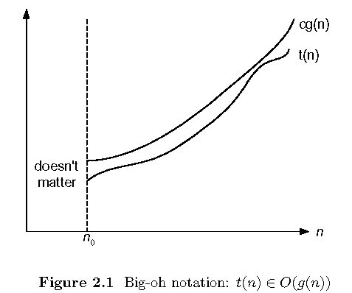
Big-oh (a.k.a. Big O)

Slide 9
Prove a Big O Property
For any function g(n), O(g(n)) is a set of functions
We say that t(n) ∈O(g(n)) iff there exist two non-negative constants c and n₀ such that
for all n ≥ n₀, t(n) ≤ c g(n)
Rewrite using ∀ and ∃ notation
Use the formal definition to prove:
If f(n)∈O(g(n)) and t(n)∈O(g(n)),
then f(n)+t(n)∈O(g(n))
Notes:
There are constants c1 ansd n1 such that …
There are constants c2 and n2 such that …
How to choose the n0 and c?
N0 = max(n1, n2). c = c1 + c2

Slide 10
Answer (Summer Only)
Recall: t(n) ∈O(g(n)) iff there exist two positive constants c and n₀ such that
for all n ≥ n₀, t(n) ≤ c g(n)
If f(n)∈O(g(n)) and t(n)∈O(g(n)),
then f(n)+t(n)∈O(g(n))
Proof By definition, there are constants c₁, c₂, n₁, n₂, such that for all n ≥ n₁, f(n) ≤ c₁ g(n) , and for all n ≥ n₂,
t(n) ≤ c₂ g(n). Let n₀ = max(n₁, n2), and let c = c1 + c2. Then for any n ≥ n₁, f(n)+t(n) ≤ c₁ g(n) + c₂ g(n) = c g(n).

Slide 11
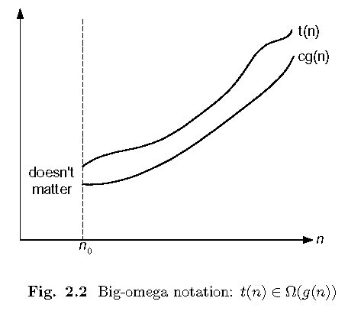
Big-omega

Slide 12
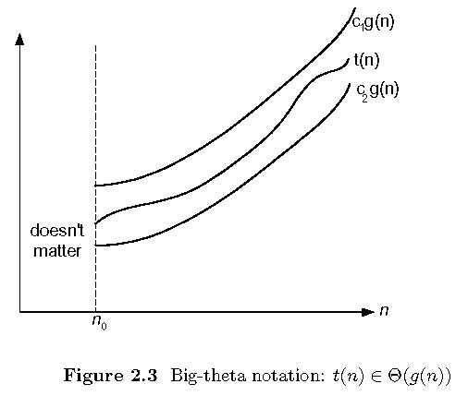
Big-theta

Slide 13
Big O examples
All that we must do to prove that t(n) is O(g(n)) is produce a pair of numbers c and n₀ that work for that case.
t(n) = n, g(n) = n².
t(n) = n, g(n) = 3n.
t(n) = n + 12, g(n) = n.
We can choose c =3 and n₀ = 6, or c = 4 and n₀ = 4.
t(n) = n + sin(n)
t(n) = n² + sqrt(n)
In CSSE 230, we do these in great detail in class.
In 473, I say, "work on them if you need review/practice", and I give you a few possible answers on the next slide.

Slide 14
Answers to examples
For this discussion, assume that all functions have non-negative values, and that we only care about n≥0.
For any function g(n), O(g(n)) is a set of functions We say that a function f(n) is (in) O(g(n)) if there exist two positive constants c and n₀ such that for all n≥ n₀, f(n) ≤c g(n).
So all we must do to prove that f(n) is O(g(n)) is produce two such constants.
f(n) = n + 12, g(n) = ???.
  g(n) = n. Then c =3 and n₀ = 6, or c = 4 and n₀ = 4, etc.
  f(n) = n + sin(n): g(n) = n, c = 2, n₀ = 1
  f(n) = n² + sqrt(n): g(n) = n2, c=2, n₀ = 1
Notes:
This is a hidden slide

Slide 15
Limits and asymptotics
Consider the limit
What does it say about asymptotics if this limit is zero, nonzero, infinite?
We could say that knowing the limit is a sufficient but not necessary condition for recognizing big-oh relationships.
It will be useful for many examples in this course.
Challenge: Use the formal definition of limit and the formal definition of big-oh to prove these properties.

Slide 16
Apply this limit property to the following pairs of functions
N and N²
N² + 3N + 2 and N²
N + sin(N) and N
log N and N
N log N and N²
Nª and a^{N} (a >1)
a^{N} and b^{N} (a < b)
log_{a}N and log_{b}N (a < b)
N! and N^{N}
Notes:
I did only #2, 4, 7, and 8 in class:
2: Divide top and bottom by N^2
4. l'Hopital's rule
(a/b)^n
Rewrite log[b]N in terms of log[a]n

Slide 17
Big-Oh Style
Give tightest bound you can
  Saying that 3N+2 ∈ O(N³) is true, but not as useful as saying it’s O(N) [What about Θ(N³) ?]
Simplify:
  You could say:
  3n+2 ∈ O(5n-3log(n) + 17)
  and it would be technically correct…
  But 3n+2 ∈O(n) is better.
true or false? 3n+2 ∈ O(n³)

Slide 18

Interlude
If you have been procrastinating on HW1, this is your last chance. Good luck!

Slide 19
Back to our arithmetic thread

Slide 20
More efficient Fibonacci algorithm?
Let X be the matrix
Then
also
How many additions and multiplications of numbers are needed to compute the product of two 2x2 matrices?
If n = 2^{k}, how many matrix multiplications does it take to compute X^{n}?
  What if n is not a power of 2?
  Implement it with a partner (details on next slide)
  Then we will analyze it
But there is a catch!
Notes:
The file fib3.py has the solution, and fib3-incomplete.py has it partially completed.
Solution for matrix_power:
def matrix_power(m, n):
result = identity_matrix
power = x
while n > 0:
if n % 2 == 1:
result = matrix_multiply(result, power)
power = matrix_multiply(power, power)
# print "In loop:", n, power, result
n = n /2
return result

Slide 21
identity_matrix = [[1,0],[0,1]] #a constant
x = [[0,1],[1,1]] #another constant
def matrix_multiply(a, b): #why not do loops?
return [[a[0][0]*b[0][0] + a[0][1]*b[1][0],
a[0][0]*b[0][1] + a[0][1]*b[1][1]],
[a[1][0]*b[0][0] + a[1][1]*b[1][0],
a[1][0]*b[0][1] + a[1][1]*b[1][1]]]
def matrix_power(m, n): #efficiently calculate m^{n}
result = identity_matrix
# Fill in the details
return result
def fib (n) :
return matrix_power(x, n)[0][1]
# Test code
print ([fib(i) for i in range(11)])
Notes:
The file fib3.py has the solution, and fib3-incomplete.py has it partially completed.
Solution for matrix_power:
def matrix_power(m, n):
result = identity_matrix
power = x
while n > 0:
if n % 2 == 1:
result = matrix_multiply(result, power)
power = matrix_multiply(power, power)
# print "In loop:", n, power, result
n = n /2
return result

Slide 22
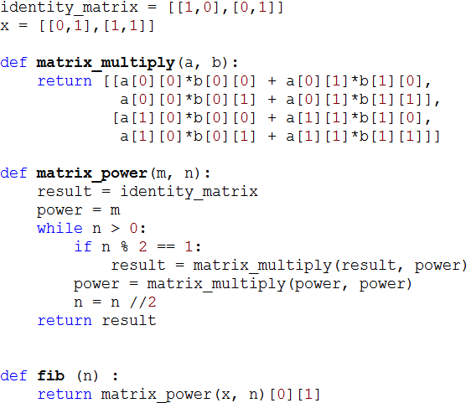

Slide 23
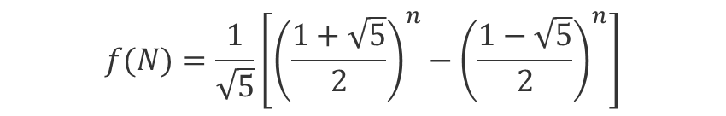
Why so complicated?
Why not just use the formula that you probably proved by induction in CSSE 230* to calculate F(N)?
*See Weiss, exercise 7.8
For review, this proof is part of HW1.
$$f(N)=\frac{1}{\sqrt{5}}\left[{\left(\frac{1+\sqrt{5}}{2}\right)}^{n}−{\left(\frac{1−\sqrt{5}}{2}\right)}^{n}\right]$$
Notes:
Because we'd have to use decimal approximation of the square roots, and that would be very messy. More so than the matrix version.

Slide 24
Can we do better than O(k²)?
Is there an algorithm for multiplying two k-bit numbers in time that is less than O(k²)?
Basis: A discovery of Carl Gauss (1777-1855)
  Multiplying complex numbers:
  (a + bi)(c+di) = ac – bd + (bc + ad)i
  Needs four real-number multiplications and three additions
  But bc + ad = (a+b)(c+d) – ac –bd
  And we have already computed ac and bd when we computed the real part of the product!
  Thus we can do the original product with 3 multiplications and 5 additions
  Additions are so much faster than multiplications that we can essentially ignore them.
  A little savings, but not a big deal until applied recursively!

Slide 25
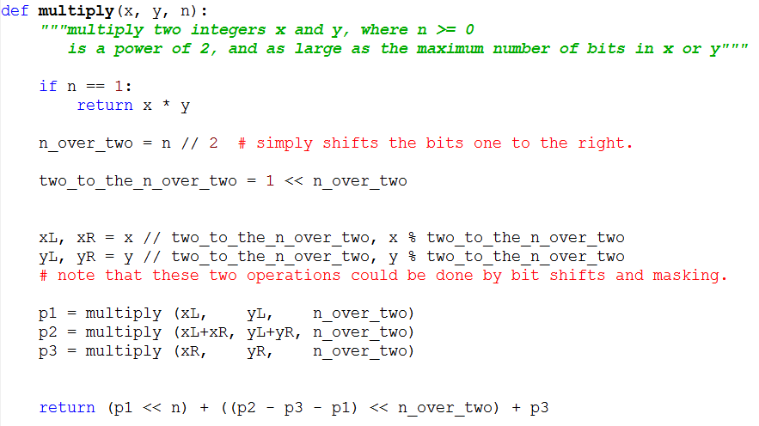
Code for Gauss-based Algorithm

Slide 26
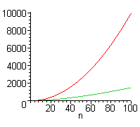
Is this really a lot faster?
Standard multiplication: Ѳ(k²)
Divide and conquer with Gauss trick: Ѳ(k^{1.59})
  Write and solve the recurrence
But there is a lot of additional overhead with Gauss, so standard multiplication
is faster for small values of n.
In reality we would not let the
recursion go down to the
single bit level, but only down
to the number of bits that our
machine can multiply in
hardware without overflow.
Notes:
Do and solve the recurrence:
T(k) = 3 T(k/2) + Θ(n)
In Master theorem, a = 3, b = 2, k = 1.
So we have the third case: T(N) = Θ(k ^ log[2]3),
Which is approximately n ^ 1.59.

