Slide 1
MA/CSSE 473 Day 01
Course Intro
Algorithms Intro
Pick up a handout from the back table

Slide 2
MA/CSSE 473 Day 01
In-class Quizzes (NOT)
Roll Call/Instructor quick intro
Questions about the Syllabus?
The importance of Data Structures
The importance of Algorithms
Begin Algorithm Overview/Review
  Which will last a few days
Notes:
Pass around attendance sheet.
Ask that it be returned to me after everyone signs it.
What do I do with them?

Slide 3
No in-class quizzes in 473
By now, you know whether they help you.
Many days, a “handout with fill-ins” instead.
You will not usually need to have your computer in class.
But if you want to follow along with the slides…
Be careful about distractions!

Slide 4
Attendance sheet
Please write the name you want me and other students to call you

Slide 5
Student Intros (hidden for 201310 because section 02 is so big)
Your name (what you want people to call you)?
What is the main thing you did this summer? Answer 2 or more of the following questions in 30 seconds or less.
Other interesting summer activities?
A favorite algorithm?
  Where were you?
  What was your role?
  For whom?
  What specifically did you work on?
  What did you learn?
  What was the main value that you added there?
  Were you helped by something from Rose courses/experiences?
  Good tools that you used?
  What was the environment like?
  Would you recommend this place to your peers?
Notes:
It feels strange doing intros in a 400-level class. Most of you probably know each other pretty well. But, amazingly, exactly half of you are folks whom I’ve never had in class.
So this won’t be too boring for you, I tried to ask questions that are things you might not know about each other.

Slide 6
A Few Claude Facts
Degrees: Caltech, Illinois, Indiana (MA, MA, CS)
This is my 29th year at Rose
Have taught about 22 different courses; favorites are …
I have 9 children, ages 14-35) 9 grandchildren.
I live very close to campus
In 2010 I was diagnosed with a very rare connective tissue disease, scleromyxedema. 2-day infusions.
Despite ugly prognosis, I still know that God's in control.
I really like it when you put 473 as part of the subject line in your email to me.

Slide 7
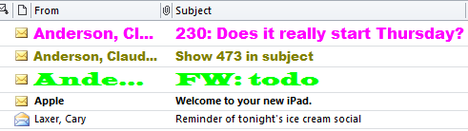
Contact Info
Claude Anderson, F-210, x8331
anderson@rose-hulman.edu
http://exchange.rose-hulman.edu/owa/calendar/anderson@rose-hulman.edu/Calendar/calendar.html . "View by week" is probably best
If you email me, please include 473 somewhere in the subject line (also include a real subject)

Slide 8
Where to find course materials
Moodle: drop boxes, solutions, etc.
Piazza: Announcements and discussions.
Schedule page and things linked from it
Notice the Hints to Exercises section that begins on
p 497 of the textbook
  First try to do each problem without using the hint.
  But if you get stuck, by all means look at the hint.
Sometimes I will post my PowerPoint slides after lectures, because they may contain spoilers. When I do post them before, I may repost a different version after.
Sometimes my slides contain more than we actually get to in class. When that happens, I will usually move
that material to the following day's class.

Slide 9
Questions about the Syllabus?
… or the schedule page?
… or other course details?
You can ask now, or ask tomorrow

Slide 10
One detail before the course intro
CSSE 230 previously discussed graph implementations
So HW1 has a problem to "review" this.
For some of you, it won't be review
So we take 5 minutes to show two representations now.

Slide 11
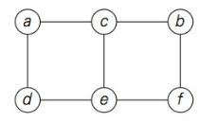
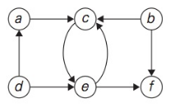
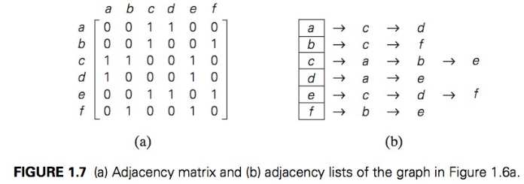
Graph representations
Graph
Vertex
Edge
Endpoints
Adjacent
Digraph Head, Tail Cycle, Loop
Complete
Connected

Slide 12
The Ideal and the Real
Ideal
  Everyone comes to this course with the material from CSSE 230 and MA 375 fresh in their minds
Real
  Only about 50% of you took 230 within the last year.
We’ll do quite a bit of review/reinforcement in this course
  In many cases, you’ll understand things much better the second time you see them.
Several of the early reading assignments discuss things you have probably seen before
  Sometimes treated at a higher level than what
  you saw before.

Slide 13
The Ideal and the Real, part 2
Ideal
  Everyone comes to this course with the same background
Real
  You have taken a variety of courses that introduce common algorithms
  Not all versions of CSSE 230 and the Disco courses are the same
  And some people have taken Graph Theory, crypto, …
Result
  For every algorithm we discuss, chances are good that someone in the class will have already seen it
What to do about it?
  Live with it, or only discuss obscure algorithms? I choose the former

Slide 14
This is a very mathematical class
More about ideas than implementations
But there will be some implementation projects
An occasional “regular” homework problem will require a small implementation (usually 50 lines of code or fewer)

Slide 15
An approach to this course
Examine and/or analyze lots of algorithms.
Look for similar approaches.
Develop a toolbox.
  Some might call it a "bag of tricks"
Internalize the common terminology and ways of talking about algorithms.

Slide 16
Ways of organizing algorithms
By area of application (230 approach), e.g.
  Sorting algorithms
  Search algorithms
  Algorithms based on what data structure is used
    Tree algorithms
    Graph algorithms
    Heap algorithms
By techniques used (473 approach), e.g.
  Brute Force
  Greedy
  Decrease and Conquer
  Divide and Conquer
  Dynamic Programming
Notes:
Both are reasonable approaches

Slide 17
Structuring Data Can Help a Lot
If you have seen this problem before, please don’t speak up (so other students get a chance to think about it).
Example is here.
(Note: I am not putting the example on-line)

Slide 18
Algorithms are Important
The next few slides are based on Chapter 0 of Algorithms by Dasgupta, Papadimitriou, and Vazirani (McGraw-Hill, 2008)
Two enterprises have fueled the computer revolution:
  Rapidly-increasing hardware speeds
  Efficient Algorithms

Slide 19
A Big Idea That Changed the World
Moveable type
  Gutenberg, 1448 (I saw a Gutenberg Bible in summer 2008 at the Library of Congress)
  According to Dasgupta, et. al
    Literacy spread
    The Dark Ages ended
    The human intellect was liberated
    Science and technology triumphed
    The Industrial Revolution happened
    Many historians say we owe all of this to typography
  For a great discussion of algorithms and typography
    See the interview with Donald Knuth in July-August CACM
    It’s assigned reading for this course. See Day 11 in schedule.

Slide 20
The Other Earth-Shaking Big Idea
Algorithms
First step: Replacing Roman Numerals by decimals (India, 7th century AD)
  Could now do arithmetic efficiently
  Codified by Al Khwarizimi (Baghdad, 9th cent.)
    Add, subtract, multiply, divide, square roots, digits of π.
    Precise, unambiguous, mechanical instructoins
    The word algorithm is derived from his name.
The champion of algorithms in the West
  Leonardo of Pisa (a.k.a. Fibonacci) (early 13th century)

Slide 21
Do you agree with Dasgupta?
Are moveable type and algorithms the biggest change motivators since the Dark Ages?
What else would you include in the list?

Slide 22
Brainstorm
What is an algorithm?
In groups of three, try to come up with a good definition.
Goal: Short but complete
Two minutes
Notes:
Q1, Q2
Ingredients:
Sequence of instructions
For solving a problem
Unambiguous (including order)
Can depend on input
Terminates in a finite amount of time

Slide 23
Write an algorithm …
… based on the schedule page for this course
Input: A session number (1 .. 40)
Output: A number representing the day of the week. 0 represents M, 1 T, 2 R, 3 F.
Write the algorithm (a function, actually) with your group.

