Slide 1
Mathematical Induction
What it is?
Why is it a legitimate proof method?
How to use it?

Slide 2
Important Sets of Integers
Z all integers (whole numbers)
Z⁺ the positive integers
Z⁻ the negative integers
N Natural numbers: non-negative integers
  Note that some people define Natural numbers as Z⁺

Slide 3
Some Logic Background
Implication: A→B, where A and B are boolean values. If A, then B
  If it rains today, I will use my umbrella.
    When is this statement true?
      When I use my umbrella
      When it does not rain
    When is it false?
      Only when it rains and I do not use my umbrella.
A | B | A→B
T | T | T
T | F | F
F | T | T
F | F | T

Slide 4
Implication: A→B
A | B | A→B
T | T | T
T | F | F
F | T | T
F | F | T
Conclusions:
  If we know that A→B is true, and B is false, then A
  must be …
  Another expression that is equivalent to A→B:
    ¬ A OR B (think about the truth table for ¬A OR B )
  What similar expression is equivalent to ¬(A→B)?
Notes:
If A→B is true, and B is false, then A must be false
Answer to second question: ¬A AND B

Slide 5
Contradictions
If A is a boolean value, the value of the expression A AND ¬A is _____. This expression is known as a contradiction.
Putting this together with what we saw previously, if B → (A AND ¬A) is True, what can we say about B?
This is the basis for “proof by contradiction”.
  To show that B is true, we find an A for which we can show that
  ¬B → (A AND ¬A) is true.
  This is the approach we will use in our proof that Mathematical induction works.
Notes:
false

Slide 6
Contrapositive of A→B
A | B | A→B | ¬B | ¬A | ¬B → ¬A
T | T | T | F | F | T
T | F | F | T | F | F
F | T | T | F | T | T
F | F | T | T | T | T
¬B → ¬A is called the contrapositive of A→B
Notice that the third and sixth columns of the truth table are the same.
Thus an implication is true if and only if its contrapositive is true.

Slide 7
Mathematical Induction What's it all about? (Outline of the next slides)
Most of the time our intuition is good enough so we don't have to resort to formal proofs of things. But sometimes ...
What kind of thing do we try to prove via induction?
What is the approach? (How does it work?)
Why does this really prove the infinite set of statements that we want to prove?
  Start with the Well-ordering Principle
  proof of Mathematical Induction Principle by contradiction.

Slide 8
What kind of things do we try to prove via induction?
In this course, it will be a property of positive integers (or non-negative integers, or integers larger than some specific number).
A property p(n) is a boolean statement about the integer n. [ p: int→ boolean ]
  Example: p(n) could be "n is an even number".
  Then p(4) is true, but p(3) is false.
If we believe that some property p is true for all positive integers, induction gives us a way of proving it.

Slide 9
What is the approach?
(How does it work?)
To prove that p(n) is true for all n ≥n₀:
    Show that p(n₀) is true.
    Show that for all k ≥ n₀,
    p(k) implies p(k+1).
    I.e, show that whenever p(k) is true, then p(k+1) is true also.

Slide 10
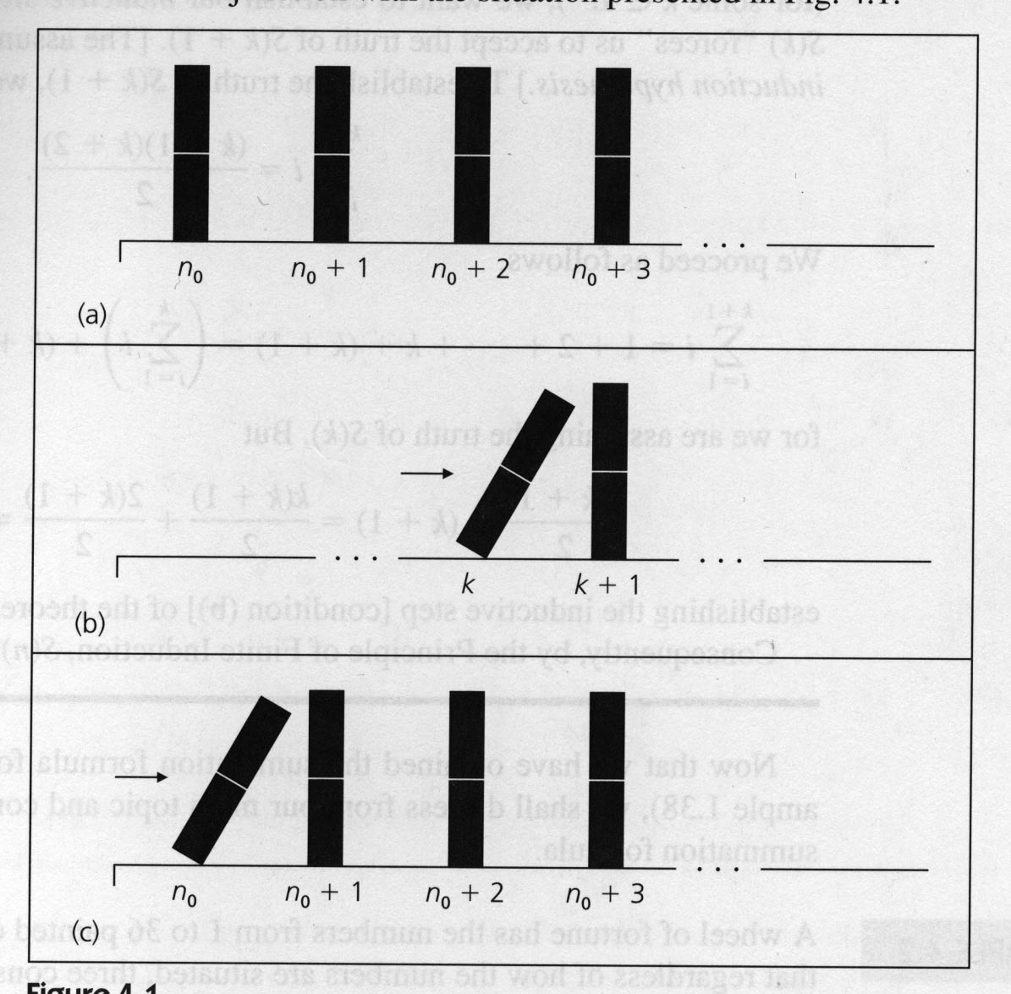
Why does induction work?
(Informal look)
To prove that p(n) is true for all n ≥n₀:
    Show that p(n₀) is true.
    Show that for all k ≥ n₀, p(k) implies p(k+1).
    I.e, if p(k) is true, then p(k+1) is true also
From Ralph Grimaldi's discrete math book.

Slide 11
Why does induction work?
Next we focus on a formal proof of this, because:
  Some people may not be convinced by the informal one
  The proof itself illustrates an important proof technique

Slide 12
The Well-ordering principle
It's an axiom, not something that we can prove.
WOP: Every non-empty set of non-negative integers has a smallest element.
Note the importance of "non-empty", "non-negative", and "integers".
  The empty set does not have a smallest element.
  A set with no lower bound (such as the set of all integers) does not have a smallest element.
    In the statement of WOP, we can replace "positive" with "has a lower bound"
  Unlike integers, a set of rational numbers can have a lower bound but no smallest member.
Assuming the well-ordering principle, we can prove that the principle of mathematical induction is true.

Slide 13
Proof that induction works (Overview)
Let p be a property (p: int → boolean).
Hypothesis:
    p(n₀) is true.
    For all k ≥ n₀, p(k) implies p(k+1). I.e, if p(k) is true,
    then p(k+1) is true also
Desired Conclusion: If n is any integer with n≥ n₀, then p(n) is true. If we can prove this, then induction is a legitimate proof method.
Proof that the conclusion follows from the hypothesis:
Let S be the set {n≥ n₀ : p(n) is false}.
It suffices to show that S is empty.
We do it by contradiction.
  Assume that S is non-empty and show that this leads to a contradiction.
Notes:
Before starting into this proof, I told them about the level of understanding that would be required for the homework(Immediate homework and later homework).

Slide 14
Proof that induction works
Hypothesis:
        p(n₀) is true.
        For all k ≥ n₀, p(k) implies p(k+1).
    Desired Conclusion: If n is any integer with n≥ n₀, then p(n) is true. If this conclusion is true, induction is a legitimate proof method.
Proof: Assume a) and b). Let S be the set {n≥ n₀ : p(n) is false}.
We want to show that S is empty; we do it by contradiction.
  Assume that S is non-empty. Then the well-ordering principle says that S has a smallest element (call it s_{min}).
  We try to show that this leads to a contradiction.
  Note that p(s_{min}) has to be false. Why?
  s_{min} cannot be n₀, by hypothesis (a). Thus s_{min} must be > n₀. Why?
  Thus smin-1 ≥ n₀. Since s_{min} is the smallest element of S, s_{min} -1 cannot be an element of S. What does this say about p (s_{min} – 1)?
    p(s_{min} -1) is true.
  By hypothesis (b), using the k= s_{min} -1 case, p(s_{min}) is also true.
  This contradicts the previous statement that p(s_{min}) is false.
  Thus the assumption that led to this contradiction (S is nonempty)
  must be false.
  Therefore S is empty, and p(n) is true for all n≥ n_{0.}
Notes:
This is a Hidden slide

Slide 15

Induction example
To prove:
What is the base case?
Induction hypothesis?
What do we need to show in the induction step?
Procedural matters:
  Start with one side of the equation/inequality and work toward the other side.
  DO NOT use the “ write what we want to prove and do the same thing to both sides of the equation to work backwards to what we are assuming" approach.
  Clearly indicate the step in which you use the induction hypothesis.

Slide 16
Another example:
Show by induction that 2n + 1 < n² for all integers n≥3.
There are other ways that we could show this (using calculus, for example).
But for now the goal is to have a simple example that can illustrate how to do proofs by induction.

Slide 17
Induction is like Recursion
When we write a recursive program, we make it work for the base case(s).
  Then, assuming that it works for smaller values, we use the solution for a smaller value to construct a solution for a larger value.
To prove that a property p(n) is true for all n>0 using (strong) mathematical induction,
  we show that
    it is true for the base case (typically n=0 or n=1), and that
    the truth of p(k) for larger values of k can be derived from the truth of p(j) for all j with n₀ ≤ j < k.

Slide 18
Fibonacci runtime problem problem
T(0) = 1, T(1) = 2, T(n) = T(n-1) + T(n-2) + 3
DO some examples to see if we can get a formula for T(n)
Prove it by induction.

