Slide 1
MA/CSSE 473 Day 38
Finish Disjoint
Sets
Dijkstra

Slide 2
MA/CSSE 473 Day 38
HW 14
  Only do problems 1, 2, 3, and 9
  (Fall, 2010 vs. Fall, 2012)
Fill out the Course evaluation form
  If everybody in a section does it, everyone in that section gets 5 bonus points on the Final Exam
  I can't see who has completed the evaluation, but I can see how many
Final Exam Monday evening, O269
Student Questions
Finish disjoint set discussion
Notes:
Pass around attendance sheet.

Slide 3
Final Exam Format
Same as previous exams.
You may bring up to four pages of notes.
  Double-sided
  Hopefully that is enough for you to write down details of things you understand but don't want to memorize.
Material from
  Chapters 1-9
  Excerpts from Weiss and Dasgupta that I posted on ANGEL
  HW 1-14
  All class days

Slide 4
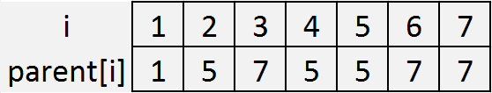
Recap: Disjoint Set Representation
Each disjoint set is a tree, with the "marked" element as its root
Efficient representation of the trees:
  an array called parent
  parent[i] contains the index of i’s parent.
  If i is a root, parent[i]=i
5
1
7
2
4
3
6
8

Slide 5
Using this representation
def makeset1(i):
parent[i] = i
makeset(i):
findset(i):
mergetrees(i,j):
  assume that i and j are the marked elements from different sets.
union(i,j):
  assume that i and j are elements from different sets
def findset1(i):
while i != parent[i]:
i = parent[i]
return i
def mergetrees1(i,j):
parent[i] = j
def union1(i,j):
mergetrees1(findset1(i), findset1(j))
Notes:
Animated slide. Figure each out together before revealing it

Slide 6
Can we keep the trees from growing so fast?
Make the shorter tree the child of the taller one
What do we need to add to the representation?
rewrite makeset, mergetrees.
findset & union
are unchanged.
What can we say about the maximum height
of a k-node tree?
def makeset2(i):
parent[i] = i
height[i] = 0
def mergetrees2(i,j):
if height[i] < height[j]): parent[i] = j
elif height[i] > height[j]:
parent[j] = i
else:
parent[i] = j
height[j] = height[j] + 1
Notes:
Before revealing code: We need to add a height array
Write makeset2 and mergetrees2 on the board together.

Slide 7
Theorem: max height of a k-node tree T produced by these algorithms is ⎣lg k⎦
Base case…
Induction hypothesis…
Induction step:
  Let T be a k-node tree
  T is the union of two trees:
  T₁ with k₁ nodes and height h₁
  T₂ with k₂ nodes and height h₂
  What can we about the heights of these trees?
  Case 1: h₁≠h₂. Height of T is
  Case 2: h₁=h₂. WLOG Assume k₁≥k₂. Then k₂≤k/2. Height of tree is 1 + h2 ≤ …
Notes:
Base case: k=1.
Induction hypothesis: For all p< k, the height of a p-node tree is at most ⎣lg p⎦.
Since k > 1, T must be the union of two trees
Case 1: height of T is max {h1, h2} <= max {⎣lg k₁⎦, ⎣lg k₂⎦ } <= ⎣lg k⎦
Case 2: 1 + h2 <= 1 + ⎣lg k₂⎦ <= 1 + ⎣lg k/2⎦ = 1 + ⎣lg k - 1⎦ = ⎣lg k⎦

Slide 8
Worst-case running time
Again, assume n makeset operations, followed by m union/find operations.
If m > n
If m < n
Notes:
n makesets are still n
union and find are m* log n
Altogether n + m log n
If m < n, we can reduce it to n + m log m

Slide 9
Speed it up a little more
Path compression: Whenever we do a findset operation, change the parent pointer of each node that we pass through on the way to the root so that it now points directly to the root.
Replace the height array by a rank array, since the number now is only an upper bound for the height.
Look at makeset, findset, mergetrees (on next slides)

Slide 10
Makeset
This algorithm represents the set {i} as a one-node tree and initializes its rank to 0.
def makeset3(i):
parent[i] = i
rank[i] = 0

Slide 11
Findset
This algorithm returns the root of the tree to which i belongs and makes every node on the path from i to the root (except the root itself) a child of the root.
def findset(i):
root = i
while root != parent[root]:
root = parent[root]
j = parent[i]
while j != root:
parent[i] = root
i = j
j = parent[i]
return root

Slide 12
Mergetrees
This algorithm receives as input the roots of two distinct trees and combines them by making the root of the tree of smaller rank a child of the other root. If the trees have the same rank, we arbitrarily make the root of the first tree a child of the other root.
def mergetrees(i,j) :
if rank[i] < rank[j]:
parent[i] = j
elif rank[i] > rank[j]:
parent[j] = i
else:
parent[i] = j
rank[j] = rank[j] + 1

Slide 13
Analysis
It's complicated!
R.E. Tarjan proved (1975)*:
  Let t = m + n
  Worst case running time is Ѳ(t α(t, n)), where
  α is a function with an extremely slow growth rate.
  Tarjan's α:
    α(t, n) ≤ 4 for all n ≤ 10¹⁹⁷²⁸
Thus the amortized time for each operation is essentially constant time.
* According to Algorithmsby R. Johnsonbaugh and M. Schaefer, 2004, Prentice-Hall, pages 160-161

Slide 14
Dijkstra's Algorithm
For a selected vertex, (call it start) in a connected, weighted graph G,
  find a shortest (minimum total weight) path from start to each other vertex
Assumption: All weights are positive

Slide 15
Dijkstra’s algorithm approach
The shortest path from vertex v to vertex w is either
  empty, if v = w, or
  obtained by adding an edge (u, w) to the end of a shortest path from v to u.

Slide 16
Dijkstra’s algorithm start-up
Begin with a subgraph that consists of only the starting vertex.
Among all edges (start, v),
  choose the one with the smallest weight,
  add it (along with the edge that connects it) to our subgraph.
  Clearly (start, v) is the shortest path from start to v.

Slide 17
Dijkstra’s algorithm continues
Loop:
Among all vertices not in a path yet, and which are also adjacent to a vertex that is in the path,
  choose one with minimal path length from start,
  and add it to the path,
  along with the edge that connects it to a path.
Which previously- studied algorithm that we have seen does this closely resemble?
Example:
g = AdjancencyListGraph(
[[1, [(2, 4), (3, 2), (5, 3)]],
[2, [(1, 4), (4, 5)]],
[3, [(1, 2), (5, 6), (4, 1), (6,3)]],
[4, [(2, 5), (6,6), (3,1)]],
[5, [(1, 3), (3,6), (6,2)]],
[6, [(5, 2), (3, 3), (4, 6)]]
])
Notes:
Result:
1 3 [5, 1]
2 7 [5, 1, 2]
3 5 [5, 6, 3]
4 6 [5, 6, 3, 4]
5 0 [5]
6 2 [5, 6]

Slide 18
Dijkstra’s algorithm data structures
A parent array as in Prim’s algorithm.
A minheap that stores “unpathed” nodes as keys and minimum path lengths (as extensions of a minimum path that has already been discovered) as weights.
  Use an indirect binary heap, just as we did for Prim.
A cost array that stores the minimum path length to each vertex
  Not strictly necessary; could reconstruct form adjacency list and parent array.

Slide 19
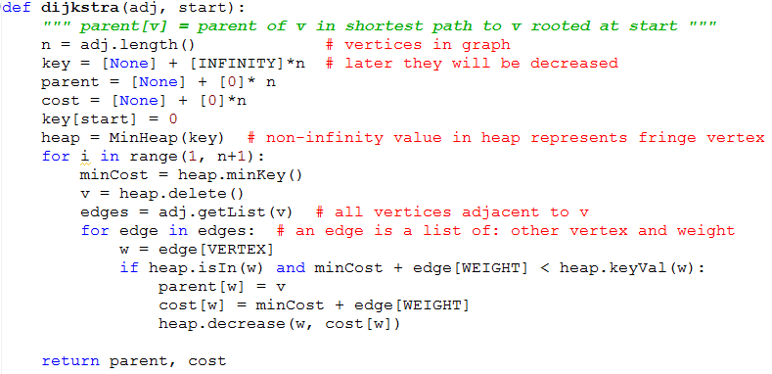
Dijkstra’s algorithm details

