Slide 1
MA/CSSE 473 Days 29-30
Optimal BSTs

Slide 2
MA/CSSE 473 Days 29-30
Student Questions?
Expected Lookup time in a Binary Search Tree
Optimal static Binary Search Tree
Using the recursive formula with dynamic programming
Greedy Algorithms
Background for file compression (Huffman's algorithm)

Slide 3
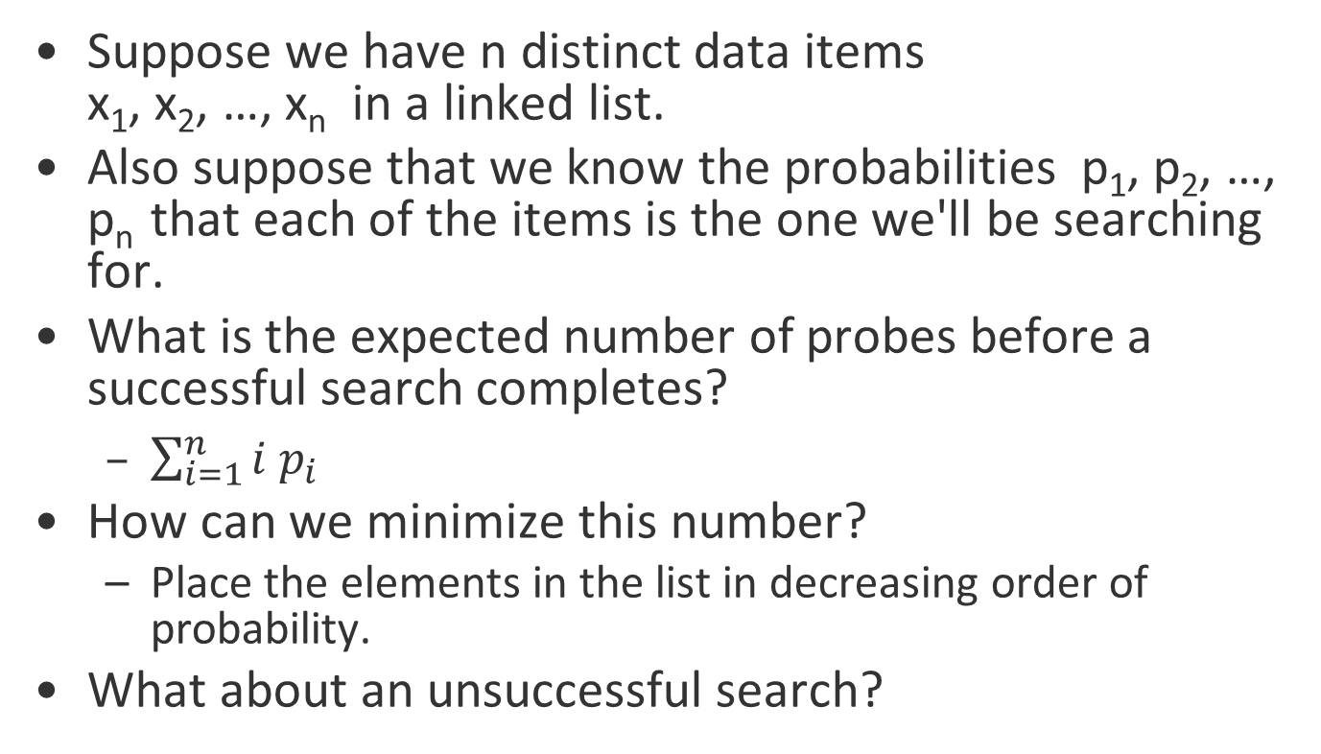
Recap: Optimal linked list order
Suppose we have n distinct data items
x₁, x₂, …, x_{n} in a linked list.
Also suppose that we know the probabilities p₁, p₂, …, p_{n} that each of the items is the one we'll be searching for.
What is the expected number of probes before a successful search completes?
  $\sum_{i=1}^{n}{i p_{i}}$
How can we minimize this number?
  Place the elements in the list in decreasing order of probability.
What about an unsuccessful search?

Slide 4
Optimal Binary Search Trees
Suppose we have n distinct data keys K₁, K₂, …, K_{n} (in increasing order) that we wish to arrange into a Binary Search Tree
This time the expected number of probes for a successful or unsuccessful search depends on the shape of the tree and where the search ends up
This discussion follows Reingold and Hansen, Data Structures. An excerpt on optimal static BSTS is posted on Moodle. I use a_{i} and b_{i} where Reingold and Hansen use α_{i} and β_{i} .

Slide 5
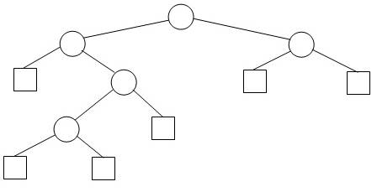
Recap: Extended binary search tree
It's simplest to describe this
problem in terms of an
extended binary search tree
(EBST): a BST enhanced by
drawing "external nodes" in
place of all of the null pointers
in the original tree
Formally, an Extended Binary Tree (EBT) is either
  an external node, or
  an (internal) root node and two EBTs T_{L} and T_{R}
In diagram, Circles = internal nodes, Squares = external nodes
It's an alternative way of viewing a binary tree
The external nodes stand for places where an unsuccessful search can end or where an element can be inserted
An EBT with n internal nodes has ___ external nodes
(We proved this by induction earlier in the term)
See Levitin: page 183 [141]

Slide 6
What contributes to the expected number of probes?
Frequencies, depth of node
For successful search, number of probes is
_______________ the depth of the corresponding internal node
For unsuccessful, number of probes is
__________ the depth of the corresponding external node
one more than
equal to
Notes:
one more than
exactly

Slide 7
Optimal BST Notation
Keys are K₁, K₂, …, K_{n}
Let v be the value we are searching for
For i= 1, …,n, let a_{i} be the probability that v is key K_{i}
For i= 1, …,n-1, let b_{i} be the probability that K_{i} < v < K_{i+1}
  Similarly, let b₀ be the probability that v < K₁,
  and b_{n} the probability that v > K_{n}
Note that
We can also just use frequencies instead of probabilities when finding the optimal tree (and divide by their sum to get the probabilities if we ever need them). That is what we will do.
Should we try exhaustive search of all
possible BSTs? Answer on next slide
Notes:
After the animation ask, "Can we apply the same idea that we used for lists here?"
Not exactly. We know that higher probabilities should go near the top, but after that it gets complicated.
A greedy algorithm that puts the highest probability as the root may not, in fact, be optimal.
What about making a max-heap based on the probabilities?"
No, because thn it would no longer be a BST< and search would not be efficient.

Slide 8

Aside: How many possible BST's
Given distinct keys K₁ < K₂ < … < K_{n}, how many different Binary Search Trees can be constructed from these values?
Figure it out for n=2, 3, 4, 5
Write the recurrence relation
Solution is the Catalan number c(n)
Verify for n = 2, 3, 4, 5.
When n=20, c(n) is almost 10¹⁰
Wikipedia Catalan article has five different proofs of
Notes:
Recurrence is c(n) = sum(c(j-1)c(n-j), j=1..n) The jth case has node j as the rrot.

Slide 9
Recap: Optimal Binary Search Trees
Suppose we have n distinct data items K₁, K₂, …, K_{n} (in increasing order) that we wish to arrange into a Binary Search Tree
This time the expected number of probes for a successful or unsuccessful search depends on the shape of the tree and where the search ends up
Let v be the value we are searching for
For i= 1, …,n, let a_{i} be the probability that v is item K_{i}
For i= 1, …,n-1, let b_{i} be the probability that K_{i} < v < K_{i+1}
Similarly, let b₀ be the probability that v < K₁,
and b_{n} the probability that v > K_{n}
Note that
but we can also just use frequencies when finding
the optimal tree (and divide by their sum to get
the probabilities if needed)
Notes:
No, because thn it would no longer be a BST< and search would not be efficient.

Slide 10
What not to measure
Earlier, we introduced the notions of external path length and internal path length
These are too simple, because they do not take into account the frequencies.
We need weighted path lengths.

Slide 11
Weighted Path Length
If we divide this by Σa_{i} + Σb_{i} we get the average search time.
We can also define it recursively:
C(□) = 0. If T = , then
C(T) = C(T_{L}) + C(T_{R}) + Σa_{i} + Σb_{i} , where the summations are over all a_{i} and b_{i} for nodes in T
It can be shown by induction that these two definitions are equivalent (good practice problem).
Note: y₀, …, y_{n} are the external nodes of the tree
T_{L}
T_{R}

Slide 12
Example
Frequencies of vowel occurrence in English
: A, E, I, O, U
a's: 32, 42, 26, 32, 12
b's: 0, 34, 38, 58, 95, 21
Draw a couple of trees (with E and I as roots), and see which is best. (sum of a's and b's is 390).
Notes:
E as root: Children: A and O.
I as root: Children: A and O.

Slide 13
Strategy
We want to minimize the weighted path length
Once we have chosen the root, the left and right subtrees must themselves be optimal EBSTs
We can build the tree from the bottom up, keeping track of previously-computed values

Slide 14
Intermediate Quantities
Cost: Let C_{ij} (for 0 ≤ i ≤ j ≤ n) be the cost of an optimal tree (not necessarily unique) over the frequencies b_{i}, a_{i+1}, b_{i+1}, …a_{j}, b_{j}. Then
C_{ii} = 0, and
This is true since the subtrees of an optimal tree must be optimal
To simplify the computation, we define
W_{ii} = b_{i}, and W_{ij} = W_{i,j-1} + a_{j} + b_{j} for i<j.
Note that W_{ij} = b_{i} + a_{i+1} + … + a_{j} + b_{j}, and so
C_{ii} = 0, and
Let R_{ij} (root of best tree from i to j) be a value of k that minimizes
C_{i,k-1} + C_{kj} in the above formula

Slide 15
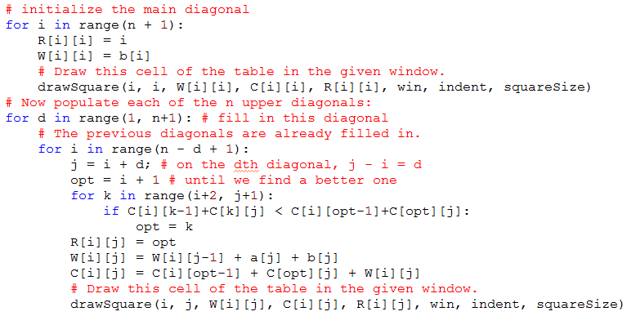
Code

Slide 16
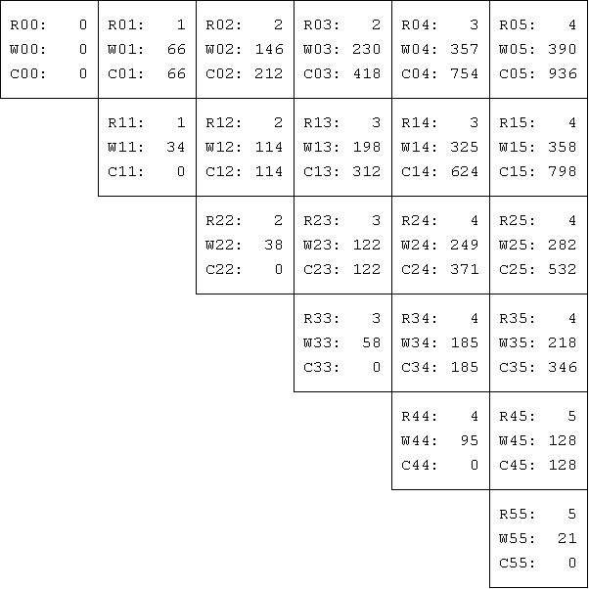
Results
Constructed
by diagonals,
from main
diagonal
upward
What is the
optimal
tree?
How to construct the optimal tree?
Analysis of the algorithm?

Slide 17

Running time
Most frequent statement is the comparison
if C[i][k-1]+C[k][j] < C[i][opt-1]+C[opt][j]:
How many times
does it execute:
Notes:
This is not trivial to show.

Slide 18
Greedy Algorithms
Do what seems best at the moment …

Slide 19
Greedy algorithms
Whenever a choice is to be made, pick the one that seems optimal for the moment, without taking future choices into consideration
  Once each choice is made, it is irrevocable
For example, a greedy Scrabble player will simply maximize her score for each turn, never saving any “good” letters for possible better plays later
  Doesn’t necessarily optimize score for entire game
Greedy works well for the "optimal linked list with known search probabilities" problem, and reasonably well for the "optimal BST" problem
  But does not necessarily produce an optimal tree
Q7

Slide 20
Greedy Chess
Take a piece or pawn whenever you will not lose a piece or pawn (or will lose one of lesser value) on the next turn
Not a good strategy for this game either

Slide 21
Greedy Map Coloring
On a planar (i.e., 2D Euclidean) connected map, choose a region and pick a color for that region
Repeat until all regions are colored:
  Choose an uncolored region R that is adjacent¹ to at least one colored region
    If there are no such regions, let R be any uncolored region
  Choose a color that is different than the colors of the regions that are adjacent to R
  Use a color that has already been used if possible
The result is a valid map coloring, not necessarily with the minimum possible number of colors
¹ Two regions are adjacent if they have a common edge

Slide 22
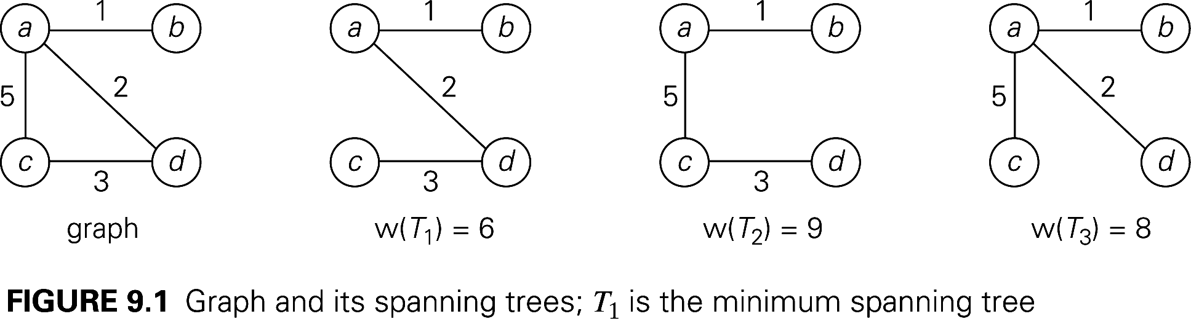
Spanning Trees for a Graph

Slide 23
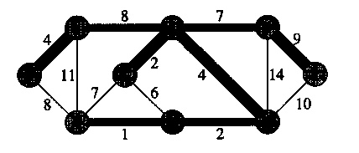
Minimal Spanning Tree (MST)
Suppose that we have a connected network G (a graph whose edges are labeled by numbers, which we call weights)
We want to find a tree T that
  spans the graph (i.e. contains all nodes of G).
  minimizes (among all spanning trees)
  the sum of the weights of its edges.
Is this MST unique?
One approach: Generate all spanning trees and determine which is minimum
Problems:
  The number of trees grows exponentially with N
  Not easy to generate
  Finding a MST directly is simpler and faster
More details soon

Slide 24
Huffman's algorithm
Goal: We have a message that co9ntains n different alphabet symbols. Devise an encoding for the symbols that minimizes the total length of the message.
Principles: More frequent characters have shorter codes. No code can be a prefix of another.
Algorithm: Build a tree form which the codes are derived. Repeatedly join the two lowest-frequency trees into a new tree.
Q8-10

