Slide 1
MA/CSSE 473 Day 27
Student questions
Leftovers from Boyer-Moore
Knuth-Morris-Pratt String Search Algorithm

Slide 2
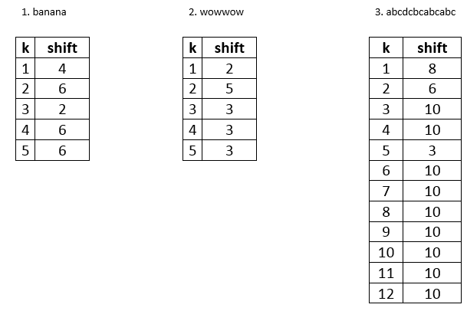
Solution (hide this until after class)

Slide 3
Boyer-Moore example (Levitin)
B E S S _ K N E W _ A B O U T _ B A O B A B S
B A O B A B
d₁ = t₁(K) = 6 B A O B A B
d₁ = t₁(_)-2 = 4
d₂(2) = 5
B A O B A B
d₁ = t₁(_)-1 = 5
d₂(1) = 2
B A O B A B (success)
A B C D E F G H I J K L M N O P Q R S T U V W X Y Z
_
1 2 6 6 6 6 6 6 6 6 6 6 6 6 3 6 6 6 6 6 6 6 6 6 6 6
6
k | pattern | d₂
1 | BAOBAB | 2
2 | BAOBAB | 5
3 | BAOBAB | 5
4 | BAOBAB | 5
5 | BAOBAB | 5

Slide 4
Boyer-Moore Example (mine)
pattern = abracadabra
text = abracadabtabradabracadabcadaxbrabbracadabraxxxxxxabracadabracadabra
m = 11, n = 67
badCharacterTable: a3 b2 r1 a3 c6 x11
GoodSuffixTable: (1,3) (2,10) (3,10) (4,7) (5,7) (6,7) (7,7) (8,7) (9,7) (10, 7)
abracadabtabradabracadabcadaxbrabbracadabraxxxxxxabracadabracadabra
abracadabra
i = 10 k = 1 t1 = 11 d1 = 10 d2 = 3
abracadabtabradabracadabcadaxbrabbracadabraxxxxxxabracadabracadabra
abracadabra
i = 20 k = 1 t1 = 6 d1 = 5 d2 = 3
abracadabtabradabracadabcadaxbrabbracadabraxxxxxxabracadabracadabra
abracadabra
i = 25 k = 1 t1 = 6 d1 = 5 d2 = 3
abracadabtabradabracadabcadaxbrabbracadabraxxxxxxabracadabracadabra
abracadabra
i = 30 k = 0 t1 = 1 d1 = 1

Slide 5
Boyer-Moore Example (mine)
First step is a repeat from the previous slide
abracadabtabradabracadabcadaxbrabbracadabraxxxxxxabracadabracadabra
abracadabra
i = 30 k = 0 t1 = 1 d1 = 1
abracadabtabradabracadabcadaxbrabbracadabraxxxxxxabracadabracadabra
abracadabra
i = 31 k = 3 t1 = 11 d1 = 8 d2 = 10
abracadabtabradabracadabcadaxbrabbracadabraxxxxxxabracadabracadabra
abracadabra
i = 41 k = 0 t1 = 1 d1 = 1
abracadabtabradabracadabcadaxbrabbracadabraxxxxxxabracadabracadabra
abracadabra
i = 42 k = 10 t1 = 2 d1 = 1 d2 = 7
abracadabtabradabracadabcadaxbrabbracadabraxxxxxxabracadabracadabra
abracadabra
i = 49 k = 1 t1 = 11 d1 = 10 d2 = 3
abracadabtabradabracadabcadaxbrabbracadabraxxxxxxabracadabracadabra
abracadabra
49
Brute force took 50 times through the outer loop; Horspool took 13; Boyer-Moore 9 times.

Slide 6
Boyer-Moore Example
On Moore's home page
http://www.cs.utexas.edu/users/moore/best-ideas/string-searching/fstrpos-example.html

Slide 7
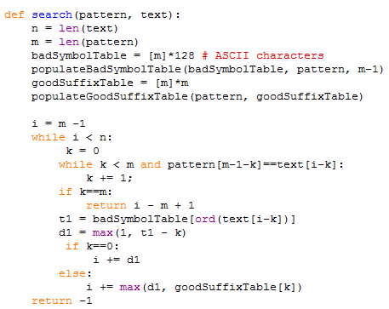
This code is online
There is an O(m) algorithm for building the goodSuffixTable. It's complicated.
My code for building the table is Θ(m²)
This code is Θ(n)

Slide 8
Knuth-Morris-Pratt Search
Based on the brute force search.
Does character-by-character matching left-to-right
In many cases we can shift by more than 1, without missing any matches.
Depends on repeated characters in p.
We call the amount of the increment the shift value.
Once we can calculate the correct shift values, the algorithm is fairly simple.
Principles are like those behind Boyer-Moore Good Suffix shifts.

Slide 9
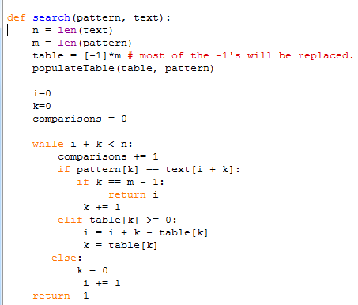

Slide 10
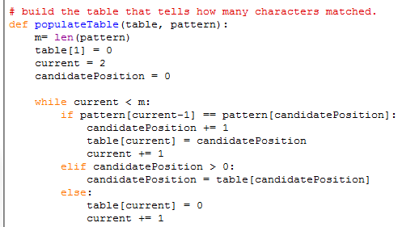

Slide 11
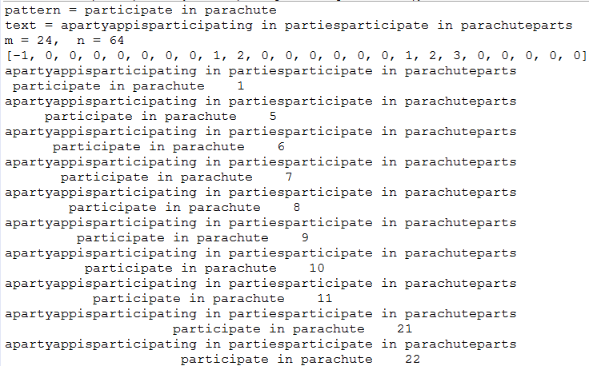

Slide 12
