Slide 1
MA/CSSE 473 Day 22
Binary Heaps
Heapsort
Answers to student questions
Exam 2
Tuesday,
Nov 4 in class
Notes:
Don't include the second Space-time tradeoffs slide in the on-line slides

Slide 2
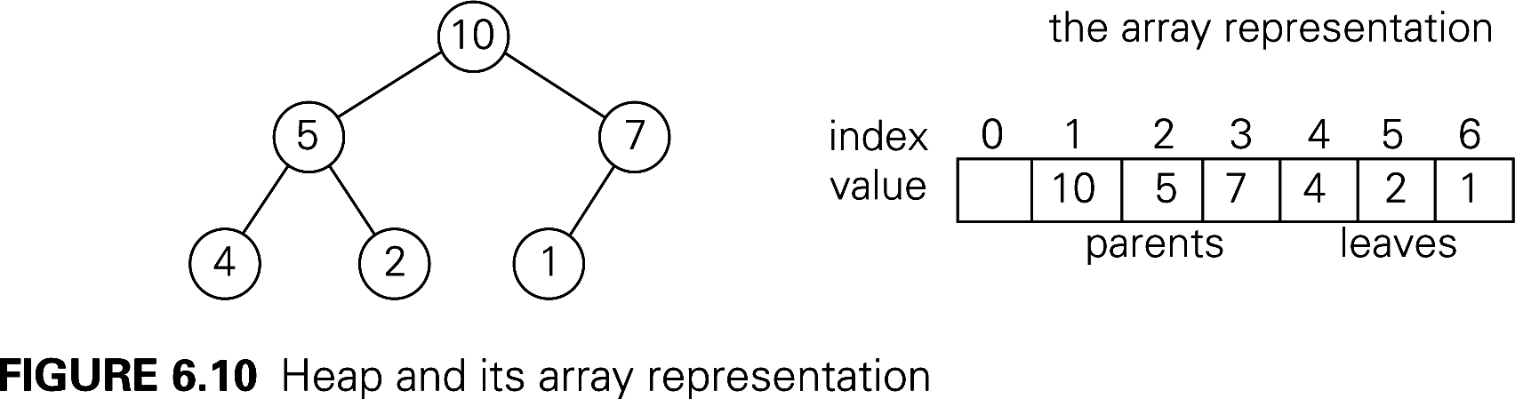
Binary (max) Heap Quick Review
Representation change example
See also Weiss, Chapter 21 (Weiss does min heaps)
An almost-complete Binary Tree
  All levels, except possibly the last, are full
  On the last level all nodes are as far left as possible
  No parent is smaller than either of its children
  A great way to represent a Priority Queue
Representing a binary heap as an array:
Notes:
My guess is that for most of you, you only need a quick refresher on the heap insert and removeMax algorithms, but that a subtle issue relating to heapSort analysis may have gone over your head.

Slide 3
Insertion and RemoveMax
Insertion:
  Insert at the next position (end of the array) to maintain an almost-complete tree, then "percolate up" within the tree to restore heap property.
RemoveMax:
  Move last element of the heap to replace the root, then "percolate down" to restore heap property.
Both operations are Ѳ(log n).
Many more details (done for min-heaps):
  http://www.rose-hulman.edu/class/csse/csse230/201230/Slides/18-Heaps.pdf
Notes:
Draw the heap rom previous slide on the board, insert 8, then 11; removeMax a couple of times.
Then show code on next slide

Slide 4
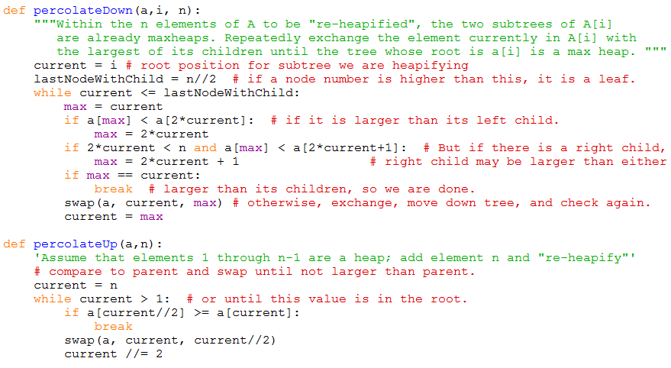
Heap utilitiy functions
Code is on-line, linked from the schedule page

Slide 5
HeapSort
Arrange array into a heap. (details next slide)
for i = n downto 2:
a[1]↔a[i], then "reheapify" a[1]..a[i-1]
Animation:
http://www.cs.auckland.ac.nz/software/AlgAnim/heapsort.html
Faster heap building algorithm: buildheap
http://students.ceid.upatras.gr/~perisian/data_structure/HeapSort/heap_applet.html

Slide 6
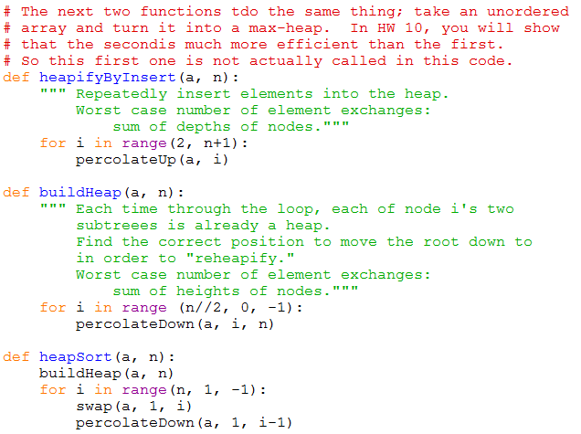
HeapSort Code

Slide 7
Recap: HeapSort: Build Initial Heap
Two approaches:
  for i = 2 to n
  percolateUp(i)
  for j = n/2 downto 1
  percolateDown(j)
Which is faster, and why?
What does this say about overall big-theta running time for HeapSort?
Notes:
What is the depth of the node in position a[i]? Answer: floor(lg i)
In a full tree, what is the relationship between Height(node[i]) and depth(node[i])?

Slide 8
Transform and conquer
Polynomial Evaluation
Problem Reductiion

Slide 9
Recap: Horner's Rule
We discussed it in class previously
It involves a representation change.
Instead of a_{n}x^{n} + a_{n-1}x^{n-1} + …. + a₁x + a₀, which requires a lot of multiplications, we write
( … (a_{n}x + a_{n-1})x + … +a₁ )x + a₀
code on next slide
Notes:
It's O(n).
It involves a representation change.
Instead of anx^n + an-1x^n-1 …. + a1x + a0 we write
( … (a_{n}x + a_{n-1})x + … )x + a₀

Slide 10
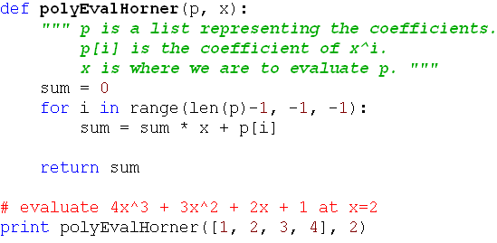
Recap: Horner's Rule Code
This is clearly Ѳ(n).
Notes:
It's O(n).
It involves a representation change.
Instead of anx^n + an-1x^n-1 …. + a1x + a0 we write
( … (a_{n}x + a_{n-1})x + … )x + a₀

Slide 11
Problem Reduction
Express an instance of a problem in terms of an instance of another problem that we already know how to solve.
There needs to be a one-to-one mapping between problems in the original domain and problems in the new domain.
Example: In quickhull, we reduced the problem of determining whether a point is to the left of a line to the problem of computing a simple 3x3 determinant.
Example: Moldy chocolate problem in HW 9.
The big question: What problem to reduce it to?
(You'll answer that one in the homework)

Slide 12
Least Common Multiple
Let m and n be integers. Find their LCM.
Factoring is hard.
But we can reduce the LCM problem to the GCD problem, and then use Euclid's algorithm.
Note that lcm(m,n)∙gcd(m,n) = m∙n
This makes it easy to find lcm(m,n)
Notes:
N = 12 = 2 2 3
M = 18 = 2 3 3
GCD = 6
LCM = 36
GCD * LCM = 6 * 36 = 216

Slide 13
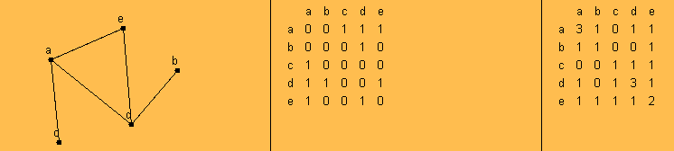
Paths and Adjacency Matrices
We can count paths from A to B in a graph by looking at powers of the graph's adjacency matrix.
For this example, I used the applet from
http://oneweb.utc.edu/~Christopher-Mawata/petersen2/lesson7.htm, which is no longer accessible
Notes:
This should be review fm 230
Take the square of the matrix

Slide 14
Linear programming
We want to maximize/minimize a linear function
, subject to constraints, which are linear equations or inequalities involving the n variables x₁,…,x_{n} .
The constraints define a region, so we seek to maximize the function within that region.
If the function has a maximum or minimum in the region it happens at one of the vertices of the convex hull of the region.
The simplex method is a well-known algorithm for solving linear programming problems. We will not deal with it in this course.
The Operations Research courses cover linear programming in some detail.

Slide 15
Integer Programming
A linear programming problem is called an integer programming problem if the values of the variables must all be integers.
The knapsack problem can be reduced to an integer programming problem:
maximize subject to the constraints
and x_{i} ∈{0, 1} for i=1, …, n

Slide 16
Space-time tradeoffs
Sometimes using a little more space saves a lot of time

Slide 17
Space vs time tradeoffs
Often we can find a faster algorithm if we are willing to use additional space.
Examples:

Slide 18
Space vs time tradeoffs
Often we can find a faster algorithm if we are willing to use additional space.
Give some examples (quiz question)
Examples:
  Binary heap vs simple sorted array. Uses one extra array position
  Merge sort
  Radix sort and Bucket Sort
  Anagram finder
  Binary Search Tree (extra space for the pointers)
  AVL Tree (extra space for the balance code)

