Slide 1
MA/CSSE 473 Day 21
AVL Tree
Maximum height
2-3 Trees
Student questions?

Slide 2
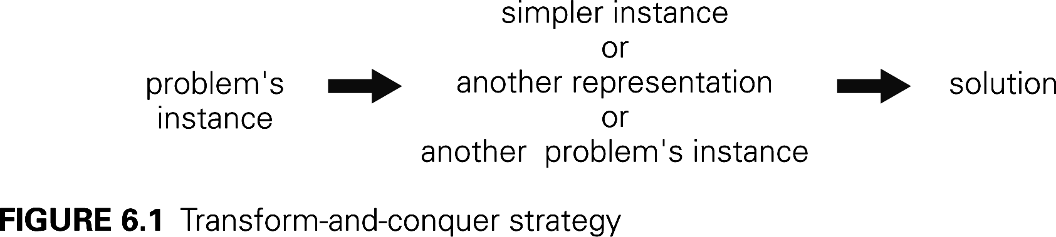
Transform and Conquer Algorithms
But first: Answer student questions
Transform a problem to a simpler instance of the same problem – instance simplification
Transformation to a different representation of the same instance – representation change
Transformation to an instance of a different problem that we know how to solve – problem reduction
Q1

Slide 3
Recap: Representation change:
AVL Trees (what you should remember…)
Named for authors of original paper, Adelson-Velskii and Landis (1962).
An AVL tree is a height-balanced Binary Search Tree.
A BST T is height balanced if T is empty, or if
  | height( T_{L} ) - height( T_{R} ) | ≤ 1, and
  T_{L} and T_{R} are both height-balanced.
Show: Maximum height of an AVL tree with N nodes is Θ(log N)
How do we maintain balance after insertion?
Exercise: Given a pointer to the root of an AVL tree with N nodes, find the height of the tree in log N time
Details on balance codes and various rotations are
in the CSSE 230 slides that are linked from the
schedule page.
Let's review that together
Notes:
Extra data to make this more efficient. Balance code in each node.
This is an essential part of the AVL data structure.

Slide 4
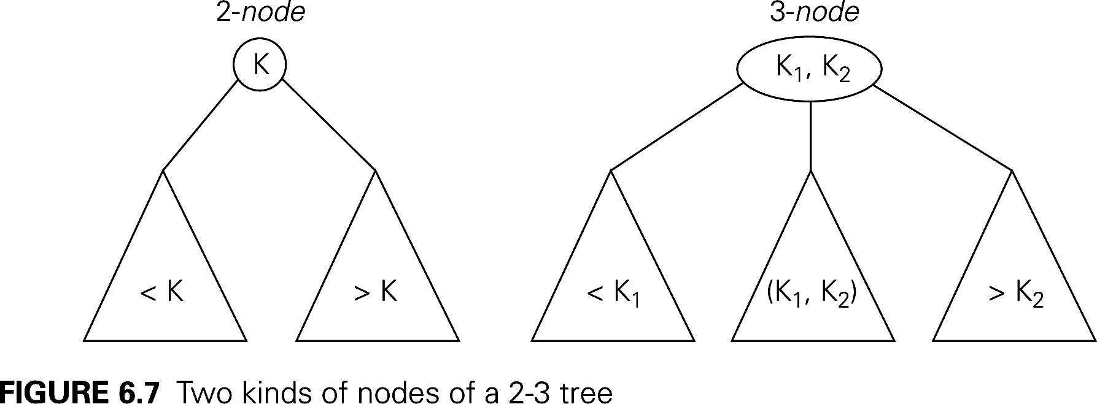
Representation change: 2-3 trees
Another approach to balanced trees
Keeps all leaves on the same level
Some non-leaf nodes have 2 keys and 3 subtrees
Others are regular binary nodes.
Notes:
Easy to balance

Slide 5
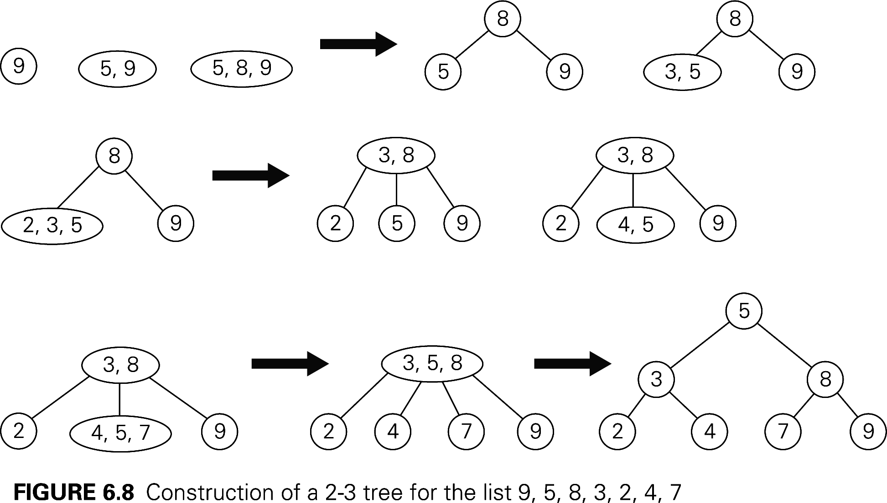
2-3 tree insertion example
More examples of insertion:
http://www.cs.ucr.edu/cs14/cs14_06win/slides/2-3_trees_covered.pdf
http://slady.net/java/bt/view.php?w=450&h=300
Add 10, 11, 12, … to the last tree

Slide 6
Efficiency of 2-3 tree insertion
Upper and lower bounds on height of a tree with n elements?
Worst case insertion and lookup times is proportional to the height of the tree.
Notes:
Upper bound: A full binary tree. So N ≥ 2^{h+1} -1. h ≤ lg(N+1) -1.
Lower bound. Full ternary tree. Two items in each node
N <= 2(1 + 3 + 3² + … + 3^{h}) = 3^{h+1} -1. So h ≥ log₃(N+1) -1

Slide 7
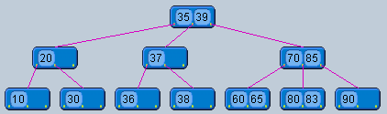
2-3 Tree insertion practice
Insert 84 into this tree and show the resulting tree

Slide 8
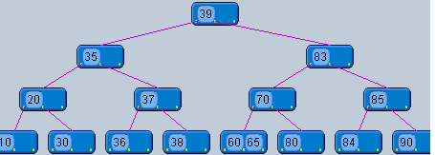
2-3 Tree insertion practice
Insert 84 into this tree and show the resulting tree

