Slide 1
MA/CSSE 473 Day 14
Permutations
wrap-up
Subset generation
(Horner’s method)

Slide 2
MA/CSSE 473 Day 14
Student questions
Monday will begin with "ask questions about exam material” time.
Exam details are Day 16 of the schedule page.
Today's topics:
  Permutations wrap-up
  Generating subsets of a set
  (Horner’s method)
Notes:
Pass around attendance sheet.

Slide 3
Permutations and order
number | permutation |  | number | permutation
0 | 0123 |  | 12 | 2013
1 | 0132 |  | 13 | 2031
2 | 0213 |  | 14 | 2103
3 | 0231 |  | 15 | 2130
4 | 0312 |  | 16 | 2301
5 | 0321 |  | 17 | 2310
6 | 1023 |  | 18 | 3012
7 | 1032 |  | 19 | 3021
8 | 1203 |  | 20 | 3102
9 | 1230 |  | 21 | 3120
10 | 1302 |  | 22 | 3201
11 | 1320 |  | 23 | 3210
Given a permutation of 0, 1, …, n-1, can we directly find the next permutation in the lexicographic sequence?
Given a permutation of 0..n-1, can we determine its permutation sequence number?
Given n and i, can we directly generate
the i^{th} permutation of 0, …, n-1?
Notes:
Discuss these, with examples:

Slide 4
Yesterday's Discovery
Which permutation follows each of these in lexicographic order?
  183647520 471638520
  Try to write an algorithm for generating the next permutation, with only the current permutation as input.
Notes:
After 183647520: 183650247 After 471638520: 471650238
Algorithm: Scan from right, find first place where p[i] < p[i+1].
find j, position of smallest among numbers in p[i+1]…p[n-1] that are greater than p[i].
exchange p[i] and p[j], then reverse p[i+1] ..p[n-1]

Slide 5
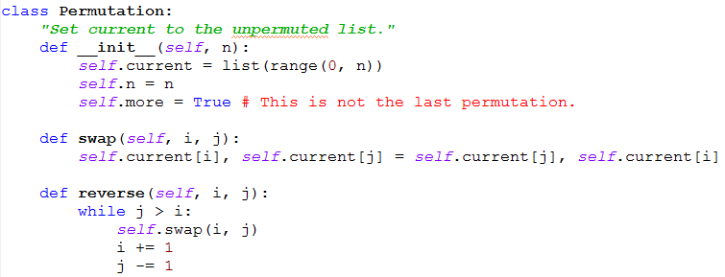
Lexicographic Permutation class
These are the basics of the class setup.
The next() method provides an iterator over the permutations. How should it get from one permutation to the next?
Notes:
Put up this example: 183647532

Slide 6
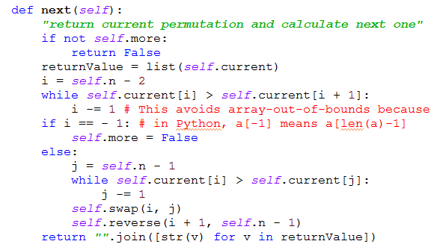
Main permutation method

Slide 7
More discoveries
Which permutation follows each of these in lexicographic order?
  183647520 471638520
  Try to write an algorithm for generating the next permutation, with only the current permutation as input.
If the lexicographic permutations of the numbers [0, 1, 2, 3, 4] are numbered starting with 0, what is the number of the permutation 14032?
  General algorithm? How to calculate efficiency?
In the lexicographic ordering of permutations of [0, 1, 2, 3, 4, 5], which permutation is number 541?
  General algorithm? How to calculate efficiently?
  Application: Generate a random permutation
Notes:
After 183647520: 183650247 After 471638520: 471650238
Algorithm: Scan from right, find first place where p[i] < p[i+1].
find j, position of smallest among numbers in p[i+1]…p[n-1] that are greater than p[i].
exchange p[i] and p[j], then reverse p[i+1] ..p[n-1]

Slide 8
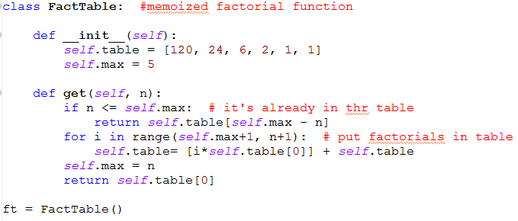
Memoized factorial function

Slide 9
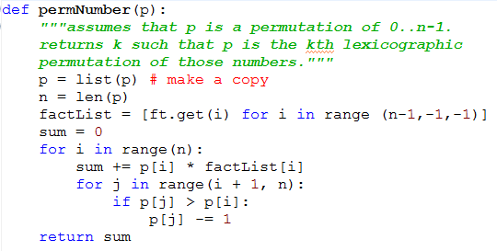
Find a permutation's sequence #

Slide 10
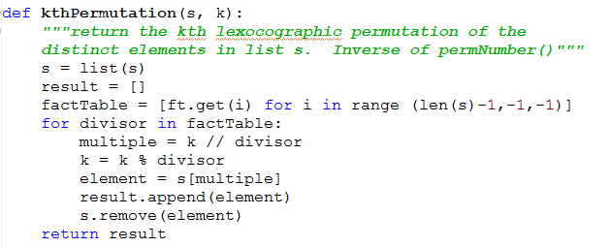
Find permutation from sequence #

Slide 11
Subset generation
Bottom-up, “numeric order”, binary reflected Gray code

Slide 12
Generate all Subsets of a Set
Sample Application:
  Solving the knapsack problem
  In the brute force approach, we try all subsets
If A is a set, the set of all subsets is called the power set of A, and often denoted 2^{A}
If A is finite, then
So we know how many subsets we need to generate.

Slide 13
Generating Subsets of {a₁, …, a_{n}}
Decrease by one (bottom up):
Generate S_{n-1}, the collection of the 2^{n-1} subsets of {a₁, …, a_{n-1}}
Then S_{n} = S_{n-1} ∪ { S_{n-1} ∪ {a_{n}} : s∈S_{n-1}}
Numeric approach:
  Each subset of {a₁, …, a_{n}} corresponds to an bit string of length n, where the i^{th} bit is 1 iff a_{i} is in the subset

Slide 14
Details of numeric approach:
Each subset of {a₁, …, a_{n}} corresponds to a bit string of length n, where the J^{th} bit is 1 if and only if a_{J} is in the subset
Output for
a=[1, 2, 3]:
[[], [1], [2], [1, 2], [3], [1, 3], [2, 3],
[1, 2, 3]]
def allSubsets(a):
n = len(a)
subsets=[]
for i in range(2**n):
subset = []
current = i
for j in range (n):
if current % 2 == 1:
subset += [a[j]]
current /= 2
subsets += [subset]
return subsets

Slide 15
Gray Codes
Named for Frank Gray
An ordering of the 2^{n} n-bit binary codes such that any two consecutive codes differ in only one bit
Example:
000, 001, 011, 010, 110, 111, 101, 100
Note also that only one bit changes between the last code and the first code.
A Gray code can be represented by its transition sequence: indicates which bit changes each time
In above example: 0, 1, 0, 2, 0, 1, 0
Traversal of the edges of a (hyper)cube.
In terms of subsets, the transition sequence tells which element to add or remove from one subset to get the next subset

Slide 16
Recursively Generating a Gray Code
Binary Reflected Gray Code
T₁ = 0
T_{n+1} = T_{n} , n, T_{n}^{reversed}
Show by induction that T_{n}^{reversed} = T_{n}
Thus T_{n+1} = T_{n} , n, T_{n}
Notes:
Do the proof by induction.
Do the traversal of the vertices of a cube.

Slide 17
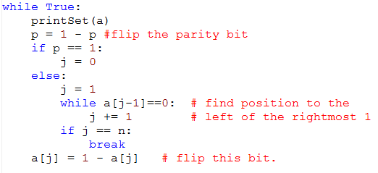
Iteratively Generating a Gray Code
We add a parity bit, p.
Set all bits (including p) to 0.
* Based on Knuth, Volume 4, Fascicle 2, page 6.

Slide 18
Side road: Polynomial Evaluation
Given a polynomial
p(x) = a_{n}x^{n} + a_{n-1}x^{n-1} + … + a₁x + a₀
How can we efficiently evaluate p(c) for some number c?
Apply this to evaluation of "31427894" or any other string that represents a positive integer.
Write and analyze (pseudo)code
Notes:
Horner's method code is on a later slide.

Slide 19
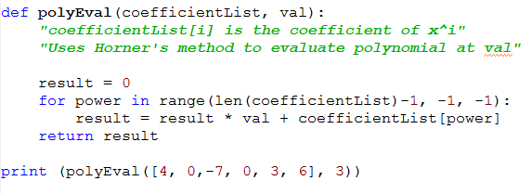
Horner's method code

Slide 20
Other Decrease-and-conquer Algorithms
Decrease by a constant factor
Decrease by a variable amount

Slide 21

Fake Coin Problem
We have n coins
All but one have the
same weight
One is lighter
We have a balance scale with two pans.
All it will tell us is whether the two sides have equal weight, or which side is heavier
What is the minimum number of weighings that will guarantee that we find the fake coin?
Decrease by factor of two.

Slide 22
Decrease by a Constant Factor
Examples that we have already seen:
  Binary Search
  Exponentiation (ordinary and modular) by repeated squaring
  Recap: Multiplication à la Russe (The Dasgupta book that I followed for the first part of the course called it "European" instead of "Russian")
    Example
    11 13
    5 26
    2 52
    1 104
    143
Then strike out any rows whose first number is even, and add up the remaining numbers in the second column.

Slide 23
Decrease by a variable amount
Search in a Binary Search Tree
Interpolation Search
  See Levitin, pp190-191
  Also Weiss, Section 5.6.3
Median Finding
  Find the k^{th} element of an (unordered) list of n elements
  Start with quicksort's partition method
  Best case analysis
Notes:
Mention the Wilkes-Barre phone book.

