Slide 1
MA/CSSE 473 Day 13
Permutation Generation
Notes:
Take Knuth Fascicle to class.

Slide 2

MA/CSSE 473 Day 13
HW 6 due Monday , HW 7 next Thursday,
Student Questions
Tuesday’s exam
Permutation generation
Notes:
Pass around attendance sheet.

Slide 3
Exam 1
If you want additional practice problems for Tuesday's exam:
  The "not to turn in" problems from various assignments
  Feel free to post your solutions in a Piazza discussion forum and ask your classmates if they think it is correct
Allowed for exam:
Calculator, one piece of paper (1 sided, handwritten)
See the exam specification document, linked from the exam day on the schedule page.
Notes:
Pass around attendance sheet.

Slide 4
About the exam
Mostly it will test your understanding of things in the textbook and things we have discussed in class.
Will not require a lot of creativity (it's hard to do much of that in 50 minutes).
Many short questions, a few calculations.
  Perhaps some T/F/IDK questions (example: 5/0/3)
You may bring a calculator.
And a piece of paper (handwritten on one side).
I will give you the Master Theorem if you need it.
Time will be a factor!
First do the questions you can do quickly

Slide 5
Possible Topics for Exam
Formal definitions of O, Θ,Ω.
Master Theorem
Fibonacci algorithms and their analysis
Efficient numeric multiplication
Proofs by induction (ordinary, strong)
Trominoes
Extended Binary Trees
Modular multiplication, exponentiation
Extended Euclid algorithm
Modular inverse
Fermat's little theorem
Rabin-Miller test
Random Prime generation
RSA encryption
What would Donald (Knuth) say?

Slide 6
Possible Topics for Exam
Brute Force algorithms
Selection sort
Insertion Sort
Amortized efficiency analysis
Analysis of growable array algorithms
Binary Search
Binary Tree Traversals
Basic Data Structures (Section 1.4)
Graph representations
BFS, DFS,
DAGs & topological sort

Slide 7
Combinatorial object Generation
Permutations
Subsets

Slide 8
Combinatorial Object Generation
Generation of permutations, combinations, subsets.
This is a big topic in CS
We will just scratch the surface of this subject.
  Permutations of a list of elements (no duplicates)
  Subsets of a set
Notes:
Evidence: The book I received in 2008
The Art of Computer Programming, Volume 4, Fascicle 2
Generating All Tuples and Permutations
127 pages of very small print.

Slide 9
Permutations
We generate all permutations of the numbers 1..n.
  Permutations of any other collection of n distinct objects can be obtained from these by a simple mapping.
How would a "decrease by 1" approach work?
  Find all permutations of 1.. n-1
  Insert n into each position of each such permutation
  We'd like to do it in a way that minimizes the change from one permutation to the next.
  It turns out we can do it so that we always get the next permutation by swapping two adjacent elements.

Slide 10
First approach we might think of
for each permutation of 1..n-1
  for i=0..n-1
    insert n in position i
That is, we do the insertion of n into each smaller permutation from left to right each time
However, to get "minimal change", we alternate:
  Insert n L-to-R in one permutation of 1..n-1
  Insert n R-to-L in the next permutation of 1..n-1
  Etc.

Slide 11

Example
Bottom-up generation of permutations of 123
Example: Do the first few permutations for n=4

Slide 12
Johnson-Trotter Approach
integrates the insertion of n with the generation of permutations of 1..n-1
Does it by keeping track of which direction each number is currently moving
The number k is mobile if its arrow points to an adjacent element that is smaller than itself
In this example, 4 and 3 are mobile

Slide 13
Johnson-Trotter Approach
The number k is mobile if its arrow points to an adjacent element that is smaller than itself.
In this example, 4 and 3 are mobile
To get the next permutation, exchange the largest mobile number (call it k) with its neighbor
Then reverse directions of all numbers that are larger than k.
Initialize: All arrows point left
Work with a partner on Q1
Notes:
Do the first few steps for n=4:
← ← ← ← ← ← ← ← ← ← ← ← ← ← ← ←
1 2 3 4 1 2 4 3 1 4 2 3 4 1 2 3
→ ← ← ← ← → ← ← ← ← → ← ← ← ← →
4 1 3 2 1 4 3 2 1 3 4 2 1 3 2 4
← ← ← ← ← ← ← ← ← ← ← ← ← ← ← ←
3 1 2 4 3 1 4 2 3 4 1 2 4 3 1 2
→ → ← ← → → ← ← → ← → ← → ← ← →
4 3 2 1 3 4 2 1 3 2 4 1 3 2 1 4

Slide 14
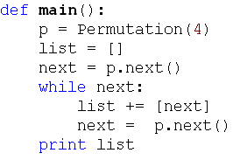
Johnson-Trotter Driver

Slide 15
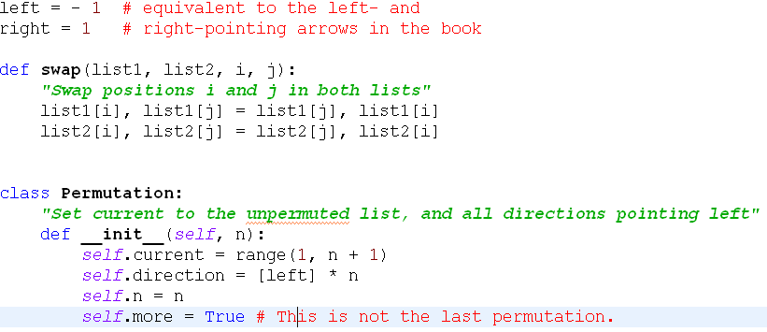
Johnson-Trotter background code

Slide 16
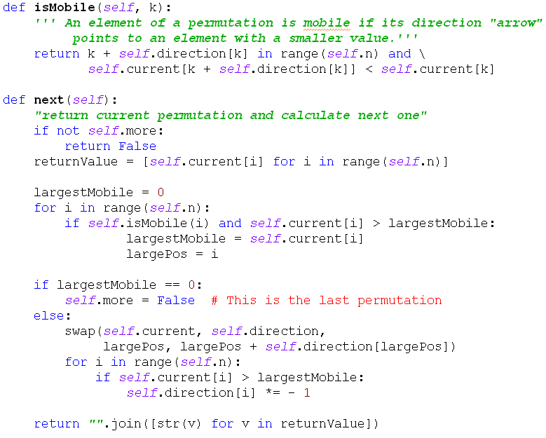
Johnson-Trotter major methods

Slide 17
Lexicographic Permutation Generation
Generate the permutations of 1..n in "natural" order.
Let's do it recursively.
Notes:
Solution on next Slide. Do not include it in the slides placed online before class.
Do this as a live coding exercise. Before class, copy PermutationStartingCode.py to PermutationSection1 and PermutationSection2 files.

Slide 18
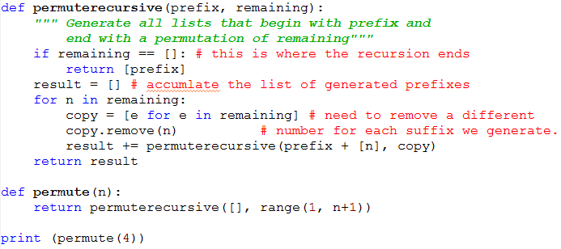
Lexicographic Permutation Code
Notes:
The book describes a "permute in place" algorithm.
We will look at that one later.

Slide 19
Permutations and order
number | permutation |  | number | permutation
0 | 0123 |  | 12 | 2013
1 | 0132 |  | 13 | 2031
2 | 0213 |  | 14 | 2103
3 | 0231 |  | 15 | 2130
4 | 0312 |  | 16 | 2301
5 | 0321 |  | 17 | 2310
6 | 1023 |  | 18 | 3012
7 | 1032 |  | 19 | 3021
8 | 1203 |  | 20 | 3102
9 | 1230 |  | 21 | 3120
10 | 1302 |  | 22 | 3201
11 | 1320 |  | 23 | 3210
Given a permutation of 0, 1, …, n-1, can we directly find the next permutation in the lexicographic sequence?
Given a permutation of 0..n-1, can we determine its permutation sequence number?
Given n and i, can we directly generate
the i^{th} permutation of 0, …, n-1?
Notes:
Discuss these, with examples:

Slide 20
Discovery time (with a partner)
Which permutation follows each of these in lexicographic order?
  183647520 471638520
  Try to write an algorithm for generating the next permutation, with only the current permutation as input.
If the lexicographic permutations of the numbers [0, 1, 2, 3, 4, 5] are numbered starting with 0, what is the number of the permutation 14032?
  General form? How to calculate efficiency?
In the lexicographic ordering of permutations of [0, 1, 2, 3, 4, 5], which permutation is number 541?
  How to calculate efficiently?
Notes:
After 183647520: 183650247 After 471638520: 471650238
Algorithm: Scan from right, find first place where p[i] < p[i+1].
find j, position of smallest among numbers in p[i+1]…p[n-1] that are greater than p[i].
exchange p[i] and p[j], then reverse p[i+1] ..p[n-1]

