Slide 1
MA/CSSE 473 Day 11
Knuth interview
Amortization (growable Array)
Brute Force Examples

Slide 2
MA/CSSE 473 Day 11
Questions?
Donald Knuth Interview
Amortization
Brute force
(if time) Decrease and conquer intro
Q1-2
Notes:
Sometimes soldiers who have been doing a long march need a while to rest.

Slide 3
Donald Knuth Interview
List a few things that you found interesting in the interview
What questions would you ask Donald Knuth if you had the chance?
Notes:
Some things of note (listed by page)
35: I was intrigued by the idea that Case was going to make me work hard. I was scared I was going to flunk out, but still I was ready to work.
36: first program: More mistakes than lines of code
36: The value of reading other people's code.
37: Turning down compiler write job ($100,000 per year, that's probably like $3-400,000 in today's money)
38: Marshall Hall
38 PhD Thesis in an hour.
38 Thought he'd write the book in a year.
39 Ulcer forced him to slow down
39 Writes his books with a pencil
40 Motivated to create TEX because he wanted his books to have a beautiful presentation.
32 There are lots of ambiguous things in a program specification that you cannot discover until you go to actually code it.
32 "I had to program in order to be a happy man"
34 Writing software was more difficult than anything else I had done in my life., I had to keep so many things in my head.
34: Literate programming: writing a program for a human being to read.
34 Don's title: Professor Emeritus of The Art of Computer Programming
35: He worries about the future of programming
35: Don't do the trendy stuff.

Slide 4
Amortized efficiency analysis
P49-50 in the textbook
We analyze not just a single operation, but a sequence of operations performed on the same structure
  We conclude something about the worst-case of the average of all of the operations in the sequence
Example: Growable array exercise from 220/230, which we will quickly review today
Notes:
To decrease an amount gradually or in installments, especially in order to write off an expenditure or liquidate a debt. He obtained a mortgage with the interest payments amortized over the life of the loan.
to write off a cost of (an asset) gradually.

Slide 5
Growable Array (implement ArrayList)
An ArrayList has a size and a capacity
The capacity is the length of the fixed-size array currently allocated to hold the list elements
For definiteness, we start with size=0 and capacity=12
We add a total of N items (N is not known in advance), one at a time, each to the end of the structure
When there is no room in the array (i.e. capacity=size and we need to add another element)
  Allocate a new, larger array
  copy the size existing elements to the new array
  add the new element to the new array
Notes:
On the board, a UML diagram showing instance variables (capacity, size, a), and
Methods (add, get)
12+13+14+15+…+N = N(N+1)/2 – 11(12)/2 . Amortized Ѳ(N)
Do it only for the case N= 12∙2^{k} + 1.
12(1 + 2 + 4 + 2^{k}) = 12 (2^{k+1} – 1) = 2(N-1) -12 = 2N-14. Amortized Ѳ(1)

Slide 6
Growable Array (implement ArrayList)
When there is no room in the array (i.e. capacity=size and we need to add another element)
  Allocate a new, larger array
  copy the size existing elements to the new array
  add the new element to the new array
What is the total/average overhead (due to element copying) if
  we add one to the array capacity each time we have to grow it?
  we double the array capacity each time we have to grow it?
Note in the second case that the amortized worst-case cost is asymptotically less than the worst case for a single element
Every time we have to enlarge the capacity, we make it
so we do not have to enlarge again soon.
Notes:
On the board, a UML diagram showing instance variables (capacity, size, a), and
Methods (add, get)
12+13+14+15+…+N = N(N+1)/2 – 11(12)/2 . Amortized Ѳ(N)
Do it only for the case N= 12∙2^{k} + 1.
12(1 + 2 + 4 + 2^{k}) = 12 (2^{k+1} – 1) = 2(N-1) -12 = 2N-14. Amortized Ѳ(1)

Slide 7
Brute Force Algorithms
Straightforward, simple, not subtle, usually a simple application of the problem definition.
Often not very efficient
Easy to implement, so often the best choice if you know you'll only apply it to small input sizes
3-4

Slide 8
What is a brute force approach to
Calculate the n^{th} Fibonacci number?
Compute the n^{th} power of an integer?
Search for a particular value in a sorted array?
Sort an array?
Search for a substring of a string?
Find the maximum contiguous subsequence in an array of integers?
Find the largest element in a Binary Search Tree?
Find the two closest points among N points in the plane?
Find the convex hull of a set of points in the plane?
Find the shortest path from vertex A to vertex B in a weighted graph?
Solve the traveling salesman problem?
Solve the knapsack problem?
Solve the assignment problem?
Solve the n×n non-attacking chess queens problem?
Other problems that you can think of?
Notes:
Use the recursive definition without memorizing
Multiply n times
Sequential search
Bubble sort
Start at each successive position, search until a match or not.
Generate every subsequence from scratch.
Go right, young person
Compare every pair of points.
Tough to do!

Slide 9
Decrease and Conquer

Slide 10
Decrease and Conquer Algorithms
What does the term mean?
  Reduce problem instance to smaller instance of the same problem
  Solve smaller instance
  Extend solution of smaller instance to obtain solution to original instance
Also referred to as inductive or incremental approach
Can be implemented either top-down or bottom-up
Three variations. Decrease by
  constant amount
  constant factor
  variable amount
Notes:
Exploit the relationship between the solution to a given instance of a problem and a solution to a smaller instance of the same problem

Slide 11
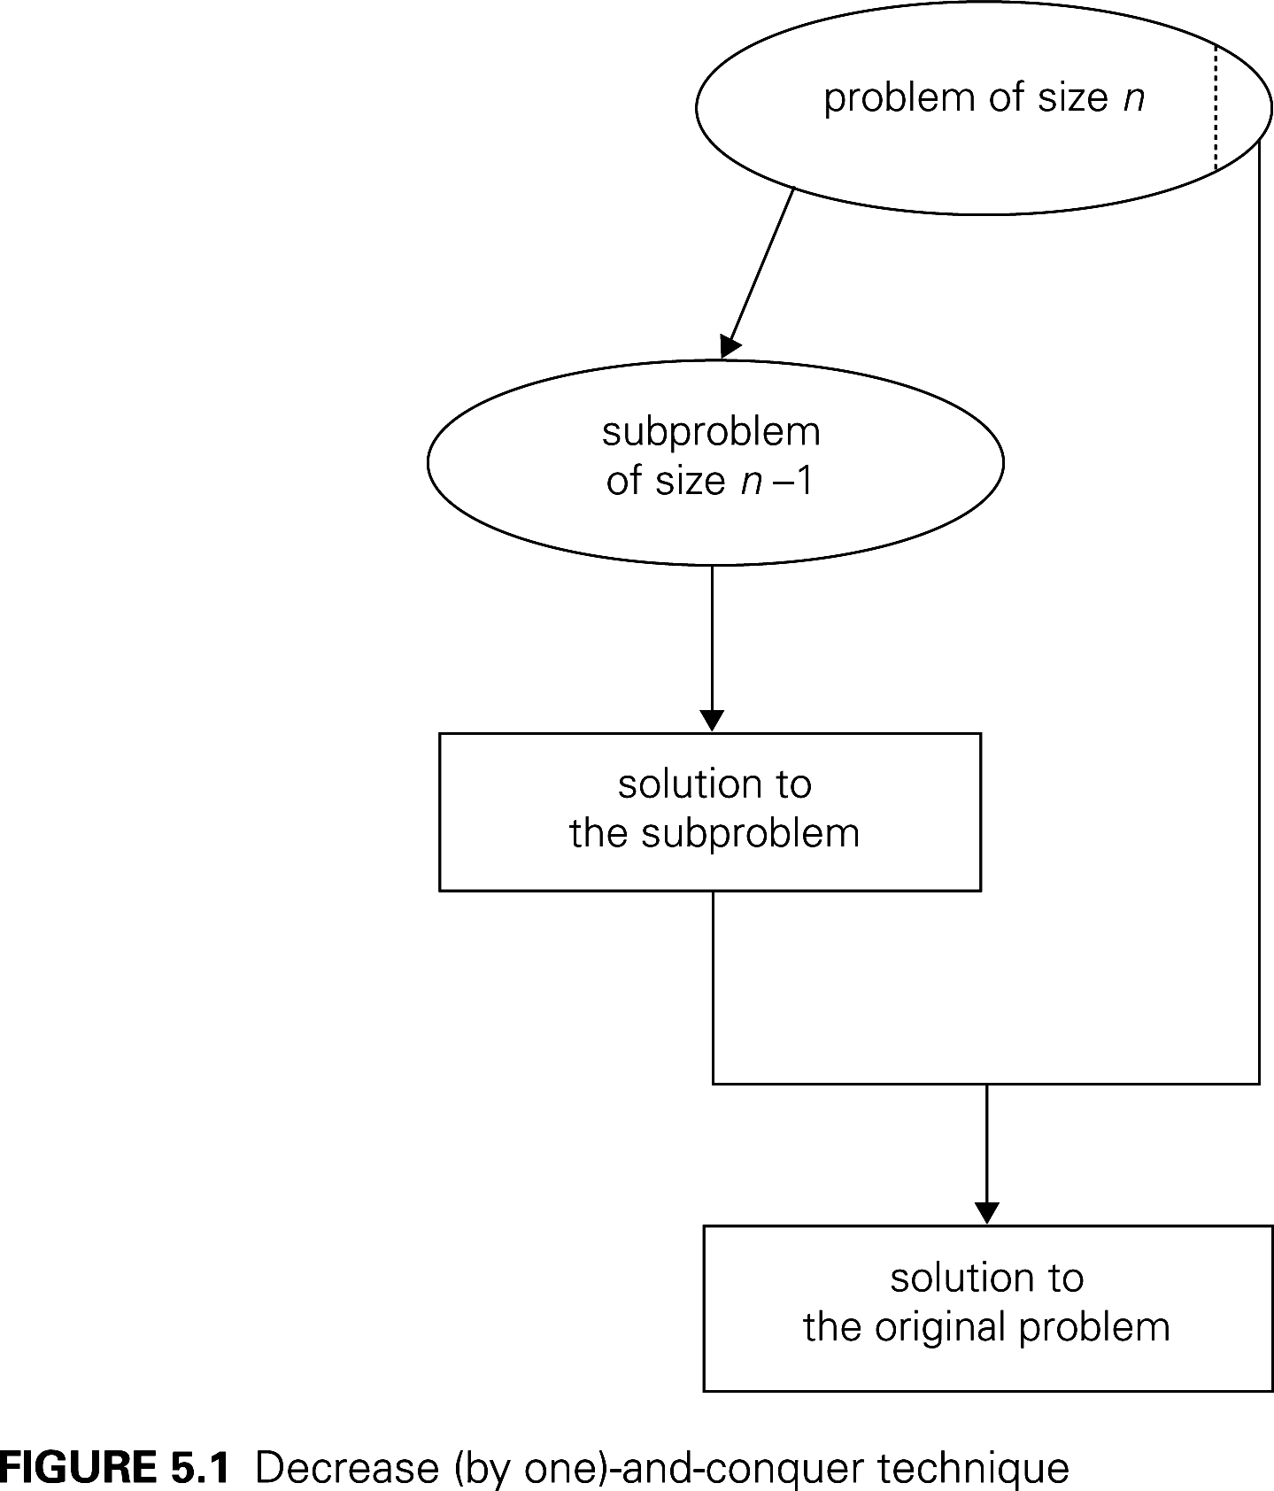
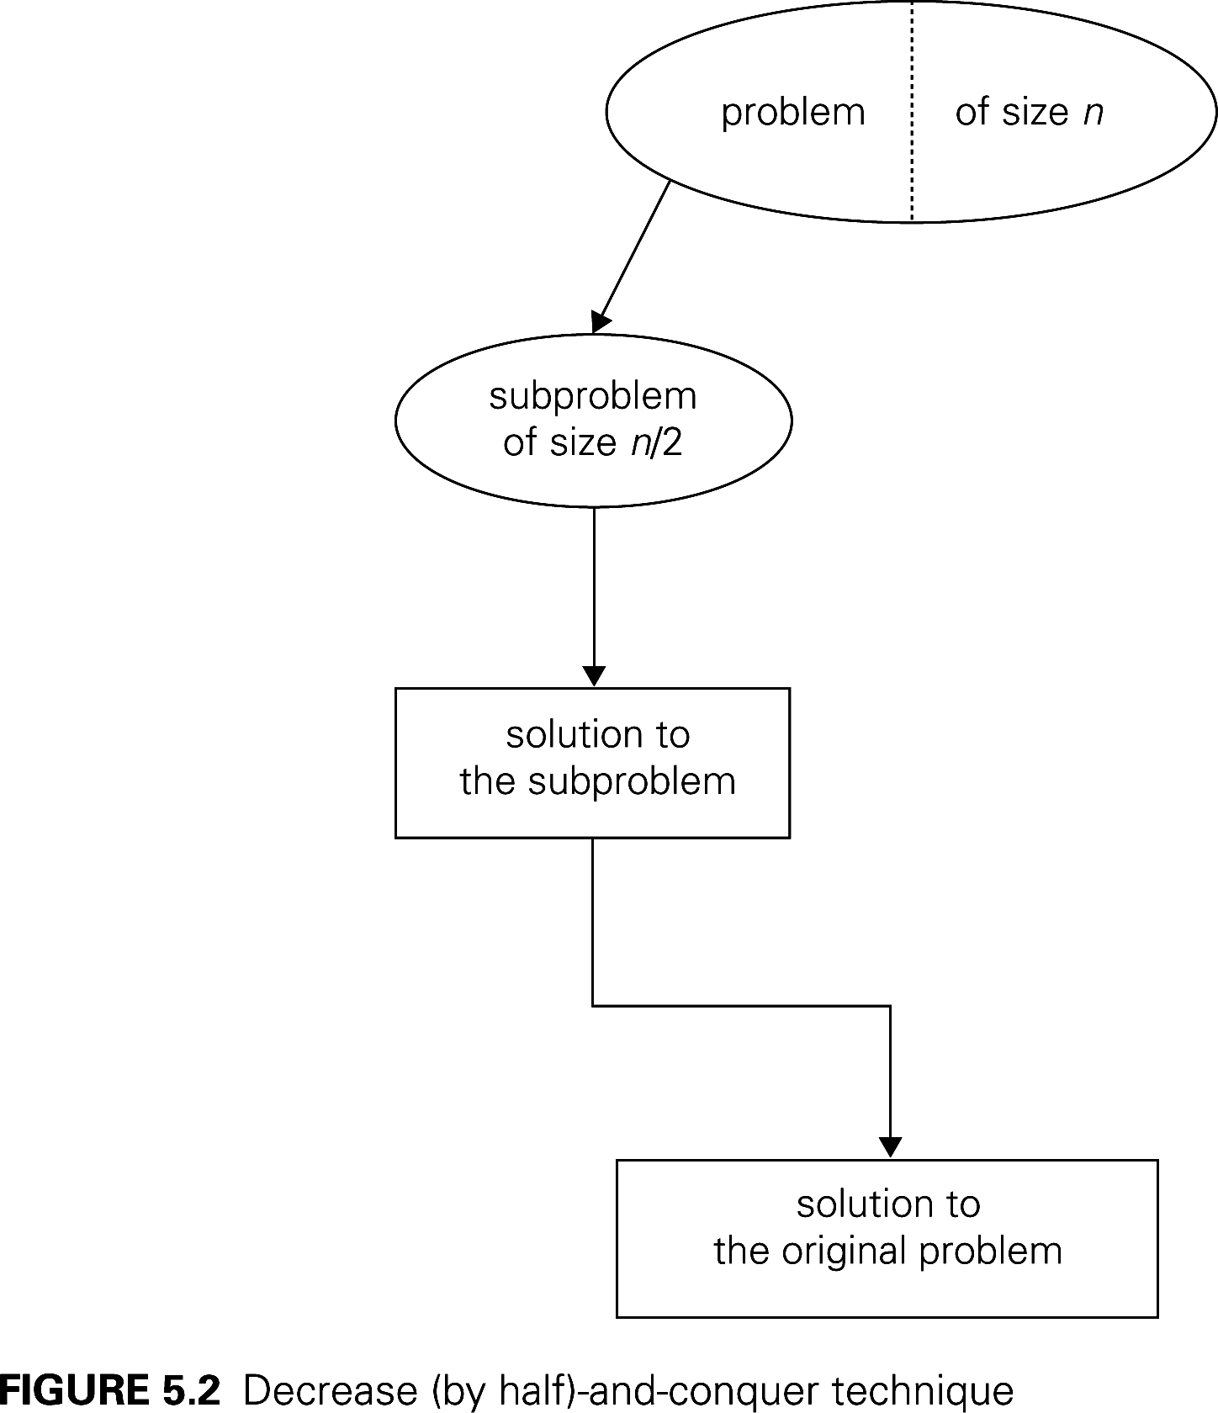
Decrease by constant vs by half

Slide 12
One Problem, Four approaches
Recall the problem of integer exponentiation: Compute a^{n}, where n is a power of 2:
  Brute Force: a^{n}= a*a*a*a*...*a
  Divide and conquer: a^{n}= a^{n/2} * a^{n/2}
  Decrease by one: a^{n}= a^{n-1}* a
  Decrease by constant factor: a^{n}= (a^{n/2})²
Notes:
Try to get the students involved in coming up with these:
Brute Force:
a^{n}= a*a*a*a*...*a
n
Divide and conquer:
a^{n}= a^{n/2} * a^{n/2} (more accurately, a^{n}= a^{⎣n/2⎦} * a ^{⎡n/2│})
Decrease by one:
a^{n}= a^{n-1}* a (one hopes a student will ask what is the difference with brute force here:
there is none in the resulting algorithm, of course, but you can arrive
at it in two different ways)
Decrease by constant factor:
a^{n}= (a^{n/2})² (again, if no student asks about it, be sure to point out the difference
with divide and conquer. Here there is a significant difference that leads to a
much more efficient algorithm – in divide and conquer we recompute a^{n/2}

Slide 13
Variable Decrease Examples
Euclid's algorithm
  b and a % b are smaller than a and b, but not by a constant amount or constant factor
Interpolation search
  The two sides of the partitioning element are smaller than n, but can be anything from 0 to n-1.
Notes:
"Known" as in "students should already know then"

Slide 14
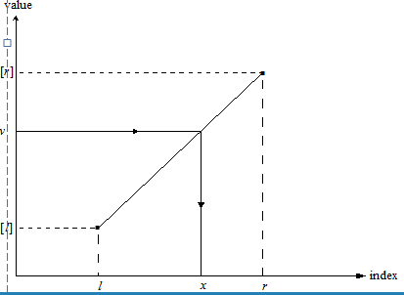
Interpolation Search
Searches a sorted array similar to binary search but estimates location of the search key in A[l..r] by using its value v.
Specifically, the values of the array’s elements are assumed to increase linearly from A[l] to A[r]
Location of v is estimated as the x-coordinate of the point on the straight line through (l, A[l]) and (r, A[r]) whose y-coordinate is v:
x = l + ⎣(v - A[l])(r - l)/(A[r] – A[l] )⎦
See Weiss, section 5.6.3
Levitin Section 4.5 [5.6]
Notes:
Take a phone book to class. Ask a student to find my phone number. Then ask them to tell me who has the number 812-299-3937 (It is Dr. Steven Black)
Make the point of how much of a difference sorting makes.
If you are looking me up in the phone book, using binary search, you would start in the middle. It would take several probes to get near me.

Slide 15
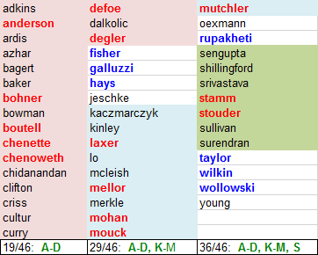
Interpolation Search Running time
Average case: Θ(log (log n)) Worst: Θ(n)
What can lead to worst-case behavior?
    Social Security numbers of US residents
    Phone book (Wilkes-Barre)
    CSSE department employees*, 1984-2017
*Red and blue are current employees
Notes:
If N is a billion, how big are lg n, lg lg N? (30, 5)
A lot of overhead in doing the calculations of where to probe, so we would only use this if the array is HUGE, or if each comparison takes a long time.
Note how many current profs are A-D, L-M, R=T (all but one)

Slide 16
Some "decrease by one" algorithms
Insertion sort
Selection Sort
Depth-first search of a graph
Breadth-first search of a graph

Slide 17
Review: Analysis of Insertion Sort
Time efficiency
C_{worst}(n) = n(n-1)/2 ∈ Θ(n²)
C_{avg}(n) ≈ n²/4 ∈ Θ(n²)
C_{best}(n) = n - 1 ∈ Θ(n)
(also fast on almost-sorted arrays)
Space efficiency: in-place
(constant extra storage)
Stable: yes
Binary insertion sort
  use Binary search, then move elements
  to make room for inserted element

Slide 18
Graph Traversal
Many problems require processing all graph vertices (and edges) in systematic fashion
Most common Graph traversal algorithms:
  Depth-first search (DFS)
  Breadth-first search (BFS)

Slide 19
Depth-First Search (DFS)
Visits a graph’s vertices by always moving from last visited vertex to unvisited one, backtracks if there is no adjacent unvisited vertex is available
Uses a stack (or could use recursion)
  a vertex is pushed onto the stack when it’s reached for the first time
  a vertex is popped off the stack when it becomes a dead end, i.e., when there are no adjacent unvisited vertices
“Redraws” graph in tree-like fashion (with tree
edges and back edges for undirected graph)
  A back edge is an edge of the graph that goes from the current vertex to a previously visited vertex
  (other than the current vertex's parent in the
  tree).

Slide 20
Notes on DFS
DFS can be implemented with graphs represented as:
  adjacency matrix: Θ(V²)
  adjacency list: Θ(|V|+|E|)
Yields two distinct ordering of vertices:
  order in which vertices are first encountered (pushed onto stack)
  order in which vertices become dead-ends (popped off stack)
Applications:
  checking connectivity, finding connected components
  checking acyclicity
  finding articulation points
  searching state-space of problems for solution (AI)
Notes:
In a connected graph, an articulation point is a vertex whose removal would result in a disconnected graph.

Slide 21
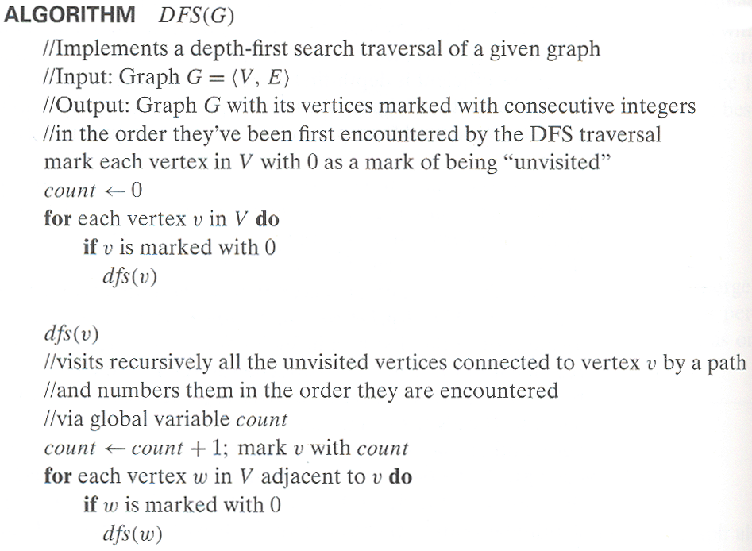
Pseudocode for DFS

Slide 22
Example: DFS traversal of undirected graph
a
b
c
d
e
f
g
h
DFS traversal stack:
DFS tree:
Notes:
Traversal using alphabetical order of vertices. Work through this example in detail, showing the traversal by highlighting edges on the graph and showing how the stack
evolves:
8 h 3
7 d 4 stack shown growing upwards
4 e 1 6 c 5 number on left is order that vertex was pushed onto stack
3 f 2 5 g 6 number on right is order that vertex was popped from stack
2 b 7 overlap is because after e, f are popped off stack, g and c
1 a 8 are pushed onto stack in their former locations.
order pushed onto stack: a b f e g c d h
order popped from stack: e f h d c g b a
* show dfs tree as it gets constructed, back edges

