Slide 1
MA/CSSE 473 Day 08
Randomized Primality Testing
Carmichael Numbers
Miller-Rabin test
Notes:
Slide 12 was hidden in 201110. Hide again?

Slide 2
MA/CSSE 473 Day 08
Student questions
Primality Testing
Implications of Fermat’s Little Theorem
  What we can show and what we can’t
Frequency of “non-Fermat” numbers
Carmichael numbers
Randomized Primality Testing.
Why a certain math prof who sometimes teaches this course does not like the Levitin textbook…
Notes:
25/37 students had scores above 48.
Quote from Dave Rader from last year's "course assessment report": The current book is too low-level, I believe.
My concern:
The upside: 60% of the students have an A or B+ at this point.
The downside: 15% have a grade below "C".
When I ask for questions in class, no one has technical questions.
Visits to my office to ask about HW problems are very rare.
Rather than asking, many of you submit garbage.
I give hard problems (not many yet, but many more to come).
I don't expect that everyone will get them on your own.
Most of you should be able to get most of them; sometimes with some help.

Slide 3
Recap: Fermat's Little Theorem
Formulation 1: If p is prime, then for every number a with 1 ≤ a <p, a^{p-1} ≡ 1 (mod p)
Formulation 2: If p is prime, then for every number a with 1 ≤ a <p, a^{p} ≡ a (mod p)
Q4-5
Notes:
Why is it called "little theorem"
Because of his "last theorem", written in 1637, margin of book. Not proven until 1995.

Slide 4
Easy Primality Test?
Is N prime?
Pick some a with 1 < a < N
Is a^{N-1} ≡ 1 (mod N)?
If so, N is prime; if not, N is composite …
Nice try, but…
  Fermat's Little Theorem is not an "if and only if" condition.
  It doesn't say what happens when N is not prime.
  N may not be prime, but we might just happen to
  pick an a for which a^{N-1}≡ 1 (mod N)
  Example: 341 is not prime (it is 11∙31), but 2³⁴⁰ ≡ 1 (mod 341)
Definition: We say that a number a passes the Fermat test
if a^{N-1} ≡ 1 (mod N). If a passes the Fermat test but N is composite, then a is called a Fermat liar, and N is a Fermat pseudoprime.
We can hope that
if N is composite, then many values of a will fail the Fermat test
It turns out that this hope is well-founded
If any integer that is relatively prime to N fails the test, then at least half of the numbers a such that 1 ≤ a < N also fail it.
"composite" means
"not prime"
Notes:
Start with:
“Pay very close attention to the material on this slide. If you get it now, you will avoid one of the major points of confusion that students in the course have had in the past.

Slide 5
How many “Fermat liars"?
If N is composite, and we randomly pick an a
such that 1 ≤ a < N, and gcd(a, N) = 1, how likely is it that
a^{N-1} is ≡ 1 (mod n)?
If a^{N-1} ≡ 1 (mod n) for some a that is relatively prime to N, then this must also be true for at least half of the choices of a < N.
  Let b be some number (if any exist) that passes the Fermat test, i.e. b^{N-1} ≡ 1 (mod N).
  Then the number a∙b fails the test:
    (ab)^{N-1} ≡ a^{N-1}b^{N-1} ≡ a^{N-1}, which is not congruent to 1 mod N.
  Diagram on whiteboard.
  For a fixed a, f: b→ab is a one-to-one function on the set of b's that pass the Fermat test,
  so there are at least as many numbers that
  fail the Fermat test as pass it.
Notes:
The diagram (next slide, hidden) is from Dasgupta, page 26.
Last bullet if ab = ac, we can just divide by a, since gcd(a, N) = 1

Slide 6
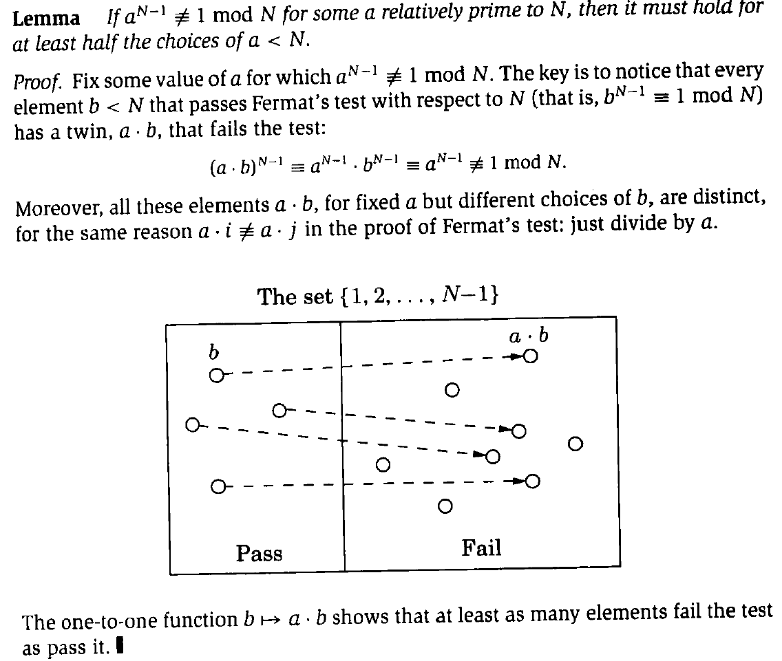
Notes:
Hidden in 201110. Hide again?

Slide 7
Carmichael Numbers
A Carmichael number is a composite number N such that
∀ a ∈ {1, ..N-1} (if gcd(a, N)=1 then a^{N-1} ≡ 1 (mod N) )
i.e. every possible a passes the Fermat test.
  The smallest Carmichael number is 561
  We'll see later how to deal with those
  How rare are they? Let C(X) = number of Carmichael numbers that are less than X.
  For now, we pretend that we live in a Carmichael-free world

Slide 8
Where are we now?
For a moment, we pretend that Carmichael numbers do not exist.
If N is prime, a^{N-1} ≡ 1 (mod N) for all 0 < a < N
If N is not prime, then a^{N-1} ≡ 1 (mod N) for at most half of the values of a<N.
Pr(a^{N-1} ≡ 1 (mod N) if N is prime) = 1
Pr(a^{N-1} ≡ 1 (mod N) if N is composite) ≤ ½
How to reduce the likelihood of error?
Notes:
Do the test for k randomly-generated values of a < N.
Probability of error is < (1/2)^k
If k=100, dasGupta says the probability of error is less than the probability of a cosmic ray flipping some bits and messing up your computer's computation

Slide 9
The algorithm (modified)
To test N for primality
  Pick positive integers a₁, a₂, … , a_{k} < N at random
  For each a_{i}, check for a_{i}^{N-1} ≡ 1 (mod N)
    Use the Miller-Rabin approach, (next slides) so that Carmichael numbers are unlikely to thwart us.
    If a_{i}^{N-1} is not congruent to 1 (mod N), or
    Miller-Rabin test produces a non-trivial
    square root of 1 (mod N)
      return false
  return true
Does this work?
Note that this algorithm may produce a “false prime”, but the probability is very low if k is large enough.
Notes:
Note that this algorithm may produce a “false prime”, but the probability is very low.

Slide 10
Miller-Rabin test
A Carmichael number N is a composite number that passes the Fermat test for all a with 1 ≤ a<N and gcd(a, N)=1.
A way around the problem (Rabin and Miller):
Note that for some t and u (u is odd), N-1 = 2^{t}u.
As before, compute a^{N-1}(mod N), but do it this way:
  Calculate a^{u} (mod N), then repeatedly square, to get the sequence
  a^{u} (mod N), a^{2u} (mod N), …, a^{2tu} (mod N) ≡ a^{N-1} (mod N)
Suppose that at some point, a^{2iu} ≡ 1 (mod N), but
a^{2i-1u} is not congruent to 1 or to N-1 (mod N)
  then we have found a nontrivial square root of 1 (mod N).
  We will show that if 1 has a nontrivial square
  root (mod N), then N cannot be prime.
Notes:
u is odd?
Or should I say "u are odd". To most of the world outside Rose-Hulman, if you would take this course or any 400-level CSSE course, U must be odd!
Note that this factorization of N-1 can be fast. Just count how many bits at the end of N-1 are 0 to get t, and then bit-shift N-1 to get u.
ON BOARD: Note that a^{N-1} = a^{u(2^t)} =(…( (a^{u})²)²… )² square t times

Slide 11
Example (first Carmichael number)
N = 561. We might randomly select a = 101.
  Then 560 = 2⁴∙35, so u=35, t=4
  a^{u} ≡ 101³⁵ ≡ 560 (mod 561) which is -1 (mod 561)
  (we can stop here)
  a^{2u} ≡ 101⁷⁰ ≡ 1 (mod 561)
  …
  a^{16u} ≡ 101⁵⁶⁰ ≡ 1 (mod 561)
  So 101 is not a witness that 561 is composite (we say that 101 is a Miller-Rabin liar for 561, if indeed 561 is composite)
Try a = 83
  a^{u} ≡ 83³⁵ ≡ 230 (mod 561)
  a^{2u} ≡ 83⁷⁰ ≡ 166 (mod 561)
  a^{4u} ≡ 83¹⁴⁰ ≡ 67 (mod 561)
  a^{8u} ≡ 83²⁸⁰ ≡ 1 (mod 561)
  So 83 is a witness that 561 is composite, because 67 is a non-trivial square root of 1 (mod 561).
Notes:
Work through another example with the students. N = 105.
Suppose we first try a = 8. (Use the modexp interactive program).
Enter 8, 104, 105: Get 1. So it passes the Fermat test.
What is u? (13). Do 8^13 (8), 8^26(64), 8^52 (1)
Then 29^104 = 1. 29^13 = 29, 29^26 = 1

