Slide 1
MA/CSSE 473 Day 06
Euclid's Algorithm

Slide 2
MA/CSSE 473 Day 06
Student Questions
Odd Pie Fight
Euclid's algorithm
(if there is time) extended Euclid's algorithm
Notes:
Pass around attendance sheet.

Slide 3
Review Thread
Quick look at review topics in textbook

Slide 4
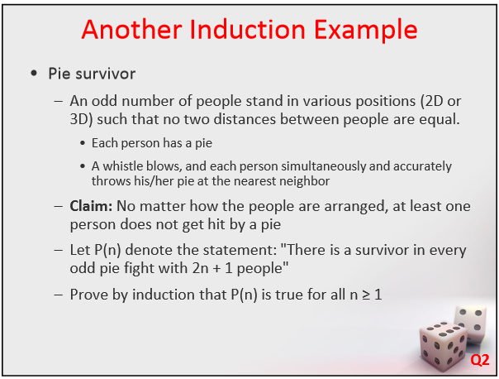

Slide 5
Odd Pie fight solution
The base case is easy: If n = 3 the two persons with the smallest pairwise distance between them throw at each other, while the third person throws at one of them (whoever is closer). Therefore, this third person remains “unharmed”.
For the inductive step, assume that the assertion is true for odd n ≥ 3, and consider n + 2 persons. Again, the two persons with the smallest pairwise distance between them (the closest pair) throw at each other.
Consider two possible cases as follows.
  If the remaining n persons all throw at one another, at least one of them remains “unharmed” by the inductive assumption.
  If at least one of the remaining n persons throws at one of the closest pair, among the remaining n − 1 persons, at most n − 2 pies are thrown at one another, and hence at least one person must remain “unharmed” because there is not enough pies to hit everybody in that group. This completes the proof.

Slide 6
Arithmetic thread
Euclid's Algorithm
Heading toward Primality Testing

Slide 7
Euclid's Algorithm: the problem
One of the oldest known algorithms (about 2500 years old)
The problem: Find the greatest common divisor (gcd) of two non-negative integers a and b.
The approach you learned in elementary school:
  Completely factor each number
  find common factors (with multiplicity)
  multiply the common factors together to get the gcd
Finding factors of large numbers is hard!
A simpler approach is needed

Slide 8
Euclid's Algorithm: the basis
Based on the following rule:
  If x and y are positive integers with x ≥ y, then gcd(x, y) = gcd(y, x mod y)
Proof of Euclid's rule:
  It suffices to show the simpler rule
  gcd(x, y) = gcd(y, x - y)
  since x mod y can be obtained from x and y by repeated subtraction
  Any integer that divides both x and y must also
  divide x – y, so gcd(x, y) ≤ gcd(y, x – y)
  Any integer that divides both y and x - y must also
  divide x, so gcd(y, x-y) ≤ gcd(y, x)
  Putting these together: gcd(y, x-y) = gcd(y, x)
Notes:
Example x = 60, y=36. gcd(60, 36) = gcd(36, 60 – 36) = gcd (36, 24) = gcd(24, 12) = gcd(12, 0) = 12
In general, if a is a common divisor of x and y, y= ay’ and x = ax’, then x – y = a(x’ – y’)

Slide 9
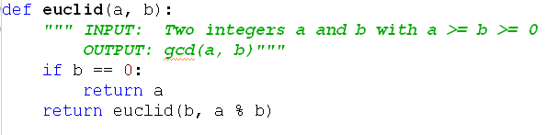
Euclid's Algorithm: the algorithm
Example: euclid(60, 36)
Does the algorithm work?
How efficient is it?
Notes:
Does it work? It's clear that it works when b is 0.
Is it clear that b will eventually be 0? Yes.
So by Euclid's rule, it works.
Efficiency? Each time, (a, b) gets replaced with (b, a mod b). How big of a reduction is that?

Slide 10
Euclid's Algorithm: the analysis
Lemma: If a ≥ b, then a % b < a/2
Proof
  If b ≤ a/2, then a % b < b ≤ a/2
  If b > a/2, then a % b = a – b < a/2
Application
  After two recursive euclid calls, both a and b are less than half of what they were, (i.e. reduced by at least 1 bit)
  Thus if a and b have k bits, at most 2k recursive calls are needed.
  Each recursive call involves a division, Ѳ(k²)
  Thus entire algorithm is at most k² * 2k, which is in Ѳ(k³)
Notes:
Does it work? It's clear that it works when b is 0.
Is it clear that b will eventually be 0? Yes.
So by Euclid's rule, it works.
Efficiency? Each time, (a, b) gets replaced with (b, a mod b). How big reduction is that?
proof:
If b ≤ a/2, then a % b < b ≤ a/2
If b > a/2, then a % b = a – b < a/2

Slide 11
Euclid's Algorithm: practical use
Divide 210 by 45, and get the result 4 with remainder 30, so 210=4·45+30.
Divide 45 by 30, and get the result 1 with remainder 15, so 45=1·30+15.
Divide 30 by 15, and get the result 2 with remainder 0, so 30=2·15+0.
The greatest common divisor of 210 and 45 is 15.

Slide 12
gcd and linear combinations
Lemma: If d is a common divisor of a and b,
and d = ax + by for some integers x and y, then
d = gcd(a,b)
Proof
  By the first of the two conditions, d divides both a and b. No common divisor can exceed their greatest common divisor, so
  d ≤ gcd(a, b)
  gcd(a, b) is a common divisor of a and b, so it must divide ax + by = d. Thus gcd(a, b) ≤ d
  Putting these together, gcd(a, b) = d
If we can, for any given a and b, find the x and y as in the lemma, we have found the gcd.
It turns out that a simple modification of Euclid's algorithm will allow us to calculate the x and y.

Slide 13
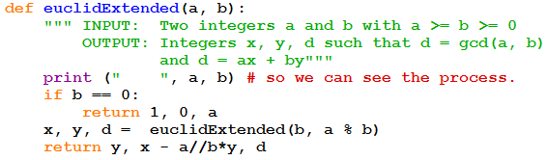
Extended Euclid Algorithm
Proof that it works
  I decided that it is a bit advanced for students who may have just seen Modular Arithmetic for the first time yesterday.
  If you are interested, look up “extended Euclid proof”
  We’ll do a couple of convincing examples.

Slide 14
Forward-backward Example: gcd (33, 14)
33 = 2*14 + 5
14 = 2 * 5 + 4
5 = 1 * 4 + 1
4 = 4 * 1 + 0, so gcd(33, 14) = 1.
Now work backwards
1 = 5 - 4. Substitute 4 = 14 - 2*5.
1 = 5 – (14 - 2*5) = 3*5 - 14. Substitute 5 = 33 - 2*14
1 = 3(33 - 2*14) -14 = 3 * 33 – 7 * 14
Thus x = 3 and y = -7 Done!

Slide 15
Another example (same computation, different order): gcd (97, 20)
97 = 4·20+17
20 = 1·17+3
17 = 5·3+2
3 = 1·2+1 so GCD is 1.
Now figure out the x and y
17 = 1·97-4·20
20-1·17 = 3 so 3 = 1·20-1·17 = 1·20-(1·97-4·20) = -1·97+5·20
17=5·3+2 so 2 = 17-5·3 = (1·97-4·20)-5(-1·97+5·20) = 6·97-29·20
1 = 3-2 = (-1·97+5·20)-(6·97-29·20) = -7·97+34·20
Thus x = -7 and y = 34 Done!

