Slide 1
MA/CSSE 473 Day 03
Asymptotics
A Closer Look at Arithmetic
With another student,
try to write a precise,
formal definition of
“t(n) is in O(g(n))”

Slide 2
Day 3
Student questions
  Course policies?
  HW assignments?
  Anything else?
The two “early course” threads
Review of asymptotic notation
Addition and multiplication algorithms

Slide 3
Two threads in lectures
Each day at the beginning of the course
A little review (today it's a lot)
Continue with discussion of efficiency of Fibonacci and arithmetic (if there is time).
Review thread for today:
Asymptotics (O, Ѳ, Ω)
Mostly a recap of 230 lecture on same topic.
I

Slide 4
Rapid-fire Review:
Definitions of O, Ѳ, Ω
I will re-use some of my slides from CSSE 230
  Some of the pictures are from the Weiss book.
And some of Levitin's pictures
A very similar presentation appears in Levitin, section 2.2
Since this is review, we will move much quicker than in 230
Notes:
Q1

Slide 5
Asymptotic Analysis
We only really care what happens when N (the size of a problem) gets large
Is the function linear? quadratic? exponential? etc.

Slide 6
Asymptotic order of growth
Informal definitions
A way of comparing functions that ignores constant factors and small input sizes
O(g(n)): class of functions t(n) that grow no faster than g(n)
Θ(g(n)): class of functions t(n) that grow at same rate as g(n)
Ω(g(n)): class of functions t(n) that grow at least as fast as g(n)

Slide 7
Formal Definition
We will write a precise formal definition of "t(n)∈O(g(n))"
  This is one thing that students in this course should soon be able to do from memory…
  … and also understand it, of course!
Notes:
There exist constants n0 and c such that whenever n>=n0, t(n) <= c*g(n).

Slide 8
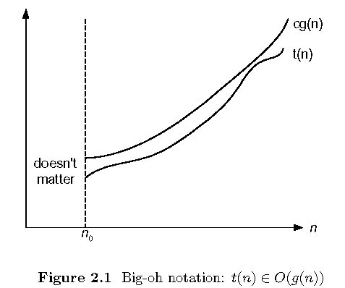
Big-oh (a.k.a. Big O)

Slide 9
Prove a Big O Property
For any function g(n), O(g(n)) is a set of functions
We say that t(n) ∈O(g(n)) iff there exist two positive constants c and n₀ such that
for all n ≥ n₀, t(n) ≤ c g(n)
Rewrite using ∀ and ∃ notation
If f(n)∈O(g(n)) and t(n)∈O(g(n)),
then f(n)+t(n)∈O(g(n))
Let's prove it
Q 2
Notes:
Q2

Slide 10
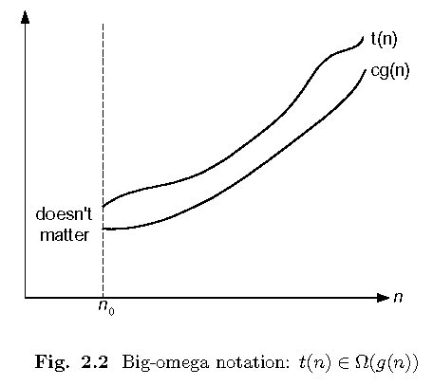
Big-omega

Slide 11
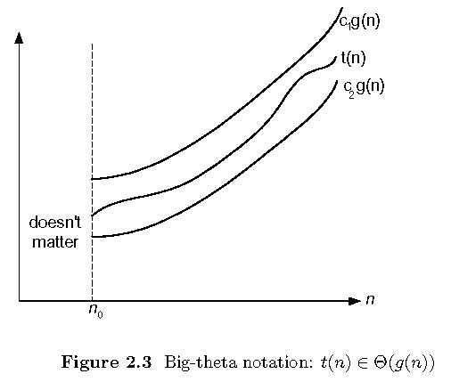
Big-theta

Slide 12
Big O examples
All that we must do to prove that t(n) is O(g(n)) is produce a pair of numbers c and n₀ that work for that case.
t(n) = n, g(n) = n².
t(n) = n, g(n) = 3n.
t(n) = n + 12, g(n) = n.
We can choose c =3 and n₀ = 6, or c = 4 and n₀ = 4.
t(n) = n + sin(n)
t(n) = n² + sqrt(n)
In CSSE 230, we do these in great detail in class.
In 473, I say, "work on them if you need review/practice, " and give you a few possible answers on the next slide.
Notes:
201310: Invite students to come to hour 7 of the 230 class today in O159

Slide 13
Answers to examples
For this discussion, assume that all functions have non-negative values, and that we only care about n≥0.
For any function g(n), O(g(n)) is a set of functions We say that a function f(n) is (in) O(g(n)) if there exist two positive constants c and n₀ such that for all n≥ n₀, f(n) ≤c g(n).
So all we must do to prove that f(n) is O(g(n)) is produce two such constants.
f(n) = n + 12, g(n) = ???.
  g(n) = n. Then c =3 and n₀ = 6, or c = 4 and n₀ = 4, etc.
  f(n) = n + sin(n): g(n) = n, c = 2, n₀ = 1
  f(n) = n² + sqrt(n): g(n) = n2, c=2, n₀ = 1
Notes:
This is a hidden slide

Slide 14
Limits and asymptotics
Consider the limit
What does it say about asymptotics if this limit is zero, nonzero, infinite?
We could say that knowing the limit is a sufficient but not necessary condition for recognizing big-oh relationships.
It will be sufficient for most examples in this course.
Challenge: Use the formal definition of limit and the formal definition of big-oh to prove these properties.
Q 3

Slide 15
Apply this limit property to the following pairs of functions
N and N²
N² + 3N + 2 and N²
N + sin(N) and N
log N and N
N log N and N²
Nª and N^{n}
a^{N} and b^{N} (a < b)
log_{a}N and log_{b}N (a < b)
N! and N^{N}
Notes:
I did only #2, 4, 7, and 8 in class:
2: Divide top and bottom by N^2
4. l'Hopital's rule
(a/b)^n
Rewrite log[b]N in terms of log[a]n

Slide 16
Big-Oh Style
Give tightest bound you can
  Saying that 3N+2 ∈ O(N³) is true, but not as useful as saying it’s O(N) [What about Θ(N³) ?]
Simplify:
  You could say:
  3n+2 is O(5n-3log(n) + 17)
  and it would be technically correct…
  But 3n+2 ∈O(n) is better
But… if I ask “true or false: 3n+2 ∈ O(n³)”, what’s the answer?
  True!

Slide 17
Back to and arithmetic thread from last time:

Slide 18
The catch!
Are addition and multiplication constant-time operations?
We take a closer look at the "basic operations"
Addition first:
At most, how many digits in the sum of three decimal one-digit numbers?
Is the same result true in binary and every other base?
Add two k-bit positive integers (53+35):
Carry:
So adding two k-bit integers is O( ).
1 1 1 1
1 1 0 1 0 1 (35)
1 0 0 0 1 1 (53)
1 0 1 1 0 0 0 (88)
Notes:
After Addition first, say,
"The next two bullets are prelminary info that we'll need in order to analyze
the runtime of integer addition."
Answers: 2, yes

Slide 19
Multiplication
Example: multiply 13 by 11
1 1 0 1
x 1 0 1 1
1 1 0 1 (1101 times 1)
1 1 0 1 (1101 times 1, shifted once)
0 0 0 0 (1101 times 1, shifted twice)
1 1 0 1 (1101 times 1, shifted thrice)
1 0 0 0 1 1 1 1 (binary 143)
There are k rows of 2k bits to add, so
we do an O(k) operation k times, thus
the whole multiplication is O( ) ?
Can we do better?
Notes:
The running time of the algorithm is O(n^2)

Slide 20
Multiplication by an Ancient Method
This approach was known to Al Khwarizimi
According to Dasgupta, et al, still used today in some European countries
Repeat until 1st number is 1, keeping all results:
  Divide 1st number by 2 (rounding down)
  double 2nd number
Example
11 13
5 26
2 52
1 104
143
Correct? Analysis
Then strike out any rows whose first number is even, and add up the remaining numbers in the second column.
Notes:
It is correct, because the same numbers get added as in the more "traditional" algorithm.
If we are multiplying n-bit numbers, the number of times through the loop is k.
And each time through the loop requires at most n steps.
And still we have to add up to k numbers of 2k bits each.
So O(k^2)

Slide 21
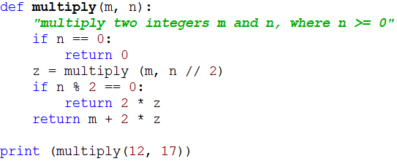
Recursive code for this algorithm

Slide 22
For reference: The Master Theorem
The Master Theorem for Divide and Conquer recurrence relations:
Consider the recurrence
T(n) = aT(n/b) +f(n), T(1)=c,
where f(n) = Ѳ(n^{k}) and k≥0 ,
The solution is
  Ѳ(n^{k}) if a < b^{k}
  Ѳ(n^{k} log n) if a = b^{k}
  Ѳ(n^{logba}) if a > b^{k}
For details, see Levitin pages 483-485 or Weiss section 7.5.3.
Grimaldi's Theorem 10.1 is a special case of the Master Theorem.
We will use this theorem often. You should review its proof soon (Weiss's proof is a bit easier than Levitin's).

Slide 23
New Multiplication Approach
Divide and Conquer
To multiply two k-bit integers x and y:
  Split each into its left and right halves so that
  x = 2^{k/2}x_{L} + x_{R}, and y = 2^{k/2}y_{L} + y_{R}
  The straightforward calculation of xy would be
  (2^{k/2}x_{L} + x_{R})(2^{k/2}y_{L} + y_{R}) =
  2^{k}x_{L}y_{L} + 2^{k/2}(x_{L}y_{R} + x_{R}y_{L}) + x_{R}y_{R}
  Code on next slide
  We can do the four multiplications of k/2-bit integers using four recursive calls, and the rest of the work (a constant number of bit shifts and additions) in time O(k)
  Thus T(k) = . Solution?
Notes:
T(k) = 4T(k/2) +O(n). Solution?
Solution is case 3 of Master Theorem.
log[2] 4 is 2, so it is n^2.

Slide 24
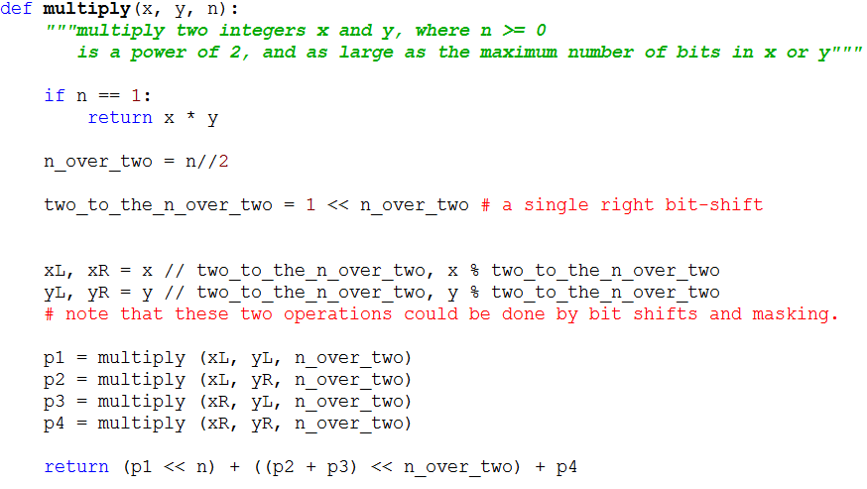
Code for divide-and-conquer multiplication

Slide 25
Can we do better than O(k²)?
Is there an algorithm for multiplying two k-bit numbers in time that is less than O(k²)?
Basis: A discovery of Carl Gauss (1777-1855)
  Multiplying complex numbers:
  (a + bi)(c+di) = ac – bd + (bc + ad)i
  Needs four real-number multiplications and three additions
  But bc + ad = (a+b)(c+d) – ac –bd
  And we have already computed ac and bd when we computed the real part of the product!
  Thus we can do the original product with 3 multiplications and 5 additions
  Additions are so much faster than multiplications that we can essentially ignore them.
  A little savings, but not a big deal until applied recursively!

Slide 26
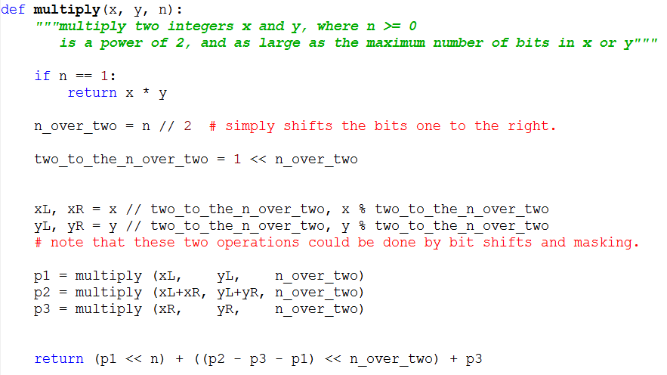
Code for Gauss-based Algorithm

Slide 27
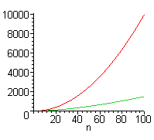
Is this really a lot faster?
Standard multiplication: Ѳ(k²)
Divide and conquer with Gauss trick: Ѳ(k^{1.59})
  Write and solve the recurrence
But there is a lot of additional overhead with Gauss, so standard multiplication
is faster for small values of n.
In reality we would not let the
recursion go down to the
single bit level, but only down
to the number of bits that our
machine can multiply in
hardware without overflow.
Notes:
Do and solve the recurrence:
T(k) = 3 T(k/2) + Θ(n)
In Master theorem, a = 3, b = 2, k = 1.
So we have the third case: T(N) = Θ(k ^ log[2]3),
Which is approximately n ^ 1.59.

