Slide 1
MA/CSSE 473 Day 02
Some Numeric Algorithms and their Analysis
Notes:
Don’t print slide 14 putting on-line: solution to Matrix mult problem.

Slide 2
Leftovers
Algorithm definition:
  Sequence of instructions
  For solving a problem
  Unambiguous (including order)
  Can depend on input
  Terminates in a finite amount of time
Session # → day of week algorithm

Slide 3
Student questions on …
Syllabus?
Course procedures, policies, or resources?
Course materials?
Homework assignments?
Anything else?
notation: lg n means log₂ n
Also, log n without a specified base will usually mean log₂ n

Slide 4
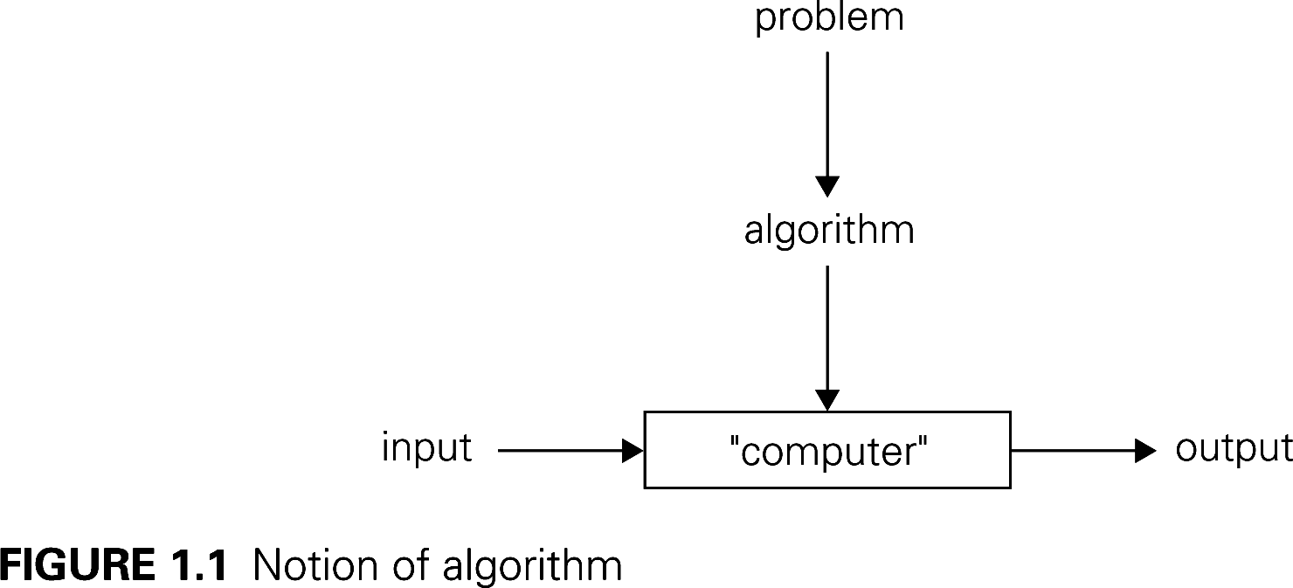
Levitin Algorithm picture

Slide 5
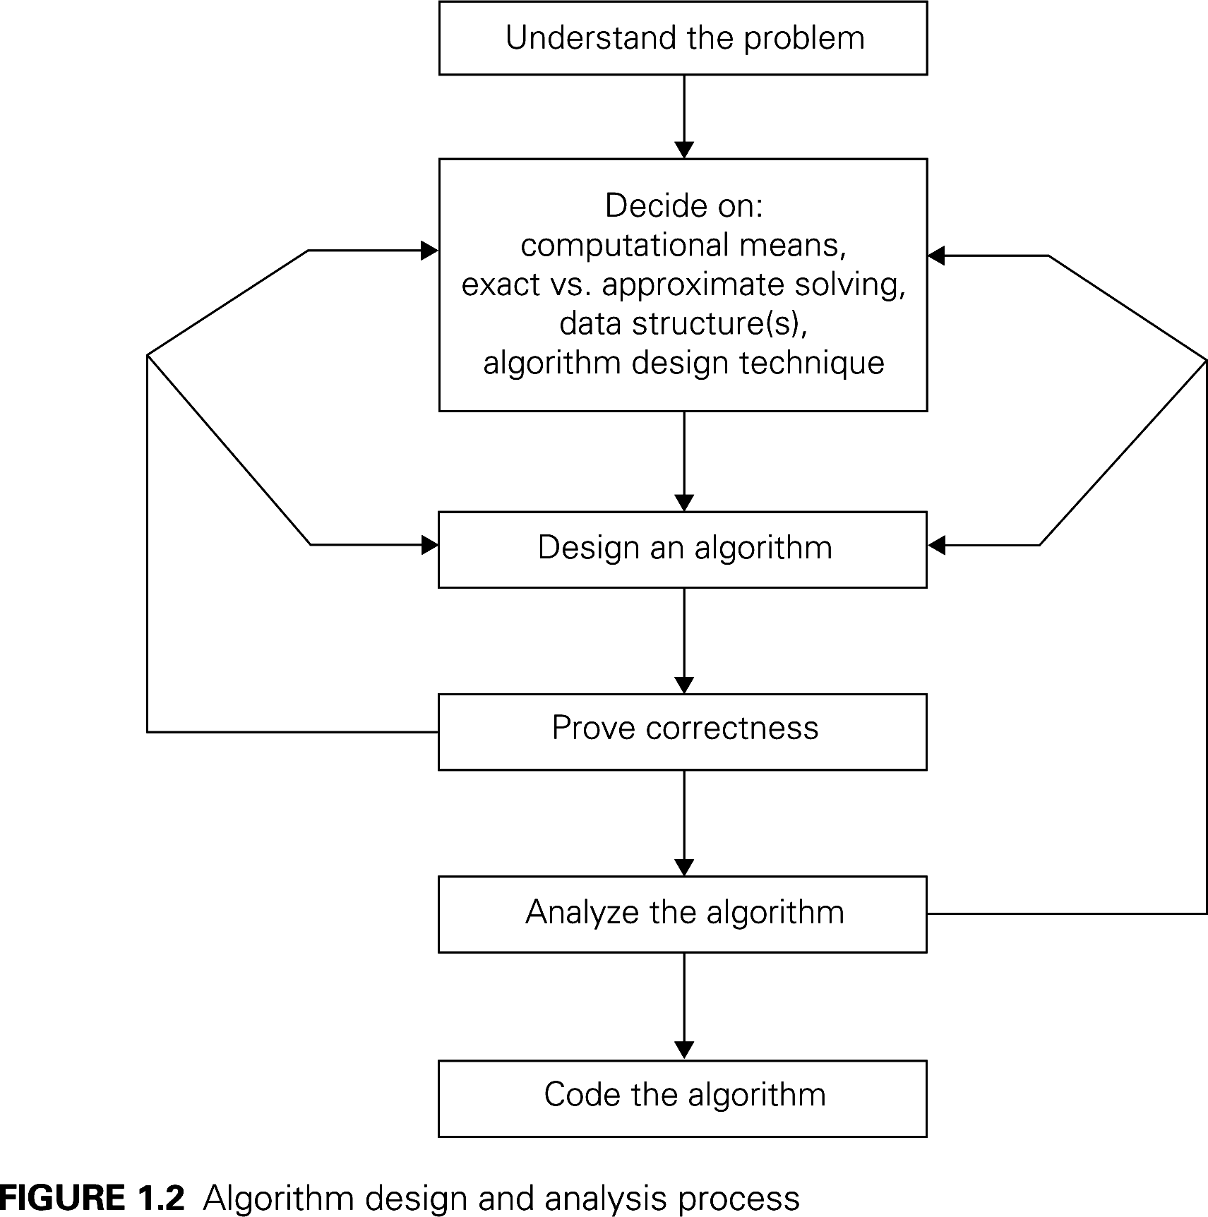
Algorithm design Process
Notes:
Note the iterative process

Slide 6
Interlude
What we become depends on what we read after all of the professors have finished with us. The greatest university of all is a collection of books.
- Thomas Carlyle

Slide 7
Review: The Master Theorem
The Master Theorem for Divide and Conquer recurrence relations:
Consider the recurrence
T(n) = aT(n/b) +f(n), T(1)=c,
where f(n) = Ѳ(n^{k}) and k≥0 ,
The solution is
  Ѳ(n^{k}) if a < b^{k}
  Ѳ(n^{k} log n) if a = b^{k}
  Ѳ(n^{logba}) if a > b^{k}
For details, see Levitin pages 490-491
[483-485] or Weiss section 7.5.3.
Grimaldi's Theorem 10.1 is a special case of the Master Theorem.
Note that page numbers in brackets refer to Levitin 2nd edition
We will use this theorem often. You should review its proof soon (Weiss's proof is a bit easier than Levitin's).
Notes:
Note that we can replace big theta by big O everywhere and it is still true.
What are a, b, k for binary search, merge sort (on ClassNotes handout)

Slide 8
Arithmetic algorithms
For the next few days:
  Reading: mostly review from CSSE 230 and DISCO
  In-class: Some review, but mainly arithmetic algorithms
    Examples: Fibonacci numbers, addition, multiplication, exponentiation, modular arithmetic, Euclid’s algorithm, extended Euclid.
  Lots of problems to do
  some over review material
  Some over arithmetic algorithms.

Slide 9
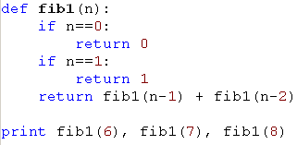
Fibonacci Numbers
F(0) = 0, F(1) = 1, F(n) = F(n-1) + F(n-2)
Sequence: 0, 1, 1, 2, 3, 5, 8, 13, 21, 34, …
Straightforward recursive algorithm:
Correctness is obvious. Why?
Notes:
Because the algorithm exactly mirrors the definition

Slide 10
Analysis of the Recursive Algorithm
What do we count?
  For simplicity, we count
  basic computer operations
Let T(n) be the number of
operations required to compute F(n).
T(0) = 1, T(1) = 2, T(n) = T(n-1) + T(n-2) + 3
What can we conclude about the relationship between T(n) and F(n)?
How bad is that?
How long to compute F(200) on an exaflop machine (10^18 operations per second)?
  http://slashdot.org/article.pl?sid=08/02/22/040239&from=rss
Notes:
Where does the 3 come from? Two comparisons plus a sum.
Conclusion: T(N) >= F(N) Show this by Mathematical induction
F(N) = (1 / sqrt(5)) * ( (1 + sqrt(5))/2)^N - (1 - sqrt(5))/2)^N ) )
This formula comes from an exercise in Chapter 7 of Weiss. It is tedious but straightforward to prove it by induction. What happens to the second term as N gets large?
(1 + sqrt(5))/2 ≈ 1.618, so it is exponential. 1.618^N = 2^(0.694*N)
How long would it take to compute F(200)? T(200) >= F(200) >= 2^138.
Last question 2^(138-18) = 2^120 seconds.
How many seconds in a year? (less than 2^22).
So time for F(200) is at least 2^98 years!

Slide 11
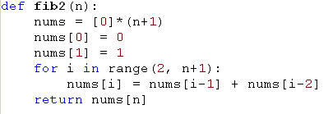
A Polynomial-time algorithm?
Correctness is obvious because it again directly implements the Fibonacci definition.
Analysis?
Now (if we have enough space) we can quickly compute F(14000)
Notes:
This algorithm is clearly linear.
Or is it? (actually, not linear)
Addition is NOT a constant-time operation unless there is a limit on the size of the numbers involved.

Slide 12
A more efficient algorithm?
Let X be the matrix
Then
also
How many additions and multiplications of numbers are needed to compute the product of two 2x2 matrices?
If n = 2^{k}, how many matrix multiplications does it take to compute X^{n}?
  What if n is not a power of 2?
  Implement it with a partner (details on next slide)
  Then we will analyze it
But there is a catch!
Notes:
The file fib3.py has the solution, and fib3-incomplete.py has it partially completed.
Solution for matrix_power:
def matrix_power(m, n):
result = identity_matrix
power = x
while n > 0:
if n % 2 == 1:
result = matrix_multiply(result, power)
power = matrix_multiply(power, power)
# print "In loop:", n, power, result
n = n /2
return result

Slide 13
identity_matrix = [[1,0],[0,1]]
x = [[0,1],[1,1]]
def matrix_multiply(a, b):
return [[a[0][0]*b[0][0] + a[0][1]*b[1][0],
a[0][0]*b[0][1] + a[0][1]*b[1][1]],
[a[1][0]*b[0][0] + a[1][1]*b[1][0],
a[1][0]*b[0][1] + a[1][1]*b[1][1]]]
def matrix_power(m, n): #efficiently calculate m^{n}
result = identity_matrix
# Fill in the details
return result
def fib (n) :
return matrix_power(x, n)[0][1]
# Test code
print ([fib(i) for i in range(11)])

Slide 14
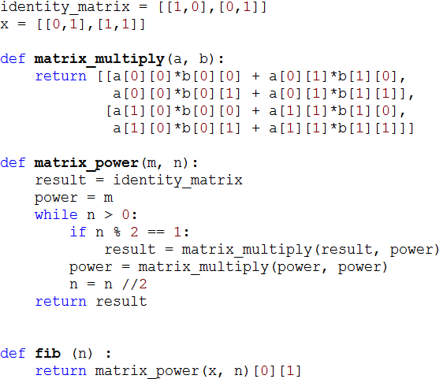

Slide 15
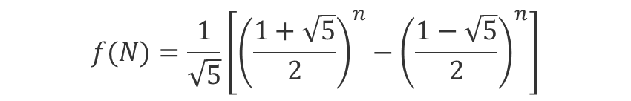
Why so complicated?
Why not just use the formula that you probably proved by induction in CSSE 230* to calculate F(N)?
*See Weiss, exercise 7.8
For review, this proof is part of HW1.
$$f(N)=\frac{1}{\sqrt{5}}\left[{\left(\frac{1+\sqrt{5}}{2}\right)}^{n}−{\left(\frac{1−\sqrt{5}}{2}\right)}^{n}\right]$$
Notes:
Because we'd have to use decimal approximation of the square roots, and that would be very messy. More so than the matrix version.

Slide 16
The catch!
Are addition and multiplication constant-time operations?
We take a closer look at the "basic operations"
Addition first:
At most, how many digits can there be in the sum of three one-digit decimal numbers?
Is the same result true in binary?
Add two 6-bit positive integers (53+35):
Carry:
So adding two k-bit integers is Θ( ) time.
1 1 1 1
1 1 0 1 0 1 (35)
1 0 0 0 1 1 (53)
1 0 1 1 0 0 0 (88)
Notes:
Θ(k)

Slide 17
Multiplication of Two k-bit Integers
Example: multiply 13 by 11
1 1 0 1
x 1 0 1 1
1 1 0 1 (1101 times 1)
1 1 0 1 (1101 times 1, shifted once)
0 0 0 0 (1101 times 1, shifted twice)
1 1 0 1 (1101 times 1, shifted thrice)
1 0 0 0 1 1 1 1 (binary 143)
There are k rows of 2k bits to add, so
we do an Θ(k) operation k times, thus
the whole multiplication is Θ( ) ?
Can we do better?
Notes:
The running time of the algorithm is Θ (k^2)

