Slide 1
Finding Objects: Hough Transforms, Templates, HOG Features, YOLO
Image Recognition
Matt Boutell
Notes:
Both

Slide 2
Detecting shapes in real images
In a previous unit, we detected shapes in noise-free binary images. Now, we advance to real, noisy images.
1. Hough transform
2. Template matching
- concepts
- using HOG features
3. CNNs, especially YOLO

Slide 3
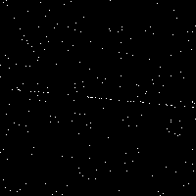
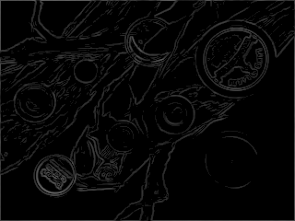
A Hough transform is a voting procedure in parameter space
What shapes are there?
How do you detect them?
Least-squares?
What do these two shapes
have in common?
They can be represented using equations represented by parameters. Points cast votes for consistent parameters and the true shape gets the most votes.
1. We'll discuss line detection in detail and see MATLAB.
2. You'll write a circle detector. (skip Spring 2023)
3. We'll extend to other shapes in theory.

Slide 4
Parameters for lines

Slide 5
How many parameters does it take to represent a line?
Two. Simplest?
y = mx + b (slope-intercept); any line is a 2D point (m,b).
Example: y=-x+4 is (-1,4)
Almost perfect. Why doesn't MATLAB use it?
Ax + By + C = 0 (standard form); any line is (A,B,C).
Do we need all 3?
x cos θ + y sin θ = ρ (Hesse normal form), any line is (ρ, θ).
ρ is distance from line to origin
θ is angle between distance segment and x-axis
2
https://en.wikipedia.org/wiki/Hough_transform
Notes:
TODO: Bring in more visualizations (even from MATLAB)

Slide 6
Voting procedure

Slide 7
Idea of a voting procedure
1. Represent a shape using parameters
2. Each edge point in the image casts a vote for all parameter combinations of which it could be part.
3. The true shape receives the most votes
Sonka, 6.2.6, Forsyth and Ponce, ch 15
Notes:
g(x) =
\begin{cases}
x \text{ if } x >= 0\\
0 \text{ otherwise }
\end{cases}

Slide 8
Applying the voting procedure to lines
1. Represent a shape using parameters
line: (m,b) in y=mx+b
2. Each edge point in the image casts a vote for all parameter combinations of which it could be part.
What votes does a single point cast?
Is there a pattern to them?
3. The true shape receives the most votes
Look for the intersection.
Example: apply to the points (4,4), (2,2), and (0,0) to detect the line y=x
Sonka, 6.2.6, Forsyth and Ponce, ch 15
Notes:
g(x) =
\begin{cases}
x \text{ if } x >= 0\\
0 \text{ otherwise }
\end{cases}

Slide 9
Noisy lines

Slide 10
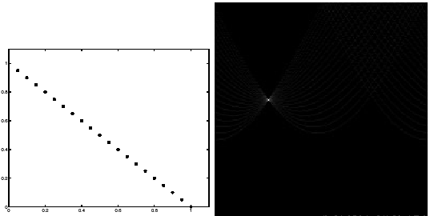
If the data is clean, there is a sharp peak in the voting space
(next 3 images from Forsyth and Ponce, ch 15)
Notes:
Dave

Slide 11
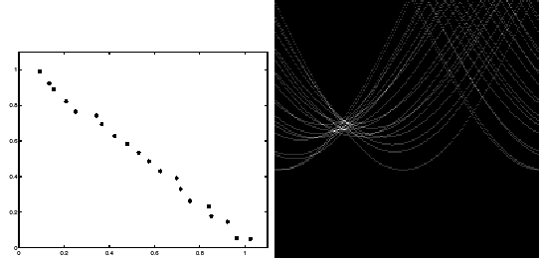
Noisier data gives a broader peak
How do we detect it?
Notes:
Dave

Slide 12
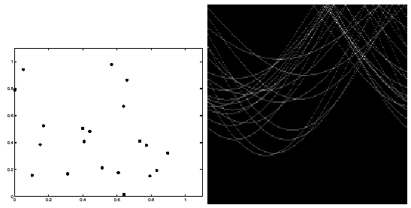
If the data is random, "phantom lines" will appear
There are many intersections – how can we handle them?
Notes:
Dave

Slide 13
Online visualization

Slide 14
Watch this visualization
http://homepages.inf.ed.ac.uk/amos/hough.html
Lots of good info there to read about, too!
Notes:
Dave

Slide 15
What is the accumulator matrix, H?
The gist of it
H = zeros(thetaResolution, rhoResolution)
for all edge points p:
for theta = 0:0.001:2*pi:
thetaBin = round(theta* thetaResolution/(2*pi))
% calc corresponding rho and rhoBin
H(thetaBin, rhoBin) = H(thetaBin, rhoBin) + 1
% Consider pi/2 and 100 bins. Ends up in bin 25, since it’s ¼ of the way from 0 to 2*pi.
Notes:
Dave

Slide 16
MATLAB functions

Slide 17
MATLAB requires three functions to detect lines
Run an edge detector first to find points that are voting
[H, theta, rho] = hough(edgeImg);
H = accumulator matrix; theta, rho = lists of parameters
peaks = houghpeaks(H,nPeaks);
lines = houghlines(BW,theta, rho, peaks)
This works for lines only.

Slide 18
Handling noisy points
See hough's rhoResolution parameter
Notes:
Dave

Slide 19
Handling phantom lines
See houghpeaks' threshold parameter
Notes:
Dave

Slide 20
Detecting Other Shapes: Circles

Slide 21
Review: Applying the voting procedure to lines
1. Represent a shape using parameters
line: (m,b)
2. Each edge point in the image casts a vote for all parameter combinations of which it could be part.
What votes does a single point cast?
Is there a pattern to them?
3. The true shape receives the most votes
Look for the intersection.
Sonka, 6.2.6, Forsyth and Ponce, ch 15
Notes:
g(x) =
\begin{cases}
x \text{ if } x >= 0\\
0 \text{ otherwise }
\end{cases}

Slide 22
Apply the voting procedure to circles of fixed radius
1. Represent a shape using parameters
(how many; what are they?)
2. Each edge point in the image casts a vote for all parameter combinations of which it could be part.
(what shape does the locus of votes make?)
3. The true shape receives the most votes
(this is just the intersection of the loci)
Sonka, 6.2.6, Forsyth and Ponce, ch 15
Notes:
g(x) =
\begin{cases}
x \text{ if } x >= 0\\
0 \text{ otherwise }
\end{cases}

Slide 23
Apply the voting procedure to circles of fixed radius
Notes:
Dave

Slide 24
Detecting other shapes: Circles, Big and Small

Slide 25
Apply the voting procedure to circles of any radius
1. Represent a shape using parameters
(how many; what are they?)
2. Each edge point in the image casts a vote for all parameter combinations of which it could be part.
(what shape does the locus of votes make?)
3. The true shape receives the most votes
(this is just the intersection of the loci)
Sonka, 6.2.6, Forsyth and Ponce, ch 15
Notes:
g(x) =
\begin{cases}
x \text{ if } x >= 0\\
0 \text{ otherwise }
\end{cases}

Slide 26
Apply the voting procedure to circles of any radius
Sonka, 6.2.6, Forsyth and Ponce, ch 15
Notes:
g(x) =
\begin{cases}
x \text{ if } x >= 0\\
0 \text{ otherwise }
\end{cases}

Slide 27
Detecting Line Segments and Other Shapes

Slide 28
Apply the voting procedure to find line segments
1. Represent a shape using parameters
(Note: You should consider how to represent various shapes like squares and rectangles)
2. How to visualize the locus of votes from any point?
Sonka, 6.2.6, Forsyth and Ponce, ch 15
Notes:
g(x) =
\begin{cases}
x \text{ if } x >= 0\\
0 \text{ otherwise }
\end{cases}

Slide 29
Apply the voting procedure to find arbitrary shapes
Any shape! But we make a simplifying assumption for now: translation is the only transformation
1. Represent a shape using parameters
2. How to visualize the locus of votes from any point?
  Ballard, Dana. 1981. Generalizing the Hough transform to detect arbitrary shapes. Pattern Recognition, 13(2):111-122.
  Dana was a long-time member of Rochester’s computer vision group.
Sonka, 6.2.6, Forsyth and Ponce, ch 15
Notes:
g(x) =
\begin{cases}
x \text{ if } x >= 0\\
0 \text{ otherwise }
\end{cases}

Slide 30
Apply the voting procedure to find arbitrary shapes
Any shape! But we make a simplifying assumption for now: translation is the only transformation
1. Represent a shape using parameters
2. How to visualize the locus of votes from any point?
Notes:
g(x) =
\begin{cases}
x \text{ if } x >= 0\\
0 \text{ otherwise }
\end{cases}

Slide 31
Lab intro

Slide 32
My circle finder: Wouldn’t this be a great lab? ☺
  Like Matlab’s hough and houghpeaks (for lines), but from scratch
  Includes two options: variable or fixed radius circles

Slide 33
Focusing the votes (optional ideas)
Each edge pixel (one with above-threshold magnitude) casts one set of votes.
Use the edge gradient information as well
Only need to cast votes for centers along the gradient
I’ve done this; it works really well
Get creative: should strong edge pixels cast more votes?

Slide 34
Template Matching

Slide 35
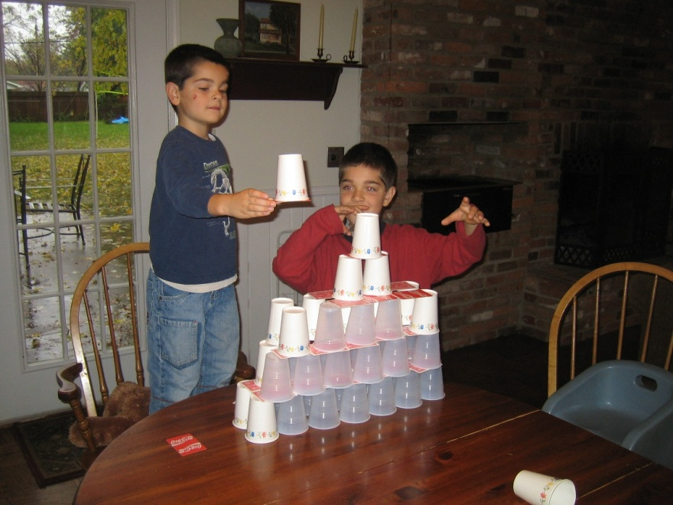

How can you look for an exact match of an object in an image?
Idea: Describe the object by a sub-image, called a template:
Sonka, 6.4

Slide 36
Simple algorithm: look for local maxima of a match criterion
1. Evaluate a match criterion at every image location (plus size, reflection, and rotation, if those variations are expected)
2. A “match” is a local maximum of the criterion, possibly above a threshold
Sonka, 6.4

Slide 37
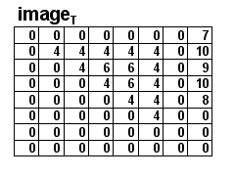
How to match? Use correlation.
Just use the template as a filter!
Idea: high correlation when
the template matches.
How does it work?

Slide 38
Improved Template Matching

Slide 39
How to match better ? Use normalized correlation.
Just use the template as a filter!
Idea: high correlation when
the template matches.
How does it work?
Problem: always high correlation when matching with a plain bright region
Solution: Normalize the template and each region by subtracting each’s mean from itself before taking dot product

Slide 40
Other Matching Algorithms

Slide 41
Other matching algorithms
Chamfering (Hausdorff distance):
http://www.cs.cornell.edu/~dph/hausdorff/hausdorff1.html
Springs and templates (Crandall and Huttenlocher)
http://www.cs.cornell.edu/~dph/papers/cvpr07.pdf
Even CNNs need to operate at various scales/patches of the image to detect objects.
Some variations have been developed to cut down on processing time.

Slide 42
Histograms of Oriented Gradients

Slide 43
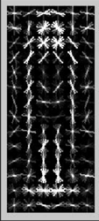
Edges are more robust features for detection than intensities
Histogram of
Oriented
Gradients
("HOG" features)
Sources:
Guest lecture by Trenton Tabor, RHIT ‘12
Sonka, et al. text, section 10.6.3
N. Dalal and B. Triggs, "Histograms of Oriented Gradients for Human Detection", Proc. IEEE Conf. Computer Vision and Pattern Recognition, vol. 1, pp. 886-893, 2005.

Slide 44
HOG features work well for pedestrian detection
Dalal and Triggs introduced it in 2005.
Their work has been cited over 13,000 times!
Used for object classification in 2006
We’ll look at usage for digit classification
Past CSSE463 teams have used for object recognition tasks

Slide 45
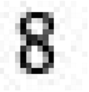
Matlab has clear docs and examples
Matlab HOG documentation
Matlab end-to-end digit recognition example
How?
Preprocessing by binarizing images
Extract HOG features on training and testing sets
Train an ensemble of linear SVMs for multiclass classification
Demo digit rec now

Slide 46
HOG Feature Extraction

Slide 47
How does HOG feature extraction work?

Slide 48
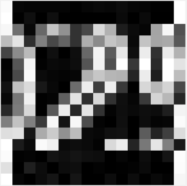

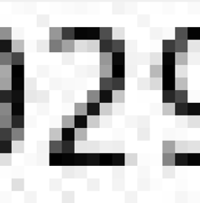
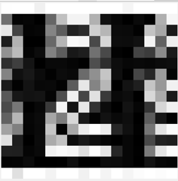
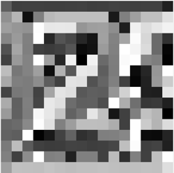
1. Calculate edge gradient magnitude and direction
dx
magnitude
-1 | 0 | 1
Orientation histogram every 20 deg (9 bins)
Compute for each cell (group of pixels)
1
0
-1
dy
Direction (0-180°)

Slide 49
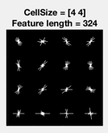
1b. Edge direction histogram visualization

Slide 50
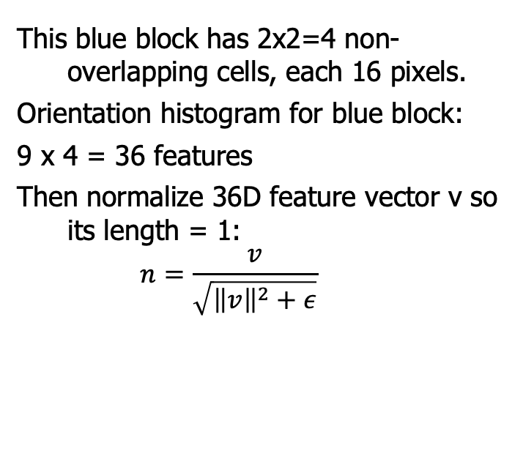
2. Repeat for each cell in block
This blue block has 2x2=4 non-overlapping cells, each 16 pixels.
Orientation histogram for blue block:
9 x 4 = 36 features
Then normalize 36D feature vector v so its length = 1:
$$n=\frac{v}{\sqrt{{\left\|v\right\|}^{2}+ε}}$$

Slide 51
3. Repeat for each block of cells in the window
Window has blocks of cells made of pixels.
etc.
36/block x 9 overlapping blocks = 324 features
Each block is normalized independently
324 features then sent to SVM to detect the object of interest in that window.
https://www.mathworks.com/help/vision/examples/digit-classification-using-hog-features.html

Slide 52
Multiclass SVMs
Train 1 SVM per class. Using a digit classifier, for example:
SVM₁ is for “1” vs “non-1” (so 0,2,3,4,5,6,7,8,9)
SVM₂ is for “2” vs “non-2”
SVM₃ for “3” vs ”non-3”
…
Feed the test vector to all SVMs
Assign class i if SVM_{i} gives max output.
Note: Still need 50/50 pos/neg to train each SVM (throw away data).
An alternative uses error correcting codes (fitECOC) from communications theory to get the SVMs to give different aggregate responses on each class.

Slide 53
Example of pedestrian classifier using HOG features
https://www.youtube.com/watch?v=TzzJC8sOe60&feature=youtu.be
Showcasing Trenton’s work:
T. Tabor, Z. Pezzementi, C. Vallespi and C. Wellington, 'People in the Weeds: Pedestrian Detection Goes Off-road', in 2015 IEEE International Symposium on Safety, Security, and Rescue Robotics, Purdue University, West Lafayette, IN, 2015.

Slide 54
Sounds great. How do I start?
Read the MATLAB example.
Try it out!
Read about parameters and experiment with them as needed:
Matlab HOG documentation

Slide 55
CNNs for Object Detection

Slide 56
Other matching algorithms (review)
Chamfering (Hausdorff distance):
http://www.cs.cornell.edu/~dph/hausdorff/hausdorff1.html
Springs and templates (Crandall and Huttenlocher)
http://www.cs.cornell.edu/~dph/papers/cvpr07.pdf
Even CNNs need to operate at various scales/patches of the image to detect objects.
Some variations have been developed to cut down on processing time.
What are the options?

Slide 57
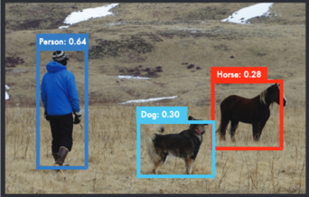
Reminder: Object Recognition
Input: an image
Output: classification
(what is there,
confidence)
+
localization
(a bounding box)
https://arxiv.org/pdf/1506.02640v5.pdf

Slide 58
Using CNNs to detect objects
Three techniques in 4 papers. Search for objects …
Exhaustively (sliding window)
Using region proposals
  R-CNN (2014)
  Fast R-CNN (2014)
  Faster R-CNN (2015)
In the whole image at once; YOLO (2016)
This lecture is a brief survey meant to help you see some different network architectures and expose you to this field.

Slide 59
Sliding window: CNNs meet template matching
Training: Use image patch → label pairs.
Just like you would on whole image → label pairs
Inference: For each image patch, pass only that patch to the CNN and get the output. If above threshold and local max, detect it.
Repeat over various overlapping locations and scales.
Conceptually simple, but too slow to use in practice.

Slide 60
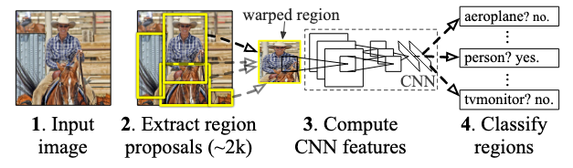
R-CNN (2014): Regions with CNN Features
Rich feature hierarchies for accurate object detection and semantic segmentation
https://arxiv.org/abs/1311.2524
Notes:
https://arxiv.org/abs/1311.2524

Slide 61
Region proposals are done using "selective search"
This algorithm first does bottom-up segmentation starting with individual pixels and grouping them into regions (1).
Then regions are grouped hierarchically and greedily until there is 1 region.
Outputs ~2000 bounding boxes containing regions
http://people.cs.uchicago.edu/~pff/papers/seg-ijcv.pdf
http://www.huppelen.nl/publications/selectiveSearchDraft.pdf
Notes:
https://arxiv.org/abs/1311.2524

Slide 62


Regions are padded and warped to 227 x 227
Padded by 16 pixels to give a little background, then warped.
Why 227 x 227?
https://arxiv.org/abs/1311.2524
Notes:
https://arxiv.org/abs/1311.2524

Slide 63
Ablation studies give early evidence for the effectiveness of feature extraction
They compared using the whole network with the {network \ fc7) and the {network \ {fc6+fc7}},
using SVMs for the classification portion.
fc7 contains 29% of the parameters in the CNN
fc6 contains 63% of the parameters in the CNN
Conv layers contain the rest (6%)
Accuracy was similar with each.
https://arxiv.org/abs/1311.2524
Notes:
https://arxiv.org/abs/1311.2524

Slide 64
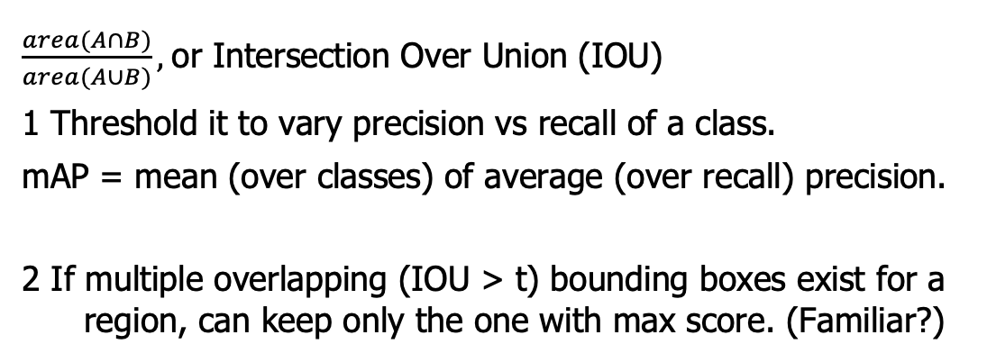
To measure match between true and detected bounding boxes, use IOU
$\frac{area(A∩B)}{area(A∪B)},$or Intersection Over Union (IOU)
1 Threshold it to vary precision vs recall of a class.
mAP = mean (over classes) of average (over recall) precision.
2 If multiple overlapping (IOU > t) bounding boxes exist for a region, can keep only the one with max score. (Familiar?)
https://arxiv.org/abs/1311.2524
Notes:
https://arxiv.org/abs/1311.2524

Slide 65
Summary of R-CNN: ok but slow
mAP = .66* on Pascal VOC 2007 20-class dataset
(vs .337 for deformable parts models that use templates)
Runs at 20 seconds/frame (or 0.05 FPS)
*Per Fast R-CNN paper; https://arxiv.org/abs/1311.2524 gives mAP = .537. Speeds per YOLO CVPR presentation
Notes:
https://arxiv.org/abs/1311.2524

Slide 66
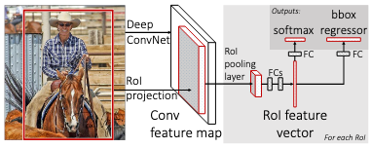
Fast R-CNN (2014) integrates region proposals into the CNN
Still uses selective search to get regions. But all regions share the conv layers, so faster.
Output is a set of class probabilities and a bounding box location (x,y,w,h) for each region.
mAP = .669, speed = 2 sec/frame or 0.5 FPS
https://arxiv.org/abs/1504.08083
Notes:
https://arxiv.org/abs/1311.2524

Slide 67
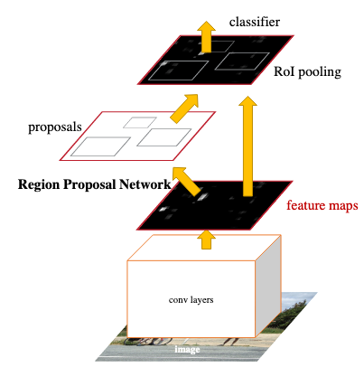
Faster R-CNN (2015) uses part of the CNN for region proposals.
Uses a CNN called a region proposal net (RPN) to get the region proposals
Output is still a set of class probabilities and a bounding box location (x,y,w,h) for each region.
They train on ImageNet and fine-tune on various object-detection datasets
mAP = .699, speed = 0.2 sec/image or 5 FPS
https://arxiv.org/abs/1506.01497
Notes:
https://arxiv.org/abs/1311.2524

Slide 68
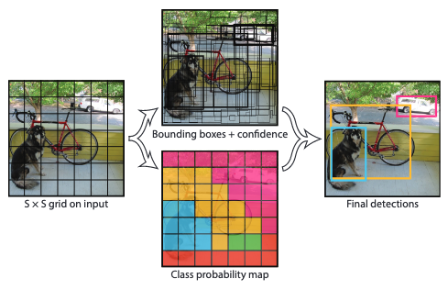
YOLO (2016) uses a single net at once to map images to bounding boxes
24 conv layers
Input: an image
Output: 1470 values (7x7 grid x {2 bounding boxes / grid, each with 5 parameters, plus a 20 class probability map})
Since the bounding boxes are real-valued (and not simply labels), it is also a regression problem (in addition to classification).
It uses only 1 system, not several, so is faster.
https://arxiv.org/abs/1506.02640
Notes:
https://arxiv.org/abs/1311.2524

Slide 69
YOLO (2016) uses a single net at once to map images to bounding boxes
24 conv layers
mAP = .634, speed = 0.022 sec/image or 45 FPS (real-time)
Pro: Uses whole image, not sliding window or region proposals, so can encode context (powerful, needs more training data). Generalizes across genres (like art)
Con: sometimes localizations are wrong
https://arxiv.org/abs/1311.2524
Notes:
https://arxiv.org/abs/1311.2524

Slide 70
They later pushed it even further in YOLO v2 (2016)
24 conv layers
mAP = 0.768, speed = 0.015 sec/image or 67 FPS (real-time)
Higher resolution inputs and grid, batch normalization, anchor boxes, clustering using k-means.
https://arxiv.org/abs/1612.08242
Notes:
https://arxiv.org/abs/1311.2524

Slide 71
Optional: Watch the YOLO CVPR presentation
CVPR = Computer Vision and Pattern Recognition, a top vision conference
https://www.youtube.com/watch?v=NM6lrxy0bxs&list=PLrrmP4uhN47Y-hWs7DVfCmLwUACRigYyT
YOLO v7v8 was recently released

