Slide 1
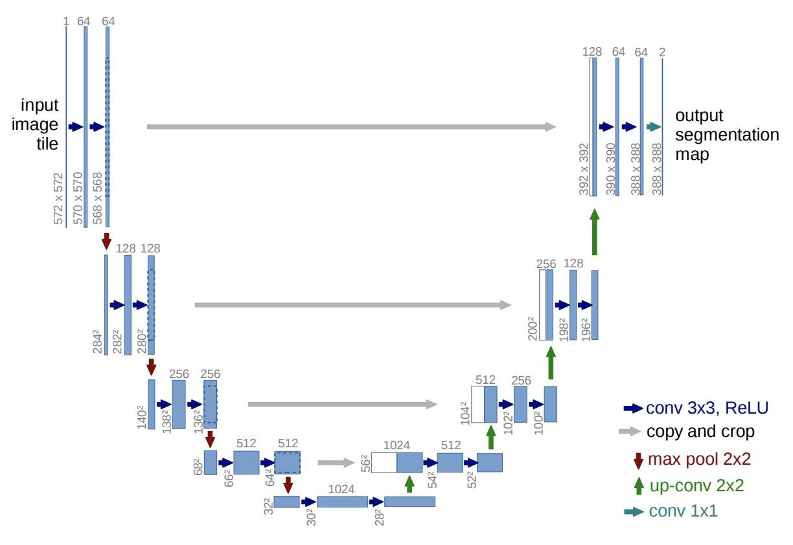
CNN Architectures
Image Recognition
Matt Boutell
Notes:
Both

Slide 2
Network architectures for image rec tasks

Slide 3
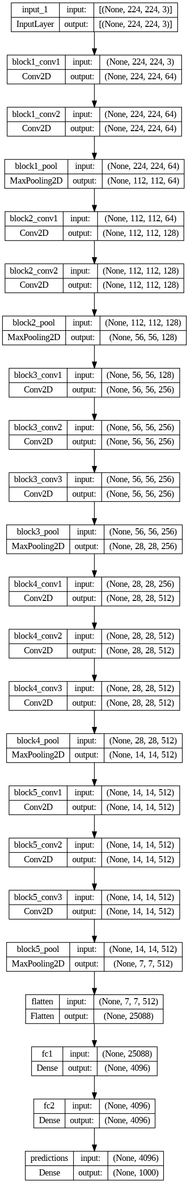
So far: whole scene classification
{Convolution/ReLU/pooling}*,
then dense and softmax layers.
Examples: LeNet, AlexNet,
VGG16, VGG19 nets
[Visual Geometry Group at Oxford]
VGG16 (total and blocks 1-2) to right:
13 convolutions in 4 blocks.
LeNet vs AlexNet: https://en.wikipedia.org/wiki/Convolutional_neural_network

Slide 4
Newer networks use regularization layers too
Reminder: One way to prevent overfitting is to stop training when validation accuracy increases (after some patience to account for noise).
Other ways are more explicit:
Dropout
Batch-normalization
Notes:
Dave

Slide 5
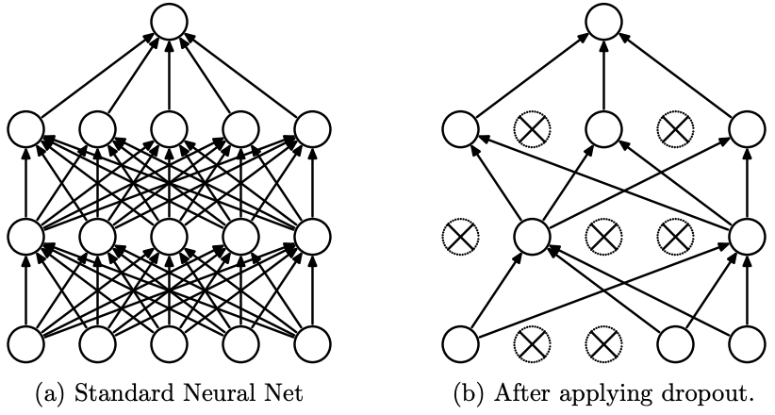
Dropout randomly sets activations to 0.
The Dropout layer randomly sets a neuron’s output to 0 with a frequency of p at each step during training time. All neurons are used at test time.
The idea is that neurons can rely too much on a neighboring neuron’s output during training and removing it temporarily breaks this.
In practice, we only need drop out on dense layers, not conv layers.
https://jmlr.org/papers/volume15/srivastava14a/srivastava14a.pdf
Notes:
Dave

Slide 6
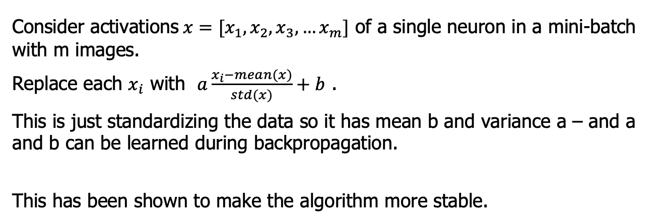
Batch normalization averages activations across a batch
Consider activations$x=[x_{1},x_{2},x_{3}, …x_{m}]$ of a single neuron in a mini-batch with m images.
Replace each $x_{i}$ with $a\frac{x_{i}−mean(x)}{std(x)}+b$ .
This is just standardizing the data so it has mean b and variance a – and a and b can be learned during backpropagation.
This has been shown to make the algorithm more stable.
https://arxiv.org/abs/1502.03167
Notes:
Dave

Slide 7
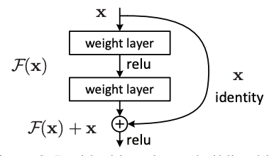
Nets with residual connections help with vanishing gradients
Problem with deeper networks:
the chain rule has many terms, and if many activations close to 0 are multiplied, the product goes to 0.
Solution: add skip connections →
Examples:
ResNet ,
Xception (40 conv layers) →
EfficientNet (B0-B7; scalable)
ResNet https://arxiv.org/abs/1512.03385
EfficientNet https://arxiv.org/abs/1905.11946 referring to
https://paperswithcode.com/method/mnasnet

Slide 8
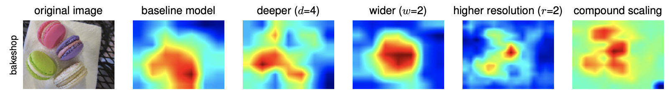
GradCam Example from EfficientNet
EfficientNet https://arxiv.org/abs/1905.11946

Slide 9
Wait, this isn’t a plain sequence any more?
Skip-connections between layers mean the pipeline is no longer a simple sequence, but a graph.
Notes:
Dave

Slide 10
Defining a non-sequential model (one residual connection)
MATLAB: Sequential->(graph)
layers = [
imageInputLayer([28 28 1])
convolution2dLayer(3,16,'Padding',1)
reluLayer('Name', 'relu_1')
maxPooling2dLayer(2,'Stride',2)
convolution2dLayer(3,32,'Padding',1)
reluLayer
additionLayer(2,'Name','add')
fullyConnectedLayer(10)
softmaxLayer
classificationLayer
];
lgraph = layerGraph(layers);
skipConv = convolution2dLayer(
1,32,'Stride',2,'Name','skipConv’);
lgraph = addLayers(lgraph,skipConv);
lgraph = connectLayers(lgraph,'relu_1','skipConv’);
lgraph = connectLayers(lgraph,'skipConv','add/in2’);
https://www.mathworks.com/help/deeplearning/ref/nnet.cnn.layergraph.html
Keras: Sequential->Functional API
def define_model():
# From Deep Learning with Python, ch 8.1.2
# Dimensions are for MNIST digit recognition: 28x28 greayscale inputs, 10 outputs (digits 0-9)
inputs = keras.Input(shape=(28, 28, 1))
x = layers.Conv2D(filters=32, kernel_size=3, activation="relu")(inputs)
mp = layers.MaxPooling2D(pool_size=2)(x)
x = layers.Conv2D(filters=64, kernel_size=3, activation="relu")(mp)
x = layers.MaxPooling2D(pool_size=2)(x)
x = layers.Conv2D(filters=128, kernel_size=3, activation="relu")(x)
x = layers.MaxPooling2D(pool_size=2)(x)
x = layers.Add()([x,mp])
x = layers.Flatten()(x)
outputs = layers.Dense(10, activation="softmax")(x)
model = keras.Model(inputs=inputs, outputs=outputs)
opt = SGD(learning_rate=0.01, momentum=0.9)
model.compile(optimizer=opt, loss='categorical_crossentropy', metrics=['accuracy’])
return model
https://stackoverflow.com/questions/64792460/how-to-code-a-residual-block-using-two-layers-of-a-basic-cnn-algorithm-built-wit
Notes:
Dave

Slide 11
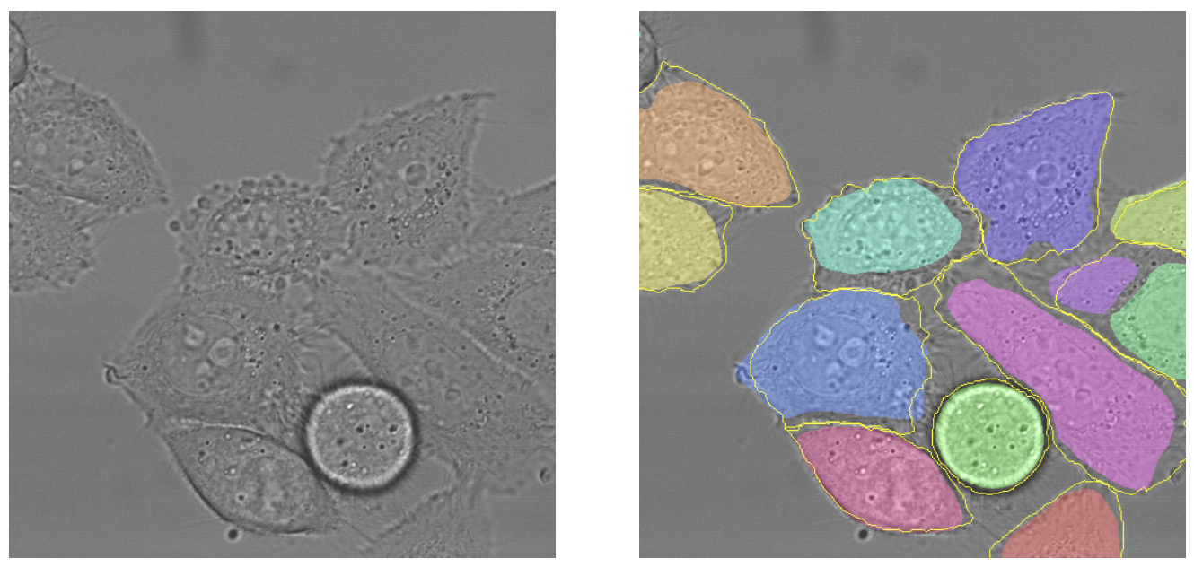
Consider a different problem: classifying each image pixel
Segmented HeLa Cells: colors are predicted regions (yellow borders are truth)
Known as semantic segmentation. You did on fruit finder! Labels = {apple, orange, banana, none}.
HeLa = human cell line from Henrietta Lacks
U-net: https://arxiv.org/pdf/1505.04597.pdf

Slide 12
To classify each pixel, output size = input size = an image!
Example: U-Net.
What is the up-conv 2x2?
U-net: https://arxiv.org/pdf/1505.04597.pdf

Slide 13
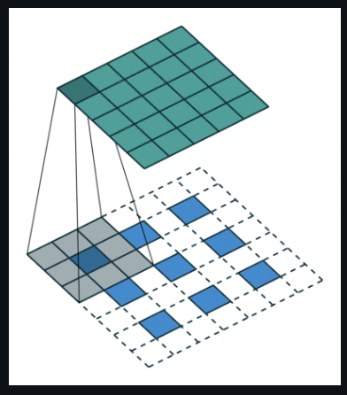
Upconv is convolution applied with spaced input
Key: up-conv (or “transposed
convolution”) to upsample blue = input, cyan = output →
See github link below for animations
Improved versions use 2x2 strides (instead max-pooling) in regular conv layers. (Taking top left of every 2x2 block works better for this kind of problem.)
Paper (https://arxiv.org/pdf/1603.07285v1.pdf ) with
animations (https://github.com/vdumoulin/conv_arithmetic )
Slides (https://cs.nyu.edu/~fergus/drafts/utexas2.pdf )

Slide 14
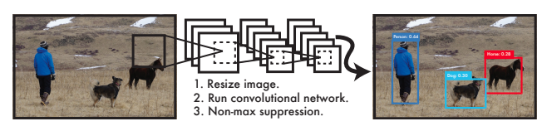
To identify objects, we also want bounding box location
Want to locate them with bounding boxes and give the class of each one
Location is numbers (__, __, __, __).
So not a classification problem, but ______________
It’s almost a classification net: just a different final layer
(no softmax)

Slide 15
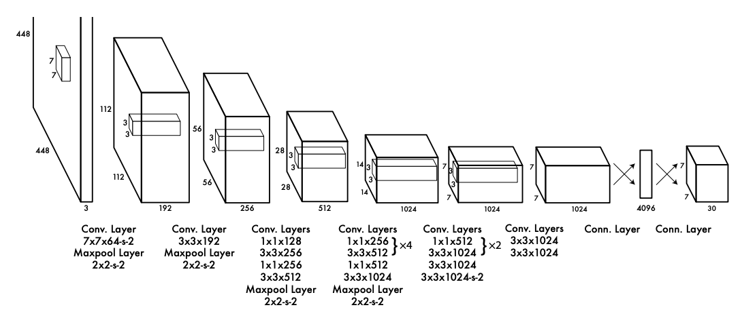
YOLO (2016) maps images to bounding boxes
Input: an image
24 convolutional layers
Output: 1470 values (7x7 grid x {2 bounding boxes / grid, each with 5 parameters (x,y,w,h,conf), plus a 20 class probability map)
Since outputs are real-valued (and not simply labels), it is formulated as a regression problem.
https://arxiv.org/abs/1506.02640
Notes:
https://arxiv.org/abs/1311.2524

Slide 16
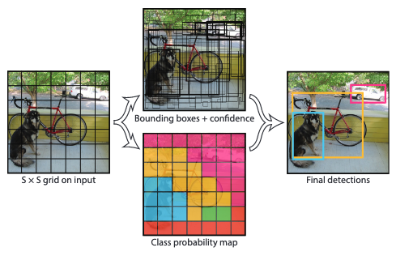
YOLO (2016) uses a single net at once to map images to bounding boxes
24 conv layers
Input: an image
Output: 1470 values (7x7 grid x {2 bounding boxes / grid, each with 5 parameters, plus a 20 class probability map})
Since the bounding boxes are real-valued (and not simply labels), it is also a regression problem (in addition to classification).
It uses only 1 system, not several, so is faster.
https://arxiv.org/abs/1506.02640
Notes:
https://arxiv.org/abs/1311.2524

Slide 17
YOLO (2016) uses a single net at once to map images to bounding boxes
24 conv layers
mAP = .634, speed = 0.022 sec/image or 45 FPS (real-time)
Pro: Uses whole image, not sliding window or region proposals, so can encode context (powerful, needs more training data). Generalizes across genres (like art)
Con: sometimes localizations are wrong
https://arxiv.org/abs/1311.2524
Notes:
https://arxiv.org/abs/1311.2524

Slide 18
They later pushed it even further in YOLO v2 (2016)
24 conv layers
mAP = 0.768, speed = 0.015 sec/image or 67 FPS (real-time)
Higher resolution inputs and grid, batch normalization, anchor boxes, clustering using k-means.
https://arxiv.org/abs/1612.08242
Notes:
https://arxiv.org/abs/1311.2524

Slide 19
Optional: Watch the YOLO CVPR presentation
CVPR = Computer Vision and Pattern Recognition, a top vision conference
https://www.youtube.com/watch?v=NM6lrxy0bxs&list=PLrrmP4uhN47Y-hWs7DVfCmLwUACRigYyT
YOLO v7v8 was recently released

Slide 20
MATLAB has pre-trained versions of many architectures
Which ones are in MATLAB?
Classification: alexnet, vgg16, resnet50, …
Segmentation: Deeplabv3plus, U-net tutorial
YOLO: darknet53-coco, …
https://github.com/matlab-deep-learning/MATLAB-Deep-Learning-Model-Hub
https://www.mathworks.com/help/deeplearning/ug/pretrained-convolutional-neural-networks.html
Others: Search for or use Keras (python)

