Slide 1
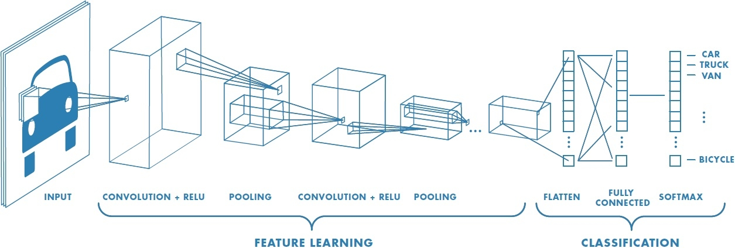
Deep Learning and
Convolutional Neural Networks
Image Recognition
Matt Boutell
Image Credit: https://www.mathworks.com/discovery/convolutional-neural-network.html
Notes:
Both

Slide 2
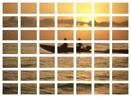
Background: we are detecting sunsets using the classical image recognition paradigm
Classifier
(1hidden layer)
Human- engineered feature extraction
feature vector
Class [-1, 1]
Support vector machine
7x7x6
=294
Grid-based Color moments
384x256x3
Build model (choose kernel, C)
Train (quadratic programming optimization with Lagrange multipliers bounded by BoxConstraints)
Predict the class of a new vector by taking the weighted sum of functions of the distances of the vector to the support vectors
Notes:
Dave

Slide 3
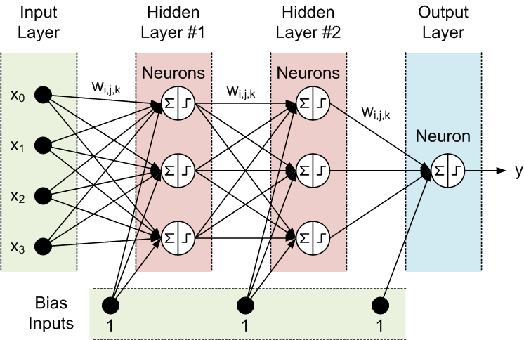
Reminder: Basic neural network architecture
“Shallow” net
Each neuron p_{i} = f(x)
Or a layer is p = f(x)
Width
Depth
http://tx.shu.edu.tw/~purplewoo/Literature/!DataAnalysis/three%20activation%20functions.files/NN1.gif
Notes:
General case is fully connected between each layer.
Width of each layer can vary.

Slide 4
Background: We could swap out the SVM for a traditional (shallow) neural network
Classifier
(1-3 layers)
Human- engineered feature extraction
feature vector
Class (0-1)
Neural net
7x7x6
=294
Grid-based Color moments
…but our choice of features may limit accuracy
384x256x3
Build model (1-2 fully-connected hidden network layers)
Train (backpropagation to minimize loss function)
Predict the class of a new vector by extracting features and forward-propagating the features through the neural network…
Notes:
Dave

Slide 5
Deep learning and convolutional neural nets

Slide 6
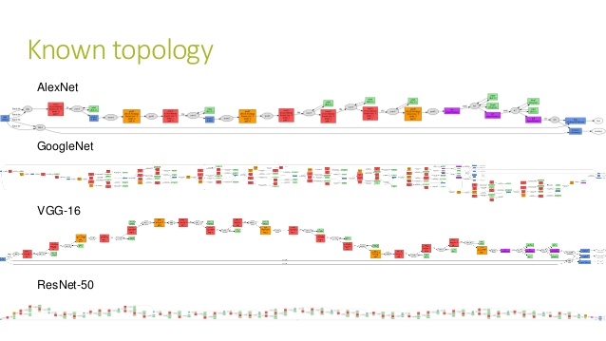
Deep learning is a vague term
“Deep” networks typically have 10+ layers.
For example, 25, 144, or 177 (we’ll use some of these!)
That’s many weights to learn.
And more choices of architectures.
Should layers be fully connected?
How to train them fast enough?
Fig: https://www.slideshare.net/Geeks_Lab/aibigdata-lab-2016-transfer-learning

Slide 7
Deep learning is a new paradigm in machine learning
Deep networks learn both which features to use and how to classify them.
There are millions of parameters
https://www.mathworks.com/discovery/convolutional-neural-network.html
Notes:
Dave

Slide 8
Image classification network layers come in several types
Convolution, ReLU, Pooling
https://www.mathworks.com/discovery/convolutional-neural-network.html
Notes:
Dave

Slide 9
Convolution

Slide 10
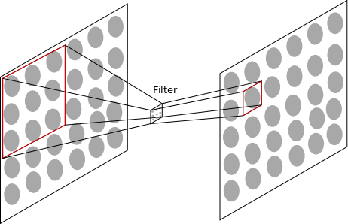
Convolution of filters with input
The network learns what weights to use from data
AJ Piergiovanni, CSSE463 Guest Lecture https://docs.google.com/presentation/d/15Lm6_LTtWnWp1HRPQ6loI3vN55EKNOUi8hOSUypsFw8/
Notes:
Dave

Slide 11
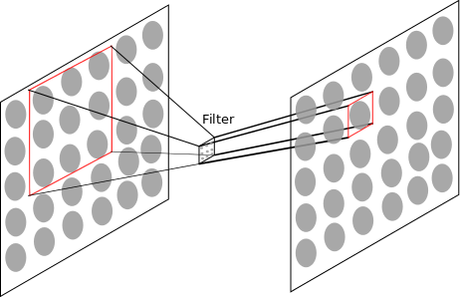
Convolution of filters with input
The network learns what weights to use from data
Notes:
Dave

Slide 12
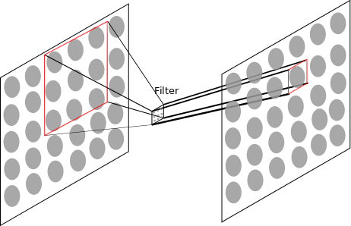
Convolution of filters with input
The network learns what weights to use from data. A set of 3x3 weights must be learned for each filter. But the same 3x3 filter connects every 3x3 patch in the first layer with every corresponding neuron in the next layer. We usually have 10-100 such filters per level.
Notes:
Dave

Slide 13
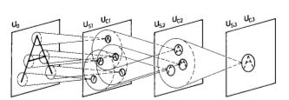
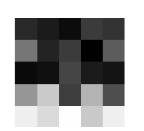
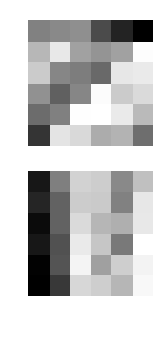
Convolutional layers learn familiar features
The first layer filters learn edges and opponent colors (color edges),
Higher level filters learn more complex features
Example Filters
Kunihiko Fukushima. “Neocognitron: A self-organizing neural network model for a mechanism of pattern recognition unaffected by shift in position”. 1980.
2
Notes:
TODO: Bring in more visualizations (even from MATLAB)

Slide 14
Other layers; ReLU, Pooling, Softmax

Slide 15
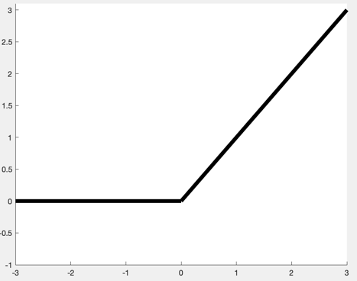
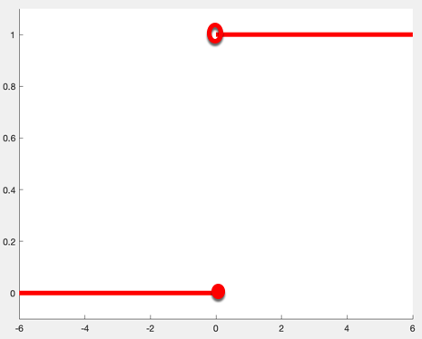
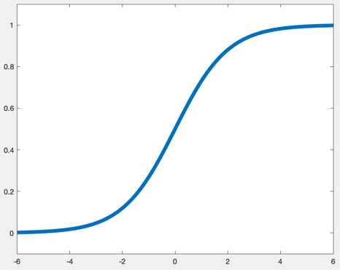
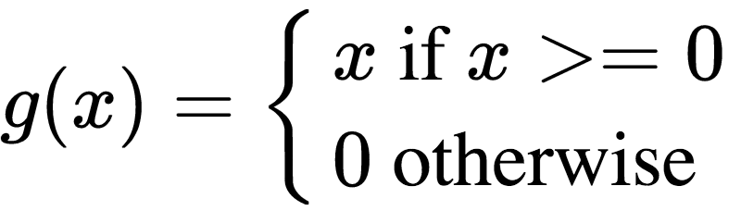
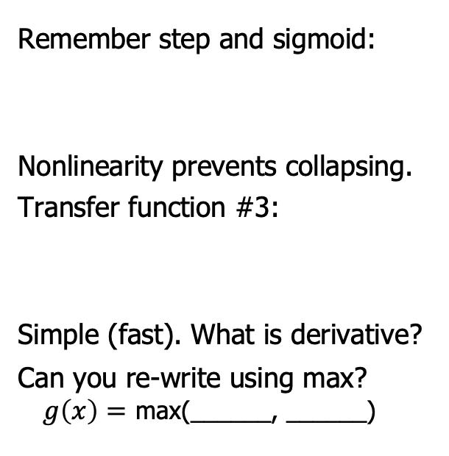
ReLU (Rectified Linear Unit) is one of the simplest non-linear transfer functions.
Remember step and sigmoid:
Nonlinearity prevents collapsing.
Transfer function #3:
Simple (fast). What is derivative?
Can you re-write using max?
$g\left(x\right)=$ max(______, ______)
CC0, https://en.wikipedia.org/w/index.php?curid=48817276
Notes:
g(x) =
\begin{cases}
x \text{ if } x >= 0\\
0 \text{ otherwise }
\end{cases}

Slide 16
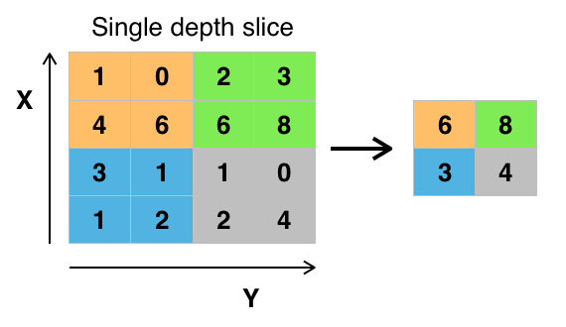
Pooling fights an increase of dimensionality
Since we learn multiple filters at each level, the dimensionality would continue to increase. The solution is to pool data at each layer and downsample.
Types:
Max-pooling
Average-pooling
Subsampling only
Example of max-pooling.
https://commons.wikimedia.org/wiki/File:Max_pooling.png#filelinks
Notes:
Dave

Slide 17
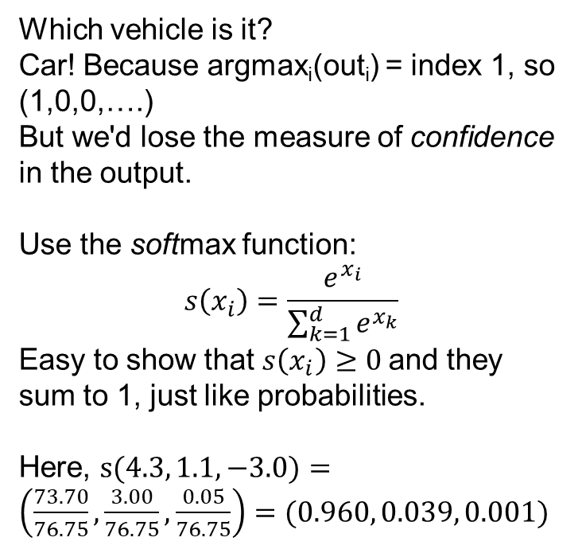
Softmax turns a layer's values into a "probability distribution"
Which vehicle is it?
Car! Because argmax_{i}(out_{i}) = index 1, so (1,0,0,….)
But we'd lose the measure of confidence in the output.
Use the softmax function:
$$s\left(x_{i}\right)=\frac{e^{x_{i}}}{\sum_{k=1}^{d}{e^{x_{k}}}}$$
Easy to show that $s\left(x_{i}\right)≥0$and they sum to 1, just like probabilities.
Here, $s(4.3, 1.1, −3.0)=\left(\frac{73.70}{76.75},\frac{3.00}{76.75},\frac{0.05}{76.75}\right)=(0.960, 0.039, 0.001)$
4.3
1.1
-3.0
0.960
0.039
0.001

Slide 18
Putting it all together:
{Convolution, ReLU, Pooling}^{N}, Fully-connected, Softmax
Notes:
Dave

Slide 19
Putting it all together: Defining a model
layers = [
imageInputLayer([28 28 1])
convolution2dLayer(3,16,'Padding',1)
reluLayer
maxPooling2dLayer(2,'Stride',2)
convolution2dLayer(3,32,'Padding',1)
reluLayer
fullyConnectedLayer(10)
softmaxLayer
classificationLayer
];
# Keras, Deep Learning with Python, ch 8.1.2
# Dimensions are for MNIST digit recognition:
# 28x28 grayscale inputs, 10 outputs (digits 0-9)
model = keras.Sequential( [
keras.Input(shape=(28, 28, 1)),
layers.Conv2D(filters=32, kernel_size=3, activation="relu"),
layers.MaxPooling2D(pool_size=2),
layers.Conv2D(filters=64, kernel_size=3, activation="relu"),
layers.MaxPooling2D(pool_size=2)
layers.Conv2D(filters=128, kernel_size=3, activation="relu"),
layers.MaxPooling2D(pool_size=2),
layers.Flatten(),
layers.Dense(10, activation="softmax")(x),
]
https://www.mathworks.com/help/deeplearning/ug/layers-of-a-convolutional-neural-network.html
https://www.mathworks.com/help/deeplearning/deep-networks-for-images.html?s_tid=CRUX_lftnav
Notes:
Dave

Slide 20
Why deep learning now?

Slide 21
While deep learning is a "new" paradigm in machine learning…
Notes:
Dave

Slide 22
… it is really just an old idea that is now practical
In 2012, a deep network was used to win the ImageNet Large Scale Visual Recognition Challenge (14M annotated images), bringing the top-5 error rate down from the previous 26.1% to 15.3%.
Deep networks keep winning and improving each year.
Why?
Faster hardware (GPUs)
Access to more training data (www)
Algorithmic advances
www.deeplearningbook.org/
Olga Russakovsky*, Jia Deng*, Hao Su, Jonathan Krause, Sanjeev Satheesh, Sean Ma, Zhiheng Huang, Andrej Karpathy, Aditya Khosla, Michael Bernstein, Alexander C. Berg and Li Fei-Fei. ImageNet Large Scale Visual Recognition Challenge. IJCV, 2015.
Notes:
Dave

Slide 23
Review (temp slide)
{Convolution, ReLU, Pooling}^{N}, Fully-connected, Softmax
Aesthetics: smaller and deeper as move away from image
See demo site: (blue vs orange, blockier)
Does a convolutional layer have more weights to learn than a dense layer?
How many weights in max-pooling? ReLU?
Notes:
Dave

Slide 24
Putting it all together: Defining a model
layers = [
imageInputLayer([28 28 1])
convolution2dLayer(3,16,'Padding',1)
reluLayer
maxPooling2dLayer(2,'Stride',2)
convolution2dLayer(3,32,'Padding',1)
reluLayer
fullyConnectedLayer(10)
softmaxLayer
classificationLayer
];
# Keras, Deep Learning with Python, ch 8.1.2
# Dimensions are for MNIST digit recognition:
# 28x28 grayscale inputs, 10 outputs (digits 0-9)
model = keras.Sequential( [
keras.Input(shape=(28, 28, 1)),
layers.Conv2D(filters=32, kernel_size=3, activation="relu"),
layers.MaxPooling2D(pool_size=2),
layers.Conv2D(filters=64, kernel_size=3, activation="relu"),
layers.MaxPooling2D(pool_size=2)
layers.Conv2D(filters=128, kernel_size=3, activation="relu"),
layers.MaxPooling2D(pool_size=2),
layers.Flatten(),
layers.Dense(10, activation="softmax")(x),
]
https://www.mathworks.com/help/deeplearning/ug/layers-of-a-convolutional-neural-network.html
https://www.mathworks.com/help/deeplearning/deep-networks-for-images.html?s_tid=CRUX_lftnav
Notes:
Dave

Slide 25
Gradient descent and stochastic gradient descent

Slide 26
Back to the big picture
Build model (many layers)
Train (gradient descent to minimize loss function)
Predict the class of a new vector by forward propagation through the network
Notes:
Dave

Slide 27
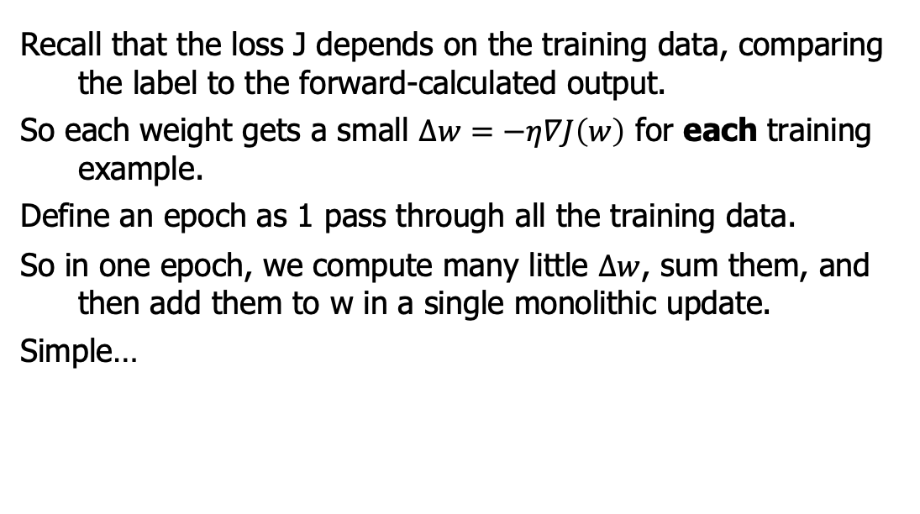
Recall that gradient descent is used to find a local optimum of the loss function
Recall that the loss J depends on the training data, comparing the label to the forward-calculated output.
So each weight gets a small $∆w=−η∇J\left(w\right)$ for each training example.
Define an epoch as 1 pass through all the training data.
So in one epoch, we compute many little $∆w$, sum them, and then add them to w in a single monolithic update.
Simple…

Slide 28
Stochastic Gradient Descent is used more often
…but what if the training set is large? You don't get the benefit of the updates until the next epoch.
Stochastic gradient descent divides the training data into many mini-batches, which are far smaller than the whole data set
  Often converges much faster
  More random → local minima often better
So 1 epoch is made of many mini-batches.

Slide 29
Hyperparameters and validation sets

Slide 30
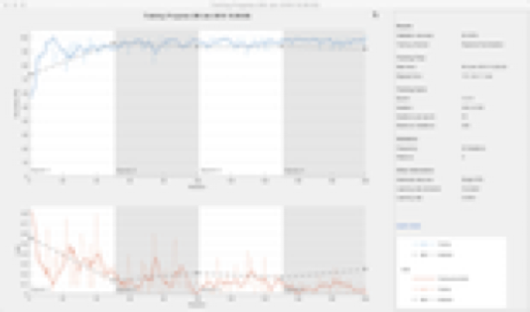
Training a neural network
Inputs:
the training set (set of images)
the network architecture (an array of layers)
the options that include hyper-parameters:
options = trainingOptions('sgdm',...
'MiniBatchSize',32,...
'MaxEpochs',4,...
'InitialLearnRate',1e-4,...
'VerboseFrequency',1,...
'Plots','training-progress',...
'ValidationData',validateImages,...
'ValidationFrequency',numIterationsPerEpoch);
Output: a trained network (with learned weights)
Notes:
Dave

Slide 31
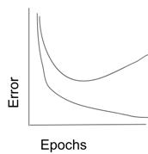
Training a neural network
Why do we split our data into 3 sets?
We learn something from each one!
Alternative do k-fold cross-validation on training+validation set.
Train
Validation
Test
Notes:
Dave

Slide 32
Building a CNN

Slide 33
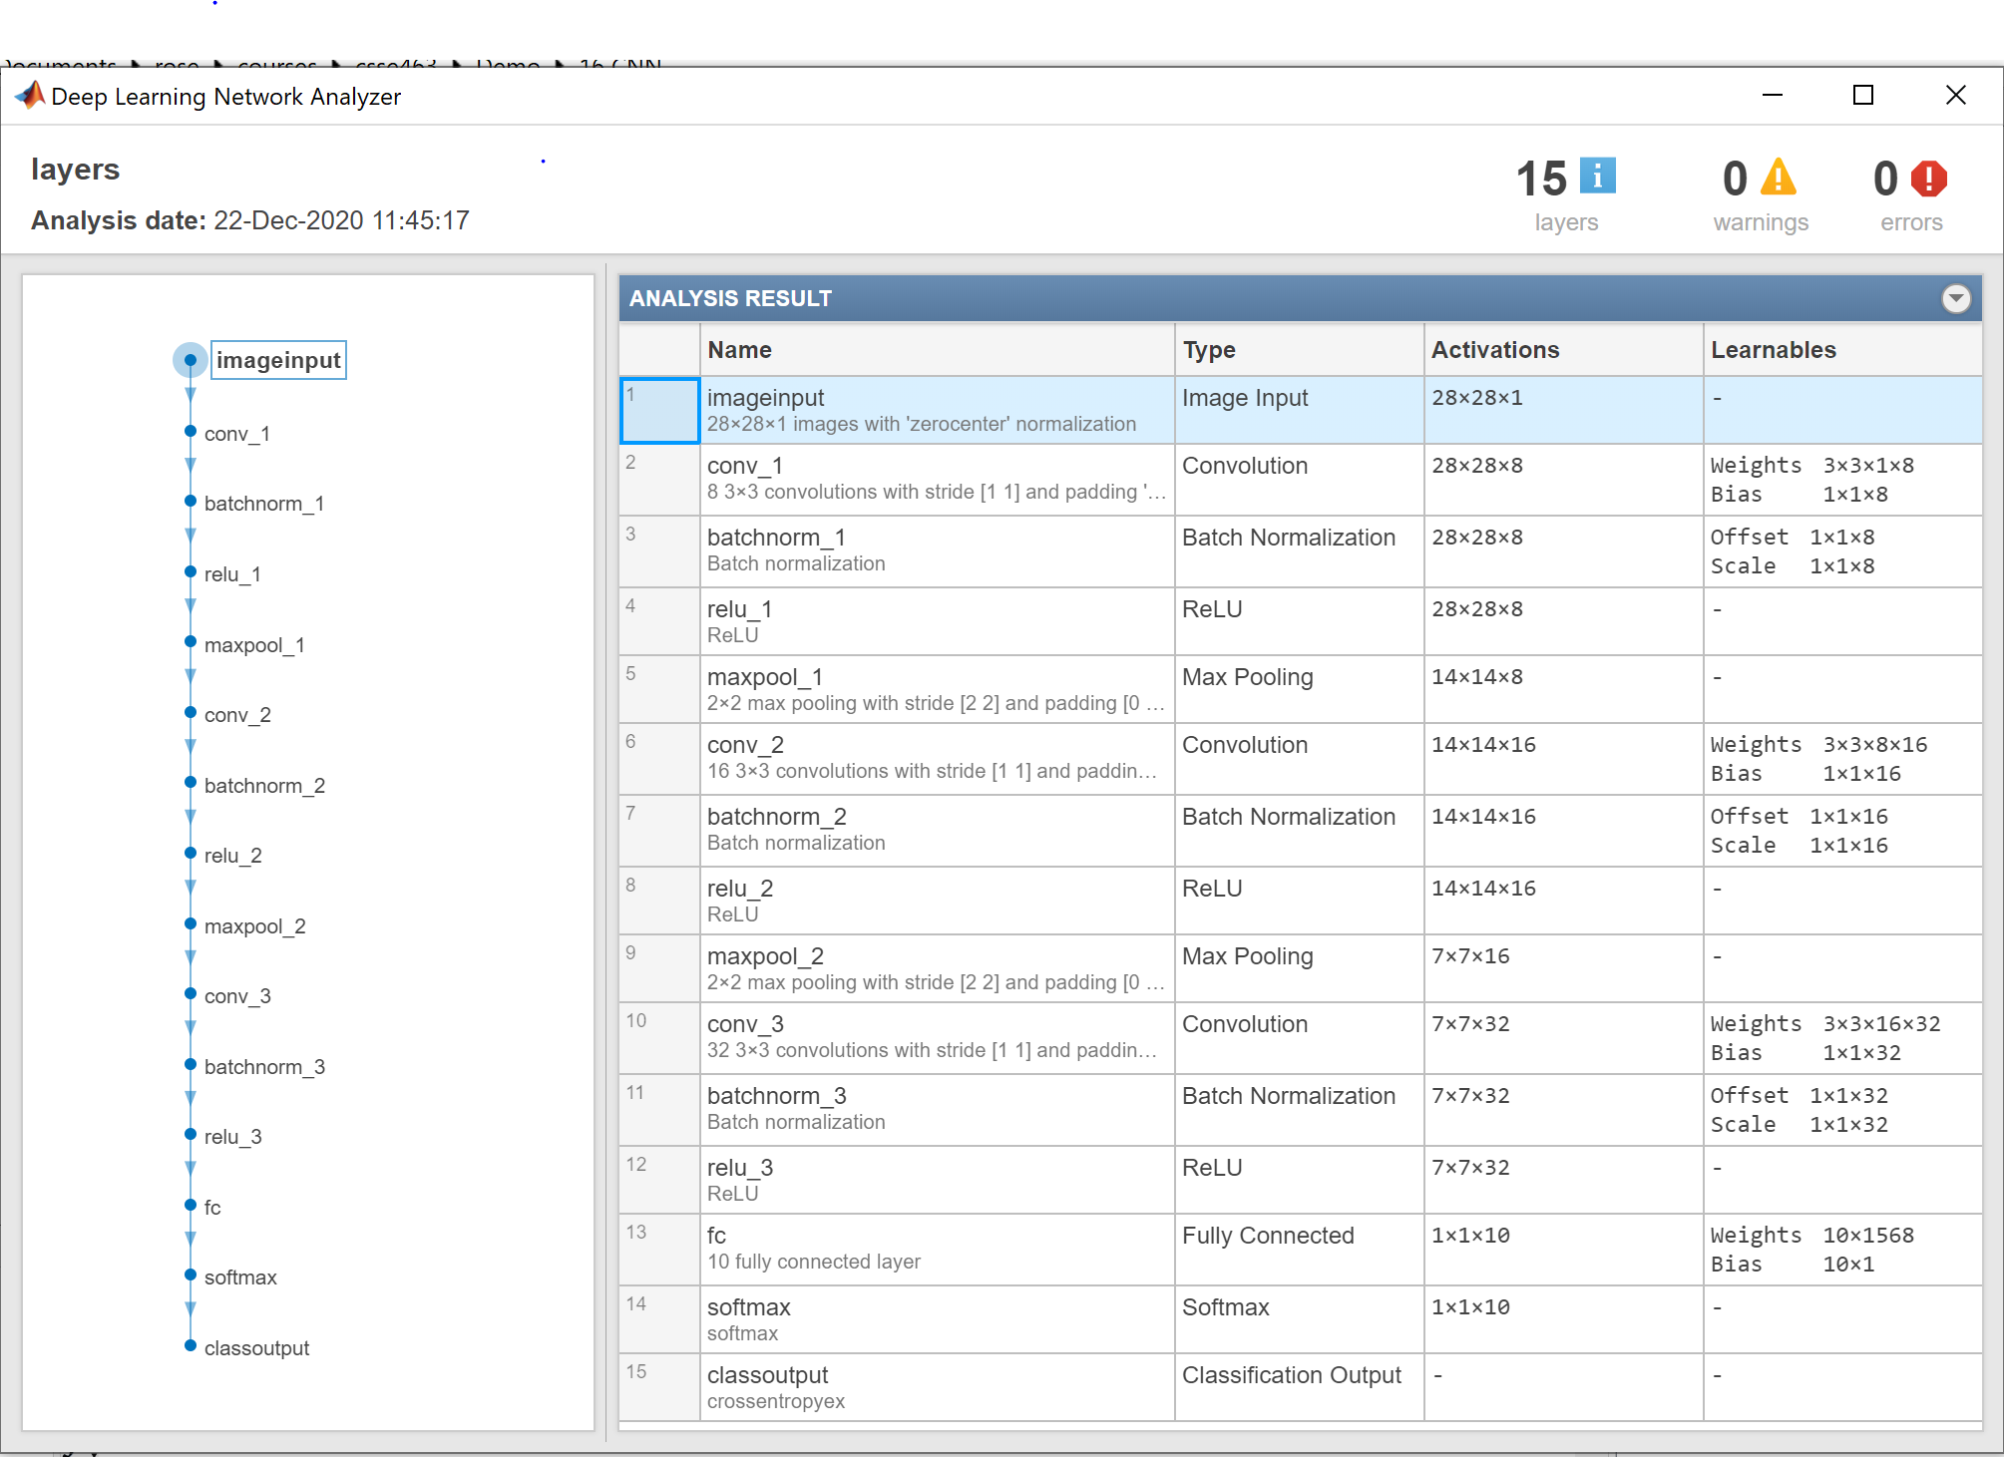
Building a CNN from Layers
Different languages allow you to do this.
You can build one in MATLAB
Uses Layer objects.
Learn from examples:
https://www.mathworks.com/help/deeplearning/ug/create-simple-deep-learning-network-for-classification.html
Do you have enough data to train it?
That tiny net has > 6000 weights
analyzeNetwork(layers)
AlexNet has 61M weights.
Notes:
Dave

Slide 34
Importing a CNN
Different languages allow you to do this.
You can import one from another package like Keras/Tensorflow or PyTorch.
Still: do you have enough data to train it?
Notes:
Dave

Slide 35
Transfer Learning: Leveraging pre-trained networks

Slide 36
Limitations of CNNs
Deep learning can be a black box - the learned weights are often not intuitive
They require LOTS of training data.
Need many, many (millions) images to get good accuracy when training from scratch
Notes:
Dave

Slide 37
Overcoming limitations: transfer learning
Some researchers have released their trained networks.
AlexNet, GoogleNet, ResNet-x, or VGG-19.
Why would we do this? # images, speed, accuracy.
Can you use them directly?
Transfer: Can you swap out and re-train only the classification layers for your problem?
  If the filters learned in the early, convolutional layers are decent, why take the time to re-train them from scratch?
Notes:
Dave

Slide 38
Leveraging pre-trained networks: Feature extraction

Slide 39
Overcoming limitations: feature extraction
Can you run the feature extraction part only and save the activations as features?
  Example: replace the 294 LST features with 4096 AlexNet features? Why not use an SVM?
Last resort: start from scratch?
Notes:
Dave

Slide 40
Lab intro and applications to signal processing

Slide 41
Next lab
The options of {pre-trained net, transfer-learning,
feature-extraction, or your-own-net} are the basis for the next lab and the sunset detector
MATLAB docs

Slide 42
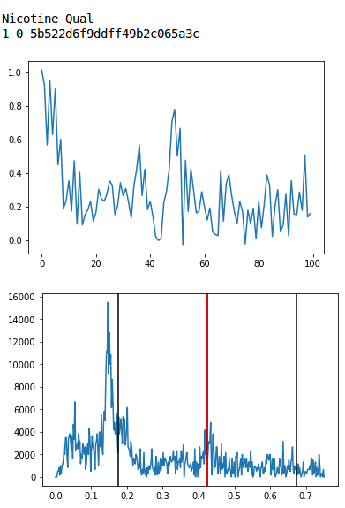
CNNs aren't just for images:
They can classify 1D signals, like chromatograms, as well.
0.00 Hi No-peak
0.17 No-peak
0.83 Small-peak
0.00 Peak
Each box is a matrix of weights or intermediate values (of neurons)
Notes:
(5 min) Architecture: Conv net, will discuss filter banks, nonlinear activation, max-pooling, classification, and that learned filters are . [The most purely-ML technical part of the talk, so I'll want to dwell here longest, relating it to successful use of ConvNets in image recognition] Filter banks learn things like smoothing, 1D, 2D.

Slide 43
Note: CNNs can classify 1D signals, like chromatograms, as well.
768
100x1
100x16
30
50x16
25x32
4
12x64
0.00 Hi No-peak
0.17 No-peak
0.83 Small-peak
0.00 Peak
Boutell and Julian, MSACL 2019
Softmax
Convolution: learn (3x1) filters x16, ReLU (nonlinear)
Max-pool
Conv (3x16)x32,
ReLU, MP
Conv (3x32)x64,
ReLU, MP
Flatten
Fully-connected
Extract Features
Classify
Notes:
(5 min) Architecture: Conv net, will discuss filter banks, nonlinear activation, max-pooling, classification, and that learned filters are . [The most purely-ML technical part of the talk, so I'll want to dwell here longest, relating it to successful use of ConvNets in image recognition] Filter banks learn things like smoothing, 1D, 2D.

Slide 44
CNNs have been applied to other domains as well
Speech recognition
Music generation
But other network architectures have been developed to handle time-series data of variable length, like language models:
Recurrent nets, LSTM, transformers (like ChatGPT)

Slide 45
Visualizations of convolutional neural networks

Slide 46
Visualizations
Activations
Filters (sort of)
Grad-CAM

Slide 47
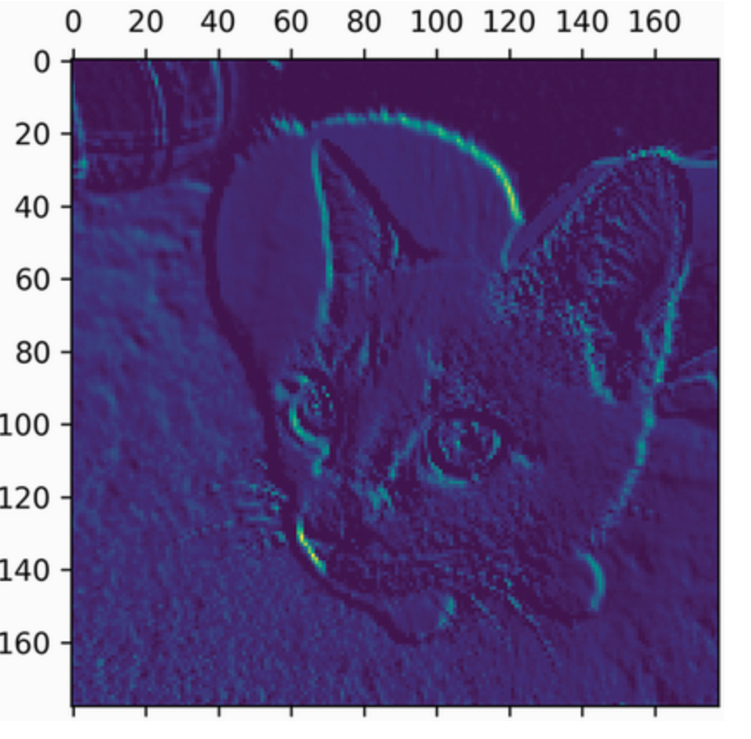
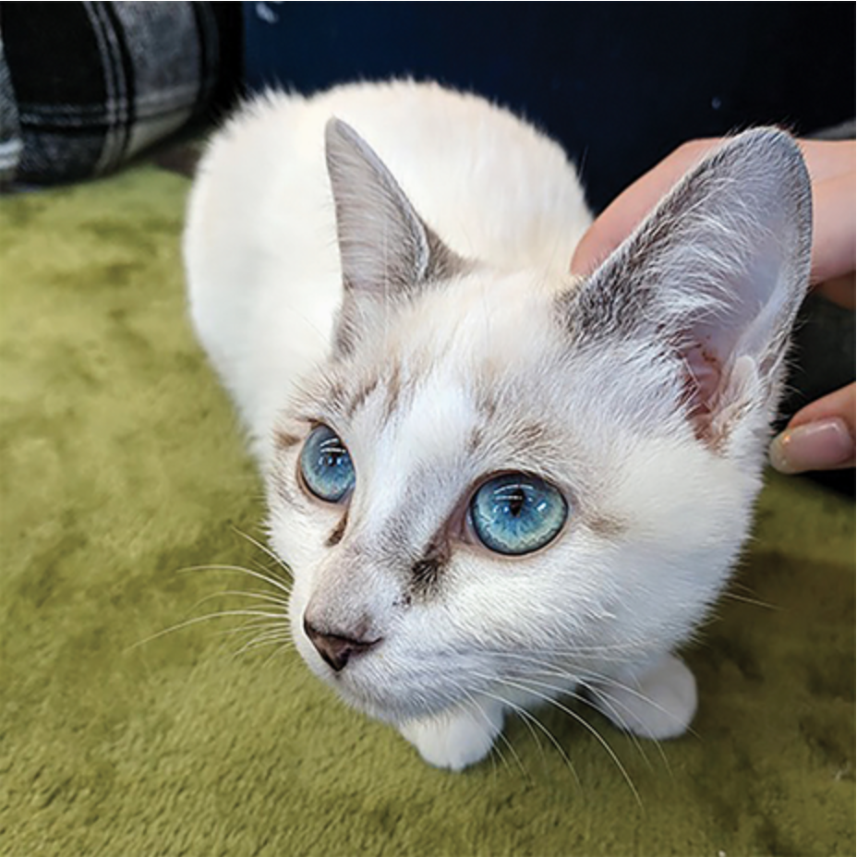
The activations of a filter are just another image
Here is one channel of the first-layer activations:
More activations:
https://debuggercafe.com/visualizing-filters-and-feature-maps-in-convolutional-neural-networks-using-pytorch/
Francois Chollet, Deep Learning with Python,
https://learning.oreilly.com/library/view/deep-learning-with/9781617296864/Text/09.xhtml#heading_id_13

Slide 48
We visualize the filters of a network by showing which images are maximally activated by them
Next section generated by code modified from this repo https://colab.research.google.com/github/fchollet/deep-learning-with-python-notebooks/blob/master/chapter09_part03_interpreting-what-convnets-learn.ipynb
Provided by Francois Chollet, Deep Learning with Python,
https://learning.oreilly.com/library/view/deep-learning-with/9781617296864/Text/09.xhtml#heading_id_13

Slide 49
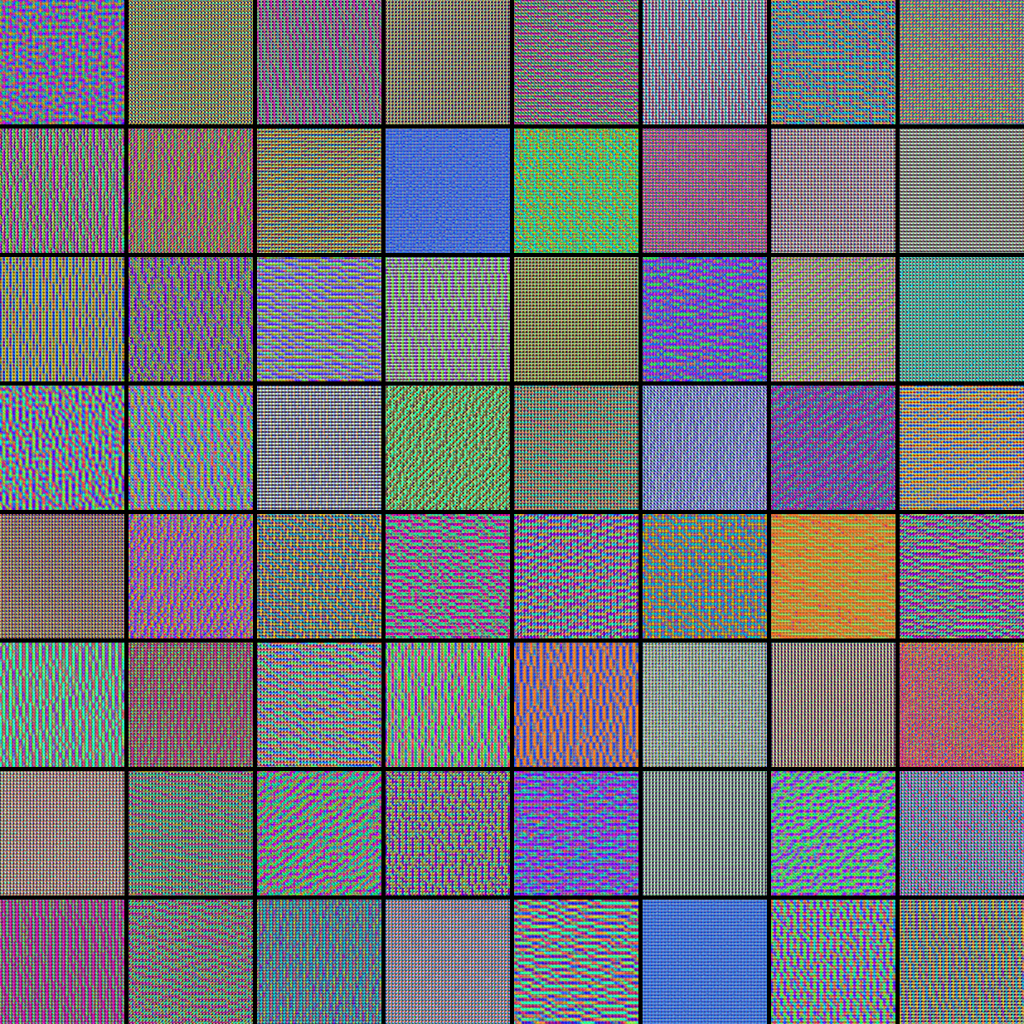
Xception
Conv layer 3 (of 40)
Oriented opponent color edges

Slide 50
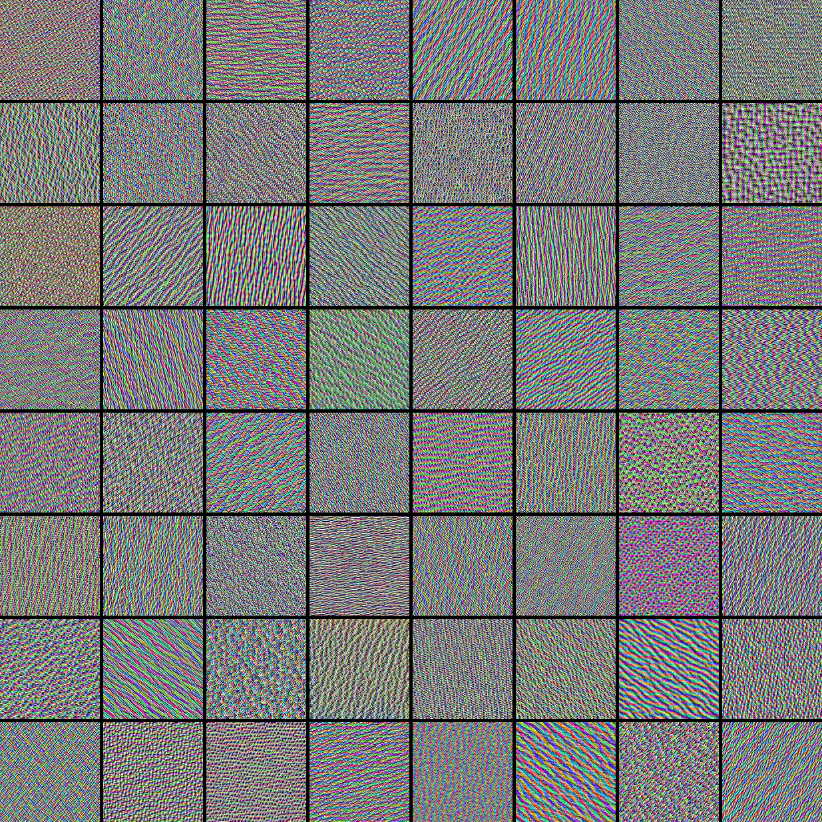
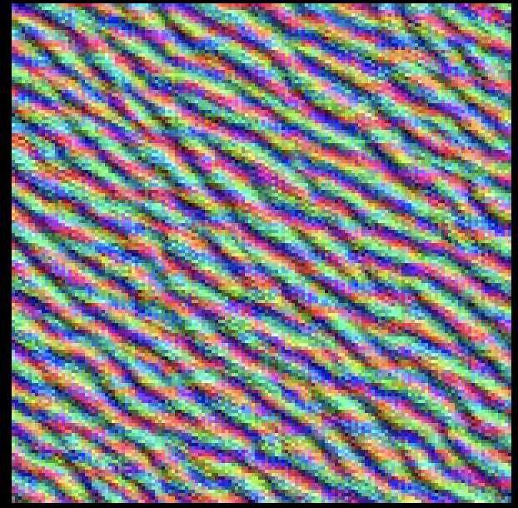
Xception
Conv layer 6 (of 40)
Textures

Slide 51
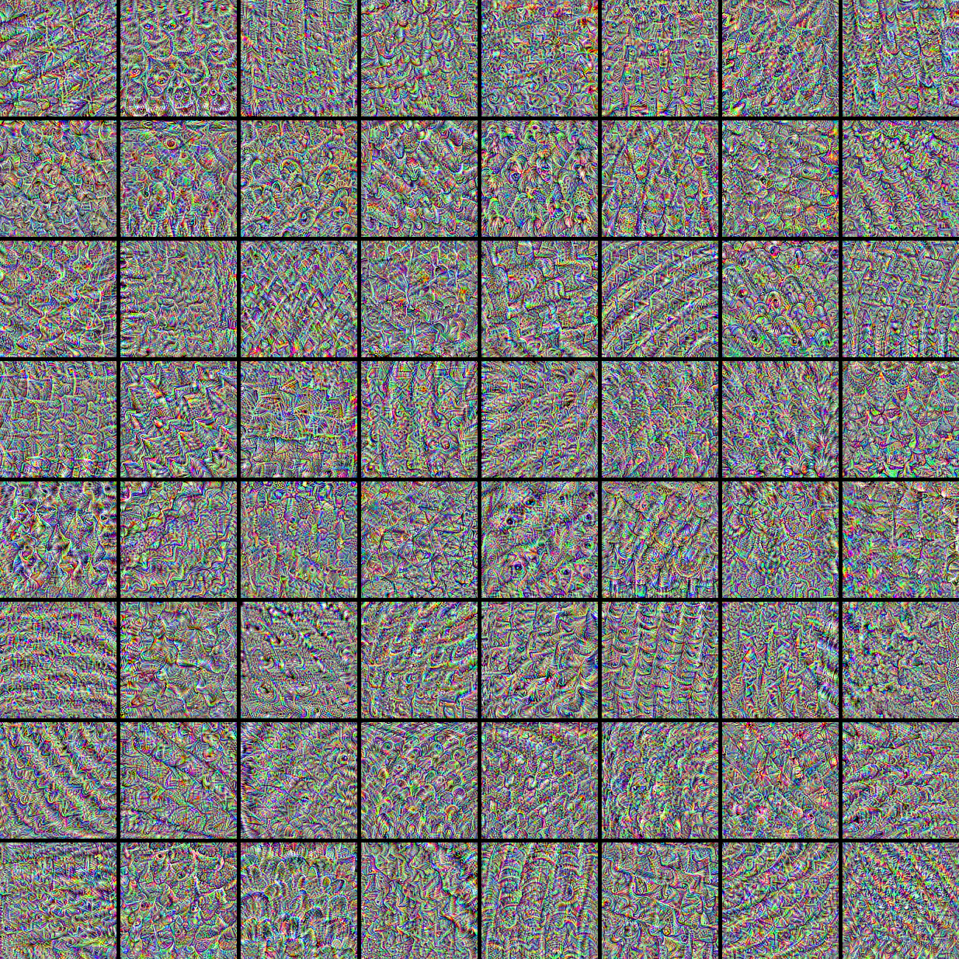
Xception
Conv layer 21 (of 40)
Larger, abstract structures

Slide 52
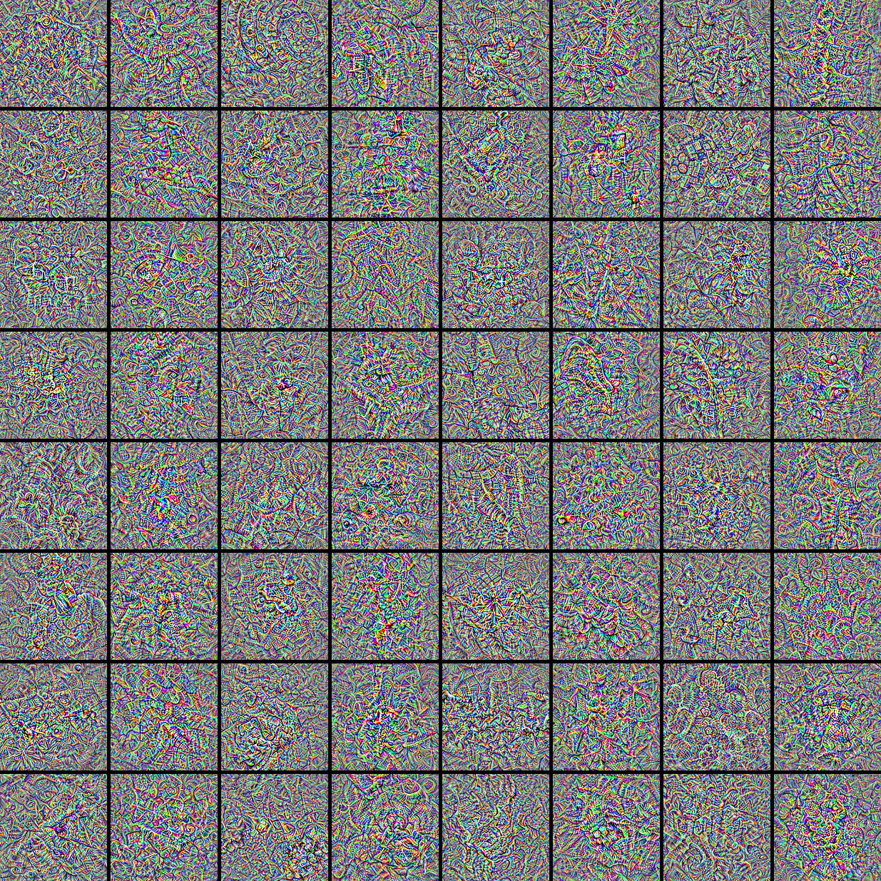
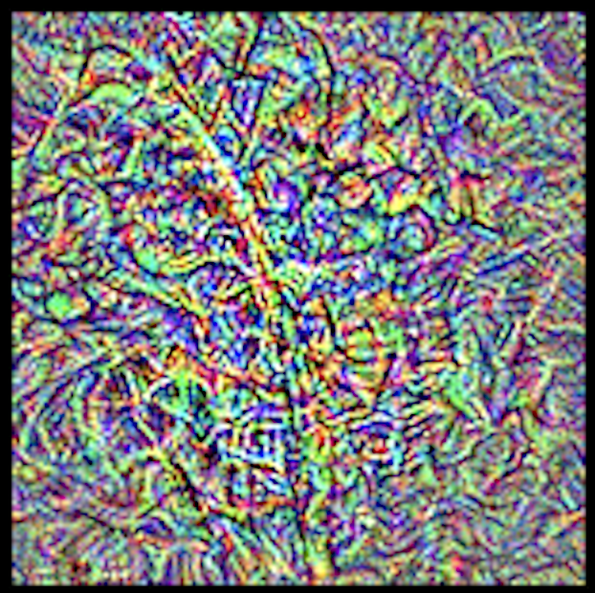
Xception
Conv layer 40 (of 40)

Slide 53
Grad-CAM
How much do various parts of an input image activate a class?
We can break this down into 2 parts:
- how much do various parts of the image activate various channels in a layer?
- how much do those channels activate a class?
Combine by taking a weighted sum
https://arxiv.org/abs/1610.02391

Slide 54
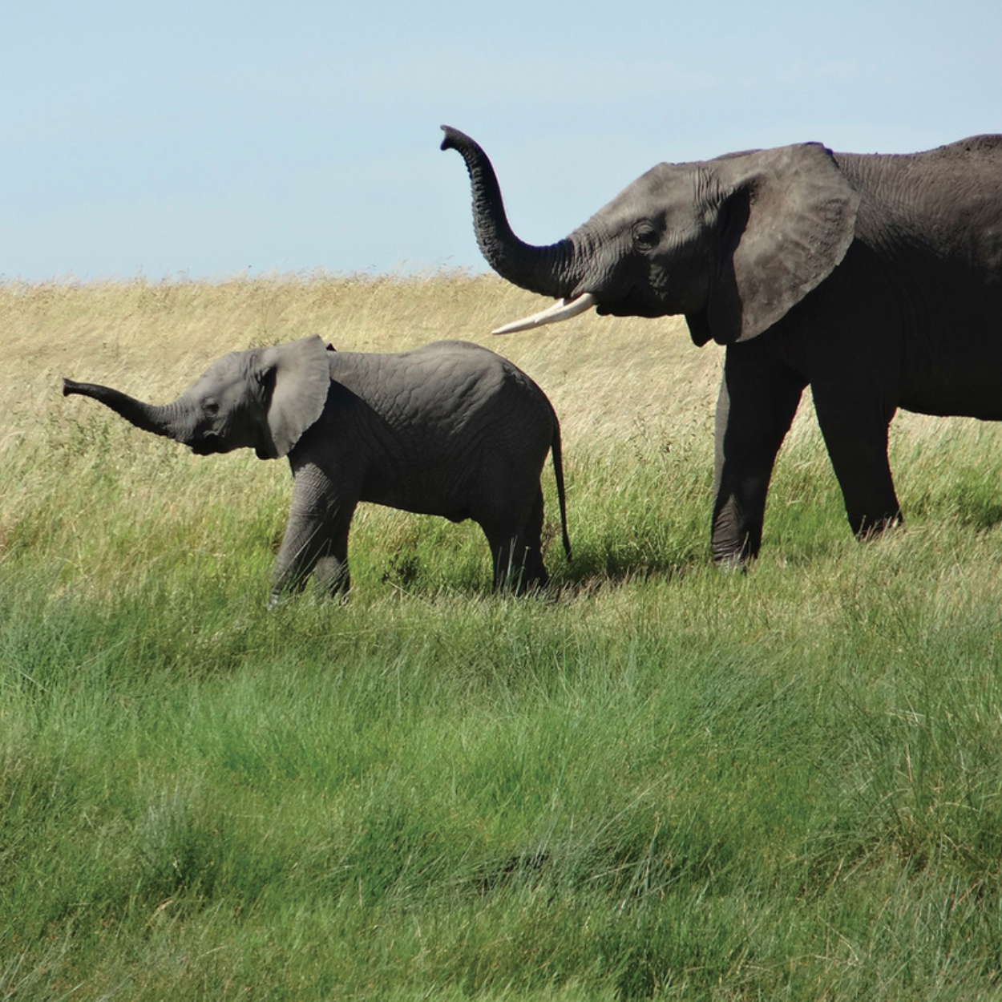
Example of Grad CAM
What parts of this image caused this photo to be recognized as an elephant? Why does this matter?
Francois Chollet, Deep Learning with Python,
https://learning.oreilly.com/library/view/deep-learning-with/9781617296864/Text/09.xhtml#heading_id_13

Slide 55
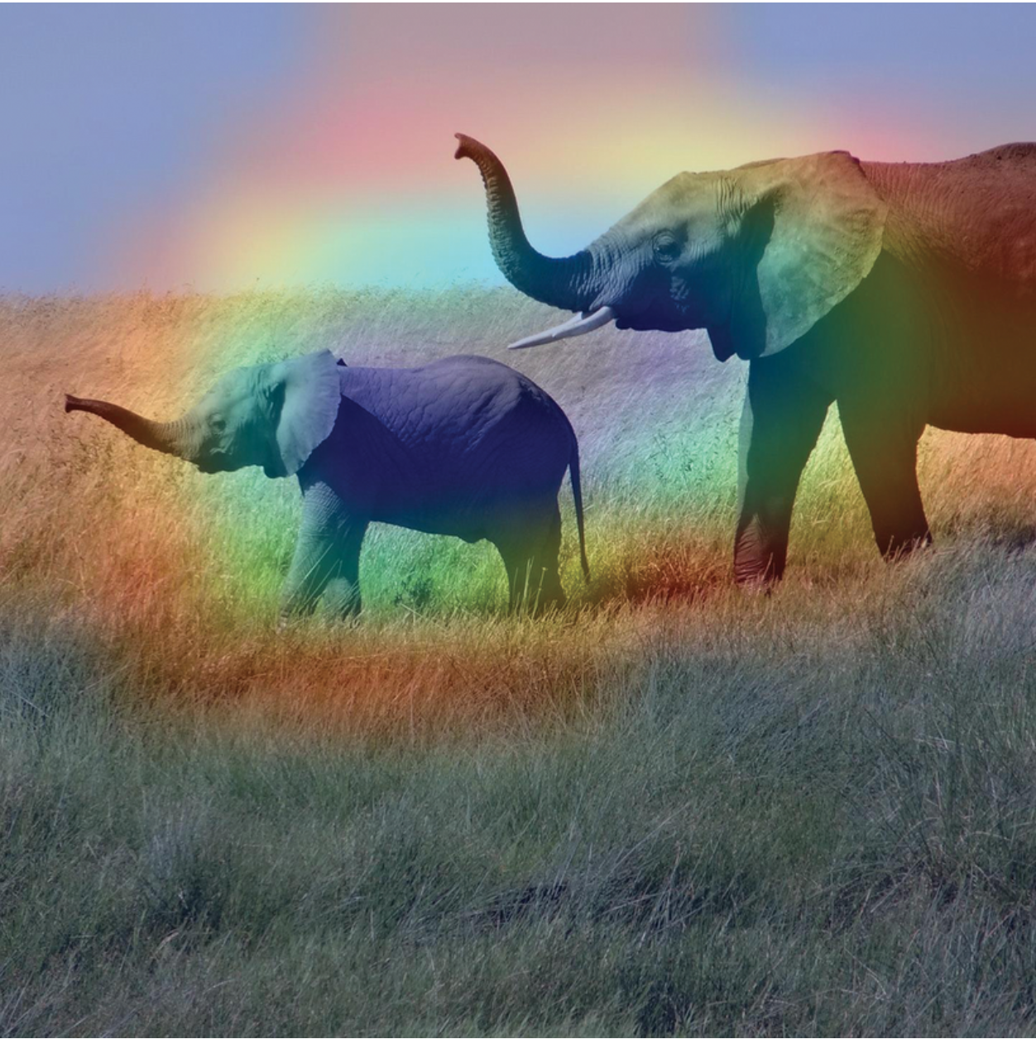
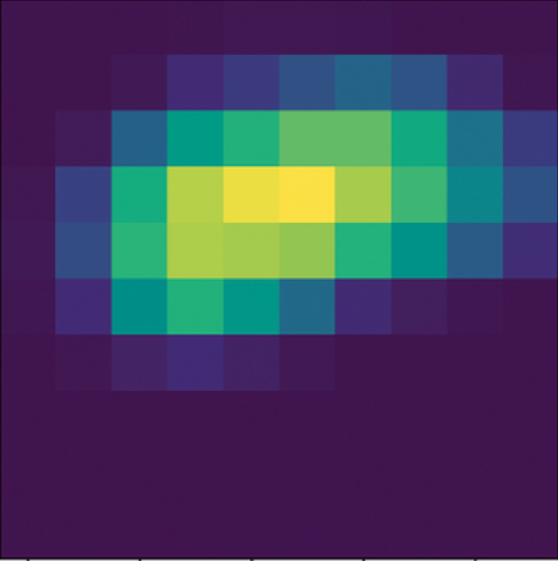
Example of Grad CAM
Heat map and result
Francois Chollet, Deep Learning with Python,
https://learning.oreilly.com/library/view/deep-learning-with/9781617296864/Text/09.xhtml#heading_id_13

Slide 56
Network architectures for image rec tasks

Slide 57
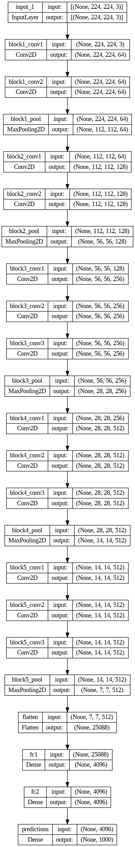
So far: whole scene classification
{Convolution/ReLU/pooling}*,
then dense and softmax layers.
Examples: LeNet, AlexNet,
VGG16, VGG19 nets
[Visual Geometry Group at Oxford]
VGG16 (total and blocks 1-2) to right:
13 convolutions in 4 blocks.
LeNet vs AlexNet: https://en.wikipedia.org/wiki/Convolutional_neural_network

Slide 58
Newer networks use regularization layers too
Reminder: One way to prevent overfitting is to stop training when validation accuracy increases (after some patience to account for noise).
Other ways are more explicit:
Dropout
Batch-normalization
Notes:
Dave

Slide 59
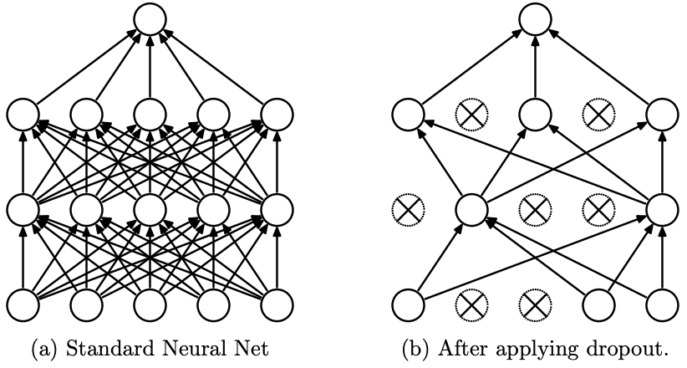
Dropout randomly sets activations to 0.
The Dropout layer randomly sets a neuron’s output to 0 with a frequency of p at each step during training time. All neurons are used at test time.
The idea is that neurons can rely too much on a neighboring neuron’s output during training and removing it temporarily breaks this.
In practice, we only need drop out on dense layers, not conv layers.
https://jmlr.org/papers/volume15/srivastava14a/srivastava14a.pdf
Notes:
Dave

Slide 60
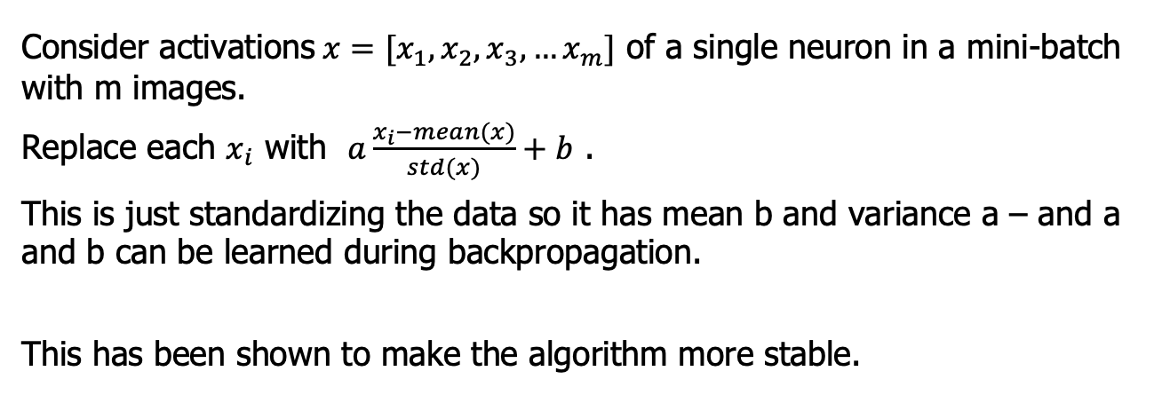
Batch normalization averages activations across a batch
Consider activations$x=[x_{1},x_{2},x_{3}, …x_{m}]$ of a single neuron in a mini-batch with m images.
Replace each $x_{i}$ with $a\frac{x_{i}−mean(x)}{std(x)}+b$ .
This is just standardizing the data so it has mean b and variance a – and a and b can be learned during backpropagation.
This has been shown to make the algorithm more stable.
https://arxiv.org/abs/1502.03167
Notes:
Dave

Slide 61
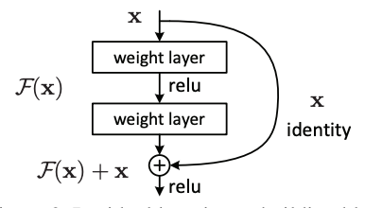
Nets with residual connections help with vanishing gradients
Problem with deeper networks:
the chain rule has many terms, and if many activations close to 0 are multiplied, the product goes to 0.
Solution: add skip connections →
Examples:
ResNet ,
Xception (40 conv layers) →
EfficientNet (B0-B7; scalable)
ResNet https://arxiv.org/abs/1512.03385
EfficientNet https://arxiv.org/abs/1905.11946 referring to
https://paperswithcode.com/method/mnasnet

Slide 62
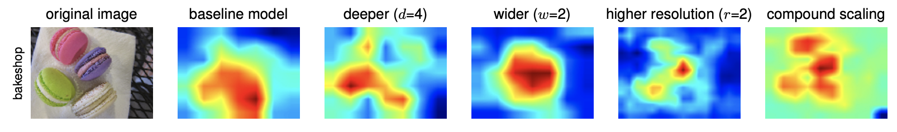
GradCam Example from EfficientNet
EfficientNet https://arxiv.org/abs/1905.11946

Slide 63
Wait, this isn’t a plain sequence any more?
Skip-connections between layers mean the pipeline is no longer a simple sequence, but a graph.
Notes:
Dave

Slide 64
Defining a non-sequential model (one residual connection)
MATLAB: Sequential->(graph)
layers = [
imageInputLayer([28 28 1])
convolution2dLayer(3,16,'Padding',1)
reluLayer('Name', 'relu_1')
maxPooling2dLayer(2,'Stride',2)
convolution2dLayer(3,32,'Padding',1)
reluLayer
additionLayer(2,'Name','add')
fullyConnectedLayer(10)
softmaxLayer
classificationLayer
];
lgraph = layerGraph(layers);
skipConv = convolution2dLayer(
1,32,'Stride',2,'Name','skipConv’);
lgraph = addLayers(lgraph,skipConv);
lgraph = connectLayers(lgraph,'relu_1','skipConv’);
lgraph = connectLayers(lgraph,'skipConv','add/in2’);
https://www.mathworks.com/help/deeplearning/ref/nnet.cnn.layergraph.html
Keras: Sequential->Functional API
def define_model():
# From Deep Learning with Python, ch 8.1.2
# Dimensions are for MNIST digit recognition: 28x28 greayscale inputs, 10 outputs (digits 0-9)
inputs = keras.Input(shape=(28, 28, 1))
x = layers.Conv2D(filters=32, kernel_size=3, activation="relu")(inputs)
mp = layers.MaxPooling2D(pool_size=2)(x)
x = layers.Conv2D(filters=64, kernel_size=3, activation="relu")(mp)
x = layers.MaxPooling2D(pool_size=2)(x)
x = layers.Conv2D(filters=128, kernel_size=3, activation="relu")(x)
x = layers.MaxPooling2D(pool_size=2)(x)
x = layers.Add()([x,mp])
x = layers.Flatten()(x)
outputs = layers.Dense(10, activation="softmax")(x)
model = keras.Model(inputs=inputs, outputs=outputs)
opt = SGD(learning_rate=0.01, momentum=0.9)
model.compile(optimizer=opt, loss='categorical_crossentropy', metrics=['accuracy’])
return model
https://stackoverflow.com/questions/64792460/how-to-code-a-residual-block-using-two-layers-of-a-basic-cnn-algorithm-built-wit
Notes:
Dave

Slide 65
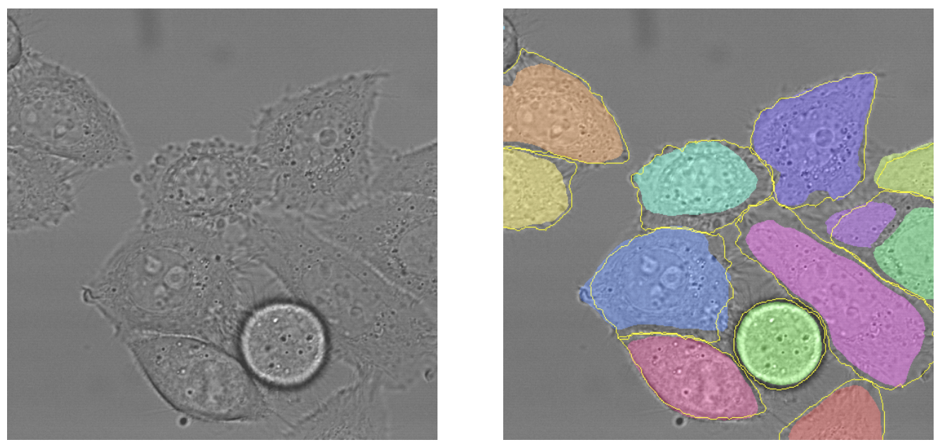
Consider a different problem: classifying each image pixel
Segmented HeLa Cells: colors are predicted regions (yellow borders are truth)
Known as semantic segmentation. You did on fruit finder! Labels = {apple, orange, banana, none}.
HeLa = human cell line from Henrietta Lacks
U-net: https://arxiv.org/pdf/1505.04597.pdf

Slide 66
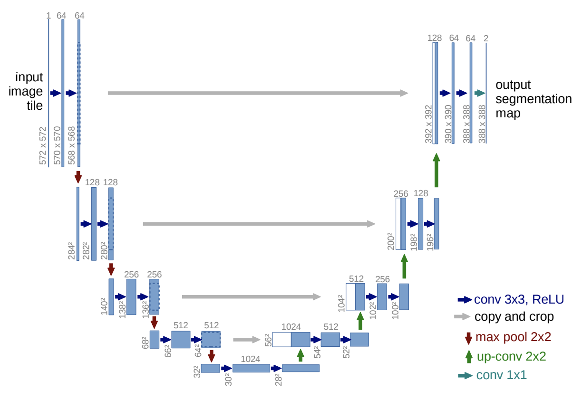
To classify each pixel, output size = input size = an image!
Example: U-Net.
What is the up-conv 2x2?
U-net: https://arxiv.org/pdf/1505.04597.pdf

Slide 67
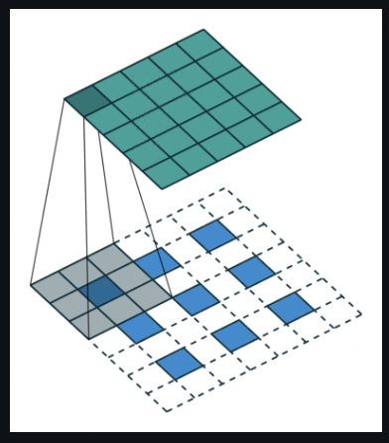
Upconv is convolution applied with spaced input
Key: up-conv (or “transposed
convolution”) to upsample blue = input, cyan = output →
See github link below for animations
Improved versions use 2x2 strides (instead max-pooling) in regular conv layers. (Taking top left of every 2x2 block works better for this kind of problem.)
Paper (https://arxiv.org/pdf/1603.07285v1.pdf ) with
animations (https://github.com/vdumoulin/conv_arithmetic )
Slides (https://cs.nyu.edu/~fergus/drafts/utexas2.pdf )

Slide 68
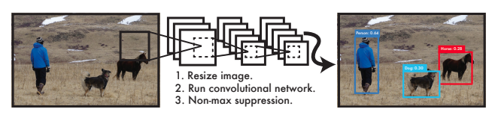
To identify objects, we also want bounding box location
Want to locate them with bounding boxes and give the class of each one
Location is numbers (__, __, __, __).
So not a classification problem, but ______________
It’s almost a classification net: just a different final layer
(no softmax)

Slide 69
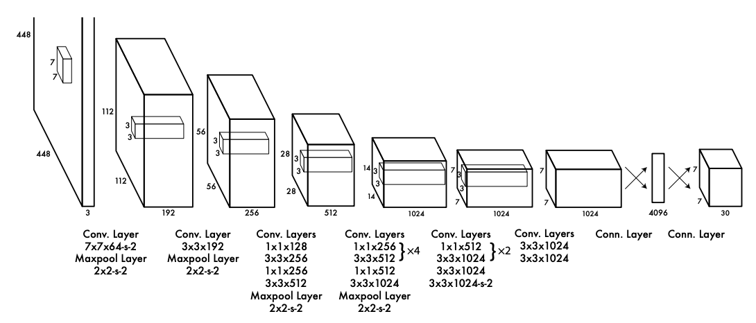
YOLO (2016) maps images to bounding boxes
Input: an image
24 convolutional layers
Output: 1470 values (7x7 grid x {2 bounding boxes / grid, each with 5 parameters (x,y,w,h,conf), plus a 20 class probability map)
Since outputs are real-valued (and not simply labels), it is formulated as a regression problem.
https://arxiv.org/abs/1506.02640
Notes:
https://arxiv.org/abs/1311.2524

Slide 70
Variational auto-encoders learn image structure
Train a U-net-like architecture, but:
Auto-encoder: feed it the same image as input and output. Goal: learn a lower-dimension representation (latent space) of the image.
Variational: If we tweak how we train the net, we can enforce the latest space to be continuous.
(Show arch and output)

Slide 71
To learn more general relationships, use attention
Won’t discuss here, but this is a big part of the Transformer architectures used in language models like ChatGPT
Instead of a fixed size of relationships (from square filters), we can weight which distance/direction relationships are most important at different scales.

Slide 72
MATLAB has pre-trained versions of many architectures
Which ones are in MATLAB?
Classification: alexnet, vgg16, resnet50, …
Segmentation: Deeplabv3plus, U-net tutorial
YOLO: darknet53-coco, …
https://github.com/matlab-deep-learning/MATLAB-Deep-Learning-Model-Hub
https://www.mathworks.com/help/deeplearning/ug/pretrained-convolutional-neural-networks.html
Others: Search for or use Keras (python)

