Slide 1
Shallow Neural Networks
Image Recognition
Matt Boutell
Notes:
Both

Slide 2
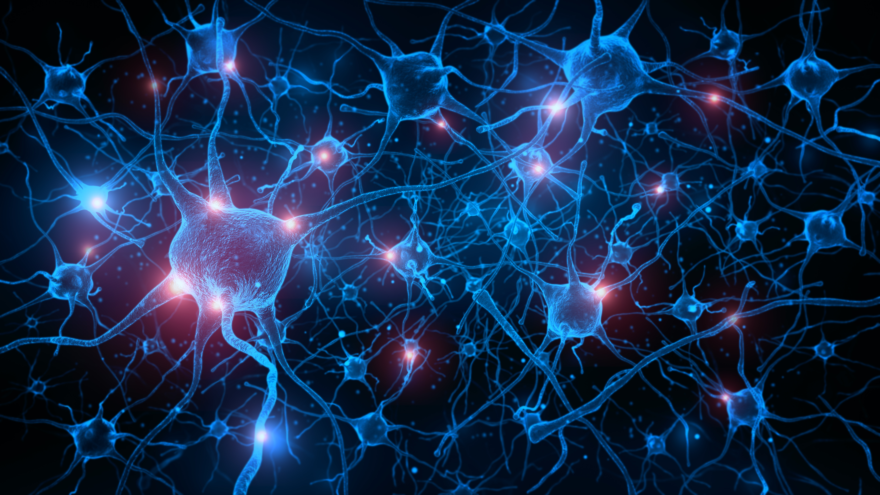
Neural networks are biologically inspired
Simple individual units
… with power in their connections
cell
…
Following ch 9 of http://faculty.marshall.usc.edu/gareth-james/ISL/ISLR%20Seventh%20Printing.pdf

Slide 3
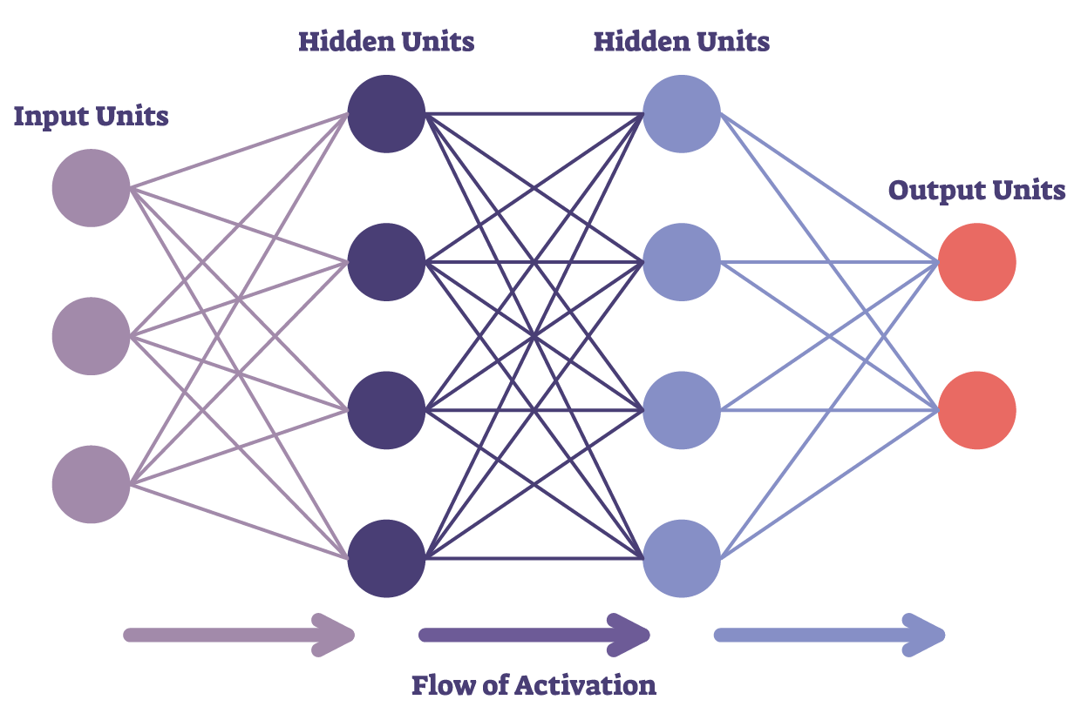
We'll study one type of neural network in this unit: multilayer feedforward networks.
The architecture is fixed but connection weights are learned.
In a later unit, we'll generalize to CNNs, a type of "deep" network.

Slide 4
Perceptrons

Slide 5
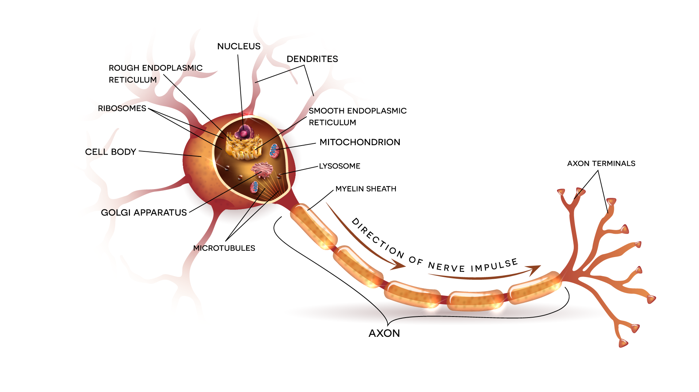
Perceptrons are the building blocks of neural networks

Slide 6
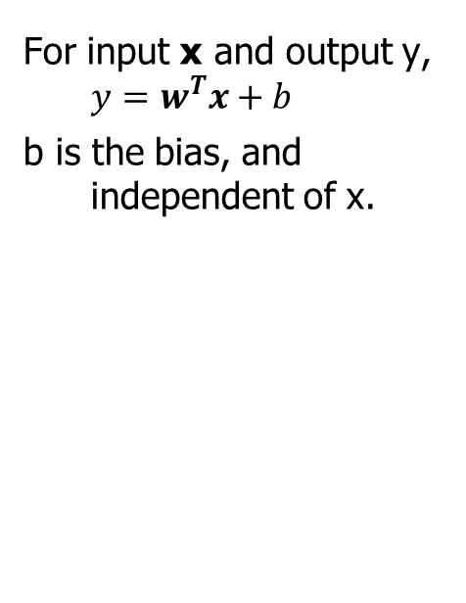
The perceptron is a computational model of a linear combination of inputs
For input x and output y, $y=w^{T}x+b$
b is the bias, and independent of x.
b
x₁
w₁
x₂
w₂
cell
y
…
w_{d}
x_{d}

Slide 7
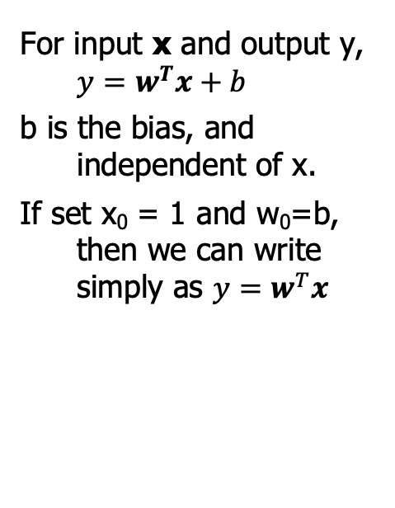
The perceptron is a computational model of a linear combination of inputs
For input x and output y, $y=w^{T}x+b$
b is the bias, and independent of x.
If set x₀ = 1 and w₀=b, then we can write simply as $y=w^{T}x$
x₀=1
x₁
w₁
w₀
x₂
w₂
cell
y
…
w_{d}
x_{d}

Slide 8
Nonlinear transfer functions

Slide 9
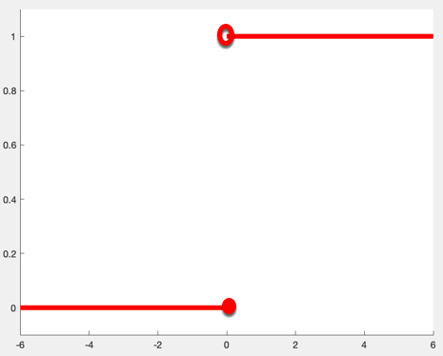
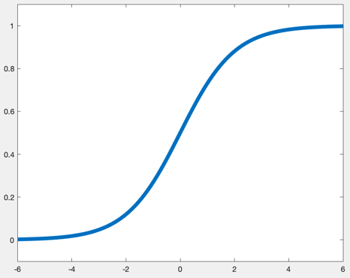
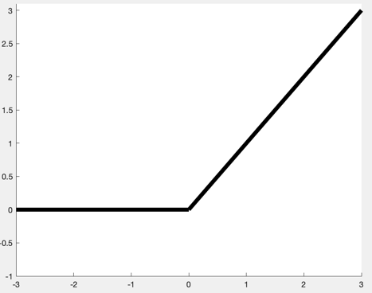
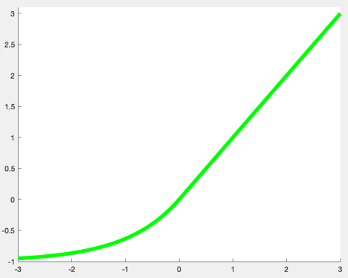
A neural network is a collection of perceptrons. If they are connected directly, the network collapses.
We'll demonstrate with a specific, tiny network.
The logic generalizes to arbitrary numbers of layers and numbers of neurons in each layer.
Solution: add nonlinear "transfer functions" between neurons: step sigmoid ReLU ELU

Slide 10
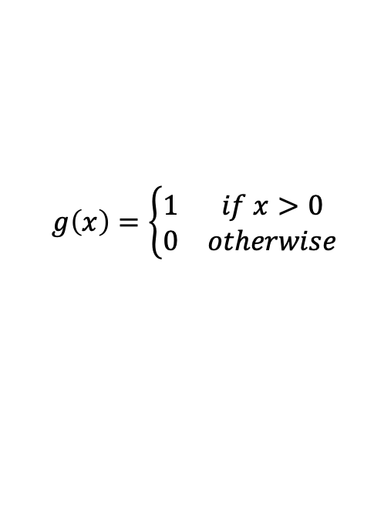
Simplest transfer function: a step function to threshold the output
$$g\left(x\right)=\left\{\begin{matrix}1 & if x>0 \\ 0 & otherwise\end{matrix}\right.$$

Slide 11
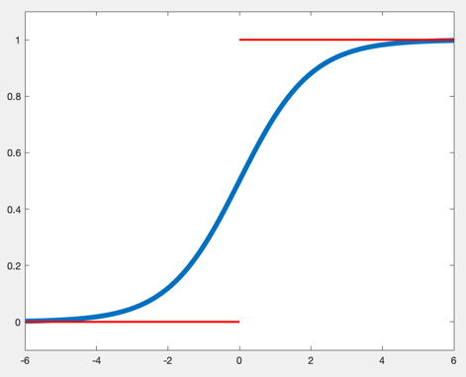
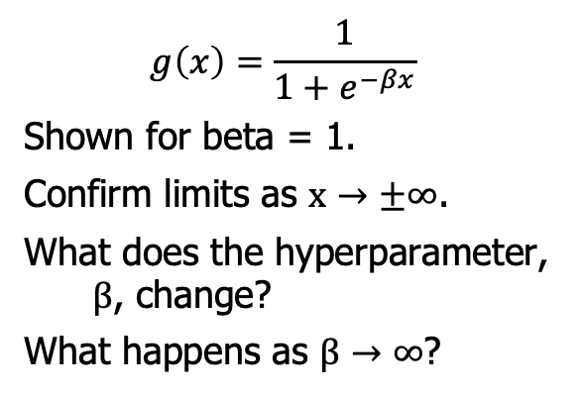
Related transfer function: sigmoid
$$g\left(x\right)=\frac{1}{1+e^{−βx}}$$
Shown for beta = 1.
Confirm limits as $x→±∞$.
What does the hyperparameter, $β$, change?
What happens as $β→∞$?

Slide 12
Examples: Logic gates

Slide 13
Example: Modeling logic gates with perceptrons
We’ll do OR together.
Inputs: x₁ = {0,1}, x₂ = {0,1}
We need to pick weights w_{i} and x₀ and g(x) such that it outputs 0 or 1 appropriately
Quiz: You do AND, NOT, and XOR.
Note that a single perceptron is limited in what it can classify. What is the limitation?

Slide 14
Solutions for AND, NOT, and XOR
Key points: AND is like OR
NOT uses only one variable.
XOR can't be modeled using a single perceptron since the decision boundary is nonlinear. We need a neural network.

Slide 15
Learning a perceptron's weights

Slide 16
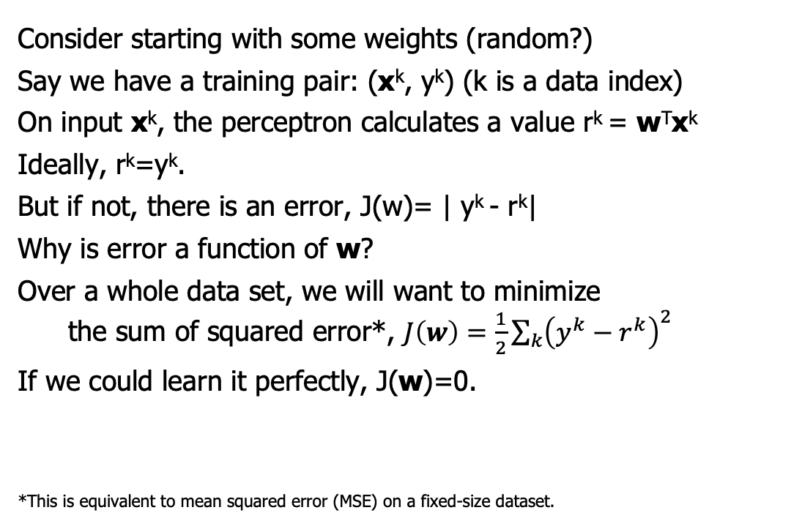
What if a perceptron doesn't calculate what it should?
Consider starting with some weights (random?)
Say we have a training pair: (x^{k}, y^{k}) (k is a data index)
On input x^{k}, the perceptron calculates a value r^{k} = w^{T}x^{k}
Ideally, r^{k}=y^{k}.
But if not, there is an error, J(w)= | y^{k} - r^{k}|
Why is error a function of w?
Over a whole data set, we will want to minimize
the sum of squared error*, $J\left(w\right)=\frac{1}{2}\sum_{k}{{\left(y^{k}−r^{k}\right)}^{2}}$
If we could learn it perfectly, J(w)=0.
*This is equivalent to mean squared error (MSE) on a fixed-size dataset.

Slide 17
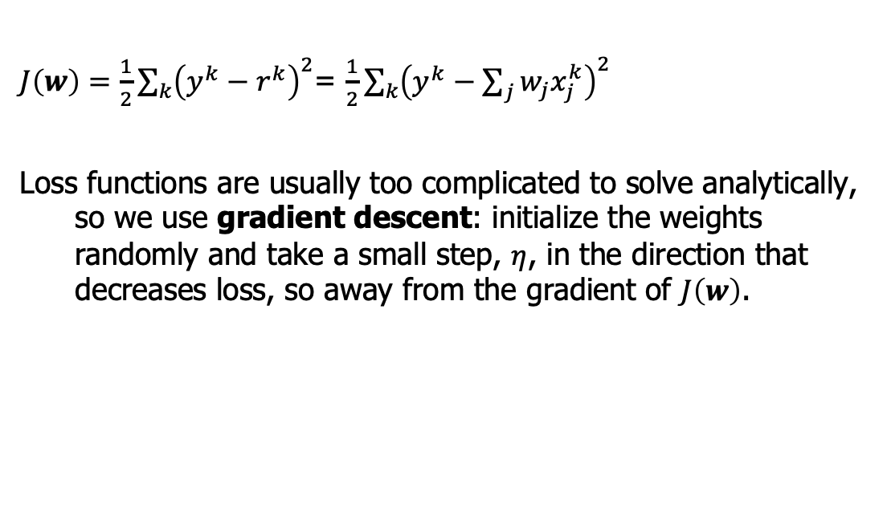
We use calculus to learn a perceptron's weight.
$J\left(w\right)=\frac{1}{2}\sum_{k}{{\left(y^{k}−r^{k}\right)}^{2}}$= $\frac{1}{2}\sum_{k}{{\left(y^{k}−\sum_{j}{w_{j}x_{j}^{k}}\right)}^{2}}$
Loss functions are usually too complicated to solve analytically, so we use gradient descent: initialize the weights randomly and take a small step, $η$, in the direction that decreases loss, so away from the gradient of $J\left(w\right)$.
https://sebastianraschka.com/Articles/2015_singlelayer_neurons.html#the-perceptron-learning-rule
https://stats.stackexchange.com/questions/137834/clarification-about-perceptron-rule-vs-gradient-descent-vs-stochastic-gradient

Slide 18
Gradient Descent is used to find local optima
Let's discuss gradient descent to find the minimum (like of a loss function).
We start at some point w where J’(w) exists.
Take a small step in the direction that makes J smaller. Since the gradient points to positive change, we step in the opposite direction.
Next slides from AJ Piergiovanni, CSSE463 Guest Lecture https://docs.google.com/presentation/d/15Lm6_LTtWnWp1HRPQ6loI3vN55EKNOUi8hOSUypsFw8/

Slide 19
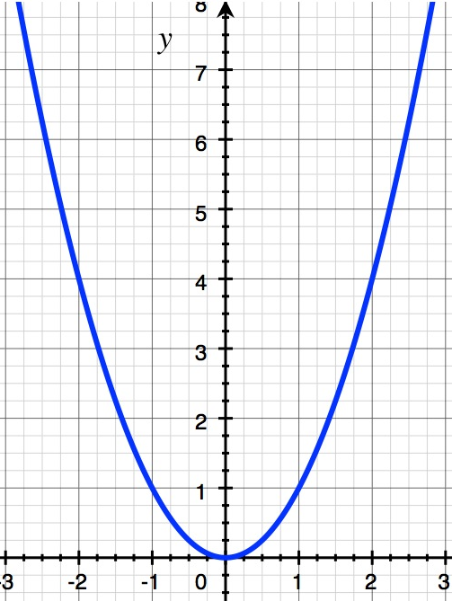
Gradient Descent

Slide 20
Gradient Descent

Slide 21
Gradient Descent

Slide 22
Gradient Descent

Slide 23
Gradient Descent

Slide 24
Gradient Descent

Slide 25
Gradient Descent

Slide 26
Gradient Descent
5

Slide 27
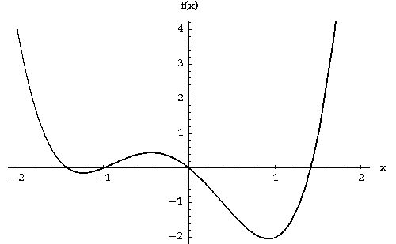
Gradient Descent - Local Min

Slide 28
Gradient Descent - Local Min

Slide 29
Gradient Descent - Local Min

Slide 30
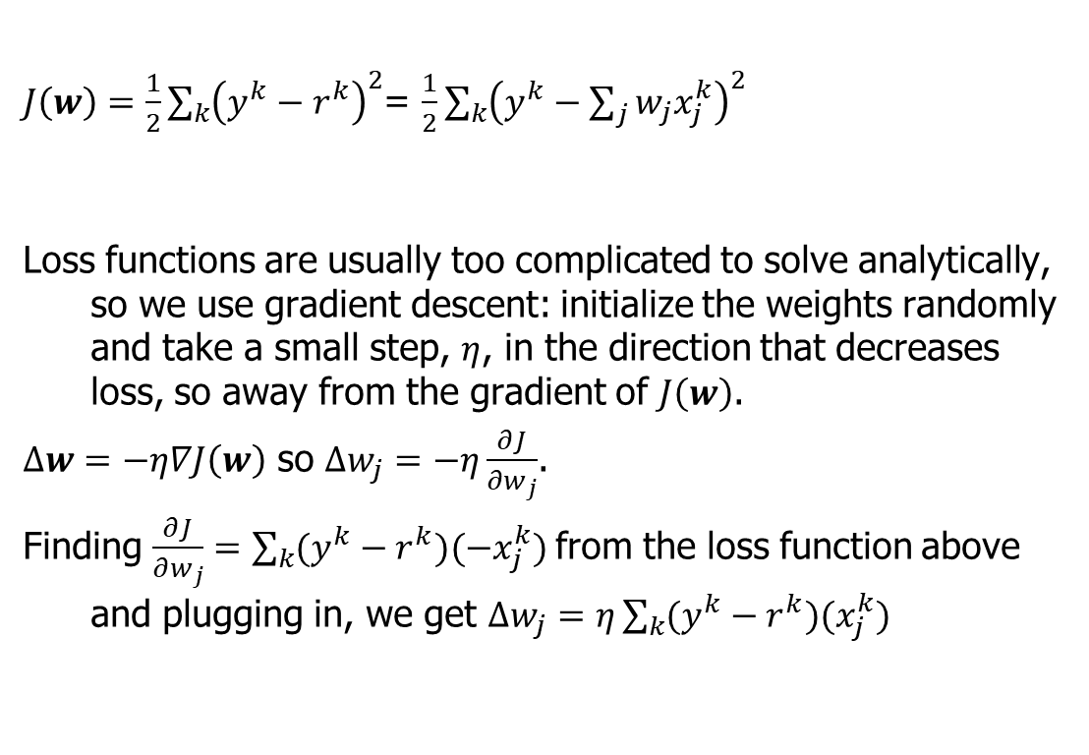
Reminder: We use calculus to learn a perceptron's weight.
$J\left(w\right)=\frac{1}{2}\sum_{k}{{\left(y^{k}−r^{k}\right)}^{2}}$= $\frac{1}{2}\sum_{k}{{\left(y^{k}−\sum_{j}{w_{j}x_{j}^{k}}\right)}^{2}}$
Loss functions are usually too complicated to solve analytically, so we use gradient descent: initialize the weights randomly and take a small step, $η$, in the direction that decreases loss, so away from the gradient of $J\left(w\right)$.
$∆w=−η∇J\left(w\right)$ so $∆w_{j}=−η\frac{∂J}{∂w_{j}}$.
Finding $\frac{∂J}{∂w_{j}}=\sum_{k}{(y^{k}−r^{k})(−x_{j}^{k}})$from the loss function above and plugging in, we get $∆w_{j}=η\sum_{k}{(y^{k}−r^{k})(x_{j}^{k}})$

Slide 31
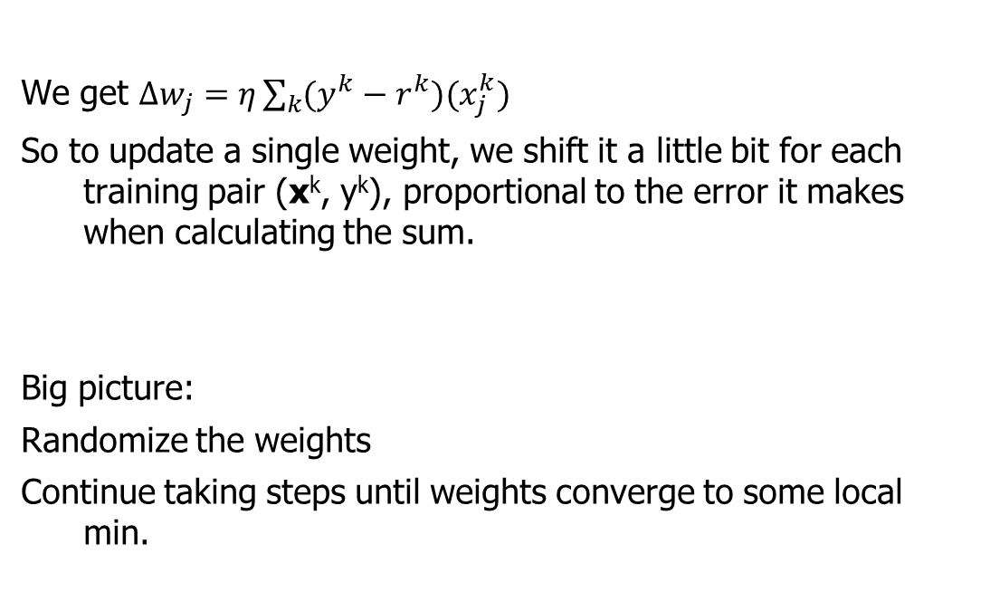
We use calculus to learn a perceptron's weight.
We get $∆w_{j}=η\sum_{k}{(y^{k}−r^{k})(x_{j}^{k}})$
So to update a single weight, we shift it a little bit for each training pair (x^{k}, y^{k}), proportional to the error it makes when calculating the sum.
Big picture:
Randomize the weights
Continue taking steps until weights converge to some local min.

Slide 32
Multilayer feedforward networks

Slide 33
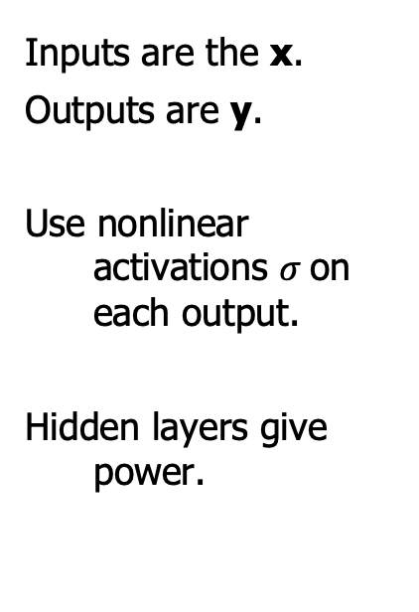
A multilayer feedforward network is composed of layers of perceptrons.
Inputs are the x.
Outputs are y.
Use nonlinear activations $σ$on each output.
Hidden layers give power.

Slide 34
Weights are updated using gradient descent.
The backpropagation algorithm does this efficiently.
Initialize all weights randomly
One Epoch (loop over each labeled example):
Calculate output using current weights
Update weights backwards from output to input
using chain rule and gradient descent
Repeat until max epochs reached or until converge
a. Calculate output (feedforward)
Repeat
b. Update weights (feedback)
Details: http://neuralnetworksanddeeplearning.com/chap2.html

Slide 35


Idea: how much would changing a weight change the output?
Let $z=w^{T}x, a=σ\left(z\right)$
$$w_{21}^{2}$$
Details: http://neuralnetworksanddeeplearning.com/chap2.html

Slide 36
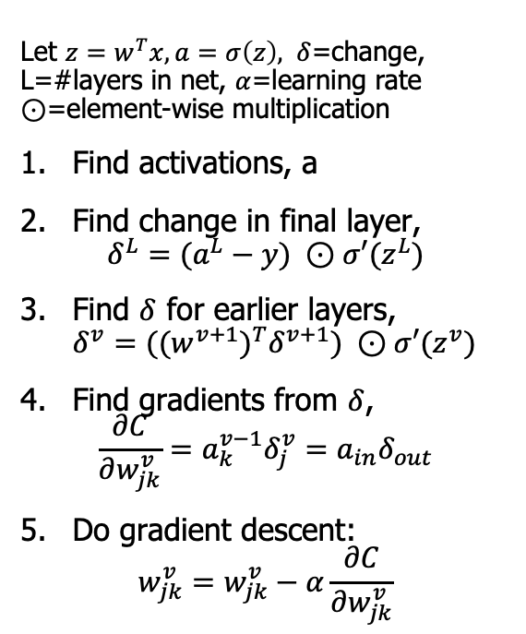
Backpropagation does all these updates efficiently:
Let $z=w^{T}x, a=σ\left(z\right), δ$=change,
L=#layers in net, $α$=learning rate
$⊙$=element-wise multiplication
Find activations, a
Find change in final layer,
$δ^{L}=(a^{L}−y) ⊙σ′(z^{L})$
Find $δ$ for earlier layers,
$δ^{v}=({(w^{v+1})}^{T}δ^{v+1}) ⊙σ′(z^{v})$
Find gradients from $δ$,
$\frac{∂C}{∂w_{jk}^{v}}=a_{k}^{v−1}δ_{j}^{v}=a_{in}δ_{out}$
Do gradient descent:
$w_{jk}^{v}=w_{jk}^{v}−α\frac{∂C}{∂w_{jk}^{v}}$
Details: http://neuralnetworksanddeeplearning.com/chap2.html

Slide 37
XOR revisited

Slide 38

XOR can be solved using hand-engineered perceptrons
$a⊕b$= XOR(a,b) =
Notes:
(a AND (NOT b)) OR ((NOT a) AND b)

Slide 39
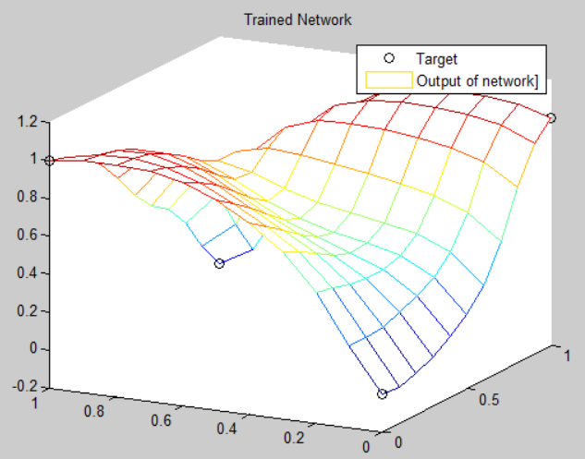
XOR can also be solved, learning it from data
2 inputs (x,y)
1 hidden layer with h=5 neurons
1 output (z)

Slide 40
Runtime and comparison with SVMs

Slide 41
Neural net prediction time is proportional to the size of the network.
Consider a network with d-dimensional inputs, 1 output, and 1 hidden layer with h neurons.
Runtime is O(____)

Slide 42
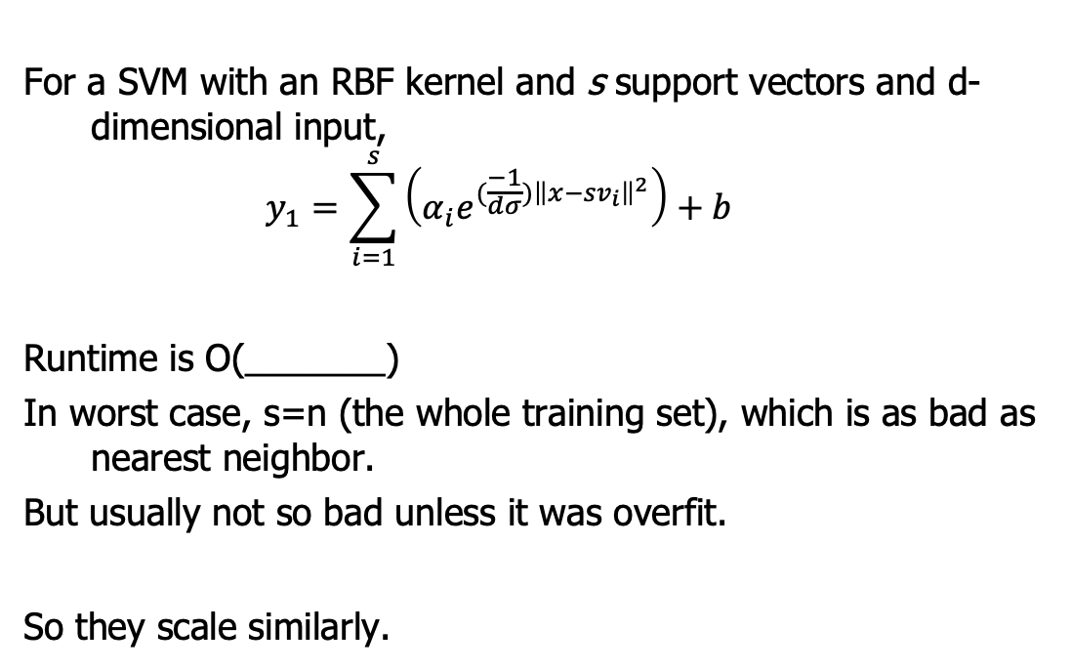
How does NN and SVM prediction runtime compare?
For a SVM with an RBF kernel and s support vectors and d-dimensional input,
$$y_{1}=\sum_{i=1}^{s}{\left(α_{i}e^{(\frac{−1}{dσ}){\left\|x−{sv}_{i}\right\|}^{2}}\right)+b}$$
Runtime is O(_______)
In worst case, s=n (the whole training set), which is as bad as nearest neighbor.
But usually not so bad unless it was overfit.
So they scale similarly.

Slide 43
More comparison with SVMs

Slide 44

Support Vector Machines vs Neural Nets
Support Vector Machines
Have good generalizability even with relatively-small training sets.
Can tune C and $σ$using a validation set.
Neural Nets
Take a long time to train with large data sets.
They have lots of hyperparameters (training time = #epochs, architecture, learning rate, transfer functions, random starts) so lots of potential tuning.
But performance can be excellent with larger networks and lots of training data: stay tuned for deep neural nets in a later unit!

