Slide 1
TermProjects
Image Recognition
Matt Boutell
Notes:
Both

Slide 2
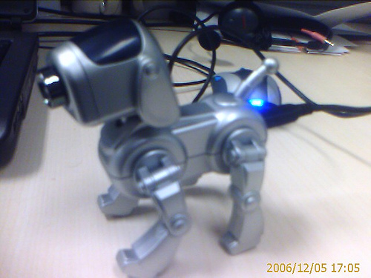
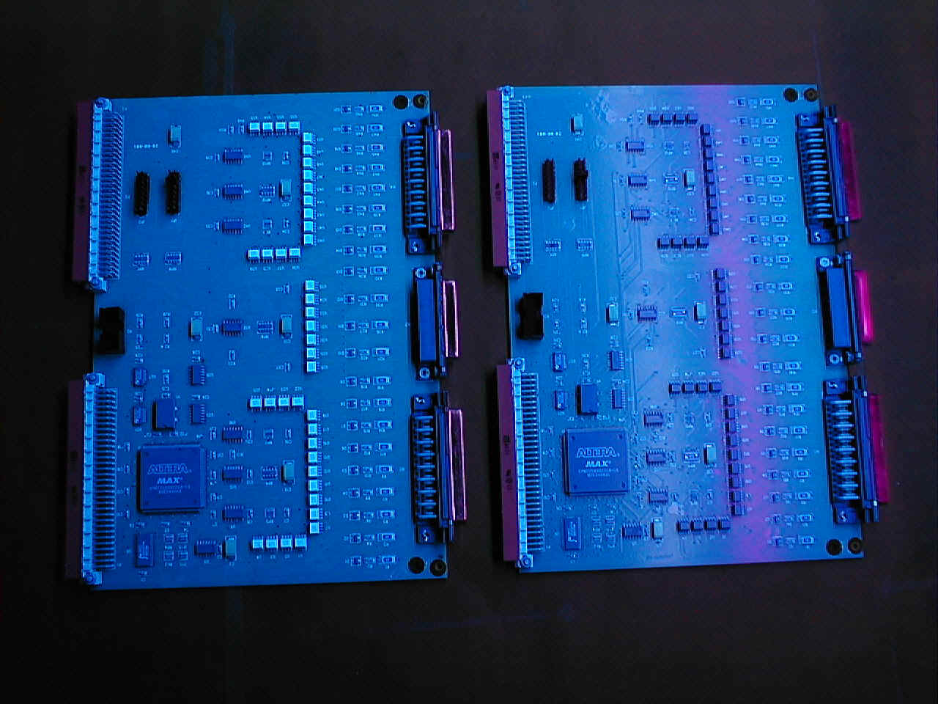
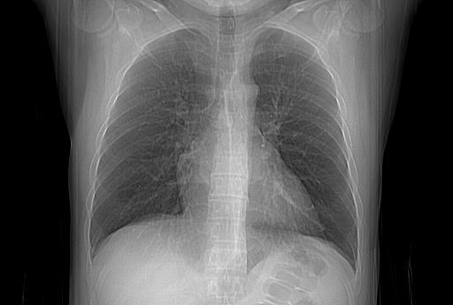
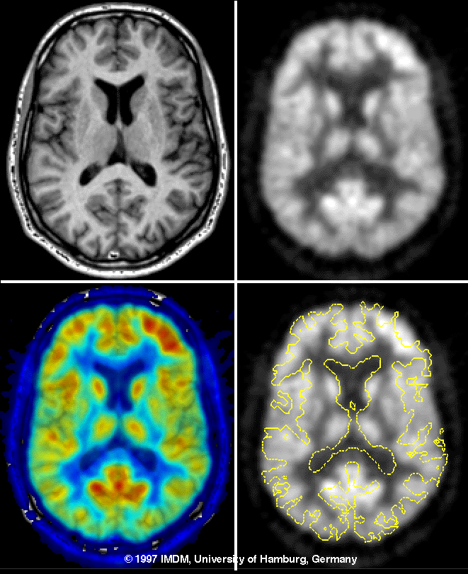
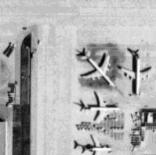
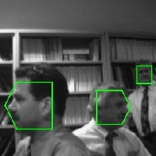
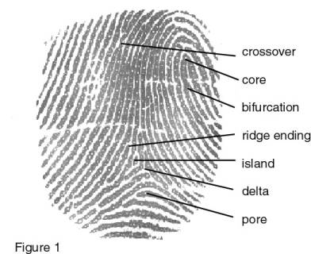
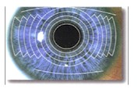
Image Recognition has a wide variety of cool apps
Robotic control
Quality control of manufactured parts
Medical imaging
  Images from Dr. Walter
Biometrics
Photograph analysis
Surveillance
Face detection
Color matching by cell-phone
Notes:
Camera dog: http://www.everbest.on.ca/ver2/showProduct.php?id=1405

Slide 3
Term Project Requirements
Interesting to you
Need to be able to get data
Teams of 4
Lightning talk requirements:
Each person/partial team submits a topic
  1 annotated slide to Moodle dropbox by 11:00 pm on the night before we present lightning talks. The slide must have your name(s), the proposed project title, >= 1 image, and >= 1 reference. (Example on next slide)
Form a team in advance → save yourself work!
  You need only submit 1 proposal per pre-formed full or partial team.
  Most students value people over projects, so try to find at least one partner by this time.
  Each will give a 2-minute, 1-slide “lightning talk” in class (or synch session)
  You will form a tentative project & full team by the end of that session.

Slide 4
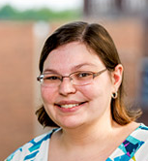
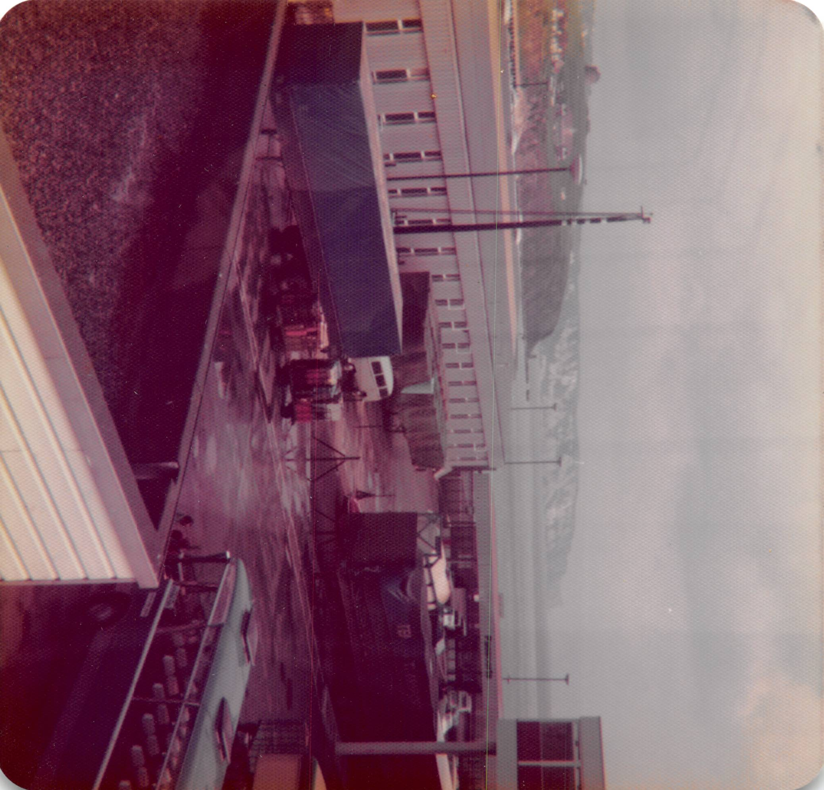
Image Auto-Rotater: Matt Boutell
Problem: Photos scanned on flatbeds don’t know which way is up!
Solution: Detect orientation (out of 4) and auto-rotate image
Dataset: 2200+ photos (already have)
Jiebo Luo and M. Boutell, "Automatic image orientation detection via confidence-based integration of low-level and semantic cues," in IEEE Transactions on Pattern Analysis and Machine Intelligence, vol. 27, no. 5, pp. 715-726, May 2005, doi: 10.1109/TPAMI.2005.96. https://ieeexplore.ieee.org/document/1407875
rotate 90
East

Slide 5
Process
What interests you, either in the list or on your own?
  Be creative!
  Dig some
  Talk to me
    Consult the literature (at least 1 reference initially)
Consider who you want to work with
  Is people or topic more important to you?
You will self-organize in class and fill out a Moodle survey.
  Then I will finalize teams after class

Slide 6
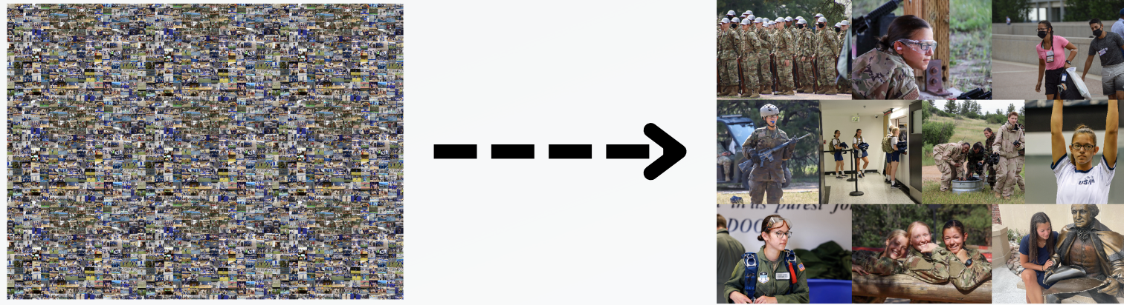
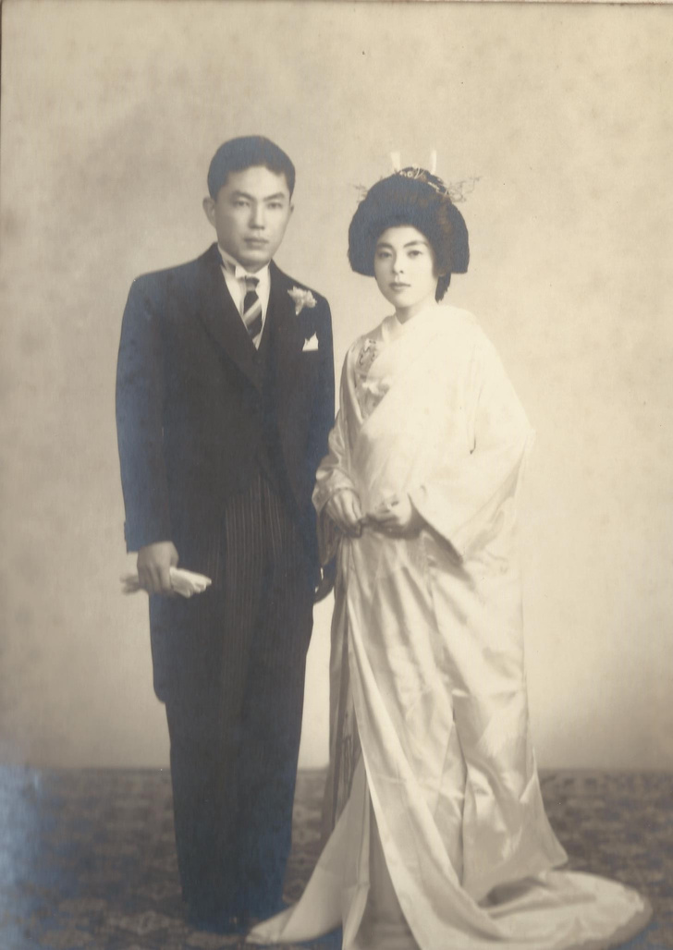
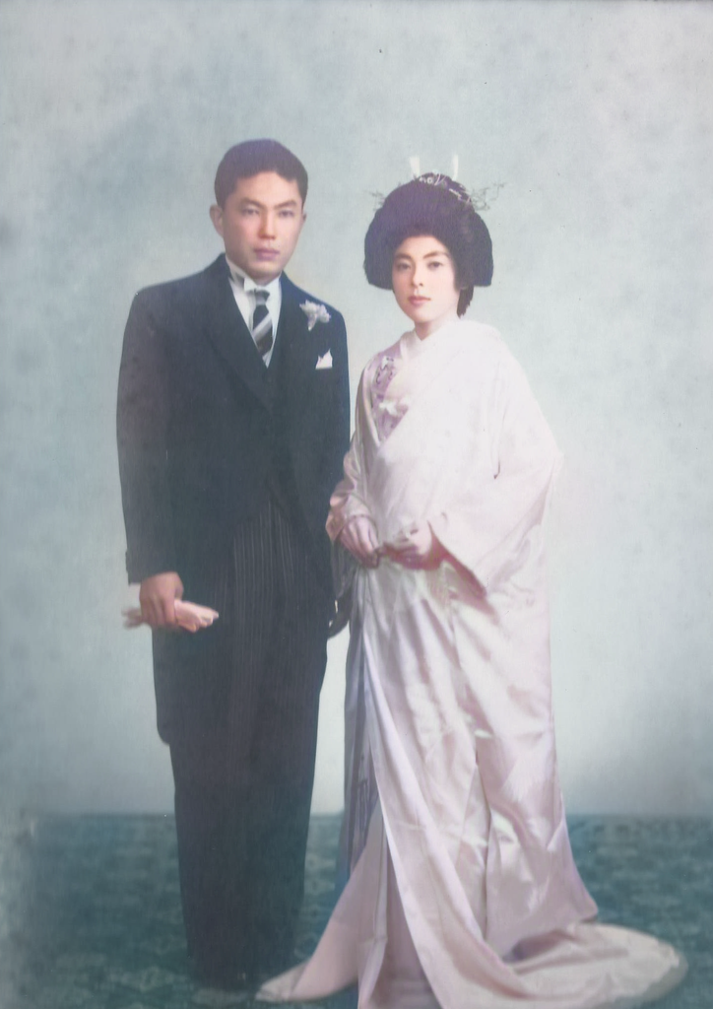
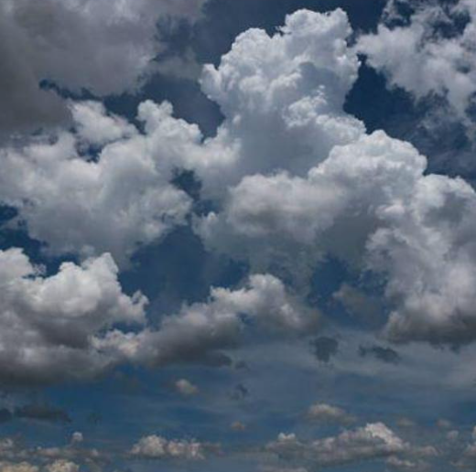
Some projects, 2022-23
Webguyer: Face clustering
Image recoloring
Cloud type classification

Slide 7
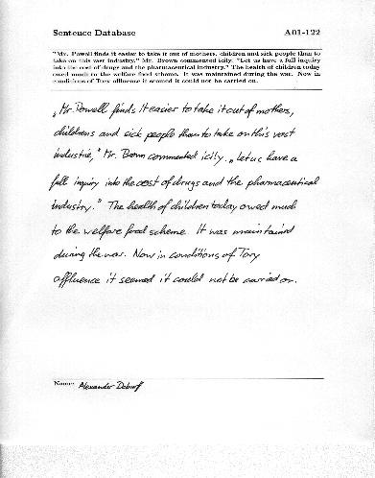
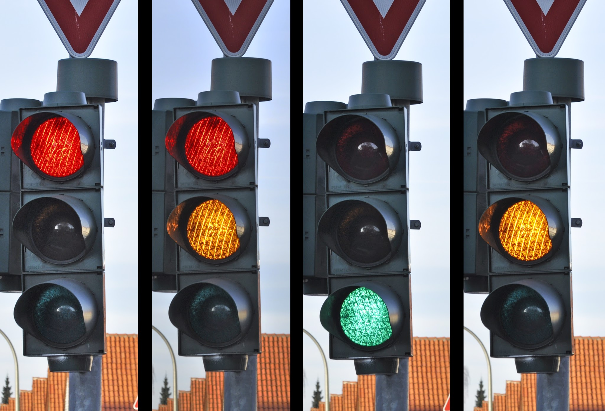
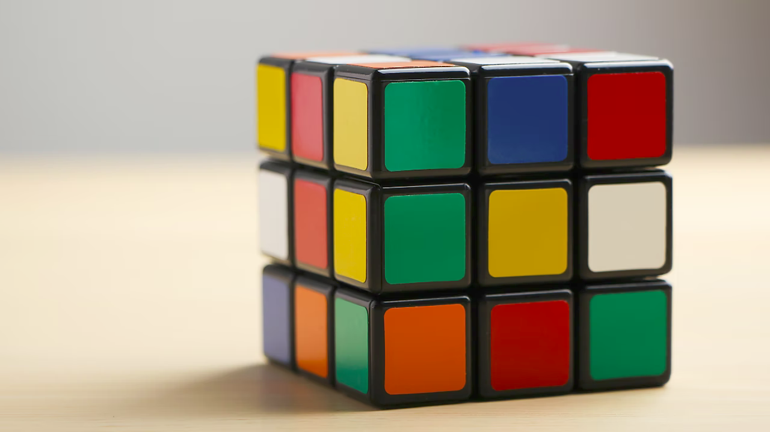
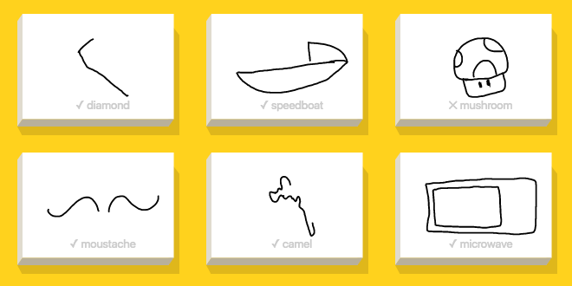

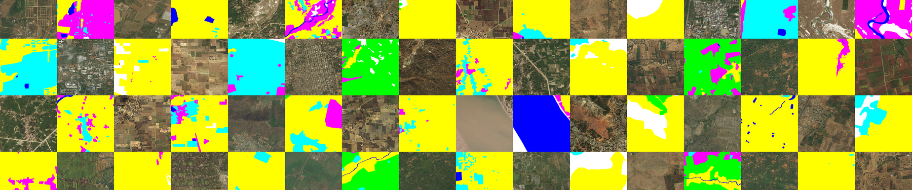
Some projects, 2021-22
Stoplight state detector
Flower detector
Handwriting to Typing
Doodle rec
Rubik’s cube recognizer/solver
Land type classification

Slide 8
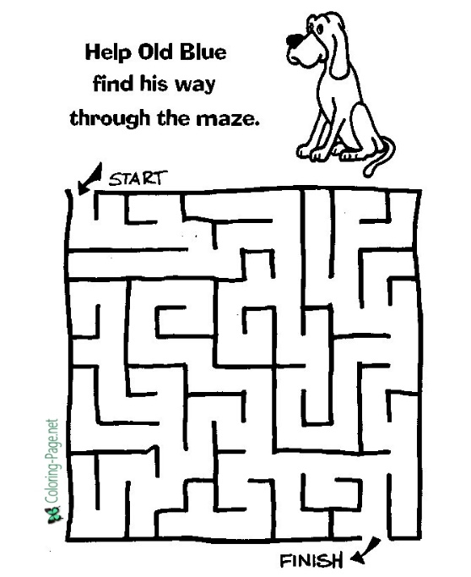
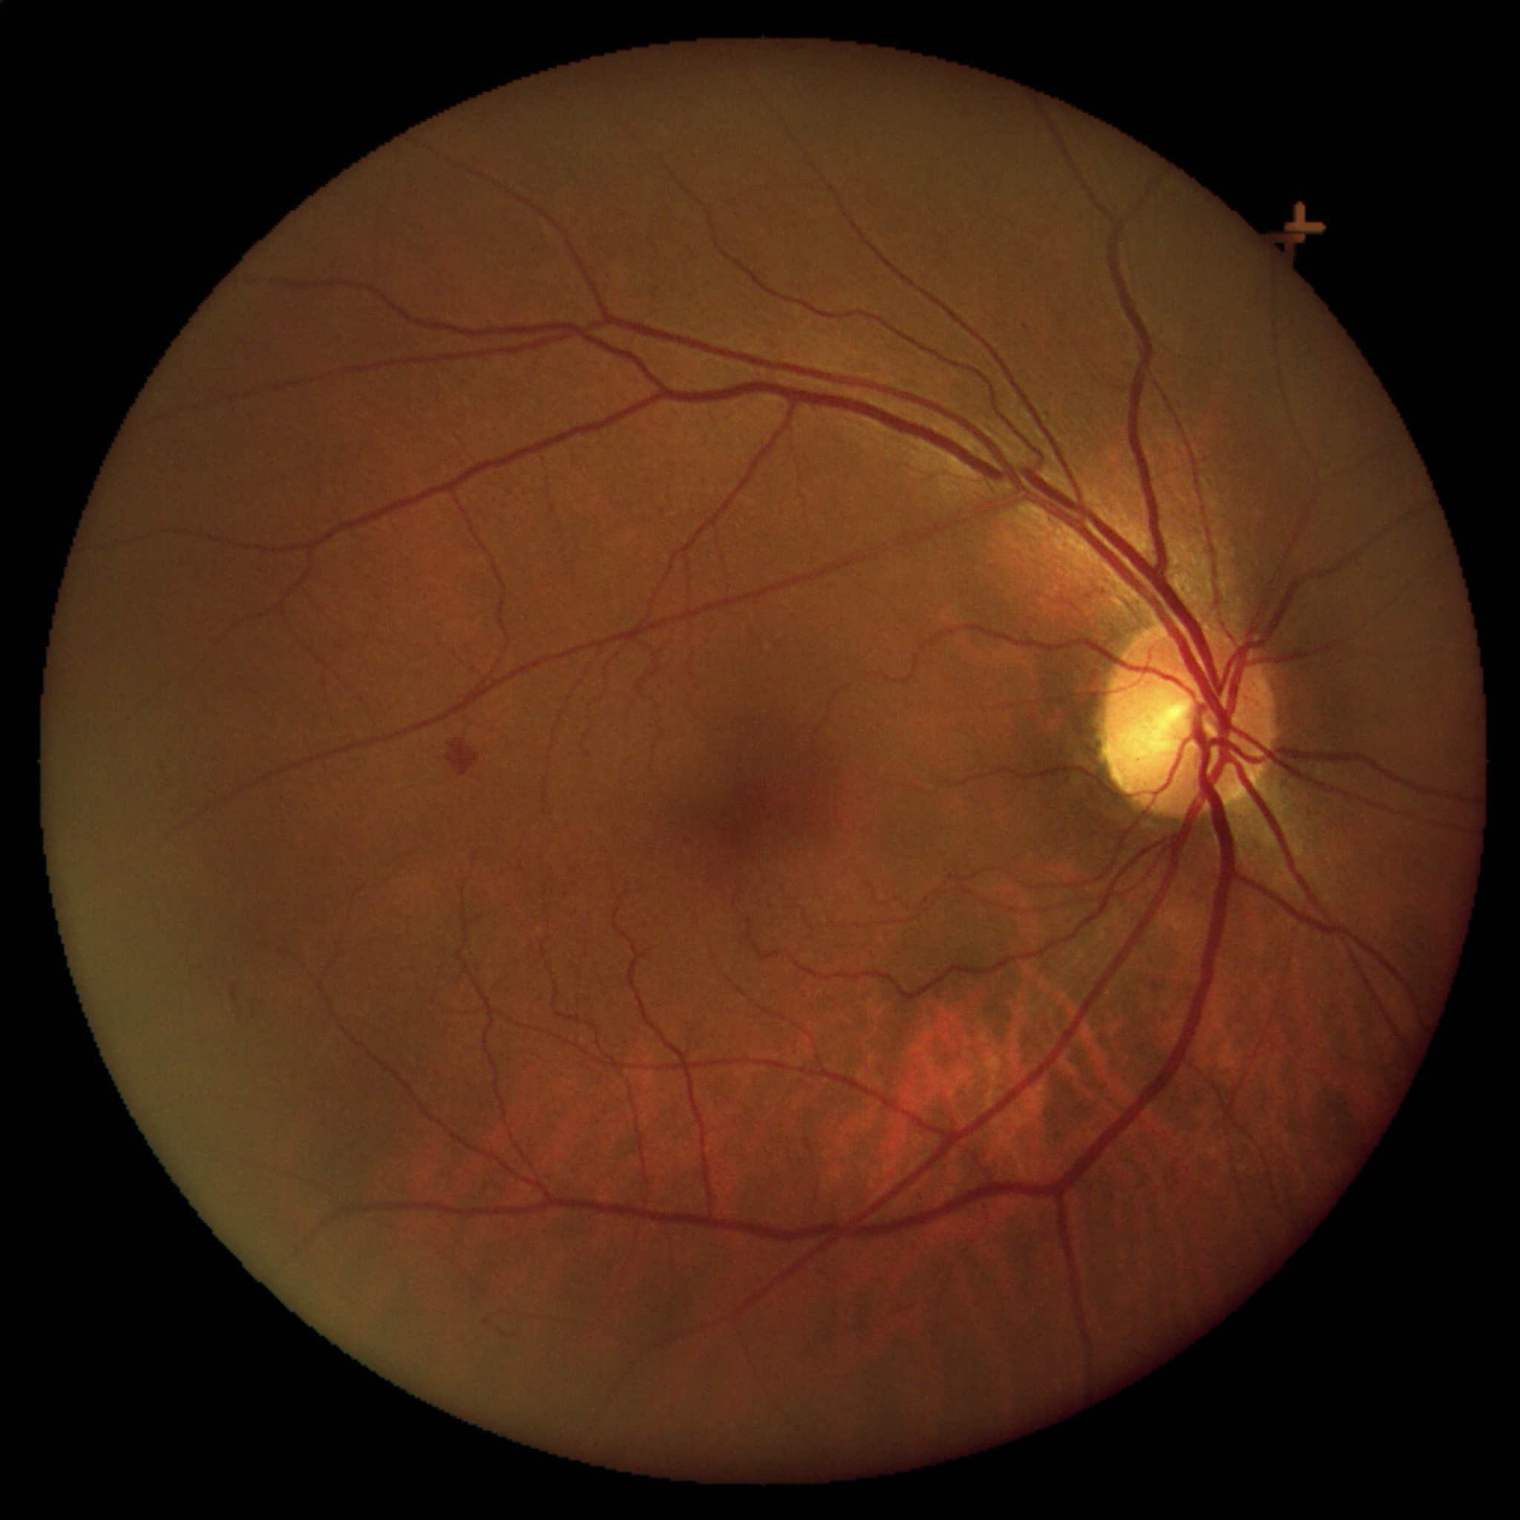


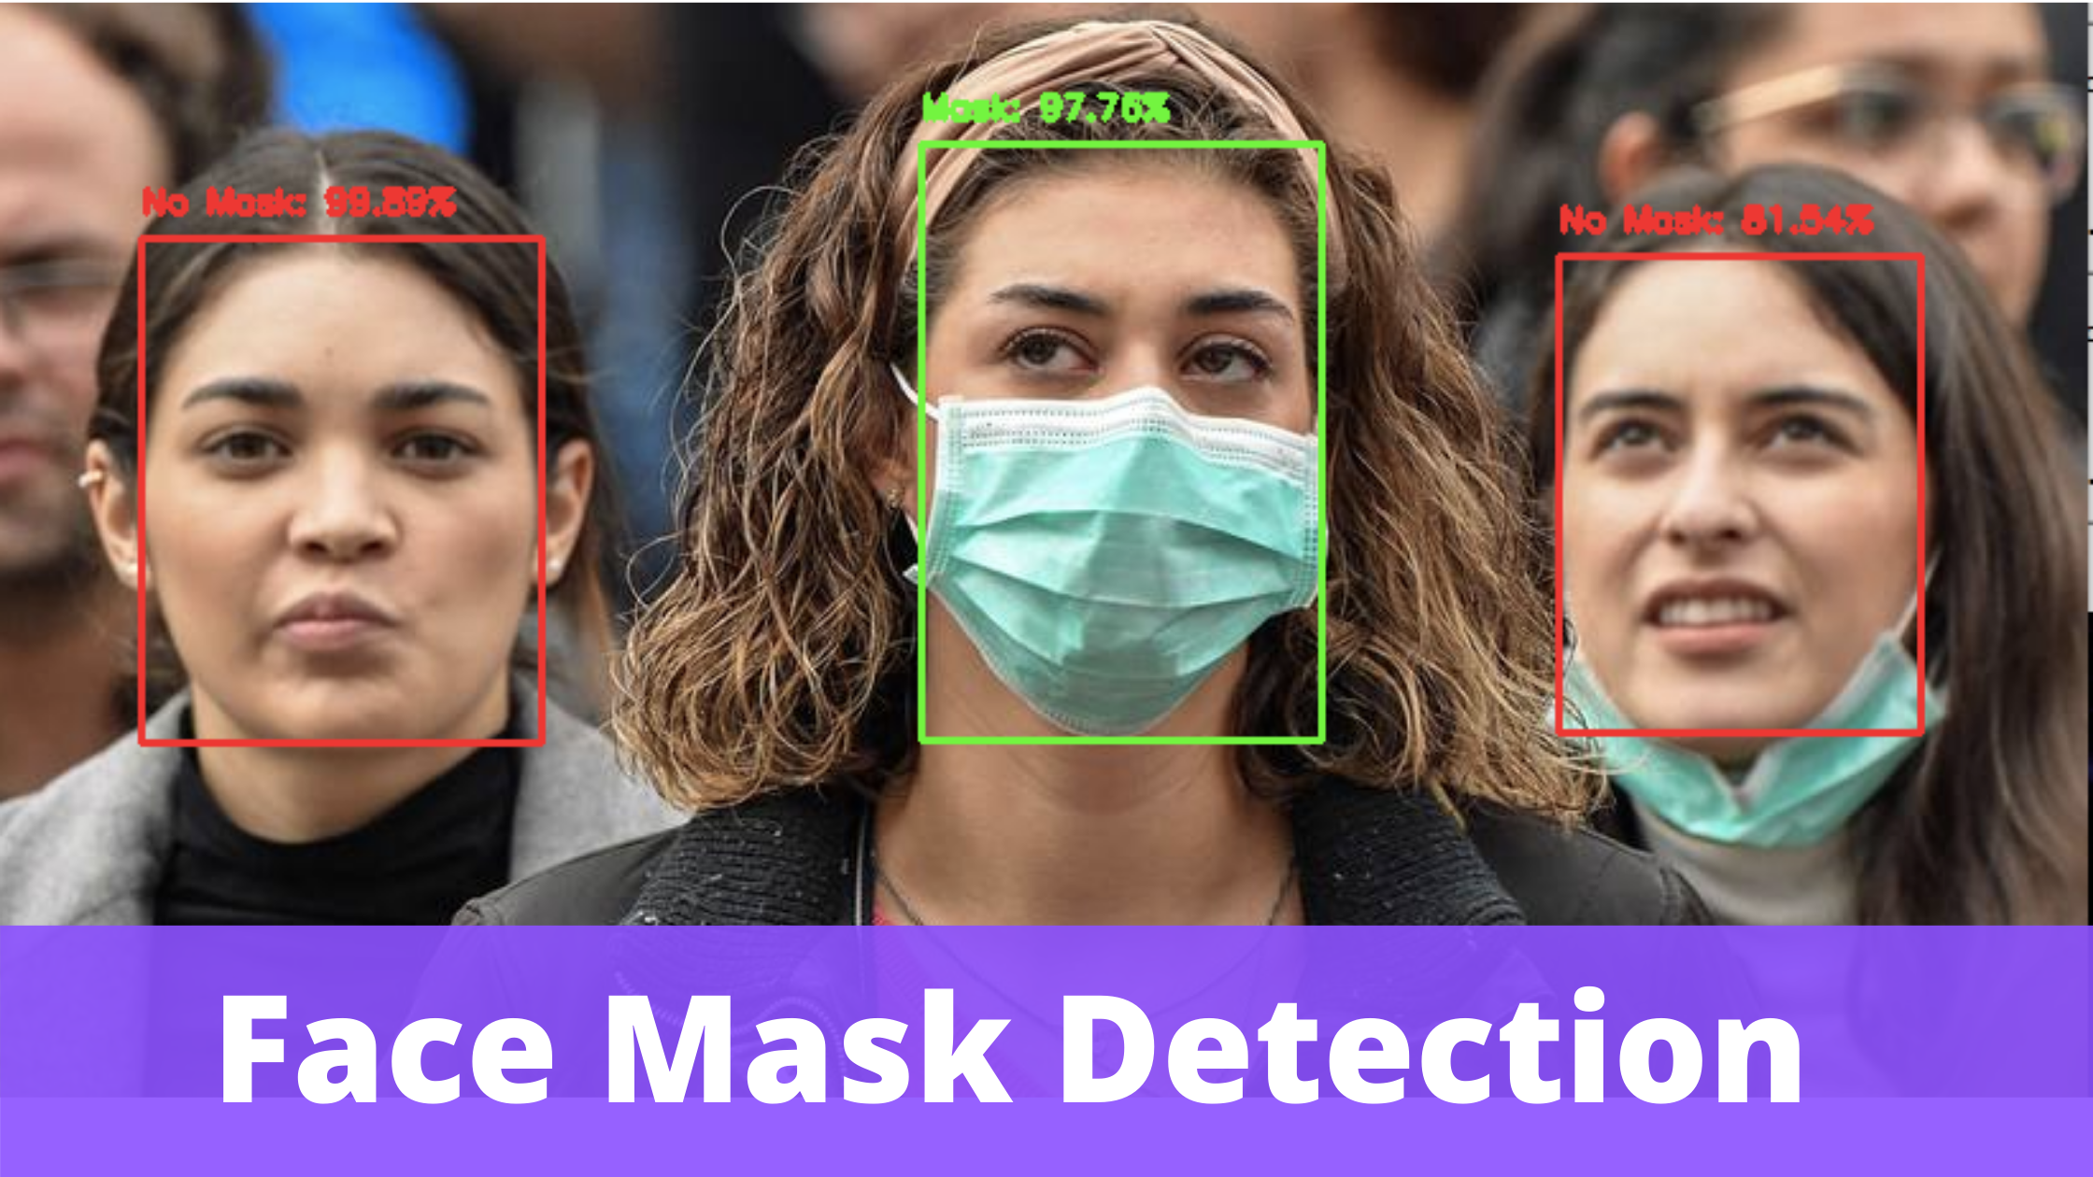

Some projects, 2020-21
Poker card recognition
Face mask detection
Handwritten equation
Diabetic Retinopathy
Maze recognition

Slide 9
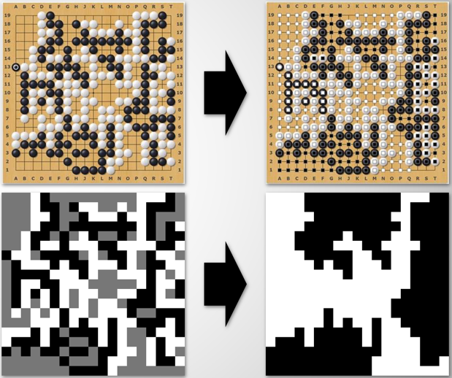
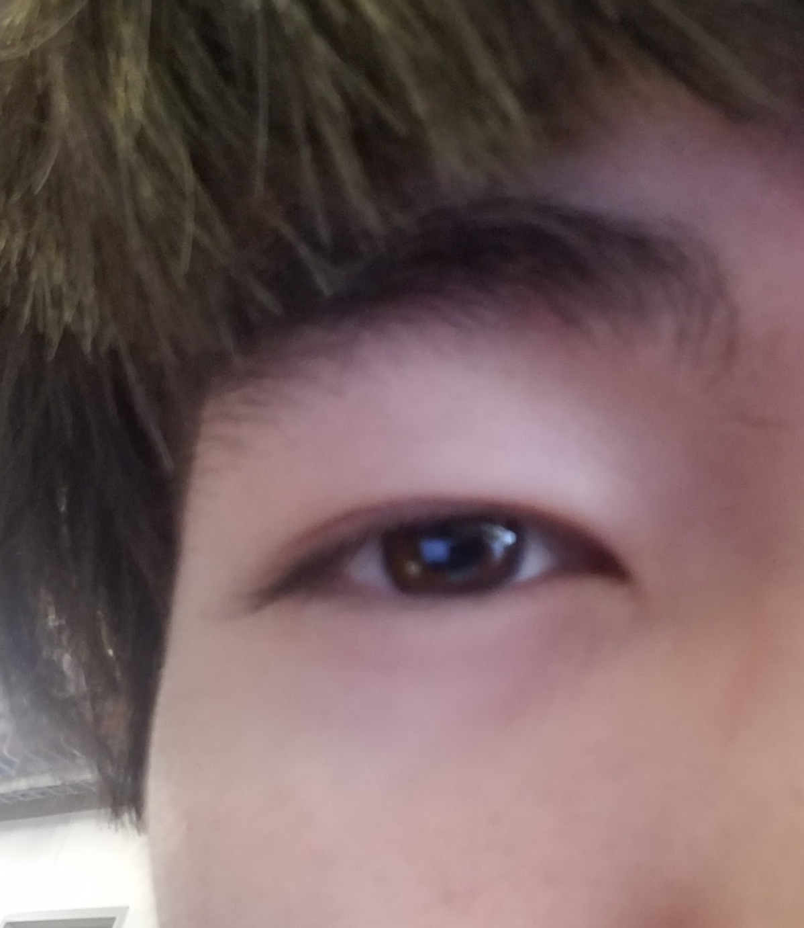
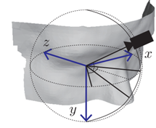
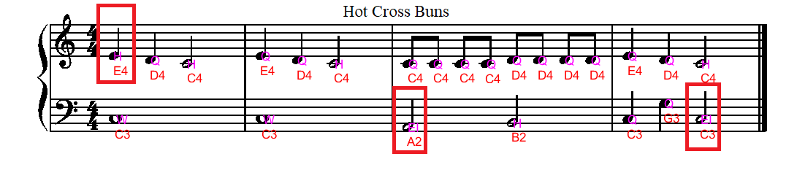
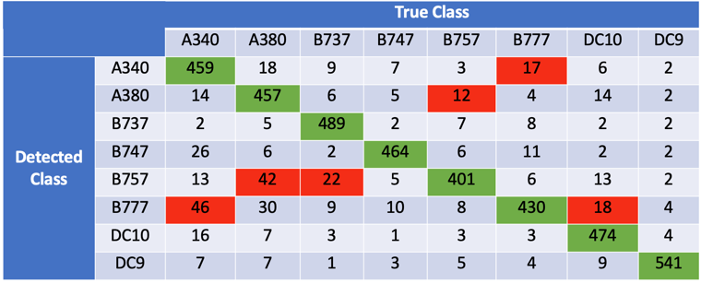
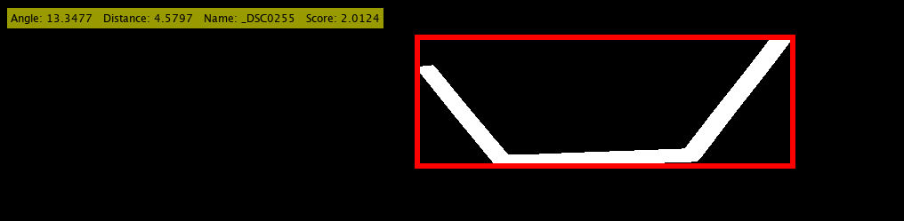
Some projects, 2019-20
Classifying Go Territories
Eye Gaze Estimation
Recognizing sheet music
ReCaptcha Classification
Plane Spotting
FRC Target Identifier

Slide 10
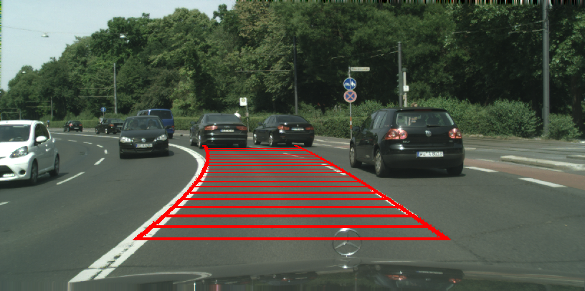
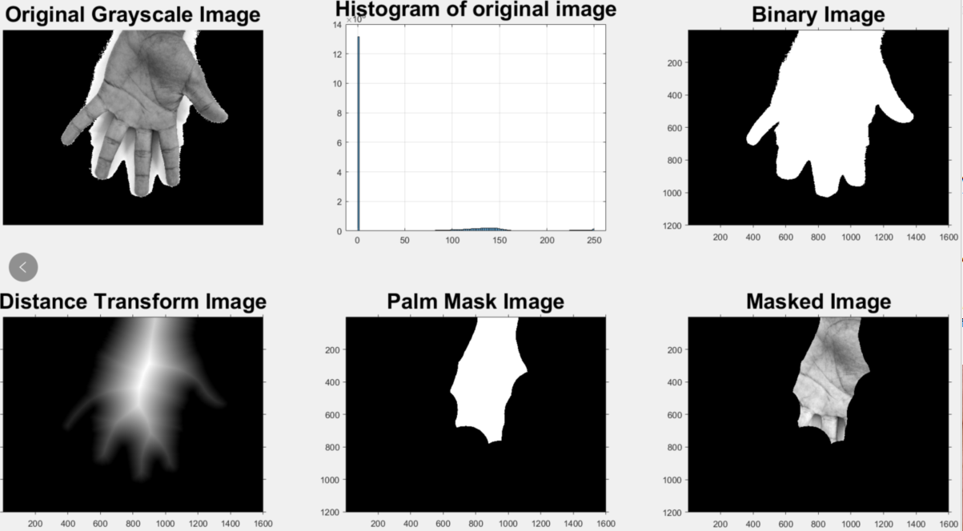
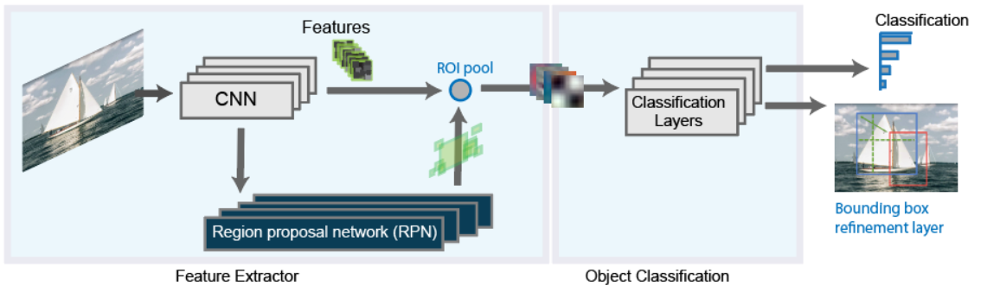
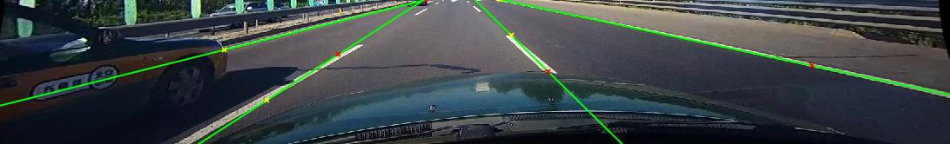
Some projects, 2018-19
Lane Detection (x2)
Palmistry
Plate Recognition
with Faster RCNN
Facial Emotion Recognition
Rainbow detector

Slide 11
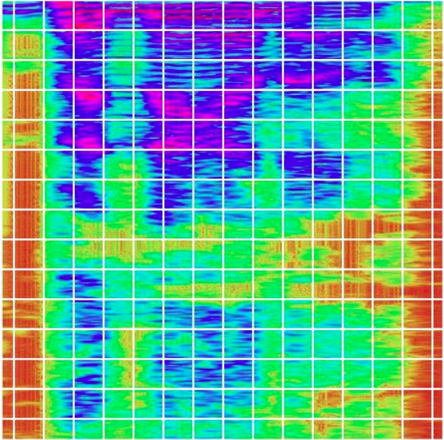
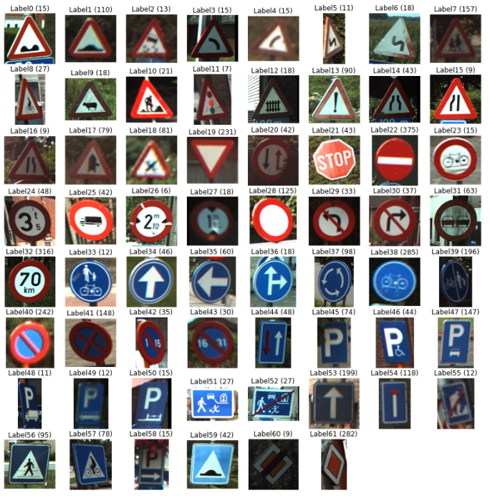
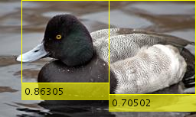


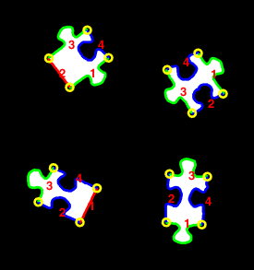

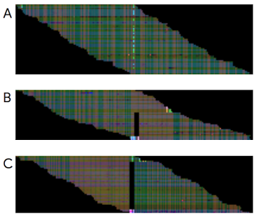
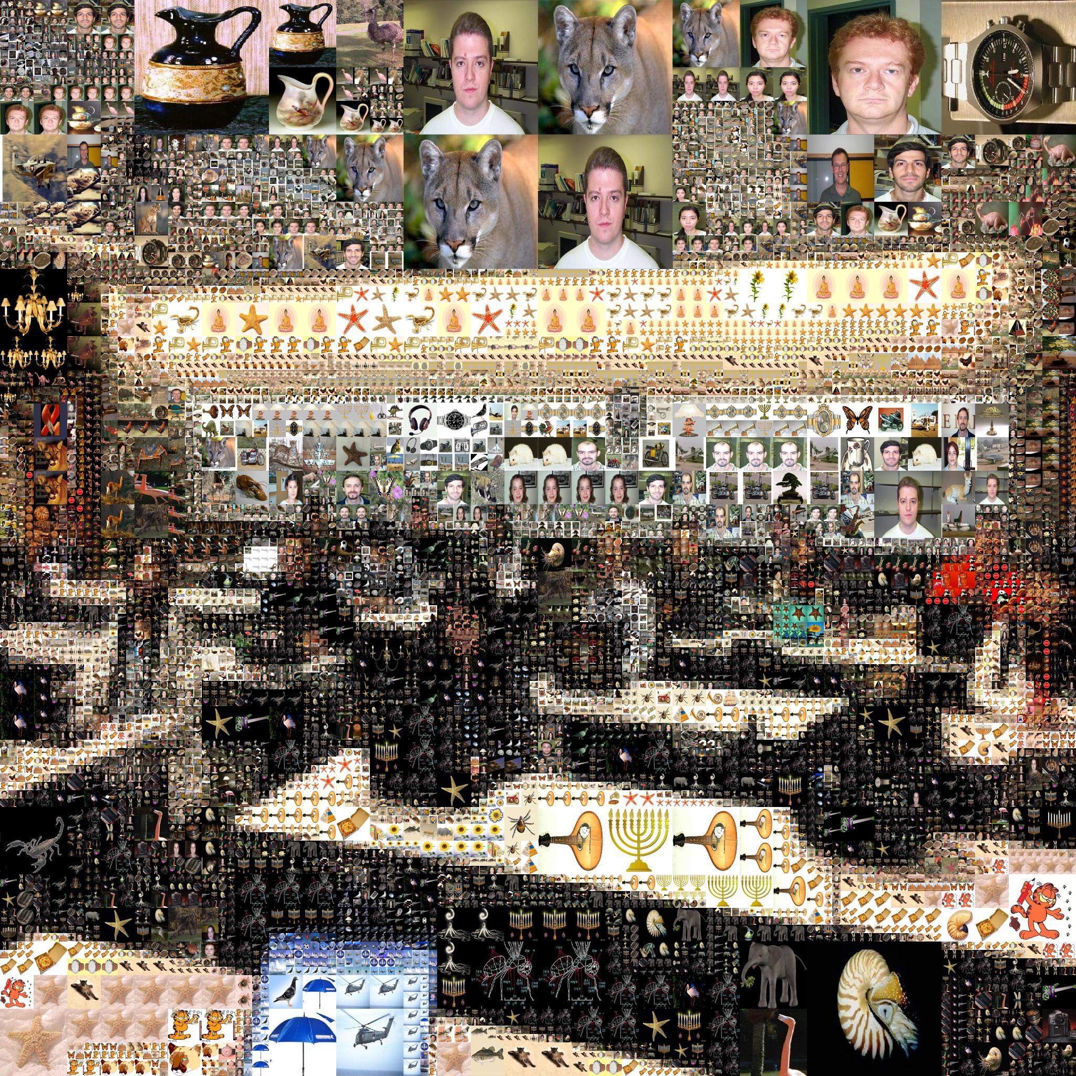
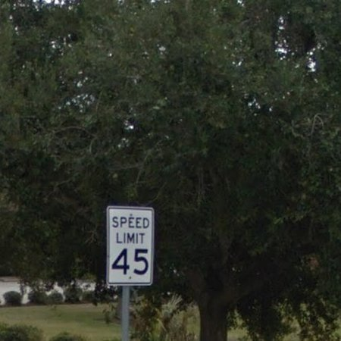
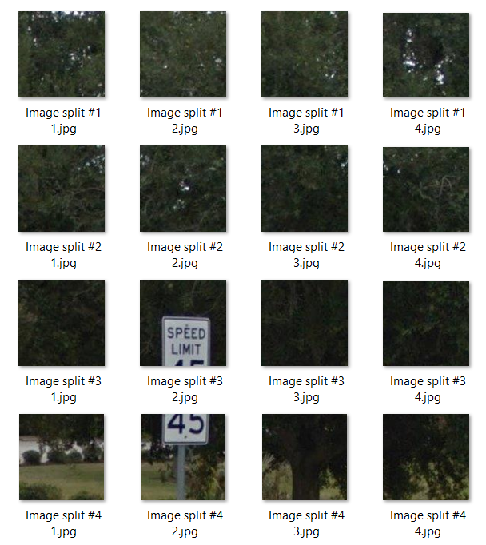
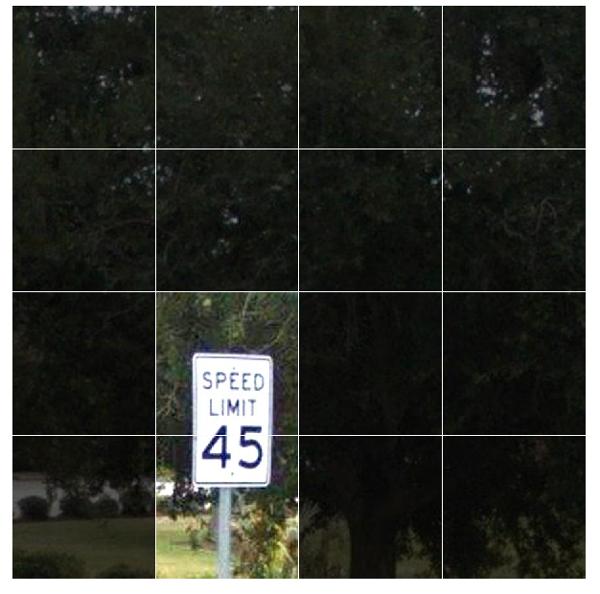
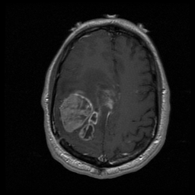
Some projects, 2017-18
Traffic Sign Detector
Spectrogram Reader
Handwriting OCR
Image Translation
BirdDetector
Puzzle Solver
reCAPTCHA
(published)
PhotoMosaic
(GoogleBrain)
Brain Tumor

Slide 12
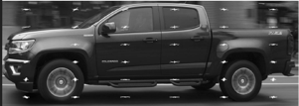
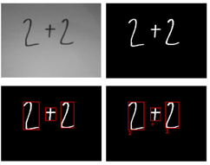
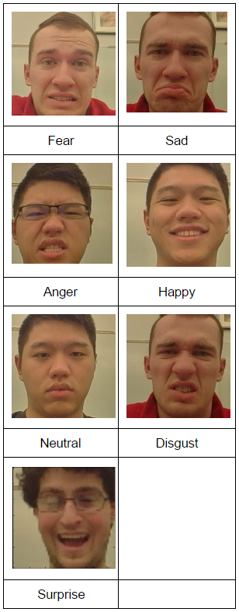
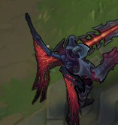

Some projects, 2016-17
Automobile classification
Handwritten math expression recognizer and solver
LOL Champion Annotator
Emotion detector

Slide 13
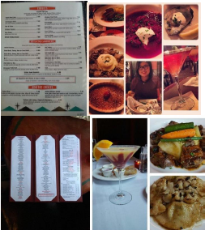
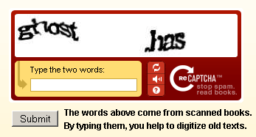
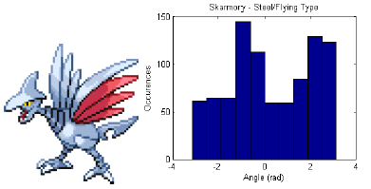
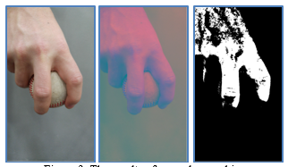



Some projects, 2015-16
Predict attribute labels using 100K+ Yelp restaurant photos
Fastball vs curveball
Reading road signs
Captcha Recognition
Pokemon type classifier
Reading whiteboard Python code
Subway Cam using HOG features

Slide 14





Some projects, 2014-15
Sheet Music to MIDI
RockerHero
Detection and Mapping of Obstacles and Lines (for Robotics club competition)
All About That Money!
Word Search
Sudoku

Slide 15






Some projects, 2013-14
Eye Tracking for Cursor Control (published)
Digits2Latex
FRC Tracker
Emotion Detection
PictoCrypto
Playing card recognition
Whiteboard TicTacToe

Slide 16







Some projects, 2012-2013
Brain Tumors
Paint by Numbers
Vision for Chess AI
Photomosaic (published)

Slide 17
Projects, 2010-11
Bejewelled AI
Gesture-controlled mouse (very cool!)
Smart Board figure detector
Visual servoing for Rovio robot (senior project)

Slide 18







Past projects, 2009-10
Road-sign detection
License-plate detection
Recognizing Constellations
IGVC Obstacle and Line Detection
Connect the Dots
Geographic Feature Extraction from Satellite Images

Slide 19





Past projects, 2008-09
Tennis-ball tracker in video (in OpenCV, not MATLAB)
Projectile Hole Recognition
  For senior project
High-capacity color barcodes
Road location from frontal view
Towards automatic generation of Miis from photos

Slide 20
Past projects, 2007-08
Handwritten digit recognition for Tablet PC
ID’ing the goal and ball in RoboCup
Playing Card ID system
Salamander recognition (for biologists)
Talk show recognition from video stills (presented at ASEE conference)
NEAT Face Detection
Towards Object Recognition, using OpenCV and real-time videos
Painting genre classifier

Slide 21









Past projects, 2006-07
Spot the differences
Connect the dots (digit recognition)
Counting cells in fly retinas
Gesture recognition
Conformal coating misapplication detection
Automated image
region tagging

Slide 22




Past projects, 2005-06
Where’s Waldo?
Face recognition in video
Iris detection
Sport classification
Eigenfaces
Aircraft detection in aerial images
Baesler’s shopping cart surveillance

