Slide 1
Classifiers and Metrics
Image Recognition
Matt Boutell
Notes:
Both

Slide 2
How do you classify data? You could use hand-tuned decision boundaries
You did in 3D (HSV) →
What if the decision boundaries were more complex?
What if the data had not 3, but 100 dimensions?
What if you had lots of labelled data you could train on?
Fruit | H | S | V
Banana | (.1, .13) | (0.5, 1) | (0.7, 1)
Apples | (0, .02) | | (0.3, 1) | (.1, .5)
Oranges | (.07, .1) | (0.5, 1) | (0.5, 1)

Slide 3
Machine Learning is a big field: where will we focus?
ML
Unsupervised
(clustering)
Supervised
(labels)
Regression
(predict number)
Classification
(predict label)

Slide 4
Nearest Neighbor Classifier

Slide 5
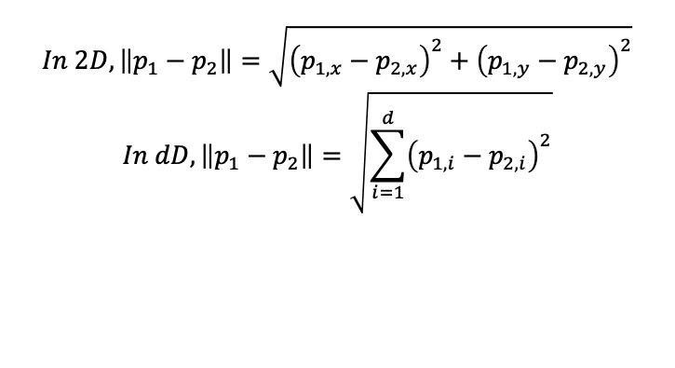
Nearest neighbor is a simple, non-parametric classifier
Non-parametric?
Assume we have a feature vector for each image (2D shown to right)
Calculate distance from new test sample to each labeled training sample.
Assign label as closest training sample (argmin)
Generalize by assigning the same label as the majority of the k nearest neighbors.
$$In 2D, \left\|p_{1}−p_{2}\right\|=\sqrt{{\left(p_{1,x}−p_{2,x}\right)}^{2}+{\left(p_{1,y}−p_{2,y}\right)}^{2}}$$
$$In dD, \left\|p_{1}−p_{2}\right\|=\sqrt{\sum_{i=1}^{d}{{\left(p_{1,i}−p_{2,i}\right)}^{2}}}$$
Notes:
Dave

Slide 6

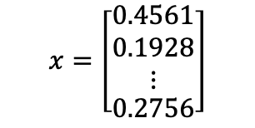
Example: classify sunsets using 294D features
1st 2 moments in LST space on grid:
Accuracy: 81.5% (vs 50% if guess)
Pros: easy to run, no parameters to tune.
Cons: slow classification, can overfit data, can't tune performance, need lots of examples to fill high dimensional space
$$x=\left[\begin{aligned}\begin{matrix}0.4561 \\ 0.1928 \\ ⋮\end{matrix} \\ 0.2756\end{aligned}\right]$$
$$In 2D, \left\|p_{1}−p_{2}\right\|=\sqrt{{\left(p_{1,x}−p_{2,x}\right)}^{2}+{\left(p_{1,y}−p_{2,y}\right)}^{2}}$$
$$In dD, \left\|p_{1}−p_{2}\right\|=\sqrt{\sum_{i=1}^{d}{{\left(p_{1,i}−p_{2,i}\right)}^{2}}}$$
Notes:
Dave

Slide 7
Nearest Neighbor Decision Boundary

Slide 8
Nearest Neighbor Decision Boundary
Let's use this tool to investigate:
http://ai6034.mit.edu/fall12/index.php?title=Demonstrations
What shape do the pieces of the boundary have?
Where are they located?
How do you combine pieces?
Notes:
Dave

Slide 9
Nearest class mean

Slide 10
Nearest class mean, using clusters, is more efficient
Find class means and calculate distance to each mean
Pro?
Con?
Partial solution: clustering
Learning vector quantization (LVQ): tries to find optimal clusters.
k-means is better.
LVQ
Notes:
Dave

Slide 11
Confusion matrix

Slide 12
How good is your classifier? Confusion matrix
Detect True | Yes | No
Yes | 500 (true pos.) | 100 (false neg.)
No | 200 (false pos.) | 10000 (true neg.)
Examples:
Object detection
Disease detection
Consider costs of false neg. vs. false pos.
Lots of different error measures
600
Total actual
positive
10200
Total actual
negative
700
Total det.
as pos.
10100
Total det.
as neg.
Notes:
Dave

Slide 13
Error metrics

Slide 14
How good is your classifier? Derived measures
Detect True | Yes | No
Yes | 500 (true pos.) | 100 (false neg.)
No | 200 (false pos.) | 10000 (true neg.)
Accuracy = correct/all = 10500/10800 = 97%. Is 97% accuracy OK?
True positive rate = TP/pos = 500/600=83%
vs. false pos rate = FP/neg = 200/10200 = 2%
Or…
Precision = TP / det-pos
= 500/700=71%
vs. recall (same as TPR)
600
Total actual
positive
10200
Total actual
negative
700
Total det.
as pos.
10100
Total det.
as neg.
Notes:
Dave

Slide 15
ROC Curve

Slide 16
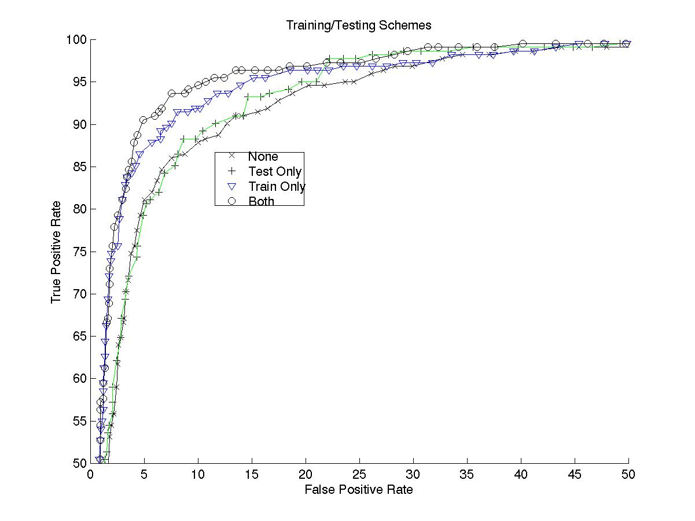
ROC curves balance TPR vs FPR (or recall vs precision)
The "Receiver-operating characteristic" is useful when you can change a threshold to get different true and false positive rates.
Much more information recorded here, like:
-How close to perfect is it?
-What is the area under the curve?
-If you require a certain FPR, what is the TPR?
Notes:
Dave

Slide 17
ROC Curve Exercise

Slide 18
How do you create an ROC curve?
Label | Feat | t=0 | t=1 | t=-2
+ | 2.9
+ | 2.8
+ | -1.2
- | -3.1
- | -1.5
- | 0.3
- | -0.5
You need to be able to move a threshold, t, between what you the classifier calls + and -.
Notes:
Dave

Slide 19
How do you create an ROC curve?
Label | Feat | t=0 | t=1 | t=-2
+ | 2.9 | TP | TP | TP
+ | 2.8 | TP | TP | TP
+ | -1.2 | FN | FN | TP
- | -3.1 | TN | TN | TN
- | -1.5 | TN | TN | FP
- | 0.3 | FP | TN | FP
- | -0.5 | TN | TN | FP
You need to be able to move a threshold, t, between what you the classifier calls + and -.
If t=0, (TPR, FPR)= (__,__)
If t=1, (TPR,FPR)=(__,__)
It t = -2, (TPR,FPR)=(__,__)
Plots with only 3 points don’t look great…
Notes:
Dave

Slide 20
Same data set with more points:
Label:
- - - + - + - - + - ++ - ++ ++ +++
Feature:
-3 -2 -1 0 1 2 3
Interpret above: Data point 1 has label -, value -3.1
If t == 0: TPR = ___, FPR = ___
If t == 1: TPR = ___, FPR = ___
Add more points, including extremes:
t = -5 and t = 5.
9/12
2/8
True Pos Rate
7/12
1/8
False Pos Rate
Notes:
Dave

Slide 21
How do you create an ROC curve if you have more than one feature?
Lab. | Cls Out | t=0 | t=1 | t=-2
+ | 2.9 | TP | TP | TP
+ | 2.8 | TP | TP | TP
+ | -1.2 | FN | FN | TP
- | -3.1 | TN | TN | TN
- | -1.5 | TN | TN | FP
- | 0.3 | FP | TN | FP
- | -0.5 | TN | TN | FP
Some classifiers output a single value that you can use:
SVMs do.
Neural nets do.
Nearest neighbor doesn't.
Notes:
Dave

Slide 22
Multiclass Confusion Matrix

Slide 23
Multiclass Confusion Matrices use TP, FP too.
You can find recall and precision for each class.
Detected
True
Beach recall: 169/(169+0+2+3+12+14)=84.5%
Note confusion between mountain and urban classes due to features (similar colors and spatial layout)
Notes:
Dave

