Slide 1
Welcome!
Image Recognition
Matt Boutell
Notes:
Both

Slide 2
Introduce yourself to a partner
Name, hometown, major/year, something not obvious about them
You will introduce your partner to the class shortly

Slide 3
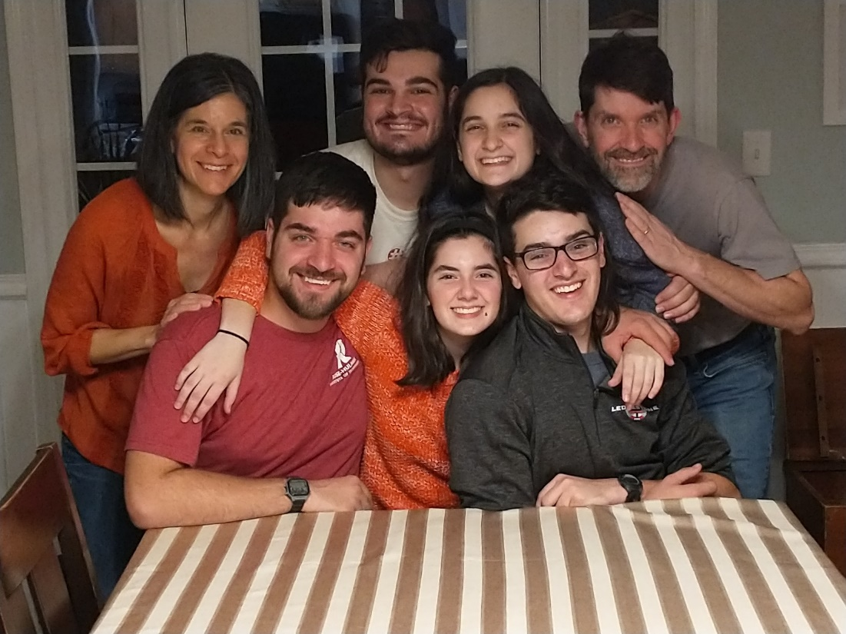
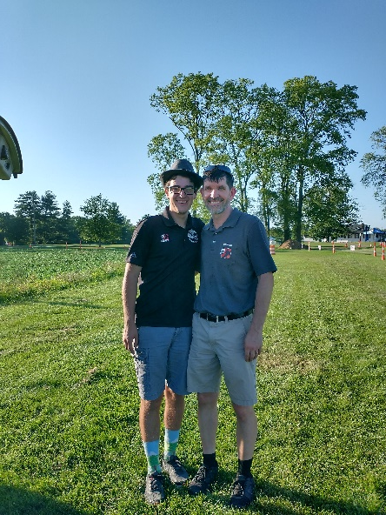
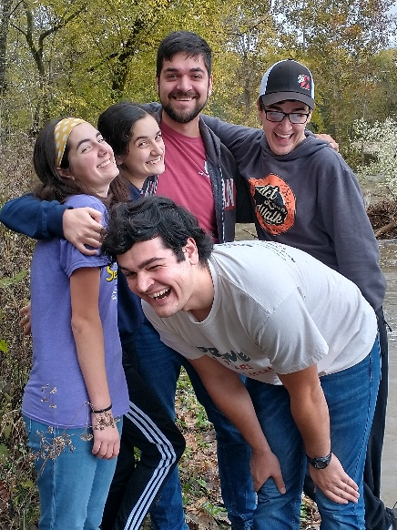
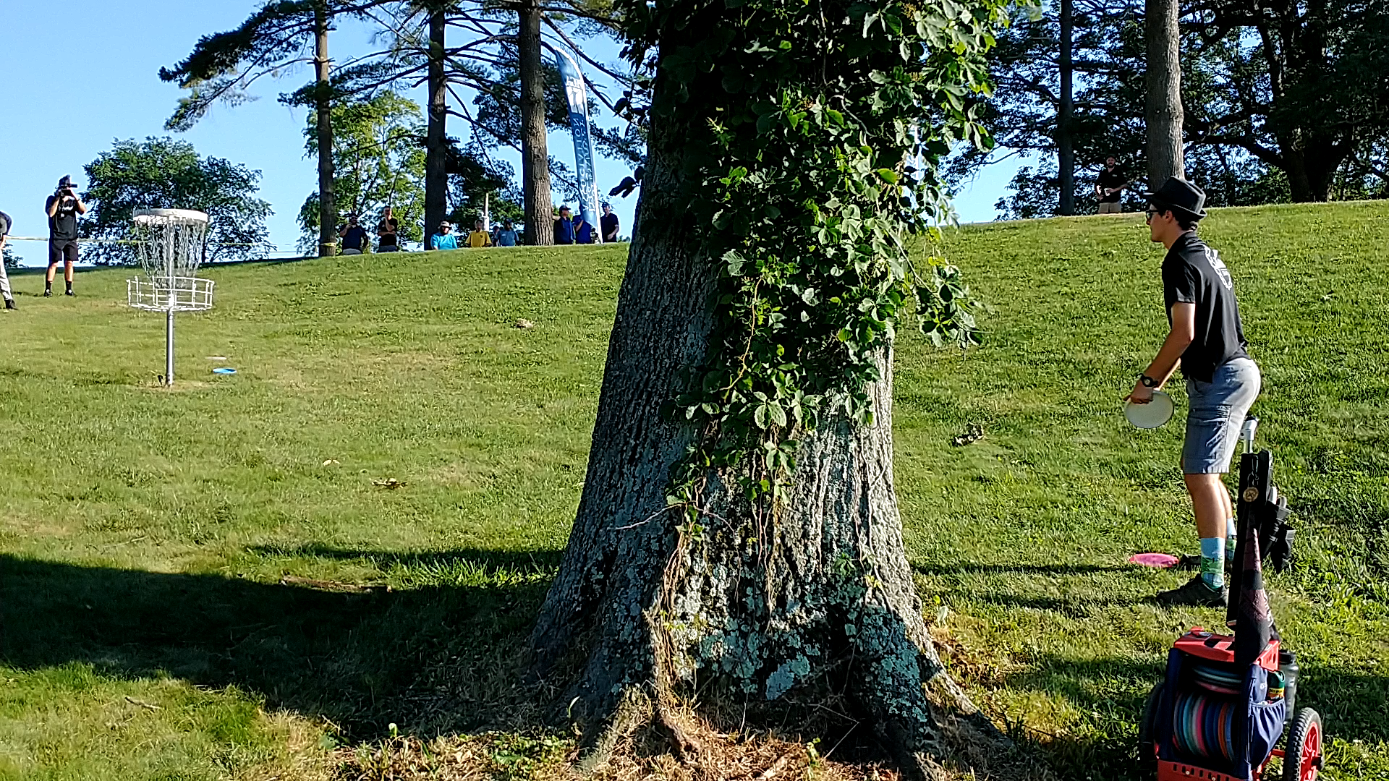
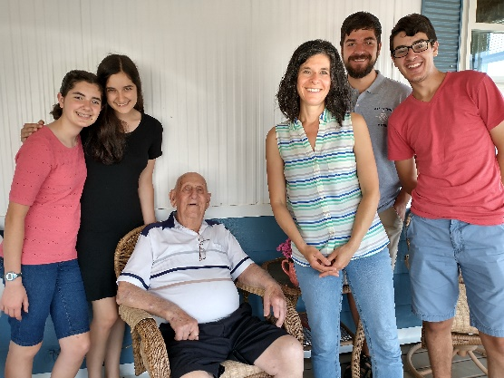
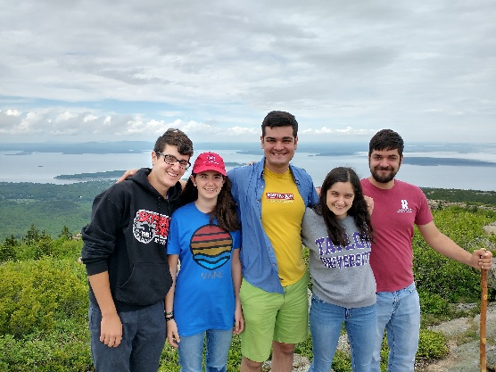

Slide 4
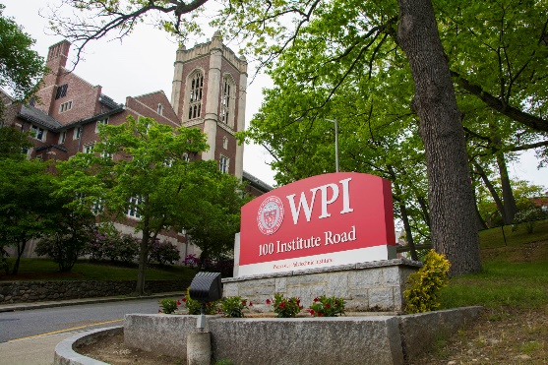



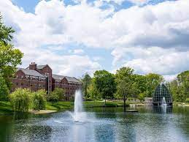

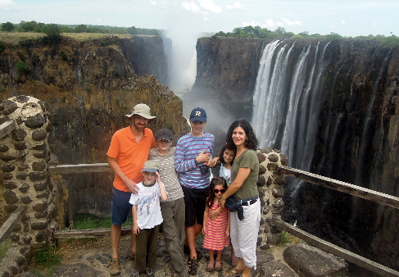
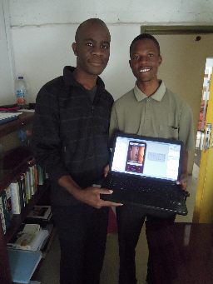

Professional Life
Norton HS:
MA, APCS
WPI ’93 MA
U Rochester ‘05 PhD CS
Kodak Research
Data Scientist, ‘18-’20
Rose-Hulman CSSE, ‘05-pres
Fulbright, Zambia ‘11-12

Slide 5
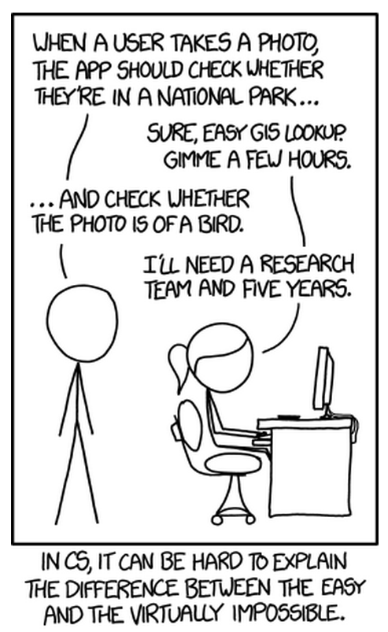
What is image recognition? (informally)
In the 1960’s, Marvin Minsky assigned a couple of undergrads to spend the summer programming a computer to use a camera to identify objects in a scene. He figured they’d have the problem solved by the end of the summer. Half a century later, we’re still working on it.
Notes:
Dave

Slide 6
What is image recognition? (formally)
Image recognition is:
…figuring out how Google Photos labels your photos
…detecting family and friends in pics
…figuring out land cover from satellite imagery
…an early step in many AI systems
It is “Making decisions based on images and explicitly constructing the scene descriptions needed to do so” (Shapiro, Computer Vision, p. 15)
Computer vision, machine vision, image understanding, and image recognition all used interchangeably
But we won't do 3D reconstruction of scenes.
Image rec is not image processing (transforming images into images) but we use some of the same fundamentals
And it's not machine learning, but we use it!
Notes:
Daveels

Slide 7
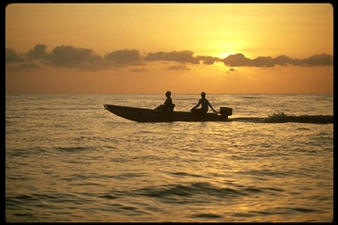
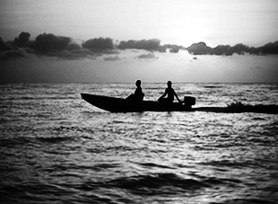
Image recognition vs. image processing
Image recognition:
Knowledge from images
What’s in this scene?
It’s a sunset
It has a boat, people, water, sky, clouds
Image processing:
Enhancing images
Change color space.
Sharpen the contrast.
Notes:
Dave

Slide 8
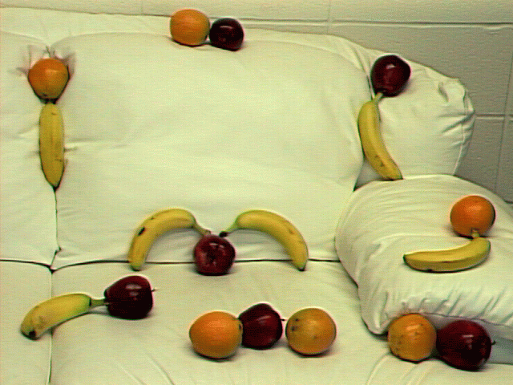
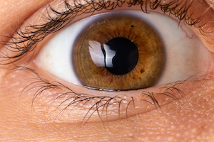
What is image recognition good for? Some examples…
Photo organization and retrieval
Security (face, iris, fingerprint rec)
Intelligent image processing
Robot control
Video surveillance
Barcode scanners
Which pixels are the fruit?
Can you think of more?
Keep your ears open for apps in the news and keep me posted; I love to stay current!
Notes:
Dave

Slide 9
Case study: Sunset detector
Notes:
Dave

Slide 10
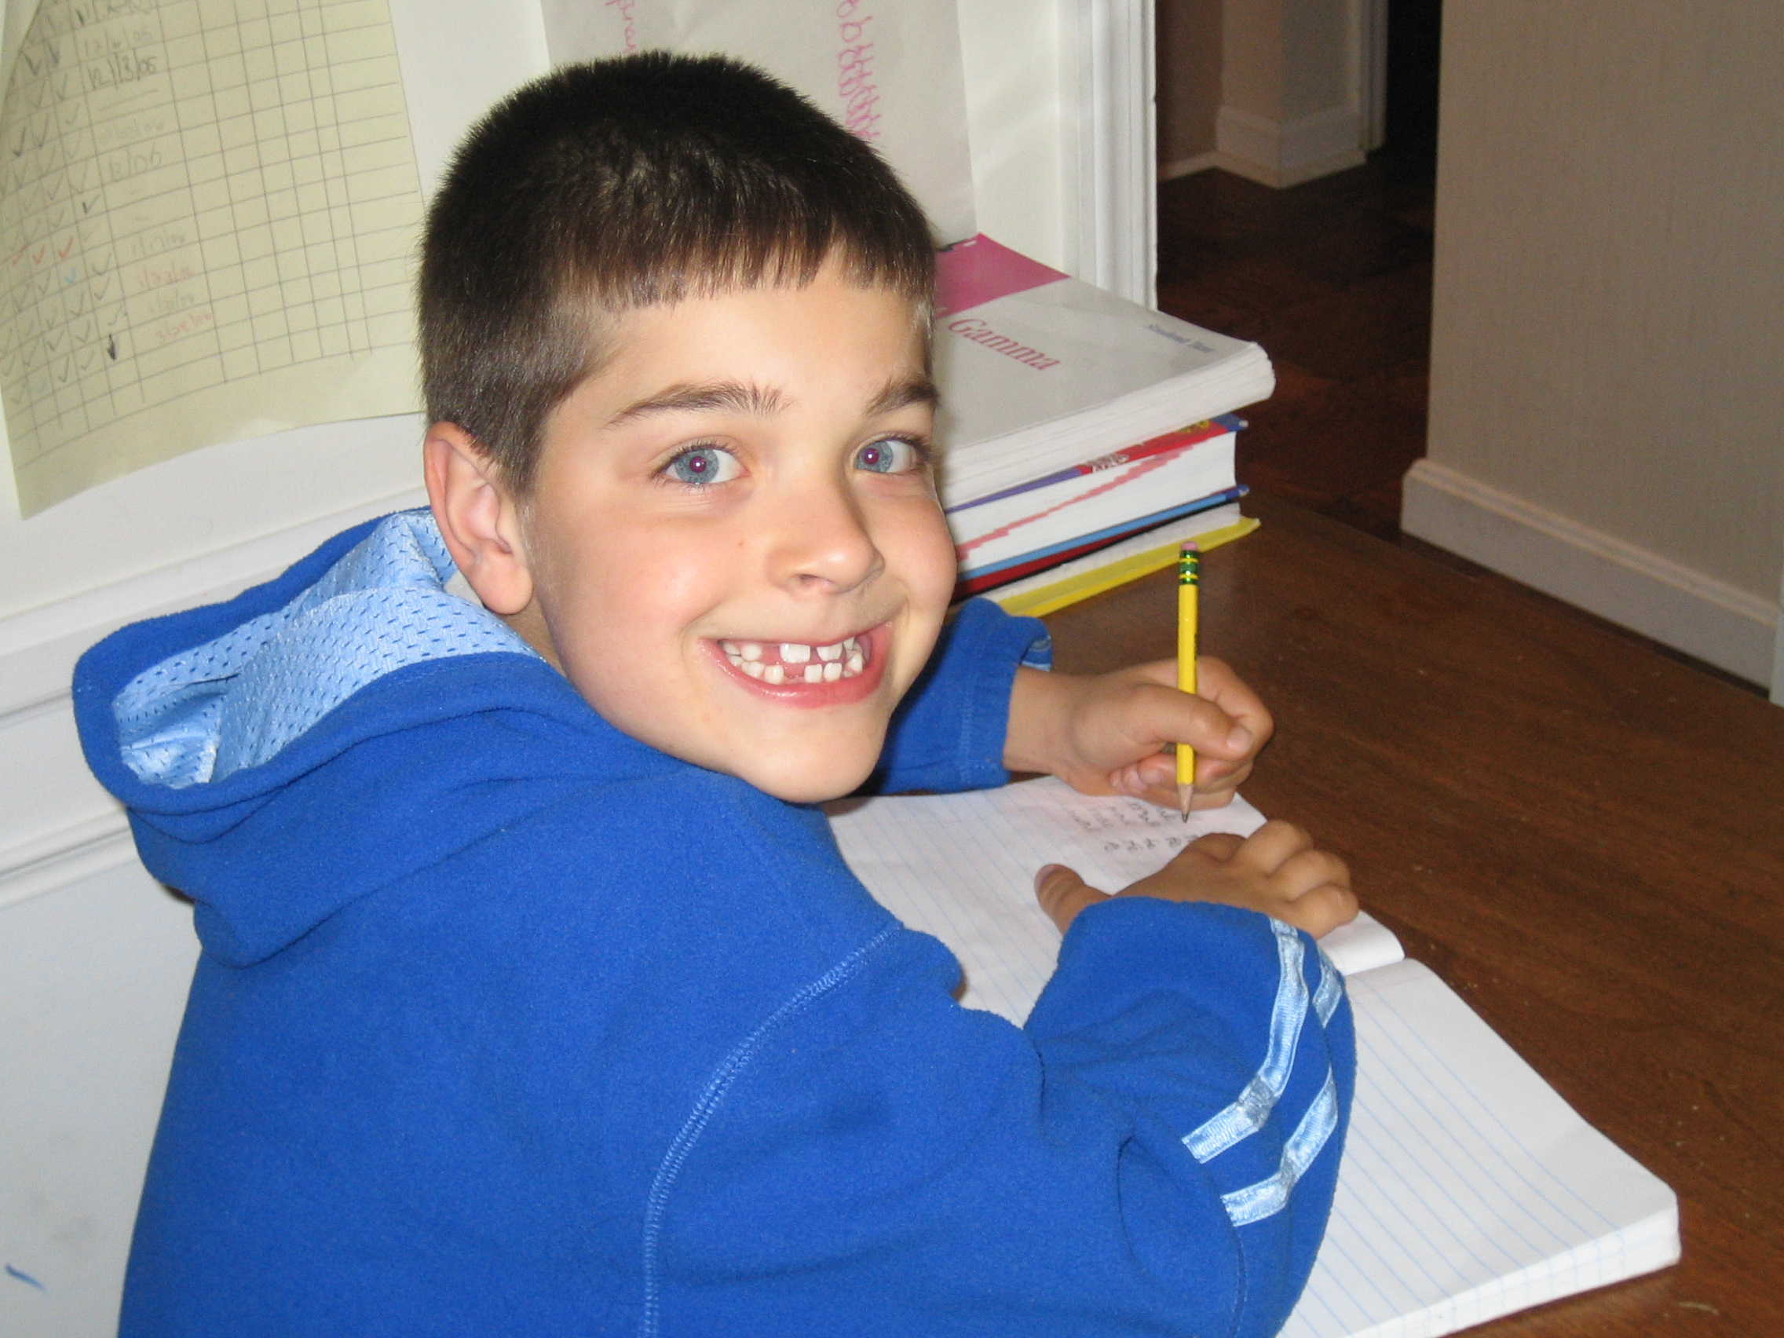
Sunset detector: A running example of image recognition
A system that will automatically distinguish between sunsets and non-sunset scenes, with a confidence measure:
→ P(sunset) = 0.95 → P(sunset) = 0.08
… a neat application area.
… and the second major programming assignment, due at midterm.
… and a warmup for your large term project!
Reading about it is part of the first assignment.
Notes:
Dave

Slide 11

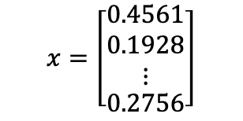
Image Recognition (formally): Pixels to predicates
1. Extract features from images (weeks 1-3)
2. Use ML to classify images or objects (weeks 4-6)
$$x=\left[\begin{aligned}\begin{matrix}0.4561 \\ 0.1928 \\ ⋮\end{matrix} \\ 0.2756\end{aligned}\right]$$
Color ←
Edges
Texture
Shape
Motion
Nearest neighbor
Support vector machines ←
Neural networks
Linear regression
CNNs do both!
Notes:
Dave

Slide 12
Course structure
Notes:
Dave

Slide 13
What will we do in this course?
Learn theory (lecture, quizzes) and “play” with it (this is a lab course: roughly every 4th day is a lab day)
You will work with a lab partner
Read about applications (papers)
Create applications and write formally about them to deepen your understanding (2 projects with a partner and a formal report, plus a big 4-person term project starting mid-term).
Learn some MATLAB. (Lab 1 is getting started)
Notes:
Dave

Slide 14
Getting started: see Blackboard!
I send you Getting Started
Blackboard has
the calendar of due dates
syllabus (course policies)
details on each unit (including some surveys)
all assignments
course files: quizzes and solutions, slides, papers
Do the Course Background Survey now
Notes:
Dave

Slide 15
Color and Images
Notes:
Dave

Slide 16
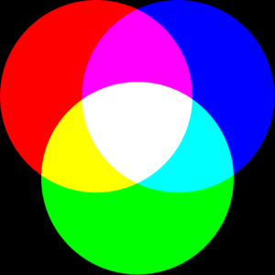
What is a color image?
Color dyes (printers):
Add to white a mix of {cyan, magenta, yellow, black} ink
Color images (displays):
Add to black a mix of {Red,Green,Blue} light
Notes:
Dave

Slide 17
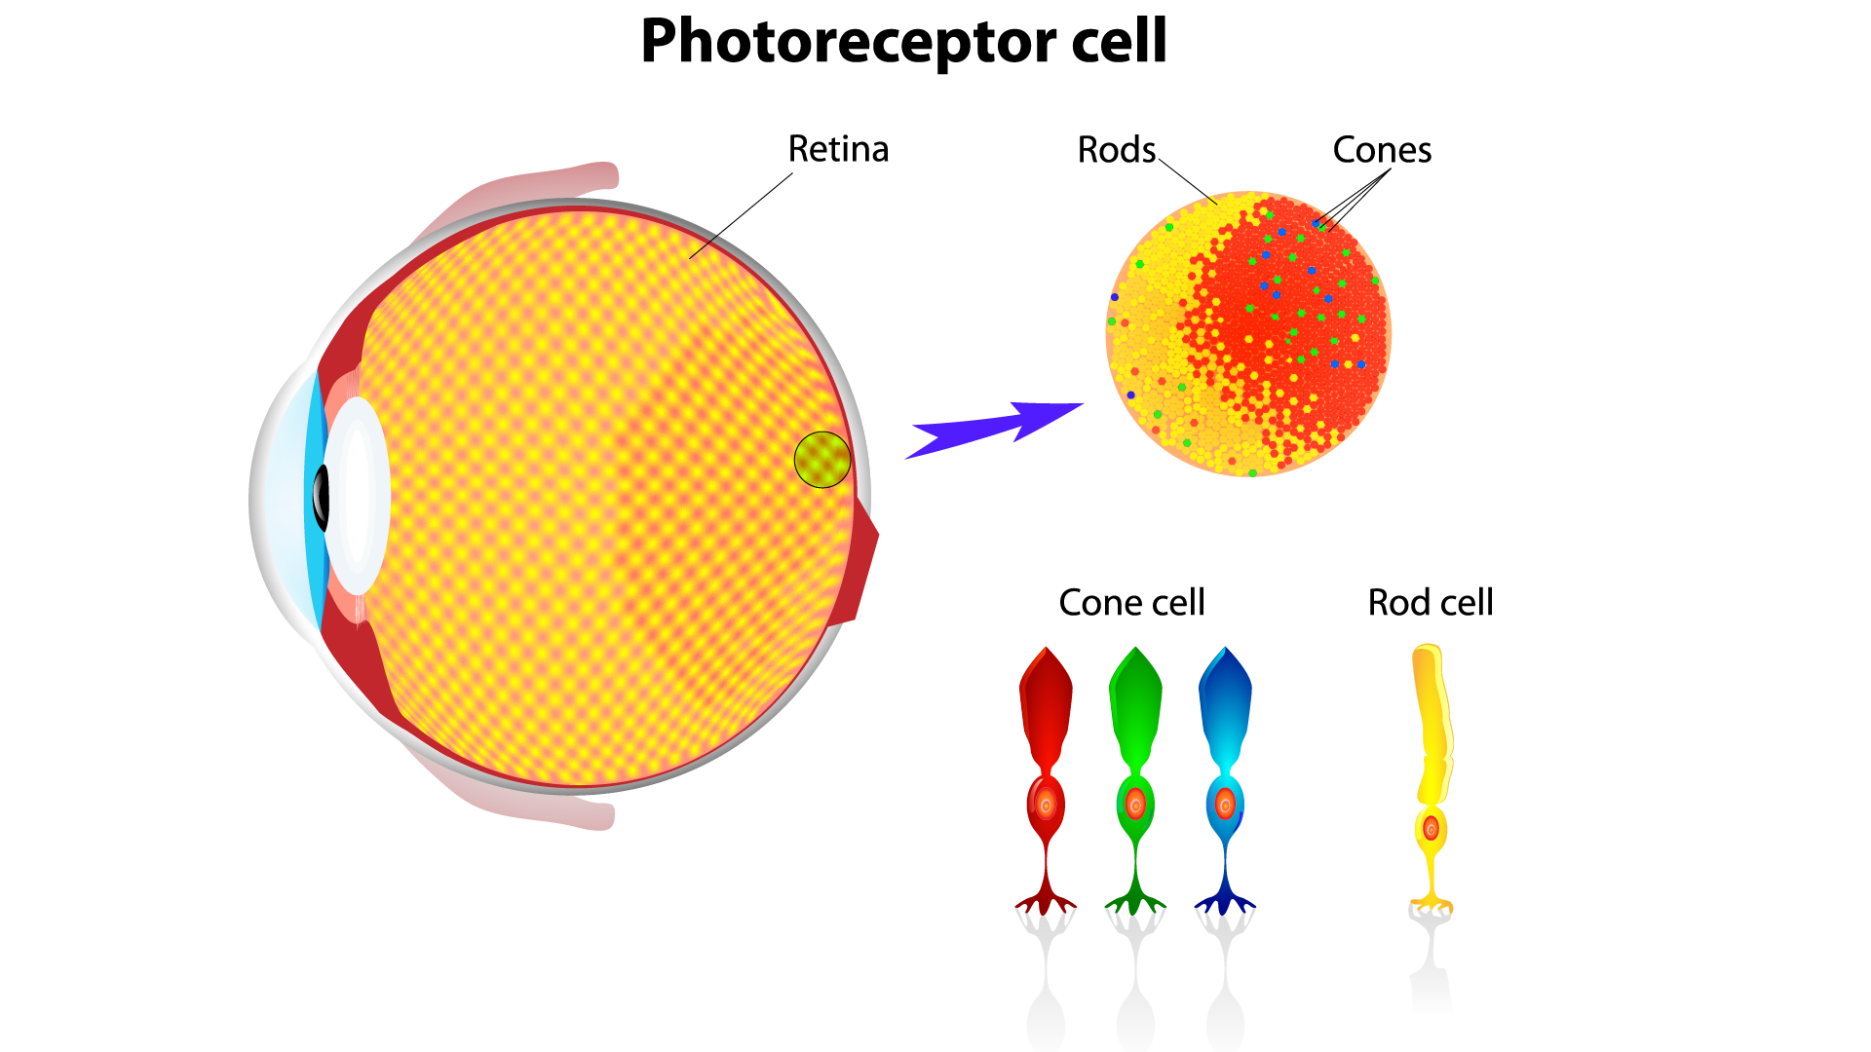
Why RGB?
Mimics cones in retina
Used in displays and sensors
There are other color spaces (this unit)
Color science is a whole field!
Notes:
Dave

Slide 18
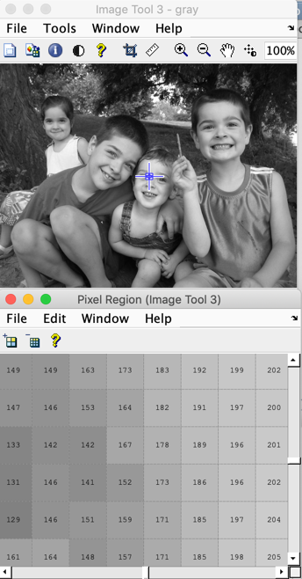
What is an intensity image?
Grayscale from black (0) to white (255)
Each pixel is (row, col), starting at top-left
not (x,y)
MATLAB uses 1-based indexing
So top right pixel is (1, width)
What is bottom left?
Notes:
Dave

Slide 19
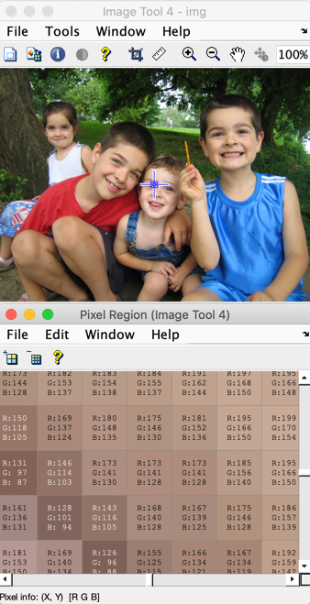
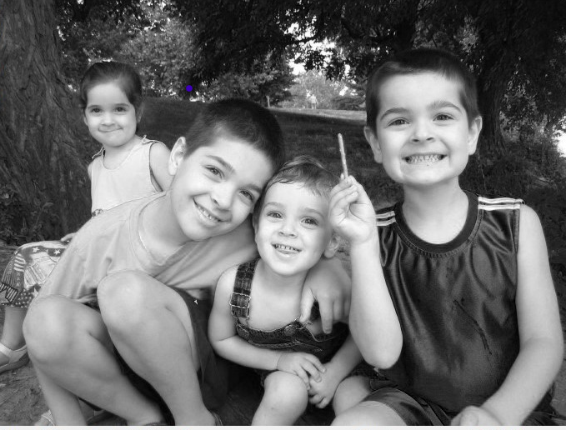
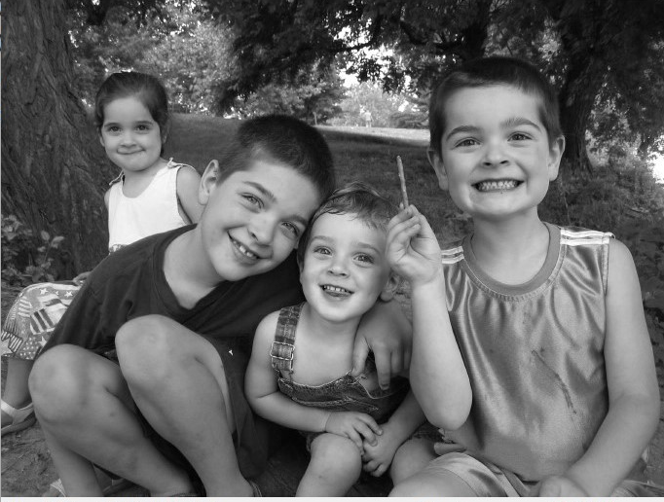
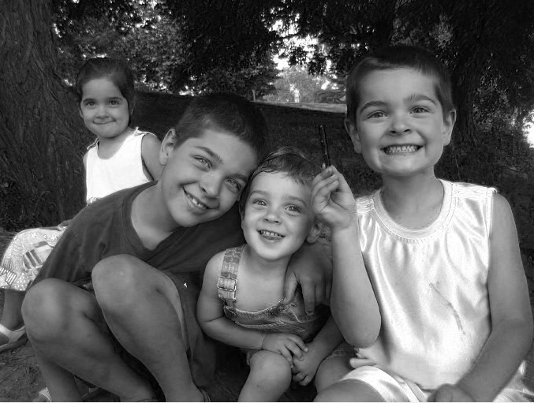
What is a color image?
Each color channel or band (R,G,B) is 0-255
R G B
←Each pixel,
located at (row, col),
has 3 values.
Channels are R,G,B planes→
R
G
B
Notes:
Dave

Slide 20
Fun closing thought about color images
What is video? A stack of color images, so _____ dimensions
What if we treat an intensity image as a 3D plot, where the 3rd dimension is the intensity?
(demo)
Notes:
Dave

Slide 21
Lab Intro
Notes:
Dave

Slide 22
Lab: Introduction to MATLAB and Image Processing Library
This lab is highly scripted since many are new to this language/libraries.
Notes:
Dave

Slide 23
Notes:
Dave

