Slide 1
K-means Algorithm and
Application to Image Segmentation
Image Recognition
Matt Boutell
Notes:
Both

Slide 2
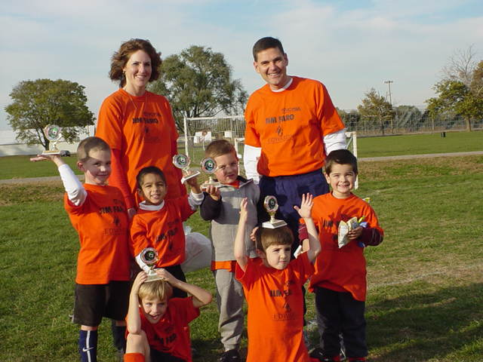
Goal: Segment an image like this

Slide 3
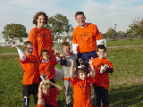
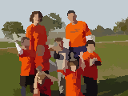
Segmentation is the process of breaking an image into regions
General-purpose, “One size fits all” segmentation is very difficult.
Mean-shift results below
Some CNN models do
Specialized segmentation for a specific domain (say fruit-, circle- or skin-finding) is easier.
Build a model of the expected shape, color, …
D. Comaniciu, P. Meer: Mean shift: A robust approach toward feature space analysis. IEEE Trans. Pattern Anal. Machine Intell, 24, 603-619, 2002. EDISON code at http://www.caip.rutgers.edu/riul/research/robust.html

Slide 4
What properties can be used to segment images?
Adjacent pixels that have homogeneous color, texture, etc. are in a region
Differences at boundaries between adjacent regions
(else merge)
Boundaries may have a smoothness condition
Idea for segmentation algorithm:
- Group pixels “close” to each other by some metric.
- Color distance, texture, intensity, spatial location, etc.
- Regions are then found using connected components
2
Notes:
TODO: Bring in more visualizations (even from MATLAB)

Slide 5
Segmentation can be performed using a clustering algorithm
Clustering is an example of unsupervised machine learning.
Famous examples:
K-means
principal components analysis
In unsupervised learning, there are no class labels
Data is cheaper to acquire
But it's harder to do!
Still relatively unexplored
Notes:
g(x) =
\begin{cases}
x \text{ if } x >= 0\\
0 \text{ otherwise }
\end{cases}

Slide 6
K-means goal

Slide 7
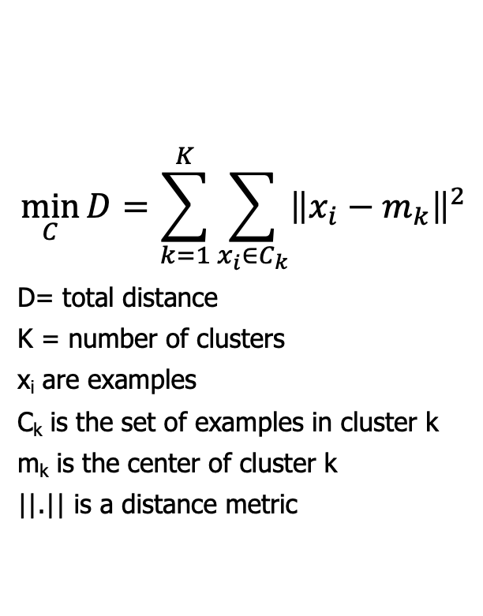
The goal of k-means is to minimize the total distance from each example to the closest cluster mean
$$\min_{C}{D=\sum_{k=1}^{K}{\sum_{x_{i}∈C_{k}}{{\left\|x_{i}−m_{k}\right\|}^{2}}}}$$
D= total distance
K = number of clusters
x_{i} are examples
C_{k} is the set of examples in cluster k
m_{k} is the center of cluster k
||.|| is a distance metric
Optimal for k=2
Not
Sonka, 6.2.6, Forsyth and Ponce, ch 15
Notes:
g(x) =
\begin{cases}
x \text{ if } x >= 0\\
0 \text{ otherwise }
\end{cases}

Slide 8
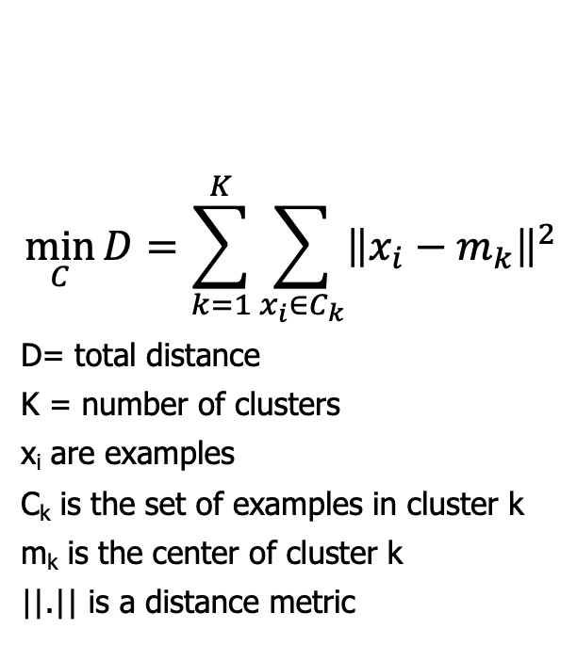
The goal of k-means is to minimize the total distance from each example to the closest cluster mean
$$\min_{C}{D=\sum_{k=1}^{K}{\sum_{x_{i}∈C_{k}}{{\left\|x_{i}−m_{k}\right\|}^{2}}}}$$
D= total distance
K = number of clusters
x_{i} are examples
C_{k} is the set of examples in cluster k
m_{k} is the center of cluster k
||.|| is a distance metric
What is the independent variable? (What does the algorithm control?)
C, the assignment of examples to each cluster. How? Specify the location of each cluster's mean. Then each example has a closest mean, which tells which cluster it is part of.
Sonka, 6.2.6, Forsyth and Ponce, ch 15
Notes:
g(x) =
\begin{cases}
x \text{ if } x >= 0\\
0 \text{ otherwise }
\end{cases}

Slide 9
K-means algorithm

Slide 10
K-means is a greedy iterative algorithm to group a data set into k clusters
Initialize K cluster means
Repeat until convergence:
1. For each example, find the closest mean and assign it to that cluster
2. Re-compute the mean of all examples assigned to the cluster
Label each example with its cluster
(Sonka, p 403; Forsyth&Ponce, p. 315; Shapiro, p. 282)
Notes:
Dave

Slide 11
K-means example using spatial distance

Slide 12
Important warm-up: clustering using 2D spatial distance

Slide 13
K-means re-cap: a chicken-and-egg problem
We are trying to determine both where the clusters are and which points are assigned to each cluster.
We iteratively solve each part:
Repeat until convergence:
Assume you know where the cluster centers are:
For each example, find the closest mean and assign it to that cluster
Assume you know which points belong to each cluster.
2. Re-compute the mean of all examples assigned to the cluster

Slide 14
K-means code for spatial distances

Slide 15
Let's write code to implement the example we did
We'll start by mapping out the data structures we'll need
Notes:
g(x) =
\begin{cases}
x \text{ if } x >= 0\\
0 \text{ otherwise }
\end{cases}

Slide 16
K-means limitations

Slide 17
K-means finds a local optimum and is easy to implement, but…
1. Local optimum is not always the global optimum (but infeasible to check all possible clusters)
2. Some clusters might have 0 points
3. The number of clusters, K, must be known in advance
Ideas:
Re-run with several random starts.
How can we tell which solution is best?
Can choose K based on observation
Use Adaptive K-means:
Split a cluster if the total distance to that cluster is too large. Do if you lose a mean along the way
Merge adjacent clusters if their total distance is small
Notes:
g(x) =
\begin{cases}
x \text{ if } x >= 0\\
0 \text{ otherwise }
\end{cases}

Slide 18
K-means code for image segmentation

Slide 19
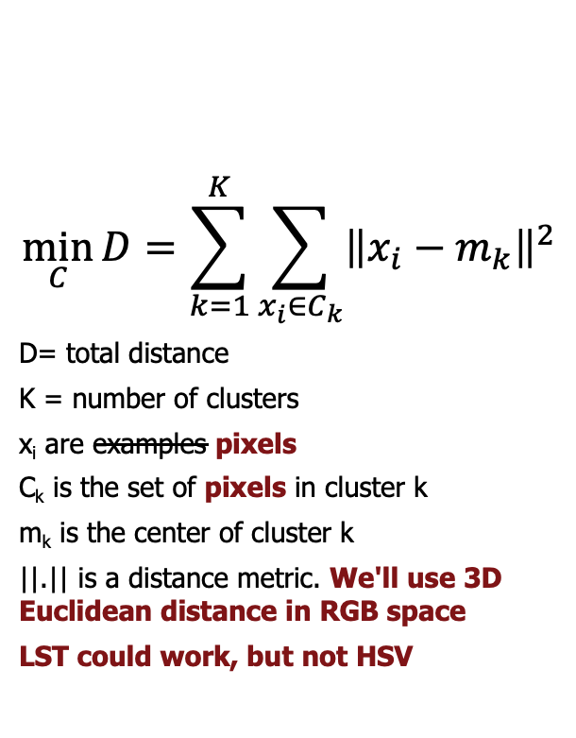
Back to the goal
$$\min_{C}{D=\sum_{k=1}^{K}{\sum_{x_{i}∈C_{k}}{{\left\|x_{i}−m_{k}\right\|}^{2}}}}$$
D= total distance
K = number of clusters
x_{i} are examples pixels
C_{k} is the set of pixels in cluster k
m_{k} is the center of cluster k
||.|| is a distance metric. We'll use 3D Euclidean distance in RGB space
LST could work, but not HSV
What is the independent variable? (What does the algorithm control?)
C, the assignment of pixels to each cluster. How? Specify the location of each cluster's mean. Then each pixel has a closest mean, which tells which cluster it is part of.
Notes:
g(x) =
\begin{cases}
x \text{ if } x >= 0\\
0 \text{ otherwise }
\end{cases}

Slide 20
K-means is a greedy iterative algorithm to group pixels into k clusters
Initialize K cluster means (random colors)
Repeat until convergence:
1. For each pixel, find the closest mean color and assign it to that cluster
2. Re-compute the mean of all examples assigned to the cluster
Each pixel gets its cluster's mean color
Note that means could be split spatially. Just post-process into connected-components

Slide 21
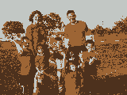
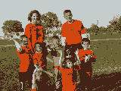
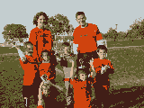
Example results with different values of K
Original (120x160)
K=3
K=5
K=7
Notes:
Dave

Slide 22
Write code to do color segmentation
Let's start by revisiting the data structures needed
Notes:
Dave

