Slide 1
Finding Objects: Hough Transforms, Templates, and HOG Features
Image Recognition
Matt Boutell
Notes:
Both

Slide 2
Detecting shapes in real images
In a previous unit, we detected shapes in noise-free binary images. Now, we advance to real, noisy images.
1. Hough transform
2. Template matching
- concepts
- using HOG features

Slide 3
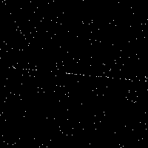
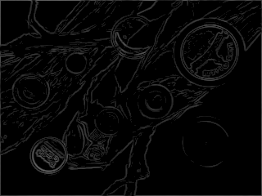
A Hough transform is a voting procedure in parameter space
What shapes are there?
How do you detect them?
Least-squares?
What do these two shapes
have in common?
They can be represented using equations represented by parameters. Points cast votes for consistent parameters and the true shape gets the most votes.
1. We'll discuss line detection in detail and see MATLAB.
2. You'll write a circle detector.
3. We'll extend to other shapes in theory.

Slide 4
Parameters for lines

Slide 5
How many parameters does it take to represent a line?
Two. Simplest?
y = mx + b (slope-intercept); any line is a 2D point (m,b).
Example: y=-x+4 is (-1,4)
Almost perfect. Why doesn't MATLAB use it?
Ax + By + C = 0 (standard form); any line is (A,B,C).
Do we need all 3?
x cos θ + y sin θ = ρ (Hesse normal form), any line is (ρ, θ).
ρ is distance from line to origin
θ is angle between distance segment and x-axis
2
https://en.wikipedia.org/wiki/Hough_transform
Notes:
TODO: Bring in more visualizations (even from MATLAB)

Slide 6
Voting procedure

Slide 7
Idea of a voting procedure
1. Represent a shape using parameters
2. Each edge point in the image casts a vote for all parameter combinations of which it could be part.
3. The true shape receives the most votes
Sonka, 6.2.6, Forsyth and Ponce, ch 15
Notes:
g(x) =
\begin{cases}
x \text{ if } x >= 0\\
0 \text{ otherwise }
\end{cases}

Slide 8
Applying the voting procedure to lines
1. Represent a shape using parameters
line: (m,b) in y=mx+b
2. Each edge point in the image casts a vote for all parameter combinations of which it could be part.
What votes does a single point cast?
Is there a pattern to them?
3. The true shape receives the most votes
Look for the intersection.
Example: apply to the points (4,4), (2,2), and (0,0) to detect the line y=x
Sonka, 6.2.6, Forsyth and Ponce, ch 15
Notes:
g(x) =
\begin{cases}
x \text{ if } x >= 0\\
0 \text{ otherwise }
\end{cases}

Slide 9
Noisy lines

Slide 10
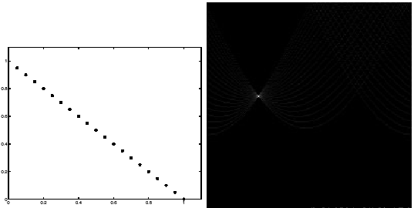
If the data is clean, there is a sharp peak in the voting space
(next 3 images from Forsyth and Ponce, ch 15)
Notes:
Dave

Slide 11
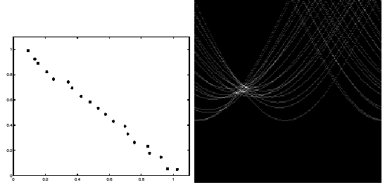
Noisier data gives a broader peak
How do we detect it?
Notes:
Dave

Slide 12
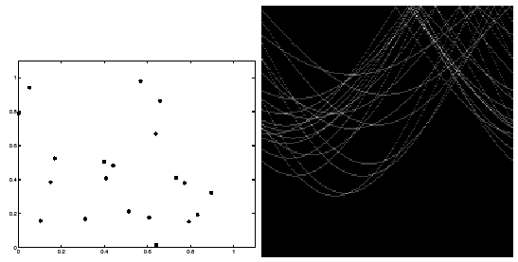
If the data is random, "phantom lines" will appear
There are many intersections – how can we handle them?
Notes:
Dave

Slide 13
Online visualization

Slide 14
Watch this visualization
http://homepages.inf.ed.ac.uk/amos/hough.html
Lots of good info there to read about, too!
Notes:
Dave

Slide 15
MATLAB functions

Slide 16
MATLAB requires two functions to detect lines
Run an edge detector first to find points that are voting
[H, theta, rho] = hough(edgeImg);
peaks = houghpeaks(H,nPeaks);
This works for lines only.

Slide 17
Handling noisy points
See hough's rhoResolution parameter
Notes:
Dave

Slide 18
Handling phantom lines
See houghpeaks' threshold parameter
Notes:
Dave

Slide 19
Detecting Other Shapes: Circles

Slide 20
Review: Applying the voting procedure to lines
1. Represent a shape using parameters
line: (m,b)
2. Each edge point in the image casts a vote for all parameter combinations of which it could be part.
What votes does a single point cast?
Is there a pattern to them?
3. The true shape receives the most votes
Look for the intersection.
Sonka, 6.2.6, Forsyth and Ponce, ch 15
Notes:
g(x) =
\begin{cases}
x \text{ if } x >= 0\\
0 \text{ otherwise }
\end{cases}

Slide 21
Apply the voting procedure to circles of fixed radius
1. Represent a shape using parameters
(how many; what are they?)
2. Each edge point in the image casts a vote for all parameter combinations of which it could be part.
(what shape does the locus of votes make?)
3. The true shape receives the most votes
(this is just the intersection of the loci)
Sonka, 6.2.6, Forsyth and Ponce, ch 15
Notes:
g(x) =
\begin{cases}
x \text{ if } x >= 0\\
0 \text{ otherwise }
\end{cases}

Slide 22
Apply the voting procedure to circles of fixed radius
Notes:
Dave

Slide 23
Detecting other shapes: Circles, Big and Small

Slide 24
Apply the voting procedure to circles of any radius
1. Represent a shape using parameters
(how many; what are they?)
2. Each edge point in the image casts a vote for all parameter combinations of which it could be part.
(what shape does the locus of votes make?)
3. The true shape receives the most votes
(this is just the intersection of the loci)
Sonka, 6.2.6, Forsyth and Ponce, ch 15
Notes:
g(x) =
\begin{cases}
x \text{ if } x >= 0\\
0 \text{ otherwise }
\end{cases}

Slide 25
Apply the voting procedure to circles of any radius
Sonka, 6.2.6, Forsyth and Ponce, ch 15
Notes:
g(x) =
\begin{cases}
x \text{ if } x >= 0\\
0 \text{ otherwise }
\end{cases}

Slide 26
Detecting Line Segments and Other Shapes

Slide 27
Apply the voting procedure to find line segments
1. Represent a shape using parameters
2. How to visualize the locus of votes from any point?
Sonka, 6.2.6, Forsyth and Ponce, ch 15
Notes:
g(x) =
\begin{cases}
x \text{ if } x >= 0\\
0 \text{ otherwise }
\end{cases}

Slide 28
Apply the voting procedure to find arbitrary shapes
Any shape! But we make a simplifying assumption for now: translation is the only transformation
1. Represent a shape using parameters
2. How to visualize the locus of votes from any point?
  Ballard, Dana. 1981. Generalizing the Hough transform to detect arbitrary shapes. Pattern Recognition, 13(2):111-122.
  Dana was a long-time member of Rochester’s computer vision group.
Sonka, 6.2.6, Forsyth and Ponce, ch 15
Notes:
g(x) =
\begin{cases}
x \text{ if } x >= 0\\
0 \text{ otherwise }
\end{cases}

Slide 29
Apply the voting procedure to find arbitrary shapes
Any shape! But we make a simplifying assumption for now: translation is the only transformation
1. Represent a shape using parameters
2. How to visualize the locus of votes from any point?
Notes:
g(x) =
\begin{cases}
x \text{ if } x >= 0\\
0 \text{ otherwise }
\end{cases}

Slide 30
Lab intro

Slide 31
My circle finder: Wouldn’t this be a great lab? ☺
  Like Matlab’s hough and houghpeaks (for lines), but from scratch
  Includes two options: variable or fixed radius circles

Slide 32
Focusing the votes (optional ideas)
Each edge pixel (one with above-threshold magnitude) casts one set of votes.
Use the edge gradient information as well
Only need to cast votes for centers along the gradient
I’ve done this; it works really well
Get creative: should strong edge pixels cast more votes?

Slide 33
Template Matching

Slide 34
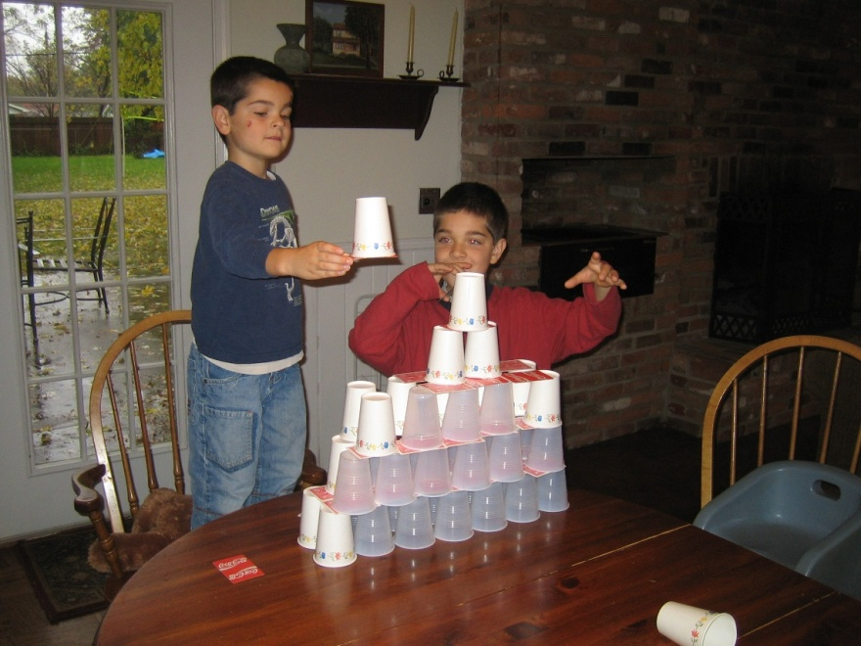

How can you look for an exact match of an object in an image?
Idea: Describe the object by a sub-image, called a template:
Sonka, 6.4

Slide 35
Simple algorithm: look for local maxima of a match criterion
1. Evaluate a match criterion at every image location (plus size, reflection, and rotation, if those variations are expected)
2. A “match” is a local maximum of the criterion, possibly above a threshold
Sonka, 6.4

Slide 36
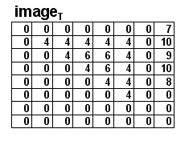
How to match? Use correlation.
Just use the template as a filter!
Idea: high correlation when
the template matches.
How does it work?

Slide 37
Improved Template Matching

Slide 38
How to match better ? Use normalized correlation.
Just use the template as a filter!
Idea: high correlation when
the template matches.
How does it work?
Problem: always high correlation when matching with a plain bright region
Solution: Normalize the template and each region by subtracting each’s mean from itself before taking dot product

Slide 39
Other Matching Algorithms

Slide 40
Other matching algorithms
Chamfering (Hausdorff distance):
http://www.cs.cornell.edu/~dph/hausdorff/hausdorff1.html
Springs and templates (Crandall and Huttenlocher)
http://www.cs.cornell.edu/~dph/papers/cvpr07.pdf
Even CNNs need to operate at various scales/patches of the image to detect objects.
Some variations have been developed to cut down on processing time.

Slide 41
Histograms of Oriented Gradients

Slide 42
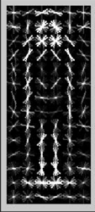
Edges are more robust features for detection than intensities
Histogram of
Oriented
Gradients
("HOG" features)
Sources:
Guest lecture by Trenton Tabor, RHIT ‘12
Sonka, et al. text, section 10.6.3
N. Dalal and B. Triggs, "Histograms of Oriented Gradients for Human Detection", Proc. IEEE Conf. Computer Vision and Pattern Recognition, vol. 1, pp. 886-893, 2005.

Slide 43
HOG features work well for pedestrian detection
Dalal and Triggs introduced it in 2005.
Their work has been cited over 13,000 times!
Used for object classification in 2006
We’ll look at usage for digit classification
Past CSSE463 teams have used for object recognition tasks

Slide 44
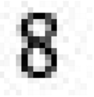
Matlab has clear docs and examples
Matlab HOG documentation
Matlab end-to-end digit recognition example
How?
Preprocessing by binarizing images
Extract HOG features on training and testing sets
Train an ensemble of linear SVMs for multiclass classification
Demo digit rec now

Slide 45
HOG Feature Extraction

Slide 46
How does HOG feature extraction work?

Slide 47
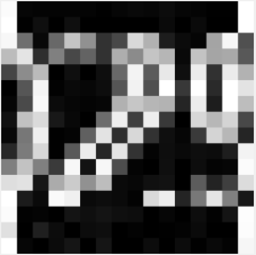

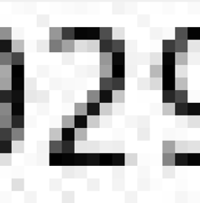

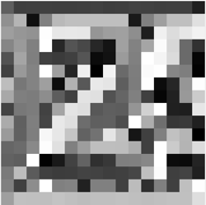
1. Calculate edge gradient magnitude and direction
dx
magnitude
-1 | 0 | 1
Orientation histogram every 20 deg (9 bins)
Compute for each cell (group of pixels)
1
0
-1
dy
Direction (0-180°)

Slide 48
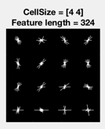
1b. Edge direction histogram visualization

Slide 49
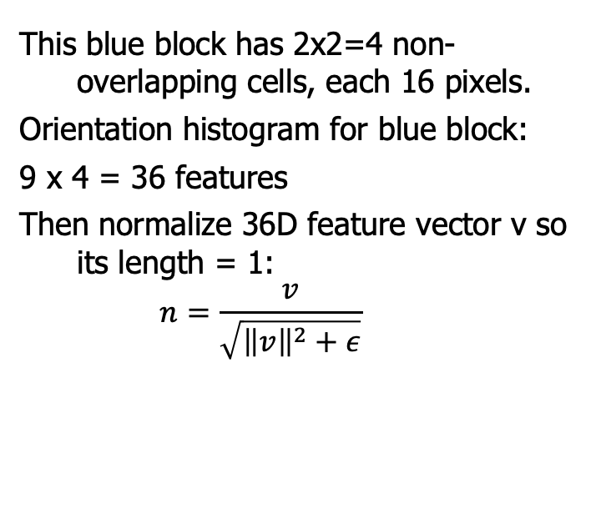
2. Repeat for each cell in block
This blue block has 2x2=4 non-overlapping cells, each 16 pixels.
Orientation histogram for blue block:
9 x 4 = 36 features
Then normalize 36D feature vector v so its length = 1:
$$n=\frac{v}{\sqrt{{\left\|v\right\|}^{2}+ε}}$$

Slide 50
3. Repeat for each block of cells in the window
Window has blocks of cells made of pixels.
etc.
36/block x 9 overlapping blocks = 324 features
Each block is normalized independently
324 features then sent to SVM to detect the object of interest in that window.
https://www.mathworks.com/help/vision/examples/digit-classification-using-hog-features.html

Slide 51
Multiclass SVMs
Train 1 SVM per class. Using a digit classifier, for example:
SVM₁ is for “1” vs “non-1” (so 0,2,3,4,5,6,7,8,9)
SVM₂ is for “2” vs “non-2”
SVM₃ for “3” vs ”non-3”
…
Feed the test vector to all SVMs
Assign class i if SVM_{i} gives max output.
Note: Still need 50/50 pos/neg to train each SVM (throw away data).
An alternative uses error correcting codes (fitECOC) from communications theory to get the SVMs to give different aggregate responses on each class.

Slide 52
Example of pedestrian classifier using HOG features
https://www.youtube.com/watch?v=TzzJC8sOe60&feature=youtu.be
Showcasing Trenton’s work:
T. Tabor, Z. Pezzementi, C. Vallespi and C. Wellington, 'People in the Weeds: Pedestrian Detection Goes Off-road', in 2015 IEEE International Symposium on Safety, Security, and Rescue Robotics, Purdue University, West Lafayette, IN, 2015.

Slide 53
Sounds great. How do I start?
Read the MATLAB example.
Try it out!
Read about parameters and experiment with them as needed:
Matlab HOG documentation

