Slide 1
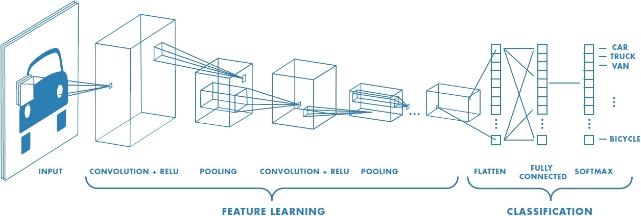
Deep Learning and
Convolutional Neural Networks
Image Recognition
Matt Boutell
Image Credit: https://www.mathworks.com/discovery/convolutional-neural-network.html
Notes:
Both

Slide 2
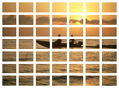
Background: we are detecting sunsets using the classical image recognition paradigm
Classifier
(1hidden layer)
Human- engineered feature extraction
feature vector
Class [-1, 1]
Support vector machine
7x7x6
=294
Grid-based Color moments
384x256x3
Build model (choose kernel, C)
Train (quadratic programming optimization with Lagrange multipliers bounded by BoxConstraints)
Predict the class of a new vector by taking the weighted sum of functions of the distances of the vector to the support vectors
Notes:
Dave

Slide 3
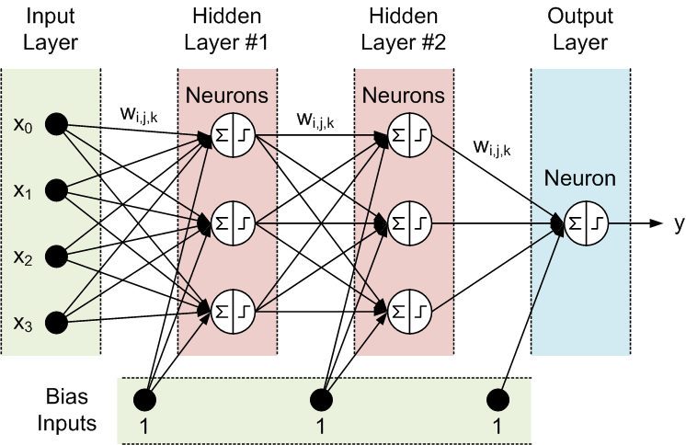
Reminder: Basic neural network architecture
“Shallow” net
Each neuron p_{i} = f(x)
Or a layer is p = f(x)
Width
Depth
http://tx.shu.edu.tw/~purplewoo/Literature/!DataAnalysis/three%20activation%20functions.files/NN1.gif
Notes:
General case is fully connected between each layer.
Width of each layer can vary.

Slide 4
Background: We could swap out the SVM for a traditional (shallow) neural network
Classifier
(1-3 layers)
Human- engineered feature extraction
feature vector
Class (0-1)
Neural net
7x7x6
=294
Grid-based Color moments
…but our choice of features may limit accuracy
384x256x3
Build model (1-2 fully-connected hidden network layers)
Train (backpropagation to minimize loss function)
Predict the class of a new vector by extracting features and forward-propagating the features through the neural network…
Notes:
Dave

Slide 5
Deep learning and convolutional neural nets

Slide 6
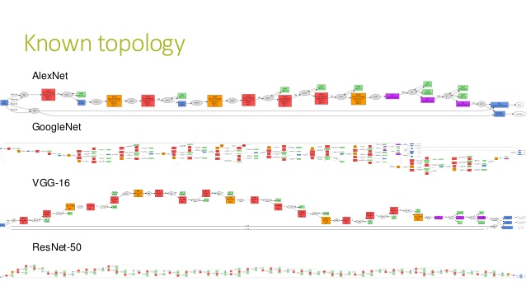
Deep learning is a vague term
“Deep” networks typically have 10+ layers.
For example, 25, 144, or 177 (we’ll use some of these!)
That’s many weights to learn.
And more choices of architectures.
Should layers be fully connected?
How to train them fast enough?
Fig: https://www.slideshare.net/Geeks_Lab/aibigdata-lab-2016-transfer-learning

Slide 7
Deep learning is a new paradigm in machine learning
Deep networks learn both which features to use and how to classify them.
There are millions of parameters
https://www.mathworks.com/discovery/convolutional-neural-network.html
Notes:
Dave

Slide 8
Image classification network layers come in several types
Convolution, ReLU, Pooling
https://www.mathworks.com/discovery/convolutional-neural-network.html
Notes:
Dave

Slide 9
Convolution

Slide 10
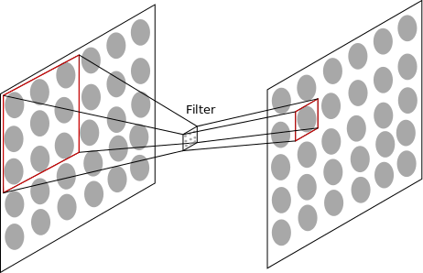
Convolution of filters with input
The network learns what weights to use from data
AJ Piergiovanni, CSSE463 Guest Lecture https://docs.google.com/presentation/d/15Lm6_LTtWnWp1HRPQ6loI3vN55EKNOUi8hOSUypsFw8/
Notes:
Dave

Slide 11
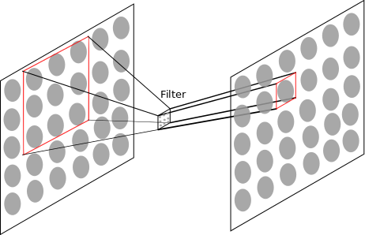
Convolution of filters with input
The network learns what weights to use from data
Notes:
Dave

Slide 12
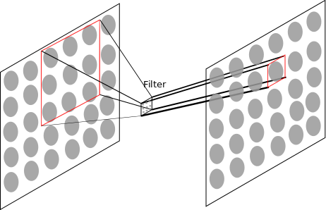
Convolution of filters with input
The network learns what weights to use from data. A set of 3x3 weights must be learned for each filter. But the same 3x3 filter connects every 3x3 patch in the first layer with every corresponding neuron in the next layer. We usually have 10-100 such filters per level.
Notes:
Dave

Slide 13
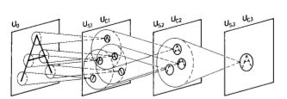
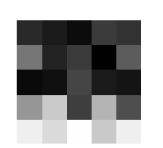
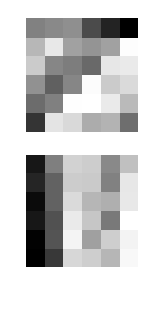
Convolutional layers learn familiar features
The first layer filters learn edges and opponent colors (color edges),
Higher level filters learn more complex features
Example Filters
Kunihiko Fukushima. “Neocognitron: A self-organizing neural network model for a mechanism of pattern recognition unaffected by shift in position”. 1980.
2
Notes:
TODO: Bring in more visualizations (even from MATLAB)

Slide 14
Other layers; ReLU, Pooling, Softmax

Slide 15
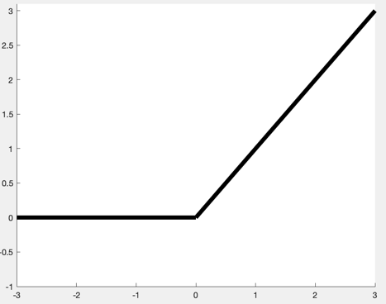
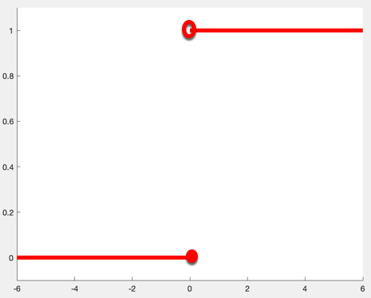
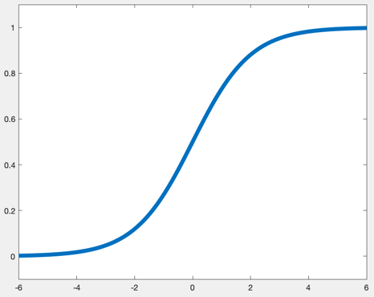
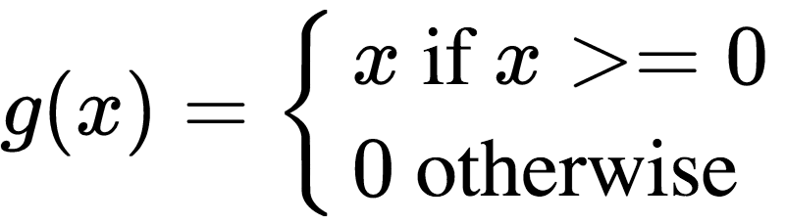
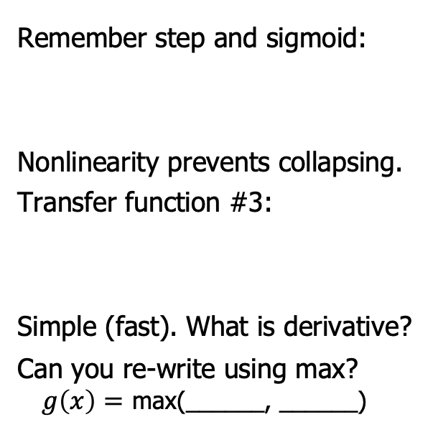
ReLU (Rectified Linear Unit) is one of the simplest non-linear transfer functions.
Remember step and sigmoid:
Nonlinearity prevents collapsing.
Transfer function #3:
Simple (fast). What is derivative?
Can you re-write using max?
$g\left(x\right)=$ max(______, ______)
CC0, https://en.wikipedia.org/w/index.php?curid=48817276
Notes:
g(x) =
\begin{cases}
x \text{ if } x >= 0\\
0 \text{ otherwise }
\end{cases}

Slide 16
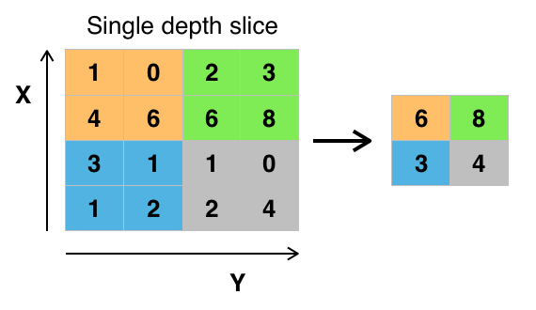
Pooling fights an increase of dimensionality
Since we learn multiple filters at each level, the dimensionality would continue to increase. The solution is to pool data at each layer and downsample.
Types:
Max-pooling
Average-pooling
Subsampling only
Example of max-pooling.
https://commons.wikimedia.org/wiki/File:Max_pooling.png#filelinks
Notes:
Dave

Slide 17
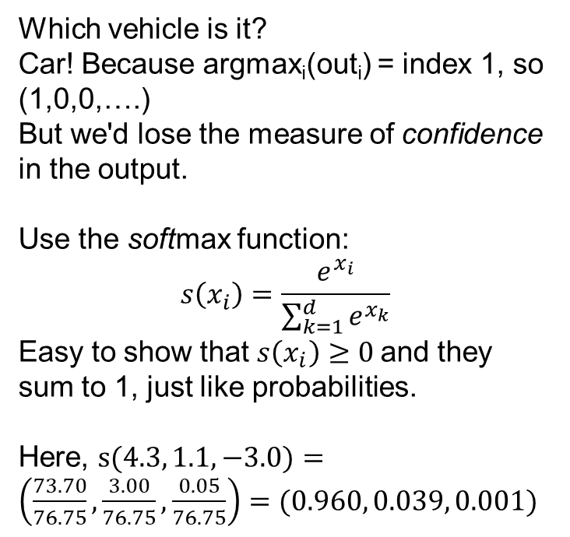
Softmax turns a layer's values into a "probability distribution"
Which vehicle is it?
Car! Because argmax_{i}(out_{i}) = index 1, so (1,0,0,….)
But we'd lose the measure of confidence in the output.
Use the softmax function:
$$s\left(x_{i}\right)=\frac{e^{x_{i}}}{\sum_{k=1}^{d}{e^{x_{k}}}}$$
Easy to show that $s\left(x_{i}\right)≥0$and they sum to 1, just like probabilities.
Here, $s(4.3, 1.1, −3.0)=\left(\frac{73.70}{76.75},\frac{3.00}{76.75},\frac{0.05}{76.75}\right)=(0.960, 0.039, 0.001)$
4.3
1.1
-3.0
0.960
0.039
0.001

Slide 18
Putting it all together:
{Convolution, ReLU, Pooling}^{N}, Fully-connected, Softmax
Newer architectures also use dropout, batch-normalization, and skip-connections between layers.
Notes:
Dave

Slide 19
Why deep learning now?

Slide 20
While deep learning is a "new" paradigm in machine learning…
Notes:
Dave

Slide 21
… it is really just an old idea that is now practical
In 2012, a deep network was used to win the ImageNet Large Scale Visual Recognition Challenge (14M annotated images), bringing the top-5 error rate down from the previous 26.1% to 15.3%.
Deep networks keep winning and improving each year.
Why?
Faster hardware (GPUs)
Access to more training data (www)
Algorithmic advances
www.deeplearningbook.org/
Olga Russakovsky*, Jia Deng*, Hao Su, Jonathan Krause, Sanjeev Satheesh, Sean Ma, Zhiheng Huang, Andrej Karpathy, Aditya Khosla, Michael Bernstein, Alexander C. Berg and Li Fei-Fei. ImageNet Large Scale Visual Recognition Challenge. IJCV, 2015.
Notes:
Dave

Slide 22
Gradient descent and stochastic gradient descent

Slide 23
Back to the big picture
Build model (many layers)
Train (gradient descent to minimize loss function)
Predict the class of a new vector by forward propagation through the network
Notes:
Dave

Slide 24
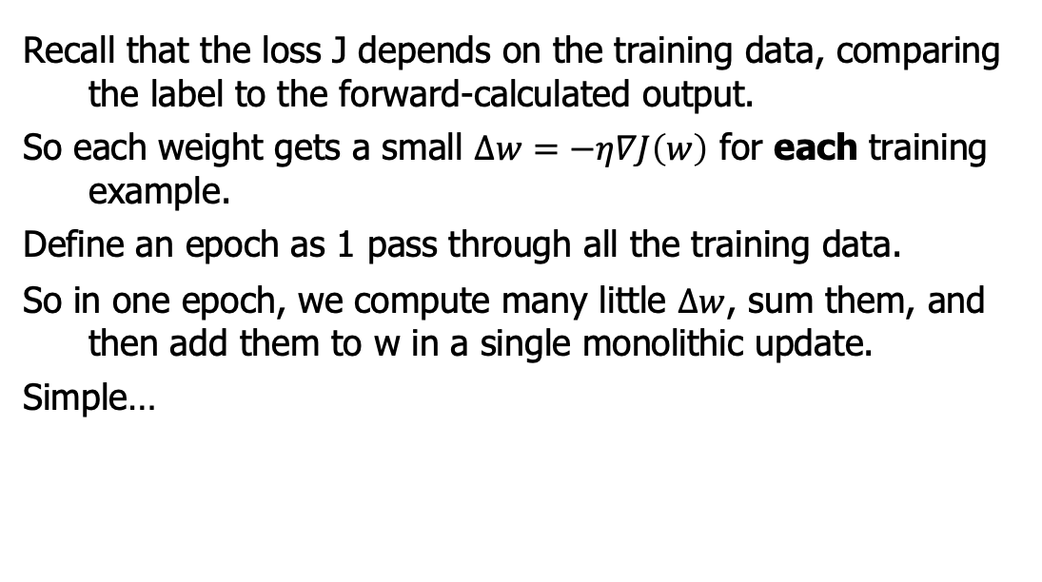
Recall that gradient descent is used to find a local optimum of the loss function
Recall that the loss J depends on the training data, comparing the label to the forward-calculated output.
So each weight gets a small $∆w=−η∇J\left(w\right)$ for each training example.
Define an epoch as 1 pass through all the training data.
So in one epoch, we compute many little $∆w$, sum them, and then add them to w in a single monolithic update.
Simple…

Slide 25
Stochastic Gradient Descent is used more often
…but what if the training set is large? You don't get the benefit of the updates until the next epoch.
Stochastic gradient descent divides the training data into many mini-batches, which are far smaller than the whole data set
  Trains faster
  Often converges much faster
So 1 epoch is made of many mini-batches.

Slide 26
Hyperparameters and validation sets

Slide 27
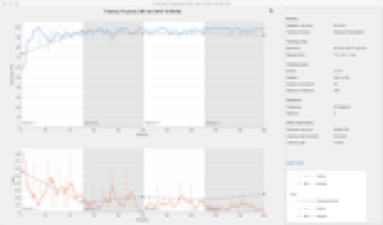
Training a neural network
Inputs:
the training set (set of images)
the network architecture (an array of layers)
the options that include hyper-parameters:
options = trainingOptions('sgdm',...
'MiniBatchSize',32,...
'MaxEpochs',4,...
'InitialLearnRate',1e-4,...
'VerboseFrequency',1,...
'Plots','training-progress',...
'ValidationData',validateImages,...
'ValidationFrequency',numIterationsPerEpoch);
Output: a trained network (with learned weights)
Notes:
Dave

Slide 28
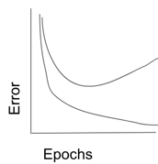
Training a neural network
Why do we split our data into 3 sets?
We learn something from each one!
Train
Validation
Test
Notes:
Dave

Slide 29
Building a CNN

Slide 30
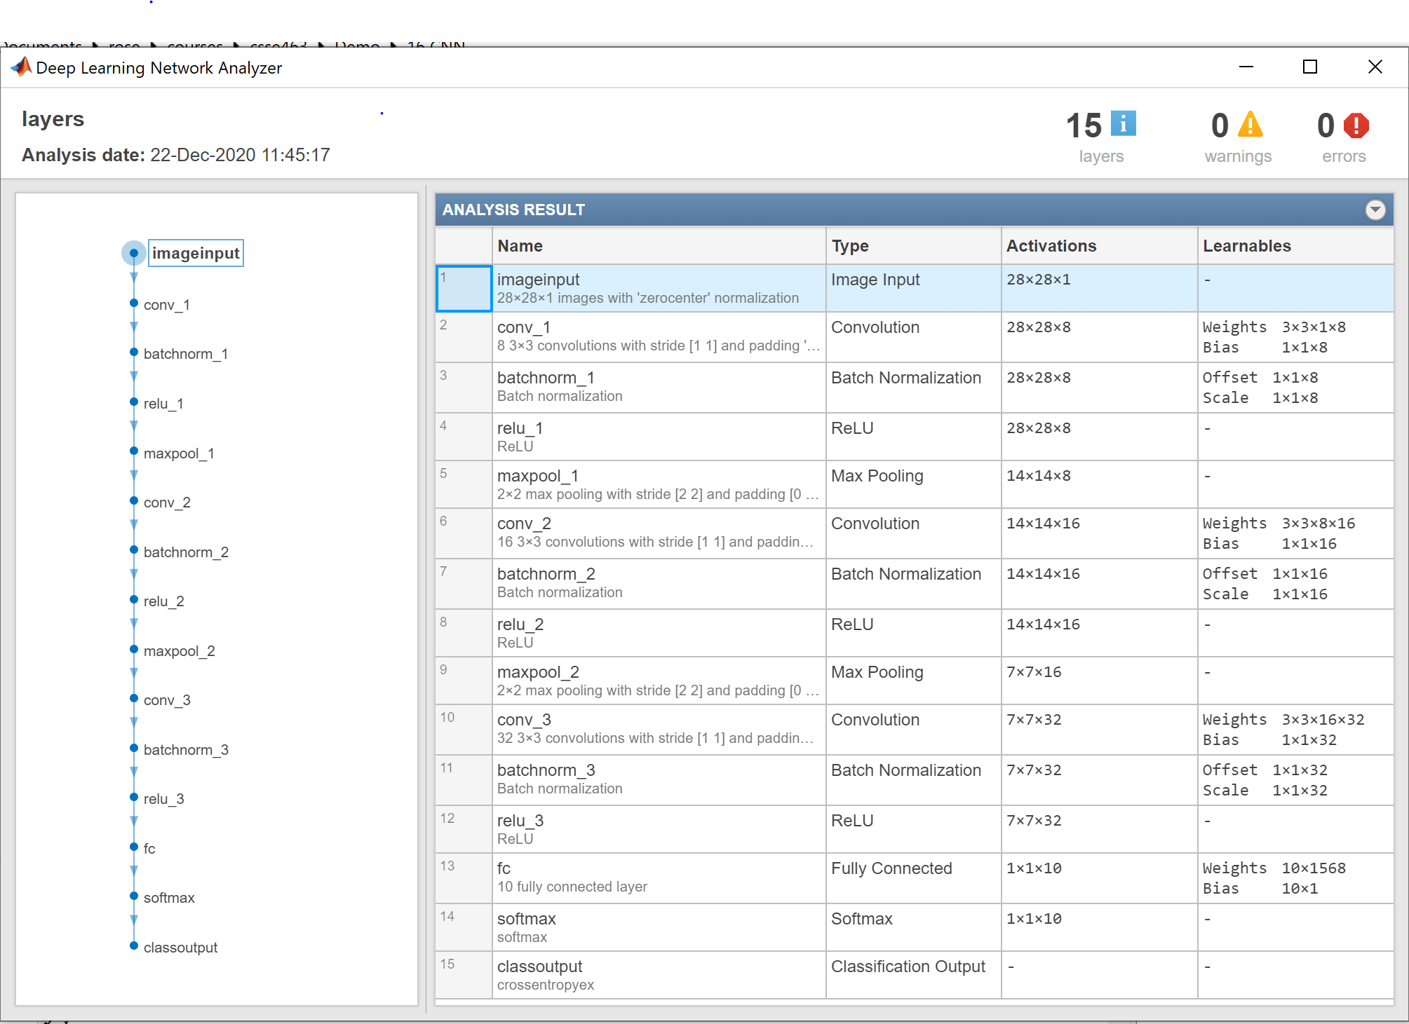
Building a CNN from Layers
Different languages allow you to do this.
You can build one in MATLAB
Uses Layer objects.
Learn from examples:
https://www.mathworks.com/help/deeplearning/ug/create-simple-deep-learning-network-for-classification.html
Do you have enough data to train it?
That tiny net has > 6000 weights
analyzeNetwork(layers)
AlexNet has 61M weights.
Notes:
Dave

Slide 31
Importing a CNN
Different languages allow you to do this.
You can import one from another package like Keras/Tensorflow or PyTorch.
Still: do you have enough data to train it?
Notes:
Dave

Slide 32
Transfer Learning: Leveraging pre-trained networks

Slide 33
Limitations of CNNs
Deep learning can be a black box - the learned weights are often not intuitive
They require LOTS of training data.
Need many, many (millions) images to get good accuracy when training from scratch
Notes:
Dave

Slide 34
Overcoming limitations: transfer learning
Some researchers have released their trained networks.
AlexNet, GoogleNet, ResNet-x, or VGG-19.
Why would we do this? # images, speed, accuracy.
Can you use them directly?
Transfer: Can you swap out and re-train only the classification layers for your problem?
  If the filters learned in the early, convolutional layers are decent, why take the time to re-train them from scratch?
Notes:
Dave

Slide 35
Leveraging pre-trained networks: Feature extraction

Slide 36
Overcoming limitations: feature extraction
Can you run the feature extraction part only and save the activations as features?
  Example: replace the 294 LST features with 4096 AlexNet features? Why not use an SVM?
Last resort: start from scratch?
Notes:
Dave

Slide 37
Lab intro and applications to signal processing

Slide 38
Next lab
The options of {pre-trained net, transfer-learning,
feature-extraction, or your-own-net} are the basis for the next lab and the sunset detector
MATLAB docs

Slide 39
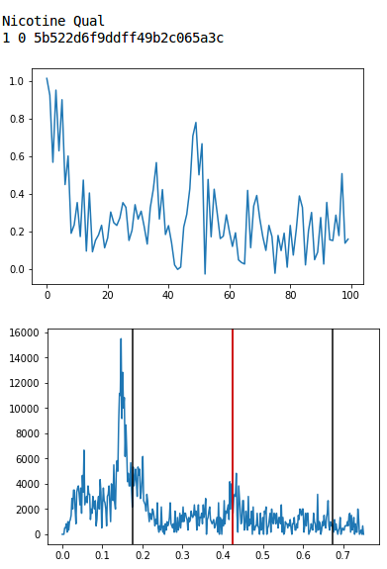
CNNs aren't just for images:
They can classify 1D signals, like chromatograms, as well.
0.00 Hi No-peak
0.17 No-peak
0.83 Small-peak
0.00 Peak
Each box is a matrix of weights or intermediate values (of neurons)
Notes:
(5 min) Architecture: Conv net, will discuss filter banks, nonlinear activation, max-pooling, classification, and that learned filters are . [The most purely-ML technical part of the talk, so I'll want to dwell here longest, relating it to successful use of ConvNets in image recognition] Filter banks learn things like smoothing, 1D, 2D.

Slide 40
Note: CNNs can classify 1D signals, like chromatograms, as well.
768
100x1
100x16
30
50x16
25x32
4
12x64
0.00 Hi No-peak
0.17 No-peak
0.83 Small-peak
0.00 Peak
Boutell and Julian, MSACL 2019
Softmax
Convolution: learn (3x1) filters x16, ReLU (nonlinear)
Max-pool
Conv (3x16)x32,
ReLU, MP
Conv (3x32)x64,
ReLU, MP
Flatten
Fully-connected
Extract Features
Classify
Notes:
(5 min) Architecture: Conv net, will discuss filter banks, nonlinear activation, max-pooling, classification, and that learned filters are . [The most purely-ML technical part of the talk, so I'll want to dwell here longest, relating it to successful use of ConvNets in image recognition] Filter banks learn things like smoothing, 1D, 2D.

Slide 41
CNNs have been applied to other domains as well
Speech recognition
Music generation
But other network architectures have been developed to handle time-series data of variable length, like language models:
Recurrent nets, LSTM, transformers

