Slide 1
Support Vector Machines
Image Recognition
Matt Boutell
Notes:
Both

Slide 2
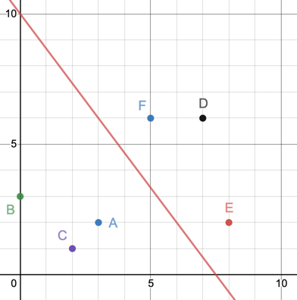
Outline: building a binary classifier
Find any hyperplane to separate 2 classes
Ex: (A,B,C vs D,E,F) →
Find the best hyperplane to separate 2 classes.
Make more robust by softening the separation requirement
Enlarge the feature space to separate more cleanly
(support vectors)
(using slack variables)
(using a kernel function)
Following ch 9 of http://faculty.marshall.usc.edu/gareth-james/ISL/ISLR%20Seventh%20Printing.pdf

Slide 3
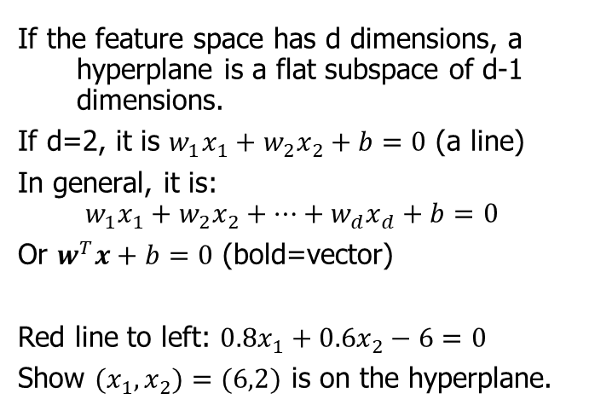
We separate feature space into 2 regions with a hyperplane
If the feature space has d dimensions, a hyperplane is a flat subspace of d-1 dimensions.
If d=2, it is $w_{1}x_{1}+w_{2}x_{2}+b=0$ (a line)
In general, it is:
$$w_{1}x_{1}+w_{2}x_{2}+…+w_{d}x_{d}+b=0$$
Or $w^{T}x+b=0$ (bold=vector)
Red line to left: $0.8x_{1}+0.6x_{2}−6=0$
Show ${(x}_{1},x_{2})=(6,2)$ is on the hyperplane.
Notes:
Dave

Slide 4
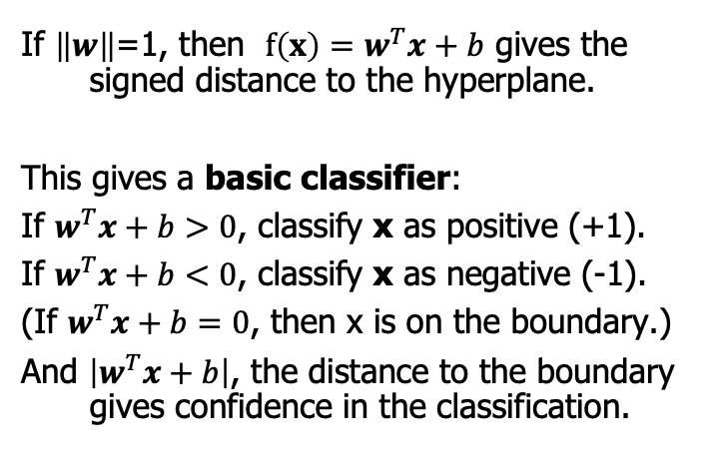
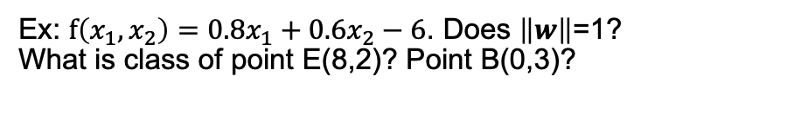
Key: if weight vector is a unit vector, then w^{T}x+b is a distance.
If $\left\|w\right\|$=1, then $f\left(x\right)=w^{T}x+b$ gives the signed distance to the hyperplane.
This gives a basic classifier:
If $w^{T}x+b>0$, classify x as positive (+1).
If $w^{T}x+b<0$, classify x as negative (-1).
(If $w^{T}x+b=0$, then x is on the boundary.)
And $\left|w^{T}x+b\right|$, the distance to the boundary gives confidence in the classification.
Ex: $f\left(x_{1},x_{2}\right)=0.8x_{1}+0.6x_{2}−6$. Does $\left\|w\right\|$=1?
What is class of point E(8,2)? Point B(0,3)?
Notes:
Dave

Slide 5
Max margin classifier

Slide 6
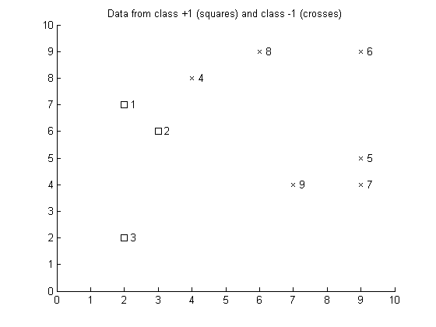
If there is more than 1 separating hyperplane, which is best?
But if the data is separable, there are many separating hyperplanes…
Which would you choose?
Notes:
Dave

Slide 7
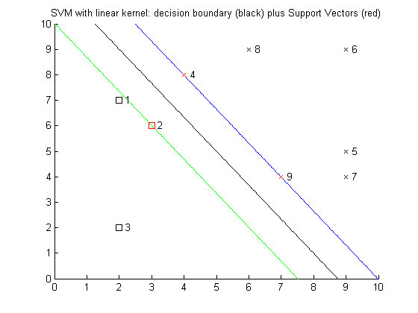
If there is more than 1 separating hyperplane, which is best?
The “best” hyperplane is the one that maximizes the "margin" between the classes.
Margin = "no-man's land"
M = distance from hyperplane to margin edge.
Some training points will always lie on the margin. These are called “support vectors”
#2,4,9 to the left
Why does this name make sense intuitively?
margin
M
ρ
Notes:
Dave

Slide 8
Why do we call them "support" vectors?
The support vectors are the toughest to classify
What would happen to the decision boundary if we moved or removed one of them, say #4?
A different margin would have maximal width!
Notes:
Dave

Slide 9
Formulation of max margin classifier

Slide 10
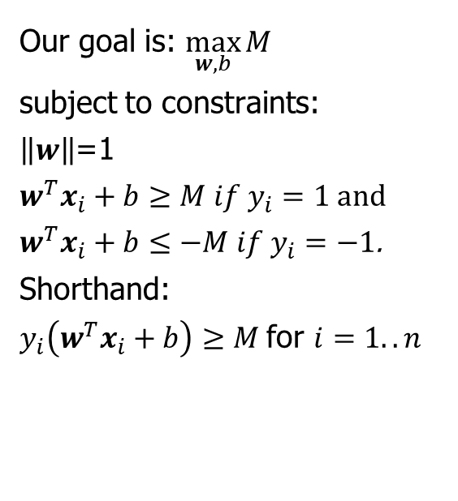
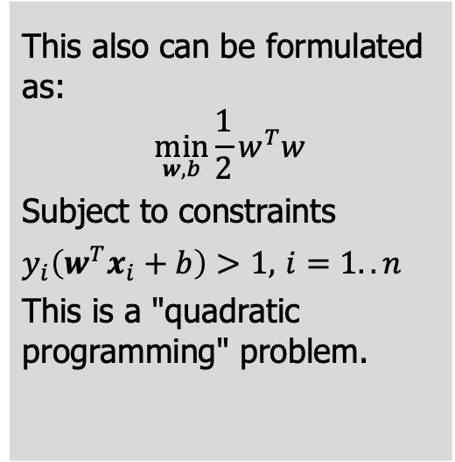
Finding the max margin classifier is an optimization problem
Our goal is: $\max_{w, b}{M}$
subject to constraints:
$\left\|w\right\|$=1
$w^{T}x_{i}+b≥M if y_{i}=1$and
$w^{T}x_{i}+b≤−M if y_{i}=−1$.
Shorthand:
$y_{i}\left(w^{T}x_{i}+b\right)≥M$ for $i=1..n$
This also can be formulated as:
$$\min_{w,b}{\frac{1}{2}w^{T}w}$$
Subject to constraints
$y_{i}\left(w^{T}x_{i}+b\right)>1,$ $i=1..n$
This is a "quadratic programming" problem.
Notes:
Dave

Slide 11
Soft-margin classifier

Slide 12
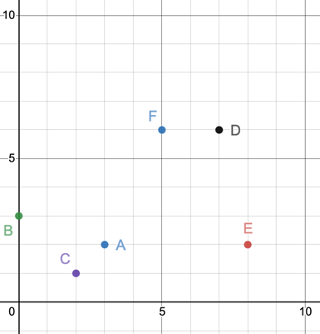
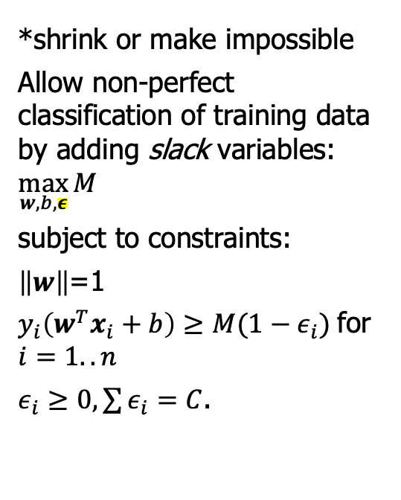
Max-margin classifiers are very sensitive to noise:
One noisy training example can wreck* the margin!
*shrink or make impossible
Allow non-perfect classification of training data by adding slack variables: $\max_{w, b,ε}{M}$
subject to constraints:
$\left\|w\right\|$=1
$y_{i}\left(w^{T}x_{i}+b\right)≥M(1−ε_{i})$ for $i=1..n$
$ε_{i}≥0, \sum{ε_{i}=C}$.
Notes:
Dave

Slide 13
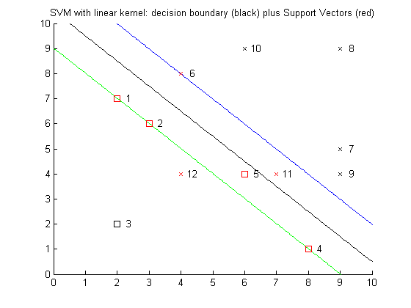
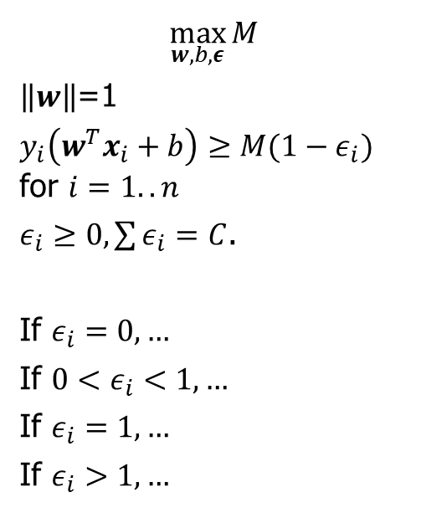
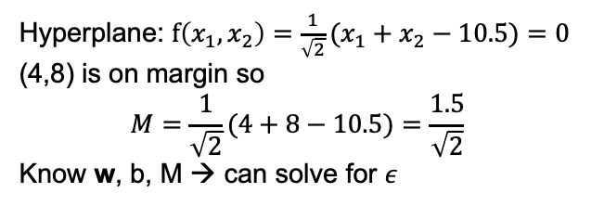
Note how the slack variables work.
$$\max_{w, b,ε}{M}$$
$\left\|w\right\|$=1
$y_{i}\left(w^{T}x_{i}+b\right)≥M(1−ε_{i})$ for $i=1..n$
$ε_{i}≥0, \sum{ε_{i}=C}$.
If $ε_{i}=0, …$
If ${0<ε}_{i}<1, …$
If $ε_{i}=1, …$
If $ε_{i}>1, …$
Hyperplane: $f\left(x_{1},x_{2}\right)=\frac{1}{\sqrt{2}}(x_{1}+x_{2}−10.5)=0$
(4,8) is on margin so
$$M=\frac{1}{\sqrt{2}}(4+8−10.5)=\frac{1.5}{\sqrt{2}}$$
Know w, b, M → can solve for $ε$
Notes:
Dave

Slide 14
Training examples with slack > 0 are also support vectors
In this example, which are SVs?
Notes:
Dave

Slide 15
Box parameter

Slide 16
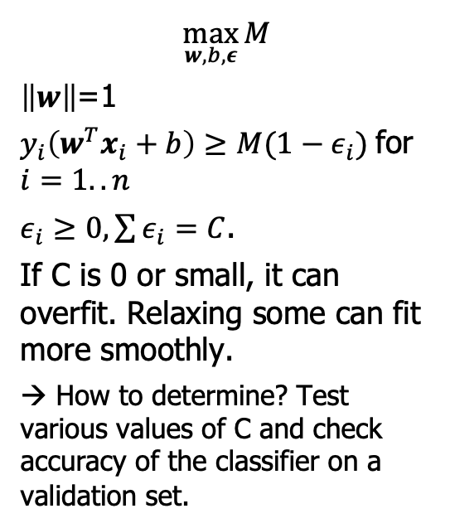
The "box parameter", C, is a hyperparameter you can tune
$$\max_{w, b,ε}{M}$$
$\left\|w\right\|$=1
$y_{i}\left(w^{T}x_{i}+b\right)≥M(1−ε_{i})$ for $i=1..n$
$ε_{i}≥0, \sum{ε_{i}=C}$.
If C is 0 or small, it can overfit. Relaxing some can fit more smoothly.
→ How to determine? Test various values of C and check accuracy of the classifier on a validation set.
Notes:
Dave

Slide 17
Kernel functions

Slide 18
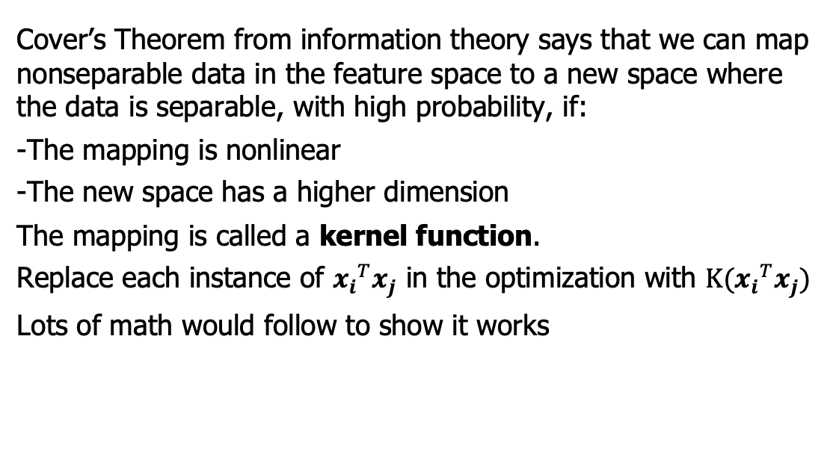
Can we enlarge the feature space to separate the data more cleanly?
Cover’s Theorem from information theory says that we can map nonseparable data in the feature space to a new space where the data is separable, with high probability, if:
-The mapping is nonlinear
-The new space has a higher dimension
The mapping is called a kernel function.
Replace each instance of ${x_{i}}^{T}x_{j}$ in the optimization with $K({x_{i}}^{T}x_{j})$
Lots of math would follow to show it works
Notes:
Dave

Slide 19
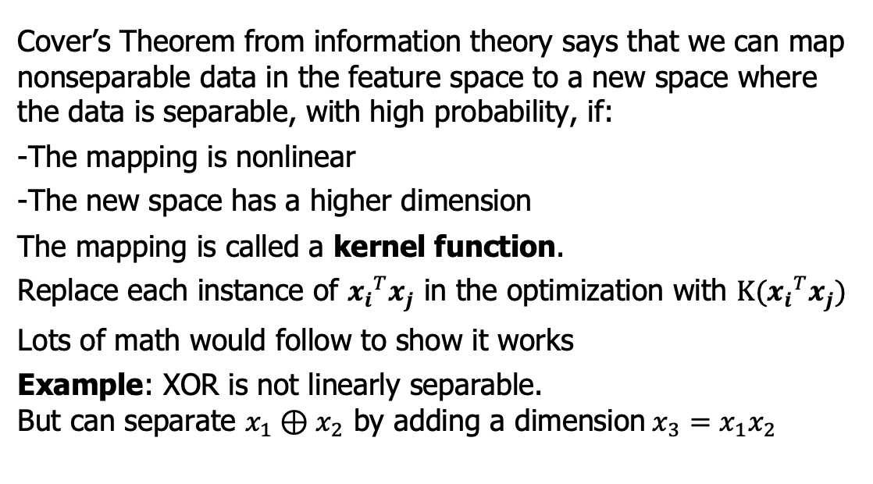
Can we enlarge the feature space to separate the data more cleanly?
Cover’s Theorem from information theory says that we can map nonseparable data in the feature space to a new space where the data is separable, with high probability, if:
-The mapping is nonlinear
-The new space has a higher dimension
The mapping is called a kernel function.
Replace each instance of ${x_{i}}^{T}x_{j}$ in the optimization with $K({x_{i}}^{T}x_{j})$
Lots of math would follow to show it works
Example: XOR is not linearly separable.
But can separate $x_{1}⊕x_{2}$ by adding a dimension$x_{3}=x_{1}x_{2}$
Notes:
Dave

Slide 20
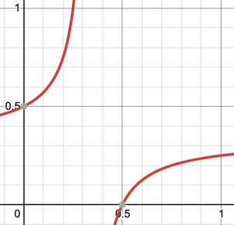
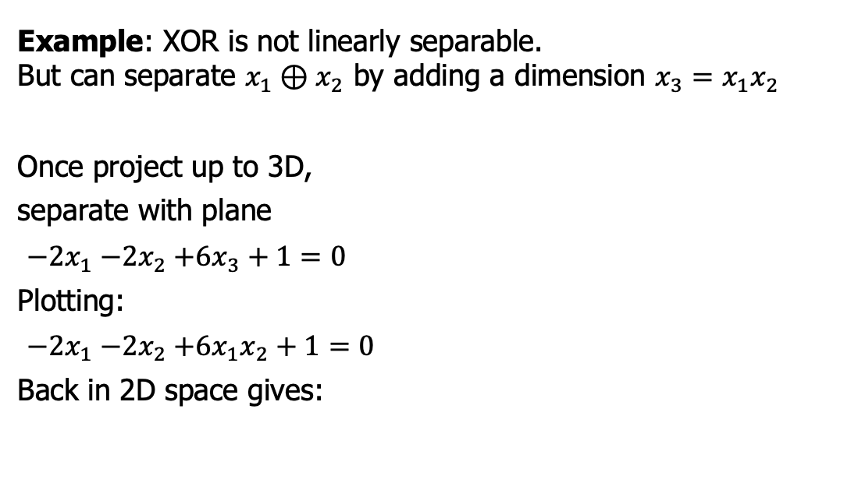
Can we enlarge the feature space to separate the data more cleanly?
Example: XOR is not linearly separable.
But can separate $x_{1}⊕x_{2}$ by adding a dimension $x_{3}=x_{1}x_{2}$
Once project up to 3D,
separate with plane
${−2x}_{1}{−2x}_{2}+6x_{3}+1=0$
Plotting:
${−2x}_{1}{−2x}_{2}+6x_{1}x_{2}+1=0$
Back in 2D space gives:
Notes:
Dave

Slide 21
RBF Kernel

Slide 22
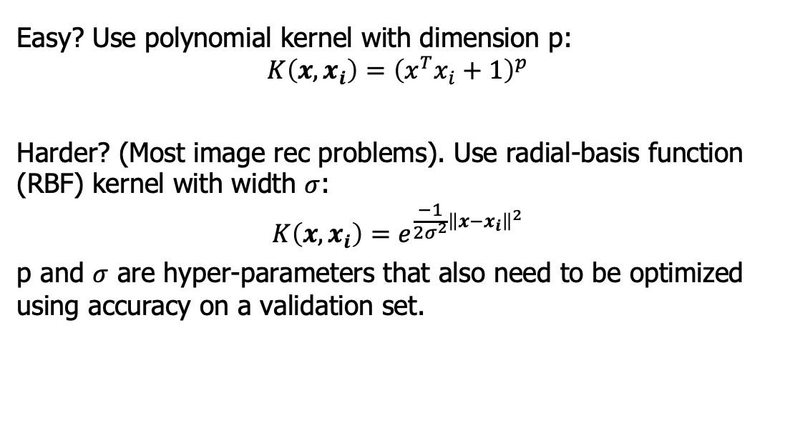
You have a choice of kernel functions depending on the complexity of the problem
Easy? Use polynomial kernel with dimension p:
$$K\left(x,x_{i}\right)={\left(x^{T}x_{i}+1\right)}^{p}$$
Harder? (Most image rec problems). Use radial-basis function (RBF) kernel with width $σ$:
$$K\left(x,x_{i}\right)=e^{\frac{−1}{2σ^{2}}{\left\|x−x_{i}\right\|}^{2}}$$
p and $σ$ are hyper-parameters that also need to be optimized using accuracy on a validation set.
Notes:
Dave

Slide 23
Demo

Slide 24
Visual demos of max margin classifier and kernel functions
Courtesy of http://ida.first.fraunhofer.de/~anton/software.html (GNU public license).
I used this SVM package for many years until MATLAB created an excellent package.
Then I updated his demo to use it.
Understanding the basics of this demo is step 1 of the next lab.
Notes:
Dave

Slide 25
Demo recap

Slide 26
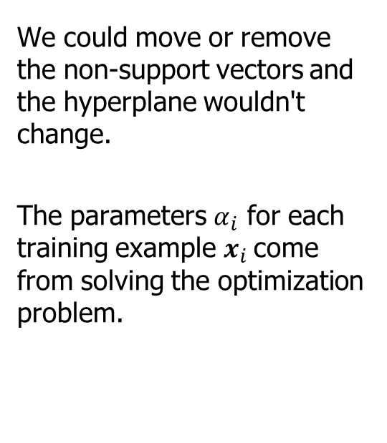
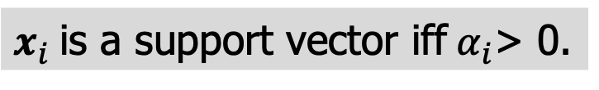
Key point 1: only the support vectors are used in classification
We could move or remove the non-support vectors and the hyperplane wouldn't change.
The parameters $α_{i}$ for each training example $x_{i}$come from solving the optimization problem.
$x_{i}$is a support vector iff$α_{i}$> 0.
Notes:
Dave

Slide 27
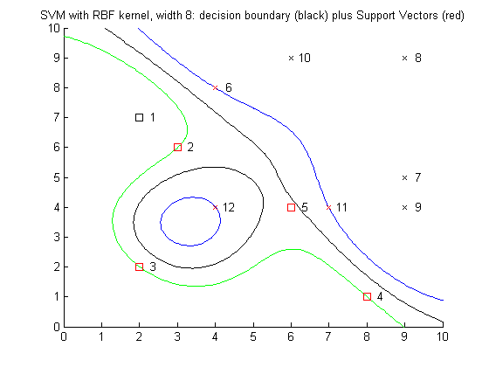
Key point 2: linear boundaries in kernel space give nonlinear boundaries in feature space
Note that a hyperplane (which, by definition, is linear) in the new space
= a nonlinear boundary in the feature space
Remember XOR.
Notes:
Dave

Slide 28
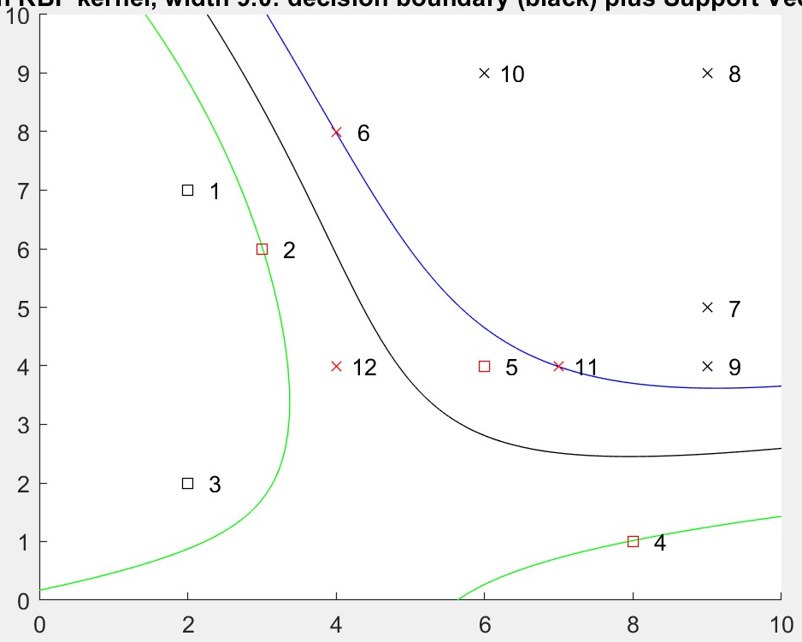
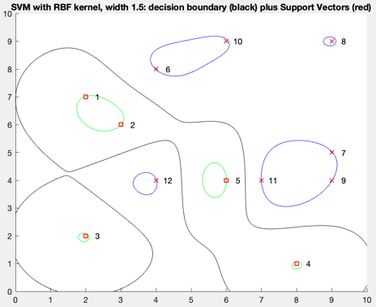
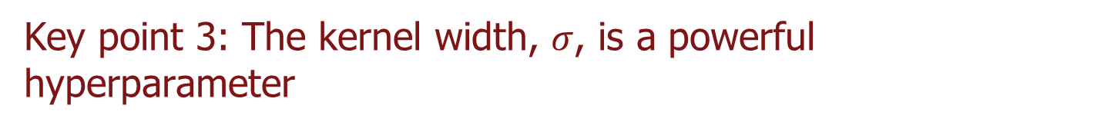
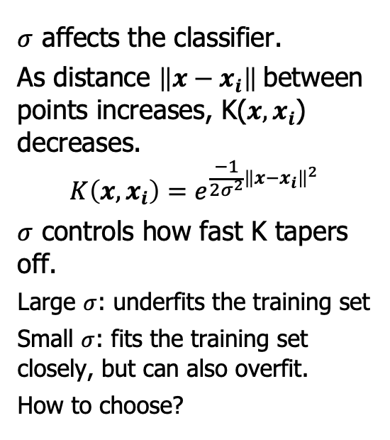
Key point 3: The kernel width, $σ$, is a powerful hyperparameter
$σ$ affects the classifier.
As distance $\left\|x−x_{i}\right\|$between points increases, K($x,x_{i}$) decreases.
$$K\left(x,x_{i}\right)=e^{\frac{−1}{2σ^{2}}{\left\|x−x_{i}\right\|}^{2}}$$
$σ$ controls how fast K tapers off.
Large $σ$: underfits the training set
Small $σ$: fits the training set closely, but can also overfit.
How to choose?
Notes:
Dave

Slide 29
Lab Intro

Slide 30
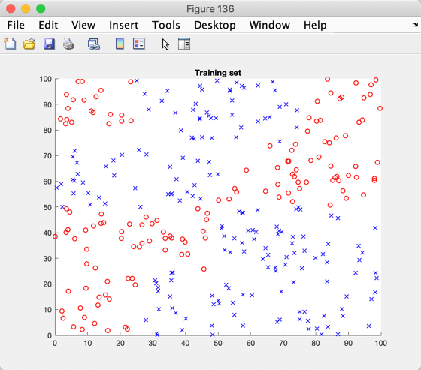
SVM Lab
Find hyperparameters that give decent accuracy on a related dataset.
Calculate the accuracy, TPR, FPR
How many support vectors does your classifier use?

