Slide 1
Shapes and shape properties
Image Recognition
Matt Boutell
Notes:
Both

Slide 2
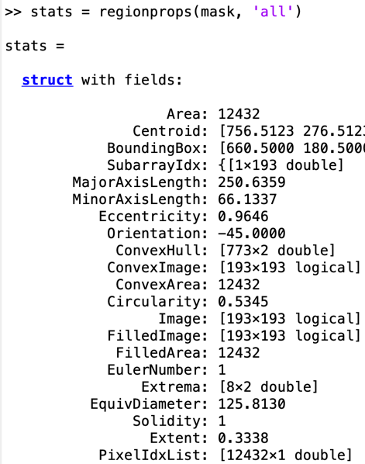
Why study shape properties?
Take a mask of a detected object
Consider properties like circularity, elongation, holes, perimeter, and centroid.
Many properties are useful…
…to describe shapes
(objects detected)
…to distinguish shapes from each other

Slide 3
How to calculate shape properties?
Use a connected components algorithm to isolate individual regions
Use MATLAB’s regionprops
We’ll roll our own in this unit to understand what MATLAB is doing

Slide 4
Regionprops

Slide 5
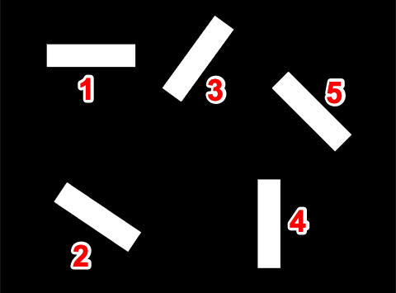
Regionprops will return stats on each region.
rect = imread('rectangles5.png');
rect(find(rect > 0)) = 255; % to BW
[cc,n] = bwlabel(rect,8);
% Returns an array of stat structs
% 'All' or just those needed
allStats = regionprops(cc, 'all');
% returns stats on region 5 only
stats = regionprops(cc==5, 'all');
stats.Area → 12432
stats.PixelList → 12432x2 double
stats.PixelIdxList → 12432 x 1 double
Notes:
Dave

Slide 6

Some immediately useful properties, part 1: Area and Centroid
stats.Area →12432 % num pixels
stats.Centroid → 756.5123 276.5123
Same as:
mean(stats.PixelList)
Or:
[r,c]=find(cc==5);
mean(r), mean(c)
Notes:
Dave

Slide 7
BoundingBox and Extent

Slide 8

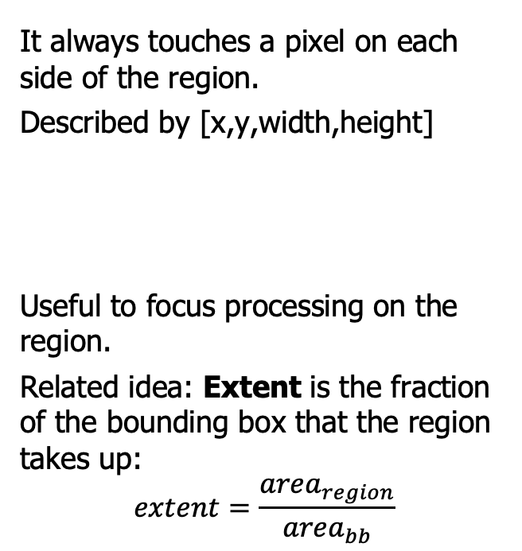
BoundingBox is the smallest axis-aligned rectangle that encloses the region
It always touches a pixel on each side of the region.
Described by [x,y,width,height]
Useful to focus processing on the region.
Related idea: Extent is the fraction of the bounding box that the region takes up:
$$extent=\frac{{area}_{region}}{{area}_{bb}}$$
(x,y)_
height
width
Notes:
Dave

Slide 9



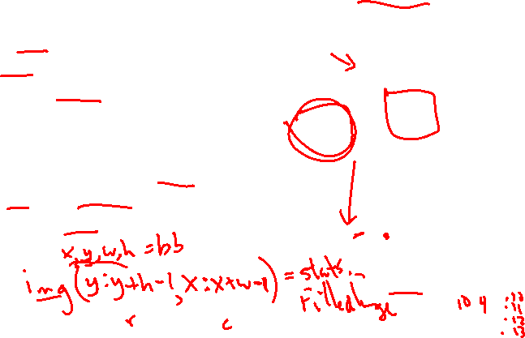
Some immediately useful properties, part 2: FilledImage
If holes are too big to fill with dilation:
stats.FilledImage
fills the holes and returns the bounding box with the filled region.
You then need to replace the original bounding box with the filled region. How?
Notes:
Dave

Slide 10

Some immediately useful properties, tangent: imfill
Turns out it's easier to use imfill to do this since it doesn't mess with bounding boxes.
filledImage = imfill(cc);
Notes:
Dave

Slide 11


Some immediately useful properties, part 3: remove small regions
Related: if noise is too big to remove with erosion, you can turn any region with small-enough area to 0, like.
stats = regionprops(cc==i, ‘Area’)
if (stats.Area < th):
cc(cc==5) = 0
Notes:
Dave

Slide 12
Euler number

Slide 13
Euler number is the number of regions minus the number of holes
Useful in character recognition:
The letter D has an Euler number of 1-1 = 0
The letter J has an Euler number of 1-0 = 1
The letter B has an Euler number of 1-2 = -1
The letter i has an Euler number of ___.
Most letters have an Euler number of ____.
This image has an Euler number of ____. →
Notes:
Dave

Slide 14
Perimeter and length

Slide 15
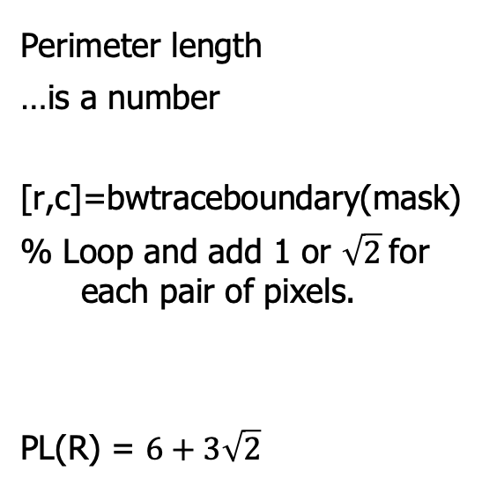
Perimeter and perimeter length aren't the same
Perimeter
…is a set of pixels
bwperim(cc==5)
P₈(R)
Perimeter length
…is a number
[r,c]=bwtraceboundary(mask)
% Loop and add 1 or $\sqrt{2}$for each pair of pixels.
PL(R) = $6+3\sqrt{2}$
R
Notes:
Dave

Slide 16
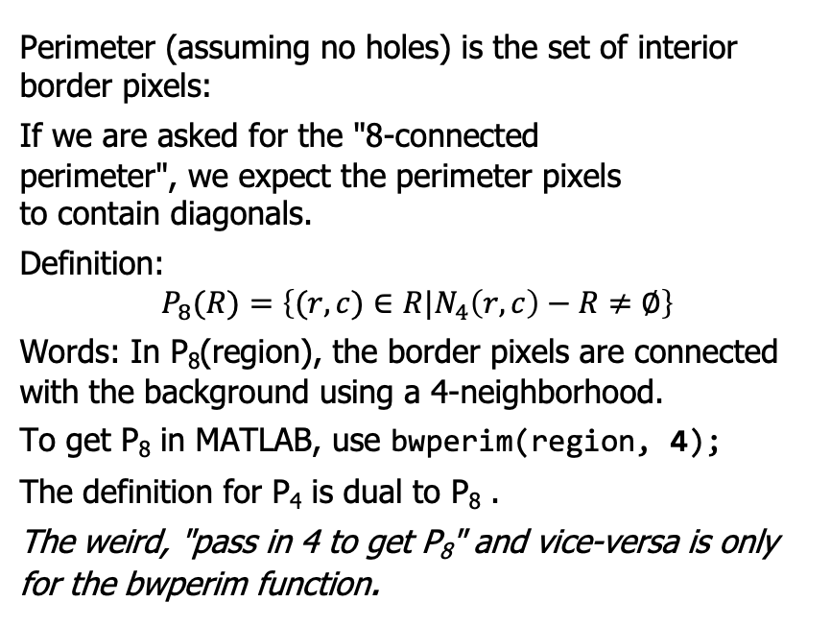
Perimeter is a set of pixels
Perimeter (assuming no holes) is the set of interior border pixels:
If we are asked for the "8-connected
perimeter", we expect the perimeter pixels
to contain diagonals.
Definition:
$$P_{8}(R)=\left\{(r,c)∈R|N_{4}\left(r,c\right)−R≠∅\right\}$$
Words: In P₈(region), the border pixels are connected with the background using a 4-neighborhood.
To get P₈ in MATLAB, use bwperim(region, 4);
The definition for P₄ is dual to P₈ .
The weird, "pass in 4 to get P₈" and vice-versa is only for the bwperim function.
Notes:
Dave

Slide 17
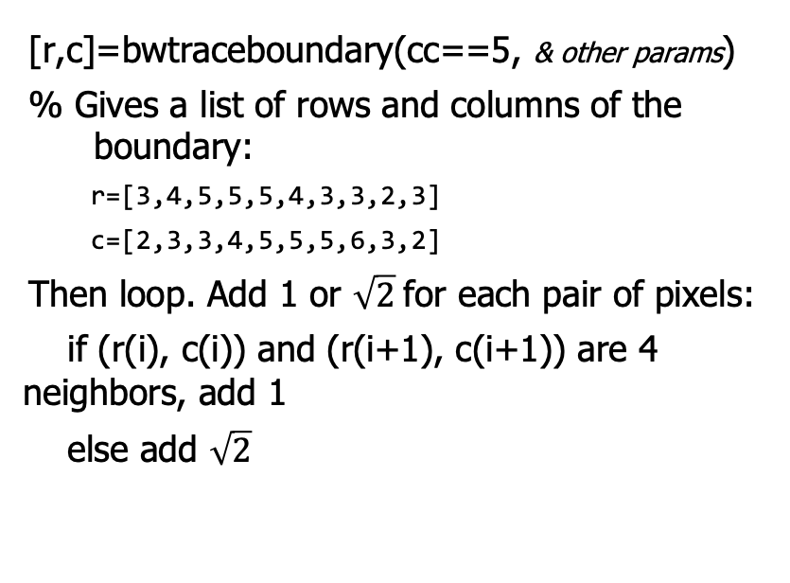
Perimeter length is a number
[r,c]=bwtraceboundary(cc==5, & other params)
% Gives a list of rows and columns of the boundary:
r=[3,4,5,5,5,4,3,3,2,3]
c=[2,3,3,4,5,5,5,6,3,2]
Then loop. Add 1 or $\sqrt{2}$for each pair of pixels:
if (r(i), c(i)) and (r(i+1), c(i+1)) are 4 neighbors, add 1
else add $\sqrt{2}$
Notes:
Dave

Slide 18
Circularity

Slide 19
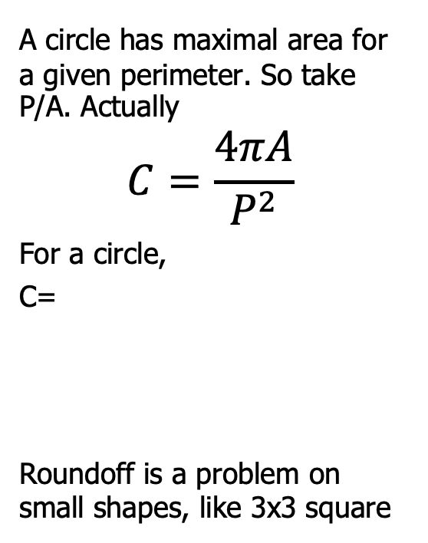
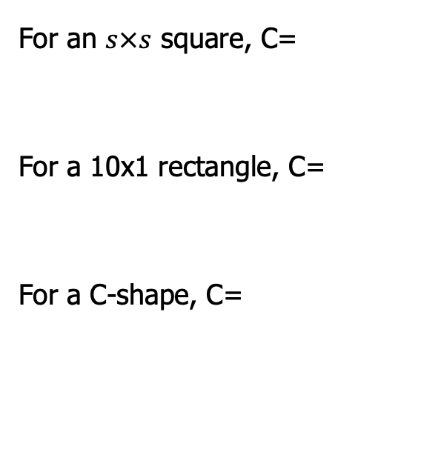
Circularity
A circle has maximal area for a given perimeter. So take P/A. Actually
$$C=\frac{4πA}{P^{2}}$$
For a circle,
C=
Roundoff is a problem on small shapes, like 3x3 square
For an $s×s$ square, C=
For a 10x1 rectangle, C=
For a C-shape, C=
Notes:
Dave

Slide 20
Principal Axes

Slide 21
Principal axes give the angle and elongation of a region
Principal components analysis is a
well-known ML technique.
1, elongation: 3.91, angle = -0.0 deg
2, elongation: 3.80, angle = -34.0 deg
3, elongation: 3.80, angle = 54.0 deg
4, elongation: 3.91, angle = -90.0 deg
5, elongation: 3.79, angle = -45.0 deg
elongation = stats(2).MajorAxisLength/stats.MinorAxisLength:
3.8016
orientation = stats(2).Orientation:
-33.9944
Notes:
Dave

Slide 22
Intuition of PCA
Shift and rotate the axes so that
one (the principal axis) captures the most variability.
How? The axes are the eigenvectors of the covariance matrix, sorted by size of eigenvalues, largest first!
Simple for shapes, since only 2D.
It works in high dimensions too.
Notes:
Dave

Slide 23
Example: size vs weight for a population of mammals
The new axes are more intuitive:
The size axis is the principal component: the direction giving greatest variability.
The girth axis is perpendicular to the size axis. It is uncorrelated and gives the direction of least variability.
size
weight
girth
height
Notes:
Dave

Slide 24
Covariance matrix

Slide 25
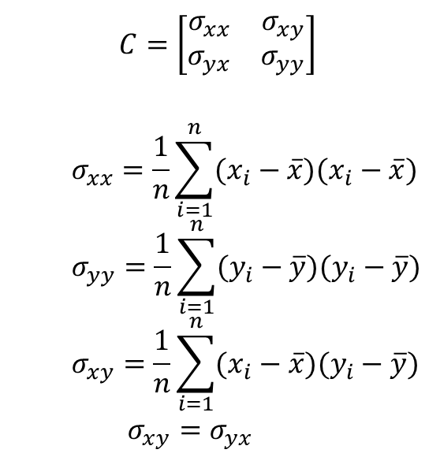
We need to find the covariance matrix, C:
$$C=\left[\begin{matrix}σ_{xx} & σ_{xy} \\ σ_{yx} & σ_{yy}\end{matrix}\right]$$
$$σ_{xx}=\frac{1}{n}\sum_{i=1}^{n}{(x_{i}−\overline{x})(x_{i}−\overline{x})}$$
$$σ_{yy}=\frac{1}{n}\sum_{i=1}^{n}{(y_{i}−\overline{y})(y_{i}−\overline{y})}$$
$$σ_{xy}=\frac{1}{n}\sum_{i=1}^{n}{(x_{i}−\overline{x})(y_{i}−\overline{y})}$$
$$σ_{xy}=σ_{yx}$$
y
x

Slide 26

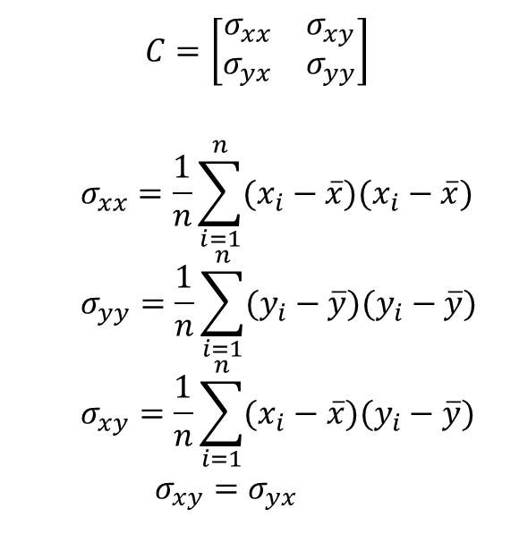

We need to find the covariance matrix, C:
$$C=\left[\begin{matrix}σ_{xx} & σ_{xy} \\ σ_{yx} & σ_{yy}\end{matrix}\right]$$
$$σ_{xx}=\frac{1}{n}\sum_{i=1}^{n}{(x_{i}−\overline{x})(x_{i}−\overline{x})}$$
$$σ_{yy}=\frac{1}{n}\sum_{i=1}^{n}{(y_{i}−\overline{y})(y_{i}−\overline{y})}$$
$$σ_{xy}=\frac{1}{n}\sum_{i=1}^{n}{(x_{i}−\overline{x})(y_{i}−\overline{y})}$$
$$σ_{xy}=σ_{yx}$$
$$y−\overline{y}$$
x$−\overline{x}$

Slide 27

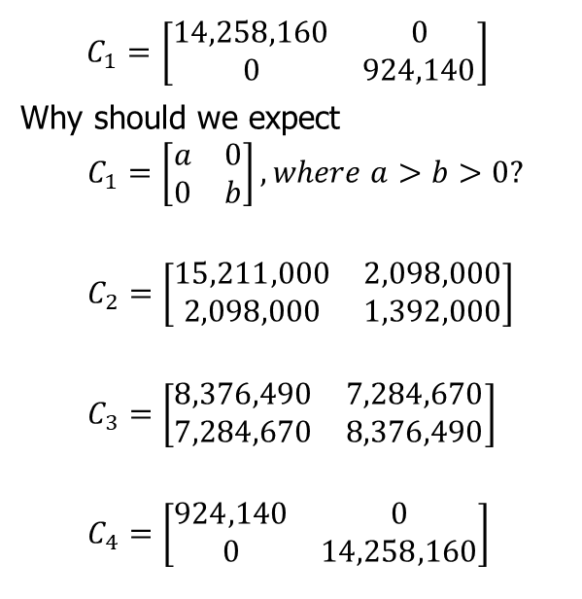
Actual and estimated covariance matrix for various shapes
$$C_{1}=\left[\begin{matrix}14,258,160 & 0 \\ 0 & 924,140\end{matrix}\right]$$
Why should we expect
$$C_{1}=\left[\begin{matrix}a & 0 \\ 0 & b\end{matrix}\right], where a>b>0?$$
$$C_{2}=\left[\begin{matrix}15,211,000 & 2,098,000 \\ 2,098,000 & 1,392,000\end{matrix}\right]$$
$$C_{3}=\left[\begin{matrix}8,376,490 & 7,284,670 \\ 7,284,670 & 8,376,490\end{matrix}\right]$$
$$C_{4}=\left[\begin{matrix}924,140 & 0 \\ 0 & 14,258,160\end{matrix}\right]$$

Slide 28
Covariance matrix using matrix calculations

Slide 29
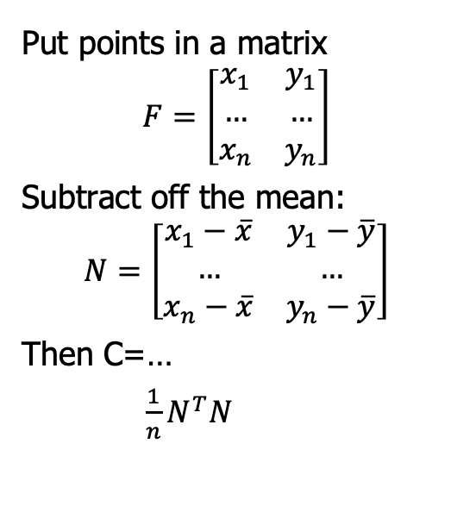
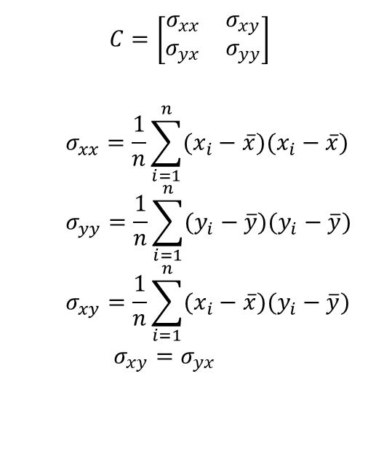
Can we find the covariance matrix, C, without loops?
$$C=\left[\begin{matrix}σ_{xx} & σ_{xy} \\ σ_{yx} & σ_{yy}\end{matrix}\right]$$
$$σ_{xx}=\frac{1}{n}\sum_{i=1}^{n}{(x_{i}−\overline{x})(x_{i}−\overline{x})}$$
$$σ_{yy}=\frac{1}{n}\sum_{i=1}^{n}{(y_{i}−\overline{y})(y_{i}−\overline{y})}$$
$$σ_{xy}=\frac{1}{n}\sum_{i=1}^{n}{(x_{i}−\overline{x})(y_{i}−\overline{y})}$$
$$σ_{xy}=σ_{yx}$$
Put points in a matrix
$$F=\left[\begin{matrix}x_{1} & y_{1} \\ … & … \\ x_{n} & y_{n}\end{matrix}\right]$$
Subtract off the mean:
$$N=\left[\begin{matrix}x_{1}−\overline{x} & y_{1}−\overline{y} \\ … & … \\ x_{n}−\overline{x} & y_{n}−\overline{y}\end{matrix}\right]$$
Then C=…
$\frac{1}{n}N^{T}N$

Slide 30
Eigenvalues and eigenvectors

Slide 31
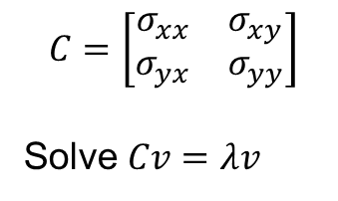
Theorem
The eigenvectors of the covariance matrix give the directions of variation, sorted from the one corresponding to the largest eigenvalue to the one corresponding to the smallest eigenvalue.
Because the matrix is symmetric, the eigenvalues are guaranteed to be positive real numbers, and eigenvectors are orthogonal
This discussion leads to the Rayleigh quotient
$$C=\left[\begin{matrix}σ_{xx} & σ_{xy} \\ σ_{yx} & σ_{yy}\end{matrix}\right]$$
Solve $Cv=λv$

Slide 32
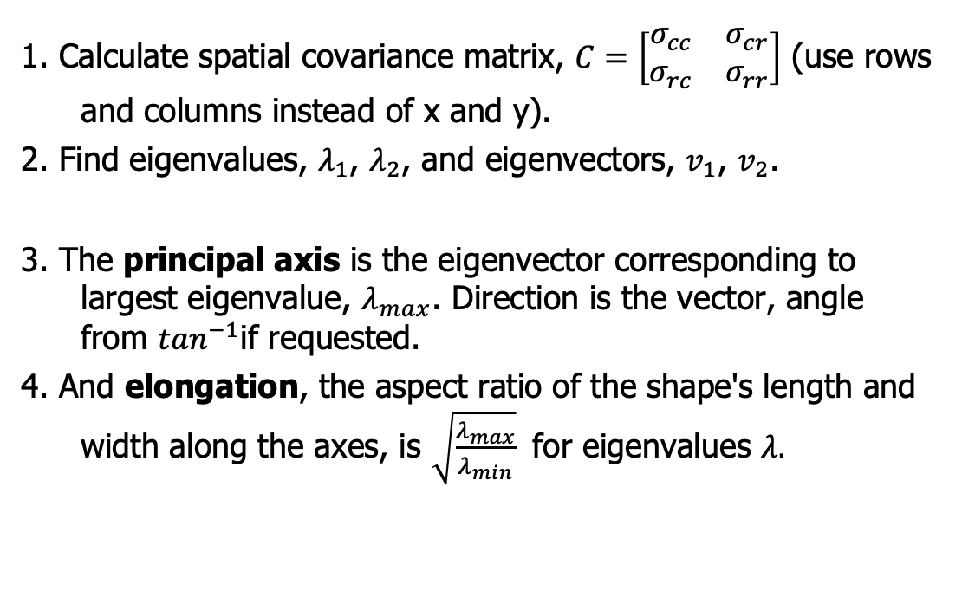
Recap: How to find principal axes and elongation?
1. Calculate spatial covariance matrix, $C=\left[\begin{matrix}σ_{cc} & σ_{cr} \\ σ_{rc} & σ_{rr}\end{matrix}\right]$ (use rows and columns instead of x and y).
2. Find eigenvalues, $λ_{1}$, $λ_{2}$, and eigenvectors, $v_{1}$, $v_{2}$.
3. The principal axis is the eigenvector corresponding to largest eigenvalue, $λ_{max}$. Direction is the vector, angle from $\tan^{−1}$if requested.
4. And elongation, the aspect ratio of the shape's length and width along the axes, is $\sqrt{\frac{λ_{max}}{λ_{min}}}$ for eigenvalues $λ.$

Slide 33
Lab

Slide 34

Lab
Could you use the region properties we’ve studied to distinguish different shapes (squares, rectangles, circles, ellipses, triangles, …)?

