Slide 1
Filters, Smoothing, and Edges
Image Recognition
Matt Boutell
Notes:
Both

Slide 2
Image enhancement: point operators

Slide 3
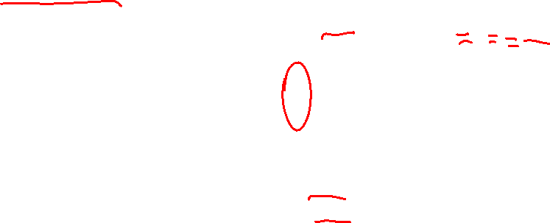
Image enhancement: replace each pixel with a new value
Each pixel p replaced by p’ = f(p, img).
Or call it y=f(x), where
x = input image
y = output image
We’ll look at two examples:
Point operators
Local operators (implemented by filters)

Slide 4
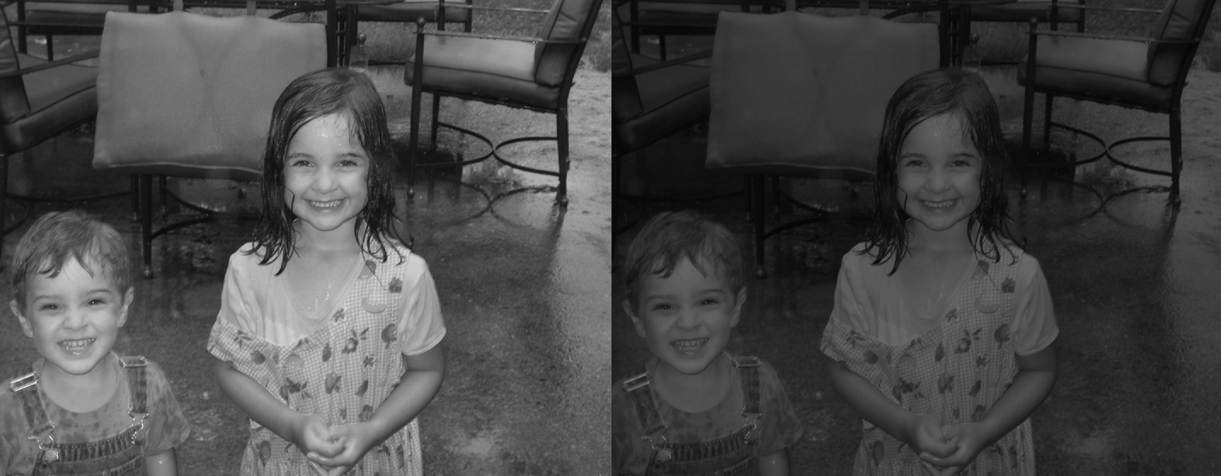
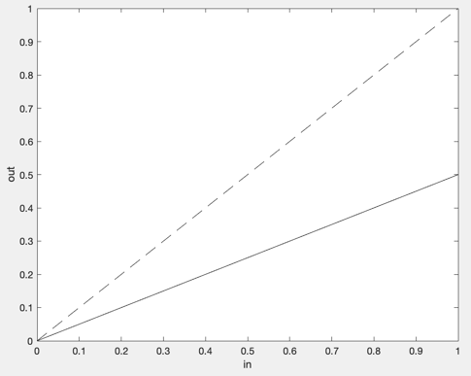

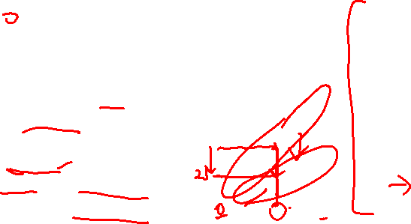
Point operators: each pixel is updated independently!
Example from lab: cut image intensity in half.
Function: $y=\frac{1}{2}x$
Words: Darker, contrast down.
Can you see from graph? →
Look-up table (LUT)
In | Out
0 | 0
1 | 0
2 | 1
3 | 1
4 | 2
…
255 | 127

Slide 5
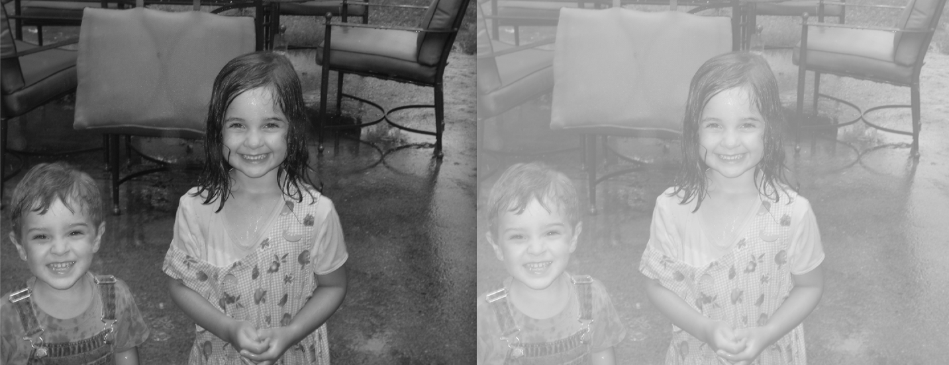
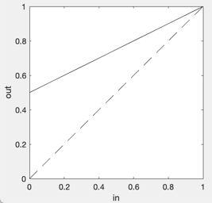

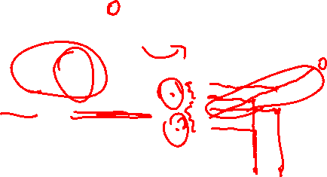
Point operators: example 2
Function: $y=\frac{1}{2}x+\frac{1}{2}$
Words: Brighter, contrast down.
Can you see from graph? →

Slide 6
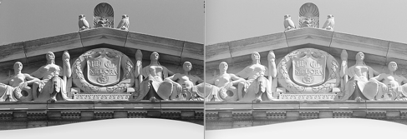
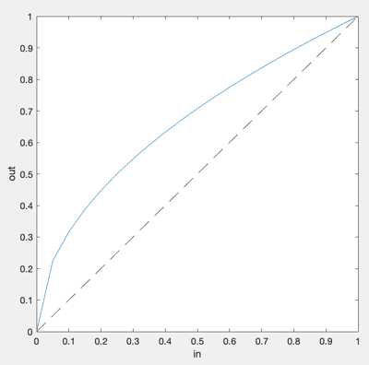
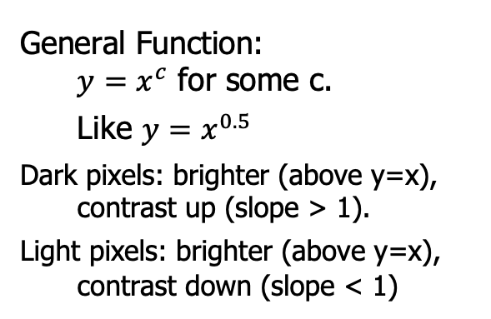
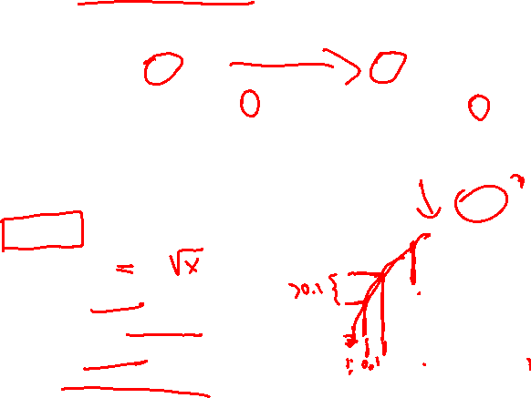
Point operators: example 3: Gamma functions
General Function:
$y=x^{c}$ for some c.
Like $y=x^{0.5}$
Dark pixels: brighter (above y=x), contrast up (slope > 1).
Light pixels: brighter (above y=x), contrast down (slope < 1)

Slide 7
Image enhancement: filters

Slide 8
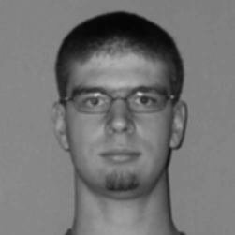
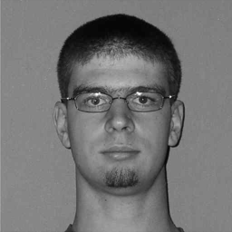
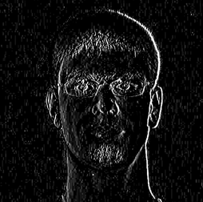
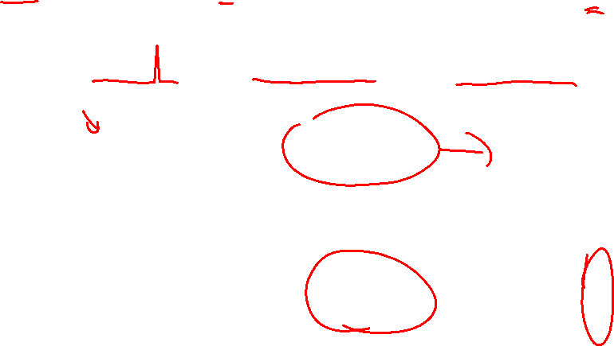


With a local operator, each p’ is a function of pixels close to p (like within 3x3 or 5x5)
Apply a filter using cross-correlation, a.k.a. shift-and-multiply.
Examples:
$$⨂$$
0.08 | 0.12 | 0.08
0.12 | 0.20 | 0.12
0.08 | 0.12 | 0.08
Gaussian
$$⨂$$
-0.25 | 0 | 0.25
-0.50 | 0 | 0.50
-0.25 | 0 | 0.25
Sobel

Slide 9
Applying filters

Slide 10
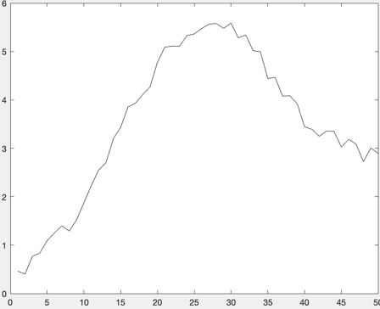
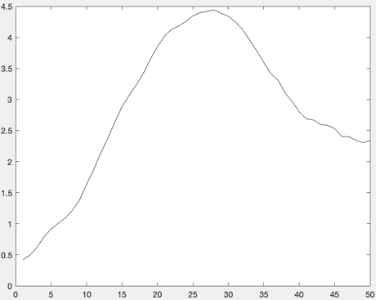
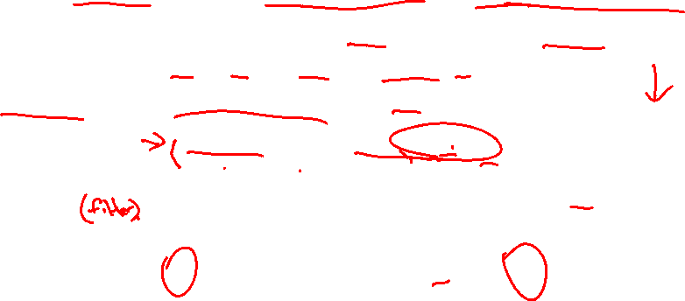
Applying a 1D filter using cross-correlation (shift-and-multiply)
Example: replace each pixel with the average of it and its two neighbors
Consider the filter, [1/3, 1/3/, 1/3] or [1,1,1]/3
Multiply filter with each point under it, then sum (like dot-product)
Input
5 | 4 | 8 | 9 | 11 | 13 | 10 | 20 | 14 | 16
1/3 | 1/3 | 1/3
1/3 | 1/3 | 1/3
1/3 | 1/3 | 1/3
Filter
…
Output
(rounded)
-- |  |  |  |  |  |  |  |  | --
5.7
7
9.3
14.7

Slide 11
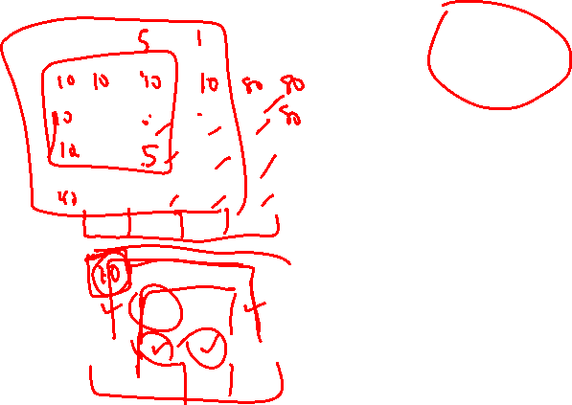
Applying a 2D filter using cross-correlation (shift-and-multiply)
Consider the filter, ones(3,3)/9 =
1/9 | 1/9 | 1/9
1/9 | 1/9 | 1/9
1/9 | 1/9 | 1/9
10 | 10 | 10 | 80
10 | 10 | 10 | 90
40 | 40 | 40 | 97
1/9 | 1/9 | 1/9
1/9 | 1/9 | 1/9
1/9 | 1/9 | 1/9
Input
1/9 | 1/9 | 1/9
1/9 | 1/9 | 1/9
1/9 | 1/9 | 1/9
=10*1/9 + 10*1/9+ 10*1/9
+10*1/9 + 10*1/9 + 10*1/9
+40*1/9 + 40*1/9 + 40*1/9
=10*1/9 + 10*1/9+ 80*1/9
+10*1/9 + 10*1/9 + 90*1/9
+40*1/9 + 40*1/9 + 97*1/9
Output
20
43

Slide 12

What about edges and corners of the input image?
From MATLAB: doc imfilter
1. Pad edges of input image with zeros (default)
will be darker on edges
2. Can copy the edge pixels (‘replicate’)
or even mirror or wrap around image (‘symmetric’, ‘circular’)
3. Could crop output to be smaller:
if 3x3 filter, output is [r-2 x c-2]

Slide 13
Smoothing filters

Slide 14
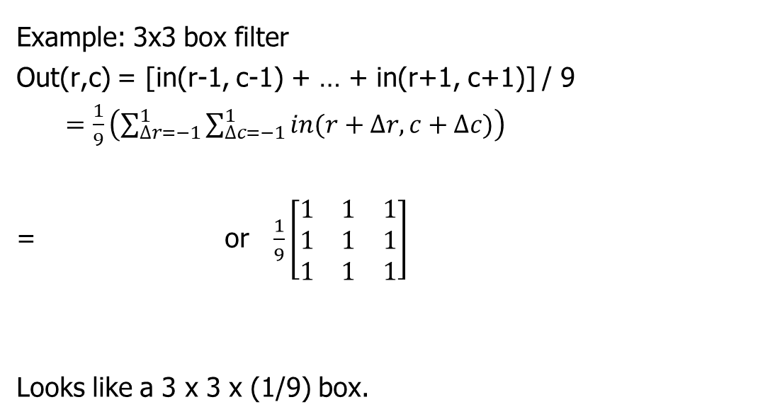
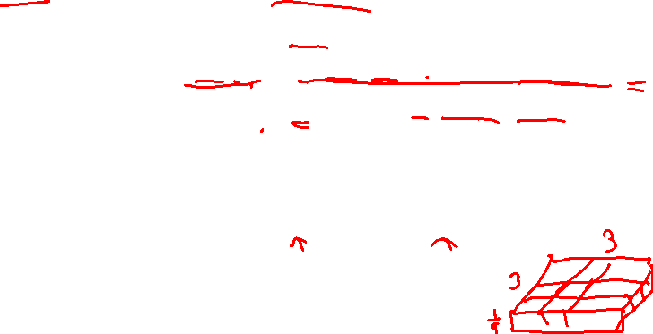
Box filters calculate unweighted averages of neighbor pixels
Example: 3x3 box filter
Out(r,c) = [in(r-1, c-1) + … + in(r+1, c+1)] / 9
$=\frac{1}{9}\left(\sum_{∆r=−1}^{1}{\sum_{∆c=−1}^{1}{in(r+∆r, c+∆c)}}\right)$
= or $\frac{1}{9}\left[\begin{matrix}1 & 1 & 1 \\ 1 & 1 & 1 \\ 1 & 1 & 1\end{matrix}\right]$
Looks like a 3 x 3 x (1/9) box.
1/9 | 1/9 | 1/9
1/9 | 1/9 | 1/9
1/9 | 1/9 | 1/9

Slide 15
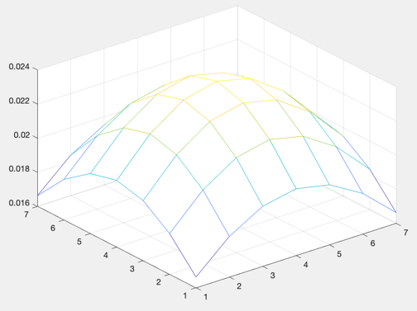
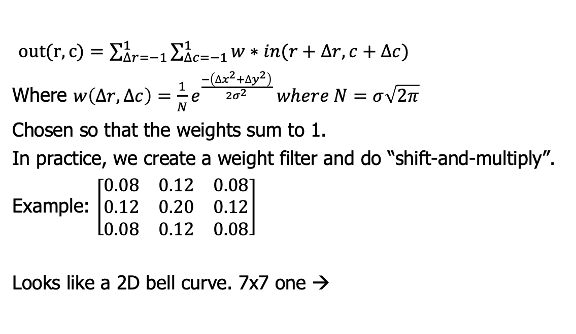
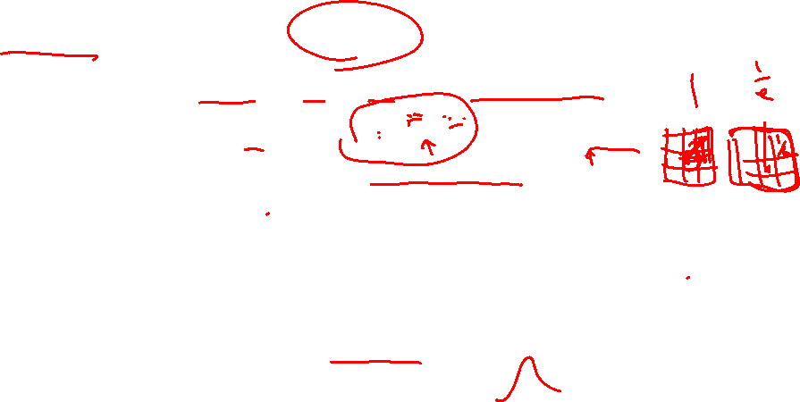
Gaussian filters calculate weighted averages of neighbor pixels
$out(r,c)=\sum_{∆r=−1}^{1}{\sum_{∆c=−1}^{1}{w∗in(r+∆r, c+∆c}})$
Where $w\left(∆r,∆c\right)=\frac{1}{N}e^{\frac{−\left({∆x}^{2}+{∆y}^{2}\right)}{2σ^{2}}} where N=σ\sqrt{2π}$
Chosen so that the weights sum to 1.
In practice, we create a weight filter and do “shift-and-multiply”.
Example: $\left[\begin{matrix}0.08 & 0.12 & 0.08 \\ 0.12 & 0.20 & 0.12 \\ 0.08 & 0.12 & 0.08\end{matrix}\right]$
Looks like a 2D bell curve. 7x7 one →

Slide 16

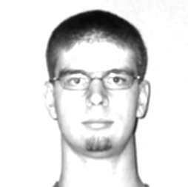
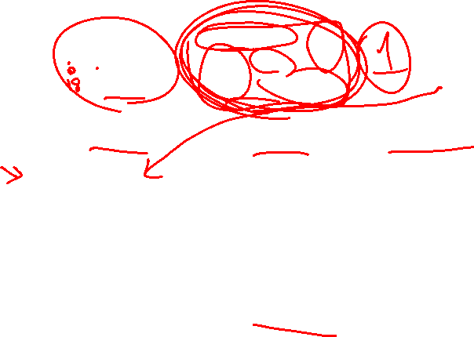
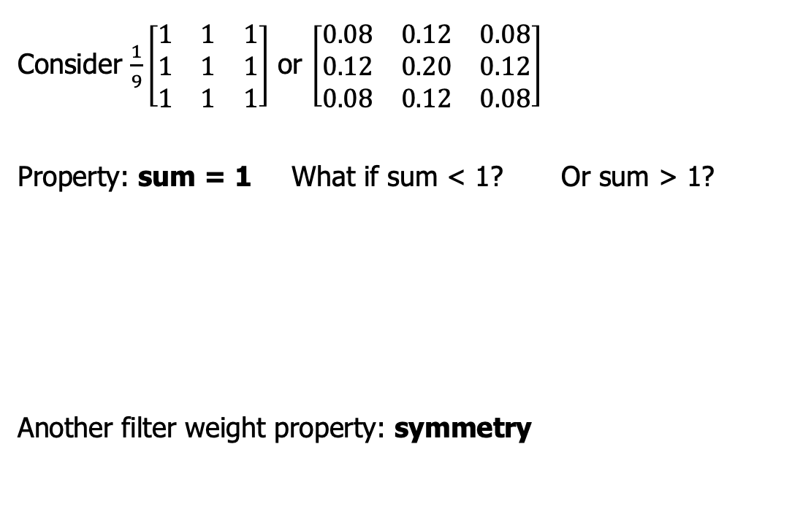
What is the sum of the filter weights in any averaging filter?
Consider $\frac{1}{9}\left[\begin{matrix}1 & 1 & 1 \\ 1 & 1 & 1 \\ 1 & 1 & 1\end{matrix}\right]$ or $\left[\begin{matrix}0.08 & 0.12 & 0.08 \\ 0.12 & 0.20 & 0.12 \\ 0.08 & 0.12 & 0.08\end{matrix}\right]$
Property: sum = 1 What if sum < 1? Or sum > 1?
Another filter weight property: symmetry

Slide 17
Median filters

Slide 18
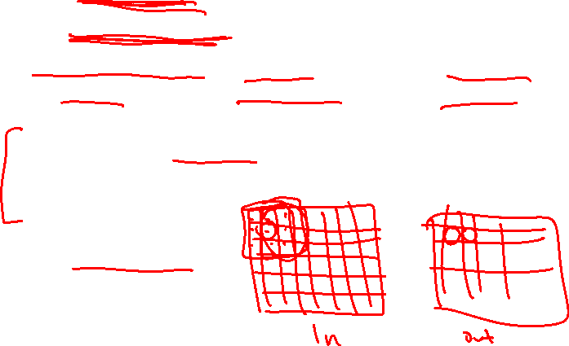
Median filters don’t blur edges.
And they handle “salt-and-pepper” noise well.
Gaussian and box filters blur edges and fail on random black and white pixels from faulty CCD elements and dust on lens.
Solution: Use a median filter: Replace each pixel with the median of the pixels in its neighborhood (sort and take middle element)
See smoothSaltDemo
Notes:
Dave

Slide 19
Edgels and Edges: What and why?
Notes:
Dave

Slide 20

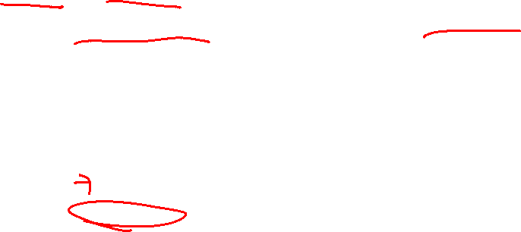
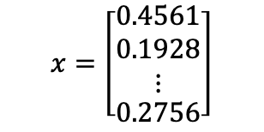
Reminder: Pixels to predicates
2. Use machine learning to classify
1. Extract features from images
$$x=\left[\begin{aligned}\begin{matrix}0.4561 \\ 0.1928 \\ ⋮\end{matrix} \\ 0.2756\end{aligned}\right]$$
Color
Edges ←
Texture
Shape
Motion
Nearest neighbor
Support vector machines
Neural networks
Linear regression
CNNs do both!
Notes:
Dave

Slide 21
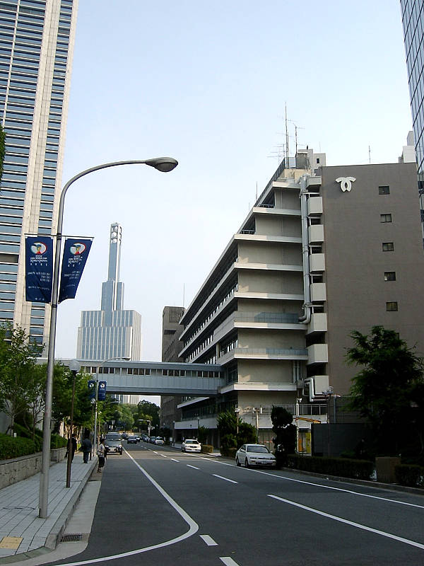
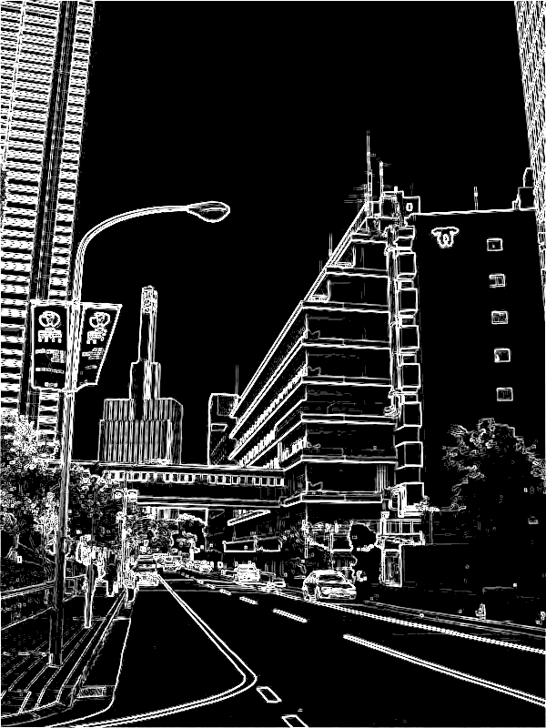

Edgel and edge features have several uses
Edgels are groups of pixels where intensity changes
Edgel density & directions can give info about the scene content:
-Orientation of the image
-Natural vs. manmade
-Presence of objects (HoG)
Edges are longer segments found by grouping edgels
Use with color to segment the image into regions.
Could enhance the fruit-finder (nice suggestion for future work).
Notes:
Dave

Slide 22
Edgel filters
Notes:
Dave

Slide 23
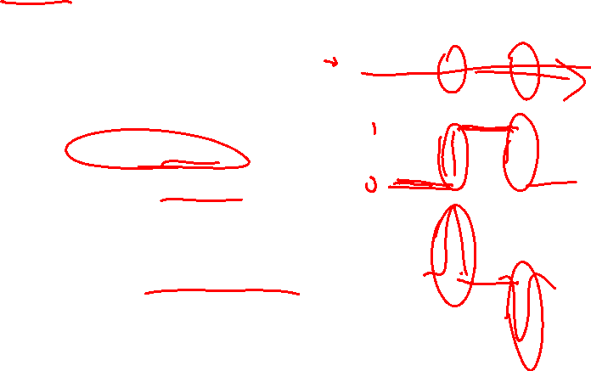
What’s an edgel, anyway?
What is an edgel?
A change in intensity.
How to find change?
How to calculate first derivative?
Notes:
Dave

Slide 24
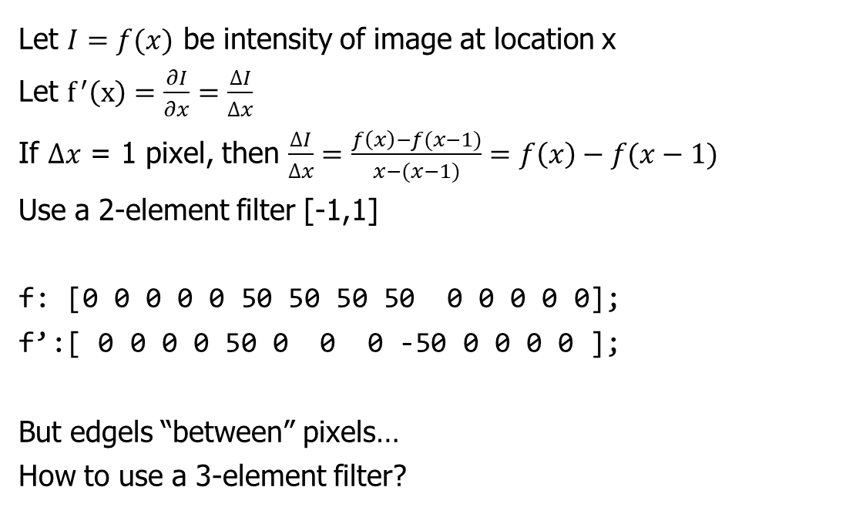
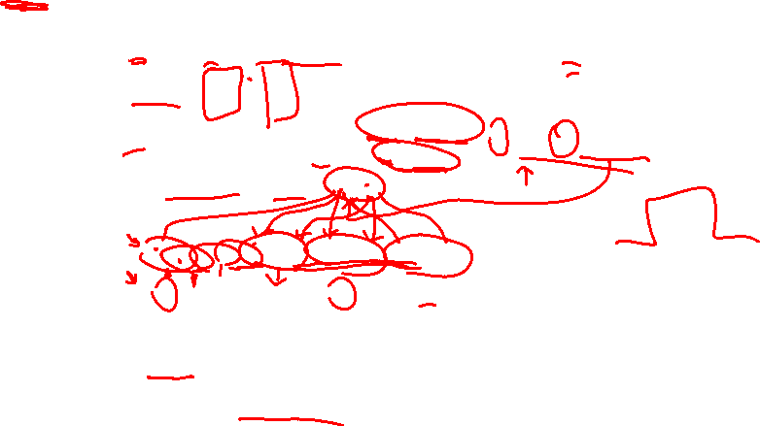
Finding 1D derivatives using filters
Let $I=f(x)$ be intensity of image at location x
Let $f^{′}\left(x\right)=\frac{∂I}{∂x}=\frac{∆I}{∆x}$
If $∆x$ = 1 pixel, then $\frac{∆I}{∆x}=\frac{f\left(x\right)−f(x−1)}{x−(x−1)}=f\left(x\right)−f(x−1)$
Use a 2-element filter [-1,1]
f: [0 0 0 0 0 50 50 50 50 0 0 0 0 0];
f’:[ 0 0 0 0 50 0 0 0 -50 0 0 0 0 ];
But edgels “between” pixels…
How to use a 3-element filter?
Notes:
Dave

Slide 25
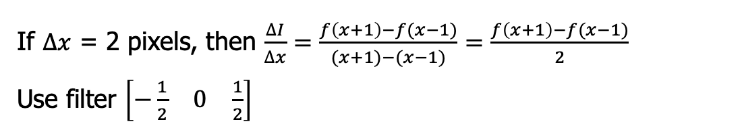
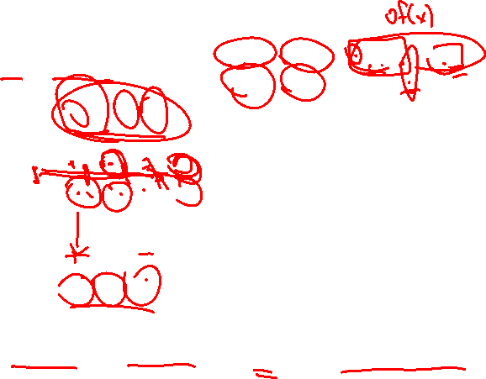
Finding 1D derivatives using filters
If $∆x$ = 2 pixels, then $\frac{∆I}{∆x}=\frac{f\left(x+1\right)−f(x−1)}{(x+1)−(x−1)}=\frac{f\left(x+1\right)−f(x−1)}{2}$
Use filter $\left[\begin{matrix}−\frac{1}{2} & 0 & \frac{1}{2}\end{matrix}\right]$
Input
5 | 4 | 8 | 9 | 2 | 13 | 10 | 20 | 14 | 16
-1/2 | 0 | 1/2
-1/2 | 0 | 1/2
-1/2 | 0 | 1/2
Filter
-- |  |  |  |  |  |  |  |  | --
Output
(rounded)
1.5
2.5
-3
…
Magnitude = edgel strength, sign = direction of change.
Notes:
Dave

Slide 26
Edgel filter properties
Notes:
Dave

Slide 27
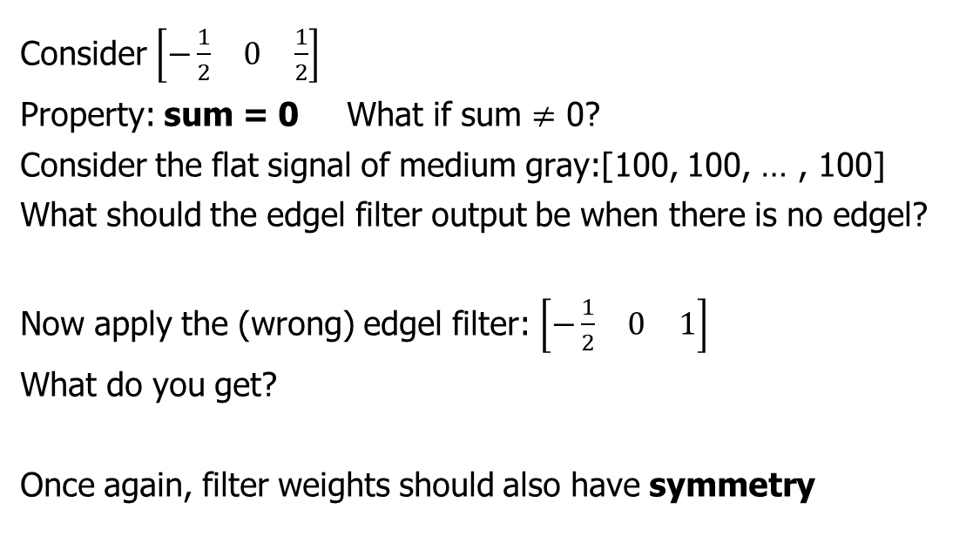
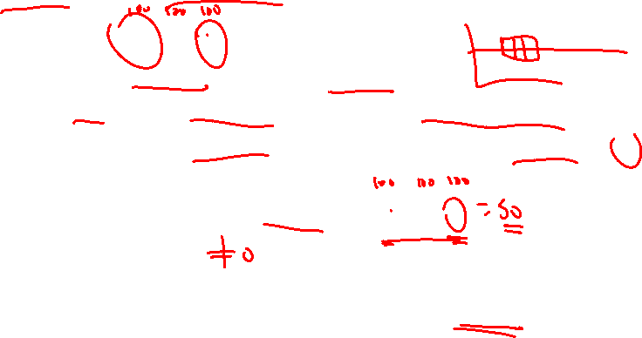
What is the sum of the filter weights in any edge filter?
Consider $\left[\begin{matrix}−\frac{1}{2} & 0 & \frac{1}{2}\end{matrix}\right]$
Property: sum = 0 What if sum $≠$ 0?
Consider the flat signal of medium gray:[100, 100, … , 100]
What should the edgel filter output be when there is no edgel?
Now apply the (wrong) edgel filter: $\left[\begin{matrix}−\frac{1}{2} & 0 & 1\end{matrix}\right]$
What do you get?
Once again, filter weights should also have symmetry

Slide 28
2D Prewitt edgel filters
Notes:
Dave

Slide 29
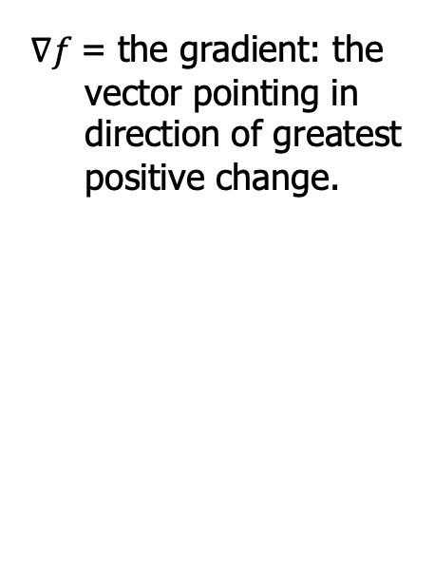
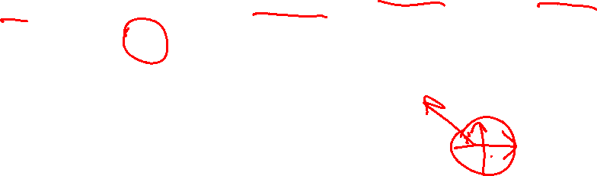
In 2D, we want the edgel gradient’s magnitude and direction
$∇f$= the gradient: the vector pointing in direction of greatest positive change.
∇f
f_{y}
f_{x}
Notes:
Dave

Slide 30
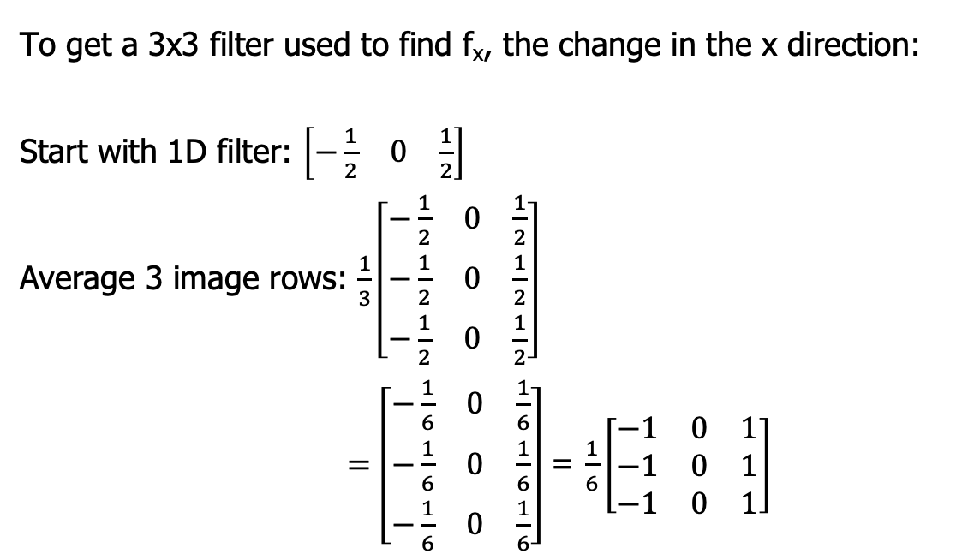
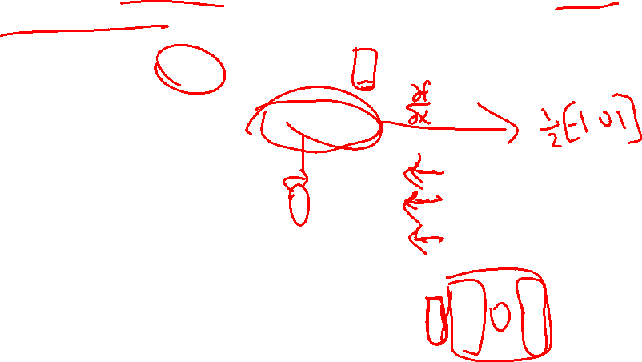
Gradients are easy to calculate once you know the change in the x and y directions.
To get a 3x3 filter used to find f_{x}, the change in the x direction:
Start with 1D filter: $\left[\begin{matrix}−\frac{1}{2} & 0 & \frac{1}{2}\end{matrix}\right]$
Average 3 image rows: $\frac{1}{3}\left[\begin{matrix}−\frac{1}{2} & 0 & \frac{1}{2} \\ −\frac{1}{2} & 0 & \frac{1}{2} \\ −\frac{1}{2} & 0 & \frac{1}{2}\end{matrix}\right]$
$=\left[\begin{matrix}−\frac{1}{6} & 0 & \frac{1}{6} \\ −\frac{1}{6} & 0 & \frac{1}{6} \\ −\frac{1}{6} & 0 & \frac{1}{6}\end{matrix}\right]$ = $\frac{1}{6}\left[\begin{matrix}−1 & 0 & 1 \\ −1 & 0 & 1 \\ −1 & 0 & 1\end{matrix}\right]$
Notes:
Dave

Slide 31
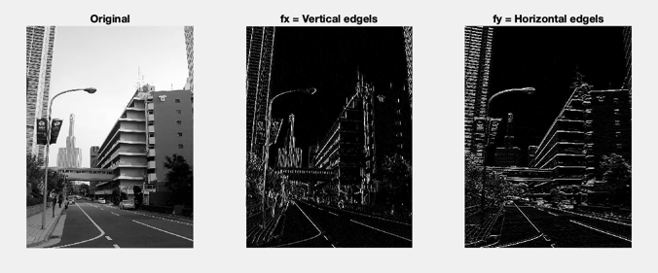
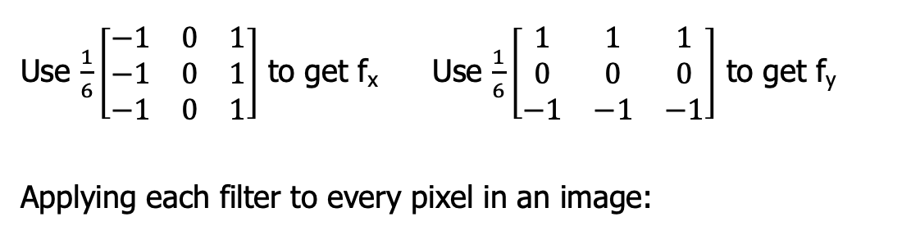
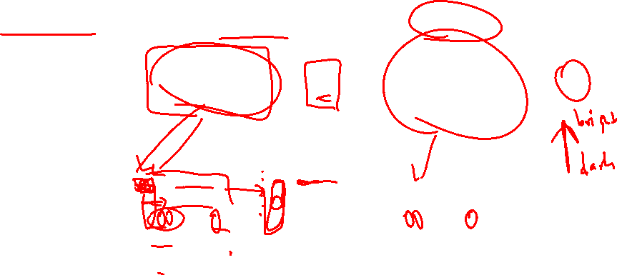
Unweighted-average edgel filters are called Prewitt filters
Use $\frac{1}{6}\left[\begin{matrix}−1 & 0 & 1 \\ −1 & 0 & 1 \\ −1 & 0 & 1\end{matrix}\right]$ to get f_{x} Use $\frac{1}{6}\left[\begin{matrix}1 & 1 & 1 \\ 0 & 0 & 0 \\ −1 & −1 & −1\end{matrix}\right]$ to get f_{y}
Applying each filter to every pixel in an image:
Notes:
Dave

Slide 32
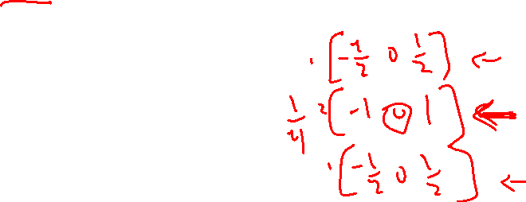
2D Sobel edgel filters
Notes:
Dave

Slide 33
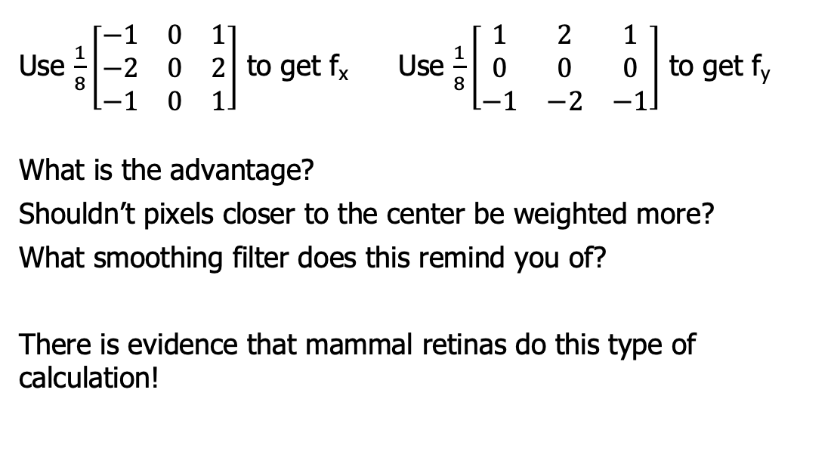

Weighted-average edgel filters are called Sobel filters
Use $\frac{1}{8}\left[\begin{matrix}−1 & 0 & 1 \\ −2 & 0 & 2 \\ −1 & 0 & 1\end{matrix}\right]$ to get f_{x} Use $\frac{1}{8}\left[\begin{matrix}1 & 2 & 1 \\ 0 & 0 & 0 \\ −1 & −2 & −1\end{matrix}\right]$ to get f_{y}
What is the advantage?
Shouldn’t pixels closer to the center be weighted more?
What smoothing filter does this remind you of?
There is evidence that mammal retinas do this type of calculation!
Notes:
Dave

Slide 34
Gradient magnitude and direction from filters
Notes:
Dave

Slide 35




Gradients are easy to calculate once you know the change in the x and y directions.
How do you find the magnitude (length) of a vector?
Right, very simple!
$$\left|∇f\right|=\sqrt{{f_{x}}^{2}+{f_{y}}^{2}}$$
→
Notes:
Dave

Slide 36





Gradient direction is the angle formed by the x-axis and the line pointing towards the light region.
Use $\tan^{−1}\left(\frac{y}{x}\right)$ But it is only over range, $\left[−\frac{π}{2},\frac{π}{2}\right]$
Instead, use MATLAB’s atan2(y,x) to get full range, [-π, π]
dir=arctan(-1,0) = -$π$/2
dir=arctan(0,1)= 0
dir=arctan(0,-1) = $π$
dir=arctan(1,0)= $π$/2
Notes:
Dave

Slide 37
From edgels to edges
Notes:
Dave

Slide 38

Edgel finders suffer some several limitations
Natural variation
Shadows and highlights can obscure edgels
Internal vs. external edges
We might want the outline of an article of clothing, but the stripes in our shirt are edges too.
Noise!
Signal-to-noise ratio important in determining how hard it is to find edges.
Notes:
Dave

Slide 39


Reminder: Edgels are unconnected groups of pixels.
Edges are segments found by grouping edgels
So edgels are stored in an image
But edges are a different data structure.
Store in a list?
[(34, 56), (34, 57), (35, 58), …]
Or since they are connected, we can compress by storing just a starting point and a list of directions to the next pixel.
(34, 56), [E, SE, …]
How do we know which edgels are edges?
Notes:
Dave

Slide 40
Canny edge detection
Notes:
Dave

Slide 41

Concepts used to move from edgels to edges:
Threshold away “weak” output
What threshold to use?
Always fixed or should it vary?
“Thin” edges by nonmaximum suppression.
Idea: If an edge is 5 pixels wide, we can replace it with only the innermost segment.
Remove the edge response of a pixel if not greater than its 2 neighbors in the direction of the gradient.
Notes:
Dave

Slide 42



The Canny edge detector is reasonably successful.
1. Smooth the original image before finding $∇f$
Parameter s controls how many edges found
2. Non-maximal suppression
3. Use two thresholds:
High: to initiate contour following
Low: to follow along a contour
Result: segments from noise are less likely to be found (unless the noise is too strong)
Then follow path (MATLAB bwtraceboundary)
Notes:
Dave

Slide 43

Canny edge detection example
Consider a path:
Consider edge magnitude along that path:
Notes:
Dave

Slide 44
Edge Lab
Notes:
Dave

Slide 45

Lab demo
My homemade edgefinder
Finds vertical and horizontal edges using Sobel filters
Combines to find edge magnitude
Combines to find edge direction
Re-scaled for display
subplot(2,4,1);
imshow(img); title('Original’)
subplot(2,4,2);
imshow(uint8(vert * 8)); title('fx = Vertical edgels')
Note that dx finds vertical edges and dy finds horizontal edges. Make sure you understand why.
Notes:
Dave

