Slide 1
Image Recognition: Color and Morphology
Matt Boutell
Notes:
Both

Slide 2
Color storage
Notes:
Dave

Slide 3
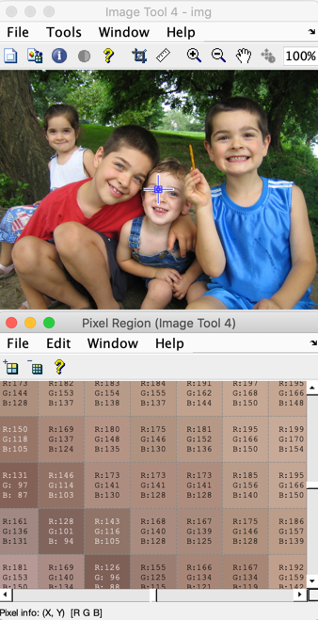
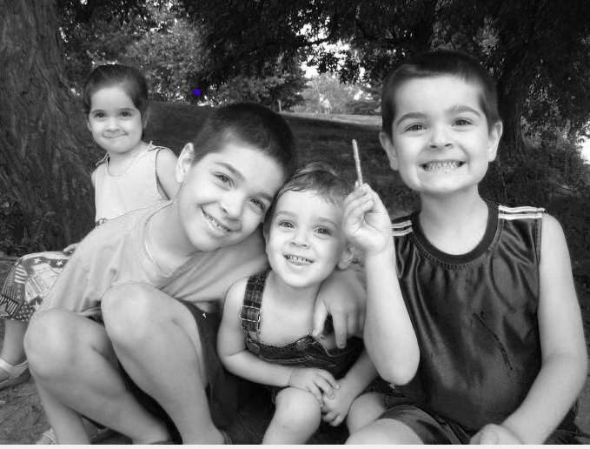
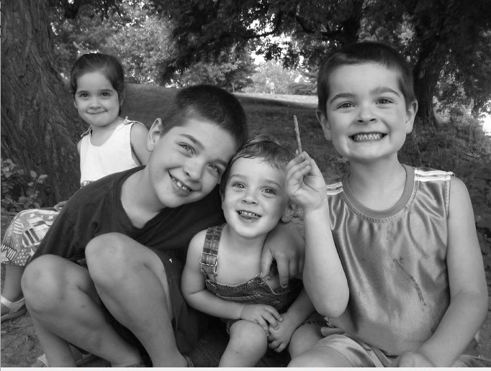
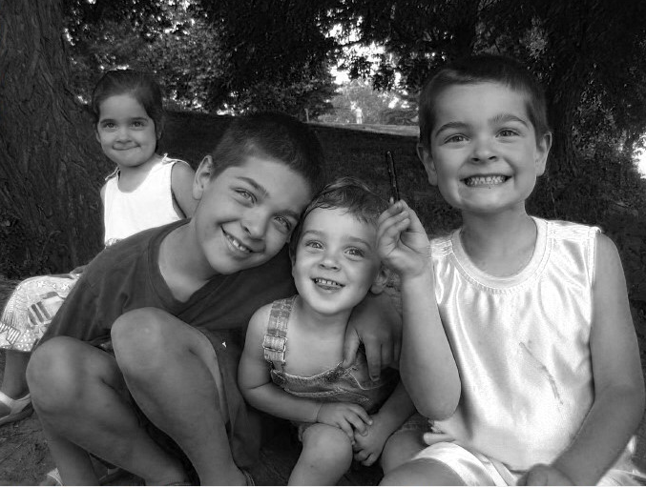
Review: color images are stored in 3 channels
Each color channel or band (R,G,B) is 0-255
R G B
←Each pixel,
located at (row, col),
has 3 values.
Channels are R,G,B planes→
R
G
B
Notes:
Dave

Slide 4
Color and intensity values can be stored as doubles or uint8
If double, then black-white range is [0,1]
If uint8 (unsigned 8-bit), then [0,255]
Why?
0.223 0.227 0.258 …
0.231 0.239 0.250 …
0.243 0.250 0.243 …
0.247 0.250 0.239 …
… … …
57 58 66 …
59 61 64 …
62 64 62 …
63 64 61 …
… … …
Notes:
Dave

Slide 5
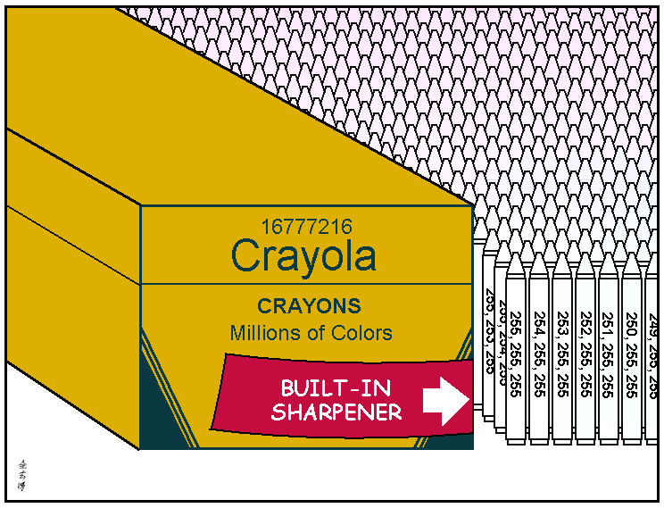
Why are there 16,777,216 crayons?
http://abstrusegoose.com/221
Notes:
Dave

Slide 6
Color spaces: RGB
Notes:
Dave

Slide 7
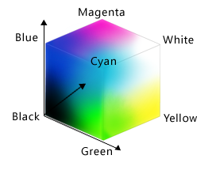
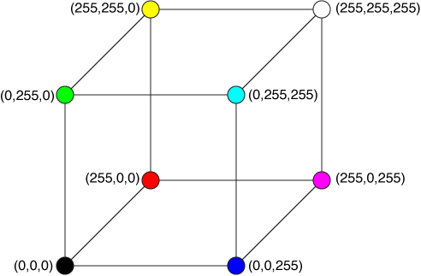
View RGB space with R,G,B axes
Each color is an (R,G,B) point.
Colors mix: B+G=cyan, B+R=magenta. R+G=???
http://xstitch.zachrattner.com/Images/RGBCube.png
http://dev.bowdenweb.com/css/colors/i/rgb-color-space-visualized-as-a-cube-msdn.png
Notes:
Dave

Slide 8
Is describing intermediate colors intuitive?
What’s (145, 194, 81)? Not intuitive!
Can you describe the black-to-white diagonal?
And what happens if you move away from the diagonal?
That makes sense. So tip it!
Notes:
Dave

Slide 9
Color spaces: HSV
Notes:
Dave

Slide 10
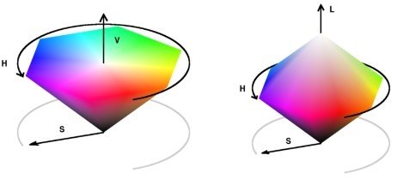
HSV (or HSL, HSI, HSB) space is more intuitive…
Vertical axis is value (lightness, intensity, brightness). How light or dark is the color?
Distance from that axis is saturation. How vibrant is the color?
Angle around the axis is hue. It’s a physical property: wavelength or frequency (location on the color spectrum)
Wikipedia, http://www.getreuer.info/_/rsrc/1311740880043/home/colorspace/colorspace_01.jpg?height=209px&width=462px
Notes:
Dave

Slide 11
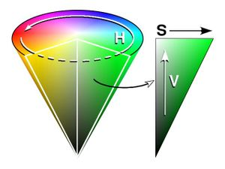
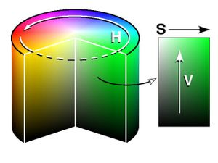
HSV (or HSL, HSI, HSB) space is more intuitive…
Vertical axis is value (lightness, intensity, brightness). How light or dark is the color?
Distance from that axis is saturation. How vibrant is the color?
Angle around the axis is hue. It’s a physical property: wavelength or frequency (location on the color spectrum)
Can compress or expand extremes.
Red = 0°
What color is (H,S,V) = (180°, 75, 25)?
S and V are in [0,100]
Wikipedia, http://www.getreuer.info/_/rsrc/1311740880043/home/colorspace/colorspace_01.jpg?height=209px&width=462px
Notes:
Dave

Slide 12
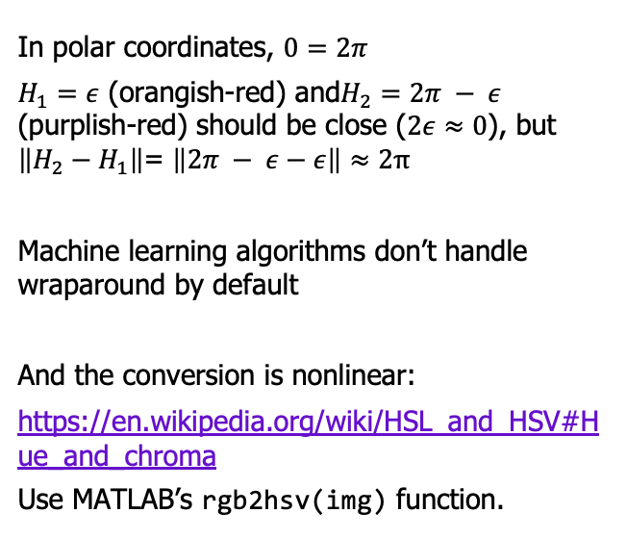
Intuitive! But you need to handle hue wrap-around
In polar coordinates, $0=2π$
$H_{1}=ε$ (orangish-red) and$H_{2}=2π − ε$ (purplish-red) should be close ($2ε≈0$), but $\left\|H_{2}−H_{1}\right\|$= $\left\|2π − ε−ε\right\|≈2π$
Machine learning algorithms don’t handle wraparound by default
And the conversion is nonlinear:
https://en.wikipedia.org/wiki/HSL_and_HSV#Hue_and_chroma
Use MATLAB’s rgb2hsv(img) function.
Wikipedia, http://www.getreuer.info/_/rsrc/1311740880043/home/colorspace/colorspace_01.jpg?height=209px&width=462px
Notes:
Dave

Slide 13
But it’s nice for human-learned features
http://www.colorpicker.com/
Notes:
Dave

Slide 14
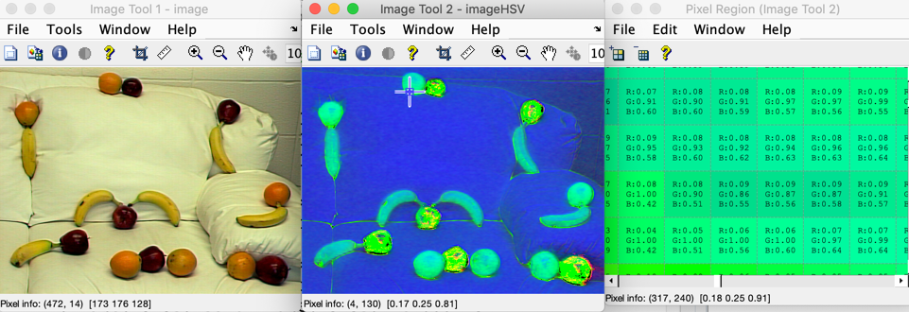
But it’s nice for human-learned features
http://www.colorpicker.com/
Zooming in on a fruit to learn how orange is an orange…
imtool(img); figure; imtool(rgb2hsv(img));
Observe; orange could be (h=0.04-0.09, s=0.85-1,v=0.4-0.7)
Notes:
Dave

Slide 15
Color spaces: LST
Notes:
Dave

Slide 16
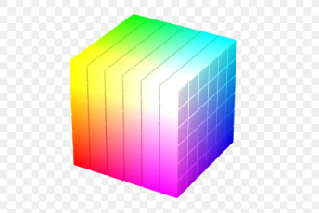
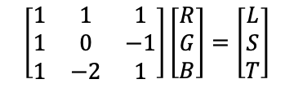
LST color space is friendlier to ML algorithms
Separates L (lightness) from color:
  L: intensity/lightness
  S: red vs blue
  T: green vs magenta
Friendly:
  Linear, so fast
  Rectangular, so no wraparound.
See connections:
  L in LST = _ in HSV
  But the S are different.
  LST are principal components of RGB space (more later)
L+
S+
T+
$$\left[\begin{matrix}1 & 1 & 1 \\ 1 & 0 & −1 \\ 1 & −2 & 1\end{matrix}\right]\left[\begin{matrix}R \\ G \\ B\end{matrix}\right]=\left[\begin{matrix}L \\ S \\ T\end{matrix}\right]$$
Y. I. Ohta, T. Kanade, and T. Sakai, Color information for region segmentation, Computer Graphics and Image Processing, Vol. 13, pp. 222-241, 1980. http://www.ri.cmu.edu/pub_files/pub4/ohta_y_1980_1/ohta_y_1980_1.pdf
https://hd.media.mit.edu/tech-reports/TR-445.pdf
https://favpng.com/png_view/space-rgb-color-model-rgb-color-space-png/c2YBj7e1
Notes:
Dave

Slide 17
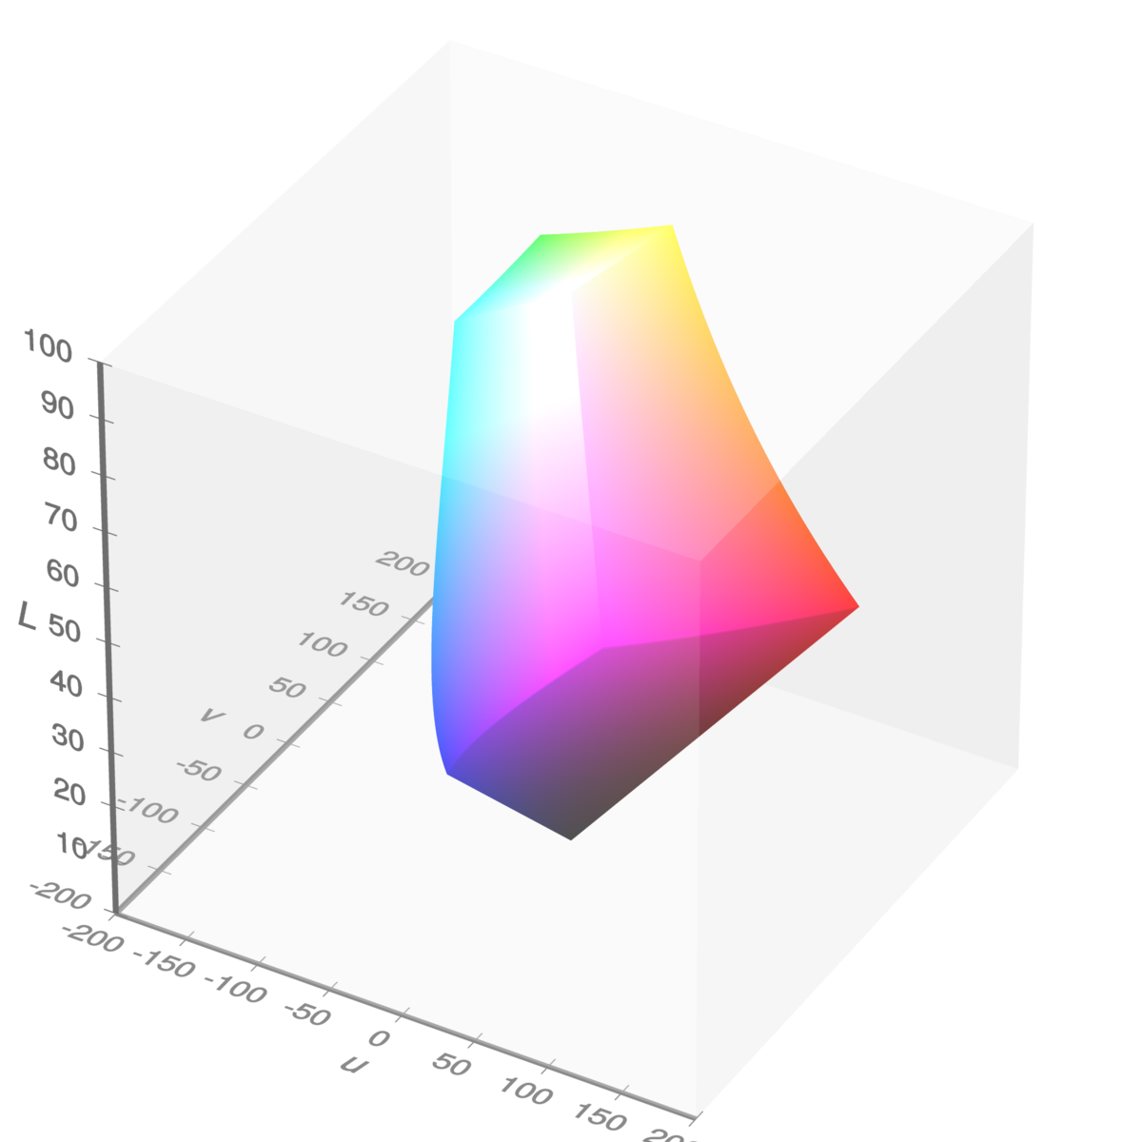
Other color spaces
L*U*V* (or CIELUV), L*a*b*, etc.
Here’s RGB inside Luv:
Nonlinear stretch so distances better match human perception.
Color science is a whole field!
https://upload.wikimedia.org/wikipedia/commons/thumb/e/e8/SRGB_gamut_within_CIELUV_color_space_isosurface.png/1200px-SRGB_gamut_within_CIELUV_color_space_isosurface.png
https://commons.wikimedia.org/w/index.php?title=File%3ASRGB_gamut_within_CIELUV_color_space_mesh.webm
Notes:
Dave

Slide 18
Summarizing colors: features
Notes:
Dave

Slide 19
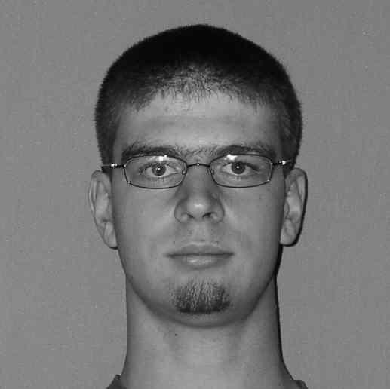
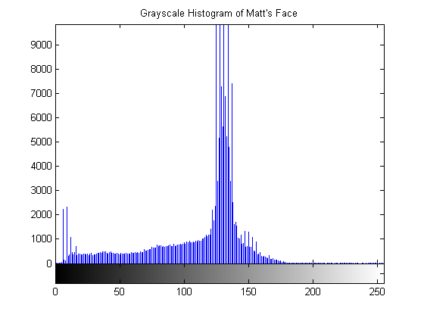
Color features: Histograms
Distribution of colors
(Sample to left is for intensities only)
Pros
  Quantizes data, but still keeps lots of info
Cons
  How to compare two images? Histogram intersection (Swain and Ballard)
  Spatial info gone (if scramble…)
Notes:
Dave

Slide 20
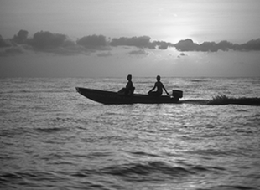
Color features: color moments of histograms
Moments are statistics
  1st order = mean
  2nd order = variance
  3rd order = skew
  4th order = kurtosis
          Some used higher order moments, but less intuitive
For color images, take moments of each band
For d>1:
m₁ = 116.3
m₂ = 1152.9
m₃ = -70078
m₄ = 7.4 million
m₁ = 132.4
m₂ = 2008.2
m₃ = 4226
m₄ =12.6 million
Notes:
Dave

Slide 21
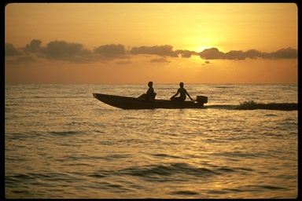
Putting it together: color statistics of each region
Break image into parts and describe each one with moments or histograms
  Sunset detector: spatial color moments in LST color space
← Regular grid: Pros? Cons?
← Image regions: Pros? Cons?
Notes:
Dave

Slide 22
Counting Fruit
Notes:
Dave

Slide 23
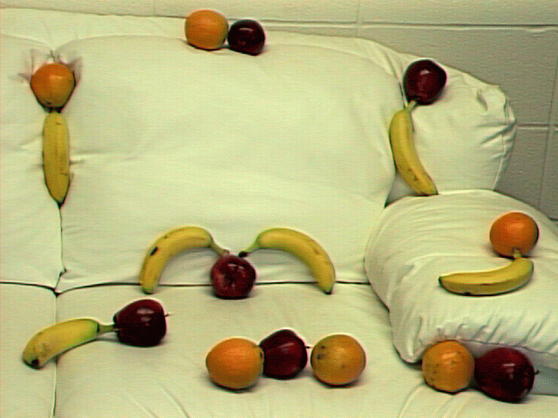
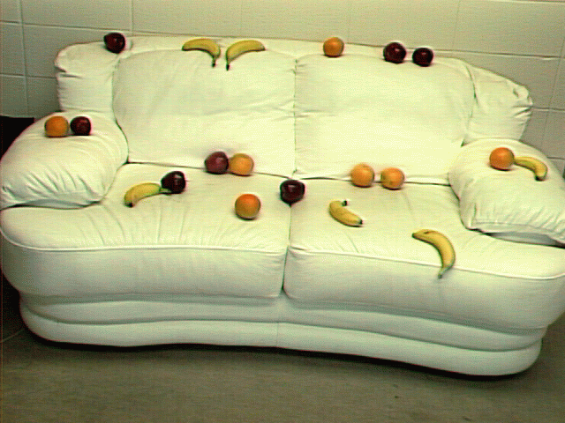
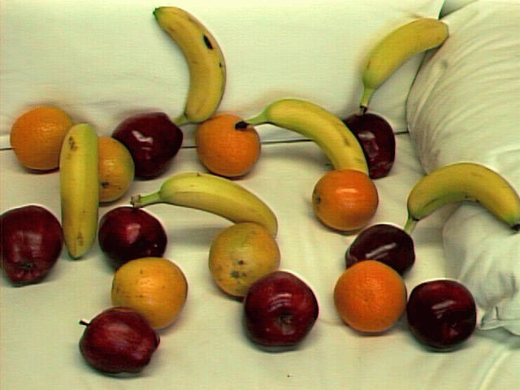
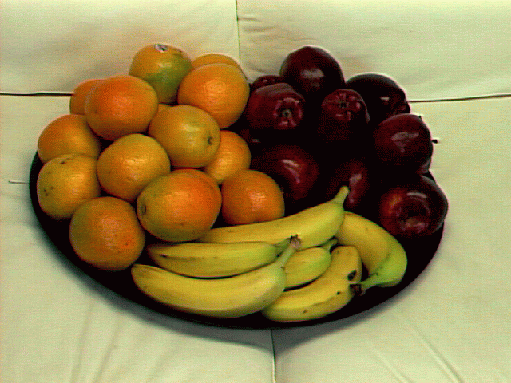
How many apples, bananas, and oranges are in each image?
Where are they? How big is each one?
6 oranges: …
Notes:
Dave

Slide 24
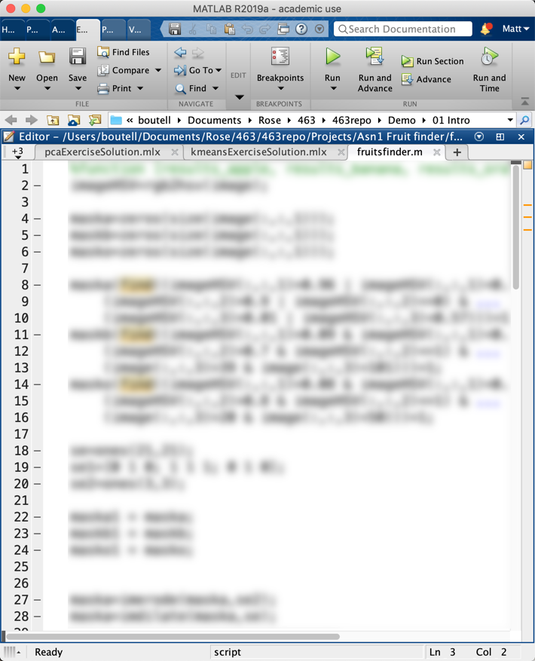
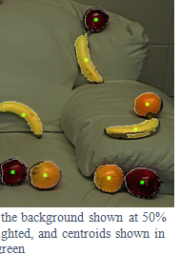
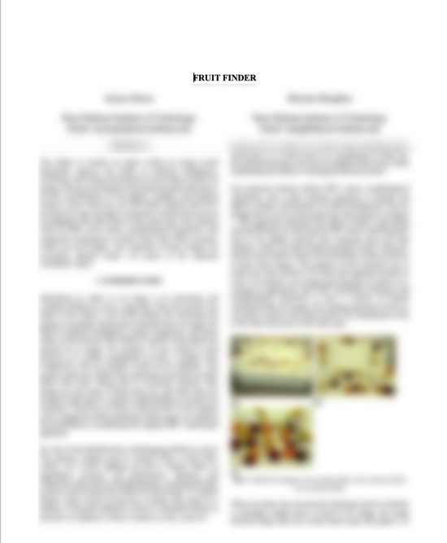
Why do so much so early in the course?
1. Practice with MATLAB
I’ll guide but not give every detail
2. Practice with color features
3. Practice writing a professional, detailed, conference-paper-style report
like ICME sunset paper (Abstract, Introduction, Process, Results, …)
but guided: specs, rubric, template
Warning: The project grade is determined by the paper quality: a finder that gets 100% accuracy can still earn an F, and one that gets
< 100% can earn a solid A.
Notes:
Dave

Slide 25
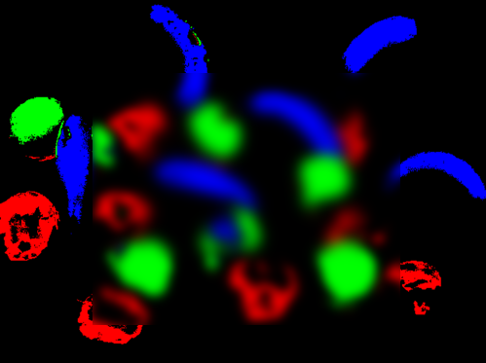
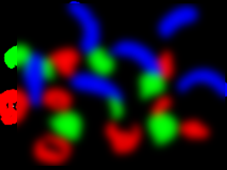
Fruit-finder big picture!
Observe: What numbers are a banana’s “yellow”? (imtool pixel zoom)
Can you differentiate between banana and orange? Orange and apple? Any and background? (Decision boundaries)
Note: no machine learning yet
Classify: each pixel using your model
Clean up: the results using mathematical morphology, size thresholds, etc.
Communicate: your results in a professional report
Notes:
Dave

Slide 26
Creating a mask of pixels with colors in given ranges
Notes:
Dave

Slide 27
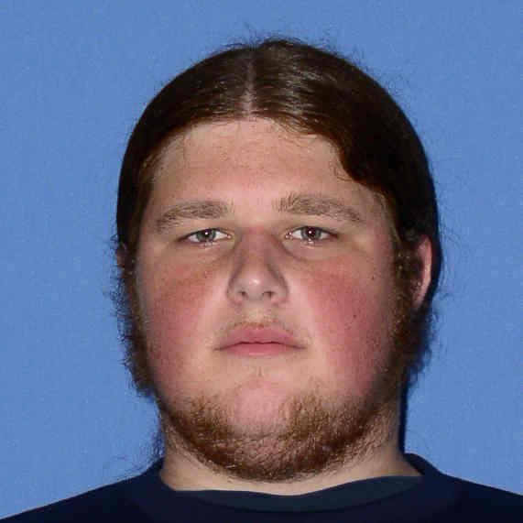

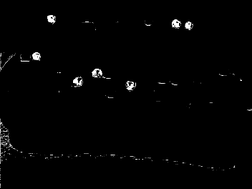
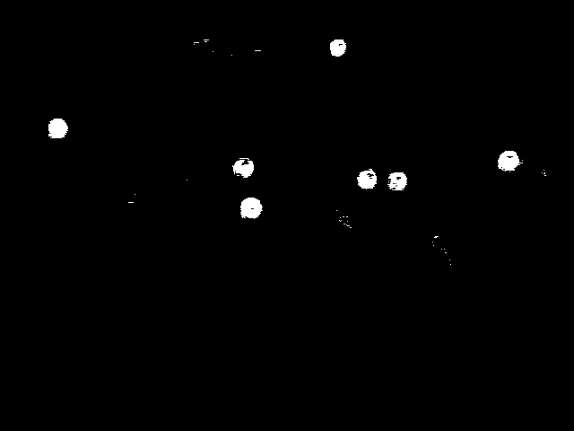
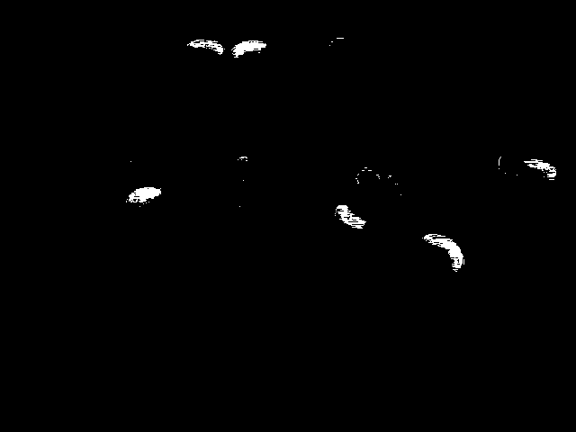
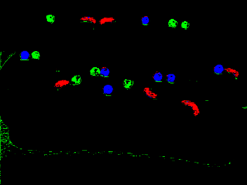
Masks show location of key pixels. They only have 2 values:
foreground: white (1 or 255)
background: black (0)
Face vs non-face →
Fruit-finding example:
Apple vs non-apl Orange vs non-orn Banana vs non-bn Each as one band
Notes:
Dave

Slide 28
Creating a mask of pixels with colors in given ranges
A hands-on exploration in MATLAB
Zeros to create a blank, black image then find to mark foreground as white.
Or Boolean expressions
Notes:
Dave

Slide 29
Connecting pixels
Notes:
Dave

Slide 30


Connecting pixels
Goal: to distinguish separate foreground regions
Is this one region or two?
It depends on how we define pixel neighbors
Notes:
Dave

Slide 31



Are diagonal pixels counted as neighbors?
If not: 4-neighborhood
Nums in no particular order.
For edge pixels, some
neighbors undefined →
If so, 8-neighborhood
Notes:
Dave

Slide 32

Connected components algorithm
Goal: each region gets a unique ID, from 1..n, labeled in column-major order.
MATLAB: cc = bwlabel(a, <4|8>)
Algorithms:
Simple? Do recursively, spreading in all directions
Fast? Do top-down in 2 passes: find equivalences, group them
1 1 0 0 0 0 4 4 4 0 0
1 1 0 0 0 0 4 4 0 0 0
0 0 2 2 0 0 0 4 4 0 0
0 0 2 2 0 0 0 4 4 0 0
0 0 0 0 0 0 3 0 0 0 0
0 0 0 0 0 0 3 0 0 0 0
0 0 0 0 0 3 3 3 0 0 5
Notes:
Dave

Slide 33
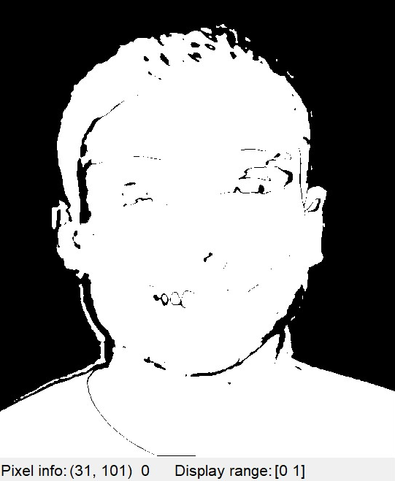
Cleaning up masks: Morphology and structure elements
Notes:
Dave

Slide 34
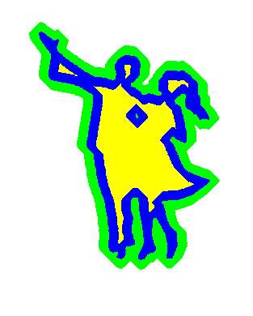

Morphological operations clean up binary images
Two primitive operations:
Dilate (imdilate): expand, fill holes
(blue→green in example)
Erode (imerode): shrink, remove noise
(blue→yellow in example)
And two derived ones: open and close
https://commons.wikimedia.org/wiki/File:DilationErosion.png
Notes:
Dave

Slide 35
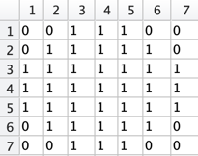
The effect depends on the structure element
Can be like neighborhoods or various shapes:
SE = strel(ones(3,3))
SE = strel([0 1 0; 1 1 1; 0 1 0])
SE = strel('diamond',r)
SE = strel('octagon',r)
SE = strel('line',len, deg)
SE = strel('rectangle',[m n])
SE = strel('square’,w)
SE = strel('disk’,r) strel('disk’,4) →
They are usually symmetric, but don’t need to be.
Larger ones have bigger effect
Notes:
Dave

Slide 36
Dilation
Notes:
Dave

Slide 37
Dilation expands the foreground region
Strel = 2x1,
centered on dot
Result = union of many copies of the structure element, centered on each foreground pixel
Notes:
Dave

Slide 38
Erosion
Notes:
Dave

Slide 39
Erosion shrinks the foreground region
Strel = 2x1,
centered on dot
If the whole structure element isn’t in the foreground, the corresponding pixel is eroded away. Generally edge pixels are exempt.
Notes:
Dave

Slide 40
Other morphology
Notes:
Dave

Slide 41


We can preserve approximate area by combining operations
Closing = dilate, then erode. Holes and inlets gone!
img closed
Opening = erode, then dilate. Noise and peninsulas gone!
img opened
Notes:
Dave

Slide 42
More morphology
1. How to make it more aggressive?
  Dilate n times
  Or use larger structure element
  Or use an alternative: size thresholding
2. Is it true that D(img) = inverse(E(inv(img)))? Always?
Note: most structure elements are symmetric, but asymmetric ones have interesting effects and are good counter-examples.
3. How to use on real world images.
Notes:
Dave

Slide 43
Lab 2: Finding RGB masks
Notes:
Dave

Slide 44
The goal of this lab is to practice what we’ve learned
Manipulating color in images
rgb2hsv
Creating masks and cleaning them up with morphology
Find a real photo with an interesting background
Be sure to attribute it
Notes:
Dave

Slide 45
Please complete and submit today’s quiz
Notes:
Dave

Slide 46

Title
Text
Notes:
Dave

