Slide 1
CSSE463:
Image Recognition
Matt Boutell
Moench D219B x8534
boutell@rose-hulman.edu

Slide 2
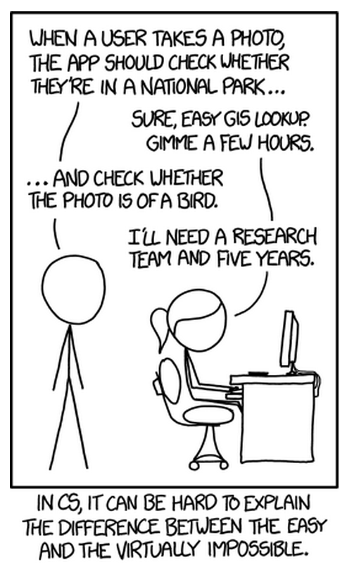
What is image recognition?
In the 1960’s, Marvin Minsky assigned a couple of undergrads to spend the summer programming a computer to use a camera to identify objects in a scene. He figured they’d have the problem solved by the end of the summer. Half a century later, we’re still working on it.
http://xkcd.com/1425/

Slide 3
Agenda: Introductions to…
The players
The topic
The course structure
The course material

Slide 4
Introductions
Roll call:
  Your name
    Pronunciations and nicknames
    Help me learn your names quickly
  Your major
  Your hometown
  Where you live in Terre Haute
Note to do a quiz question during this slide→
Q1-2

Slide 5
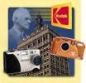
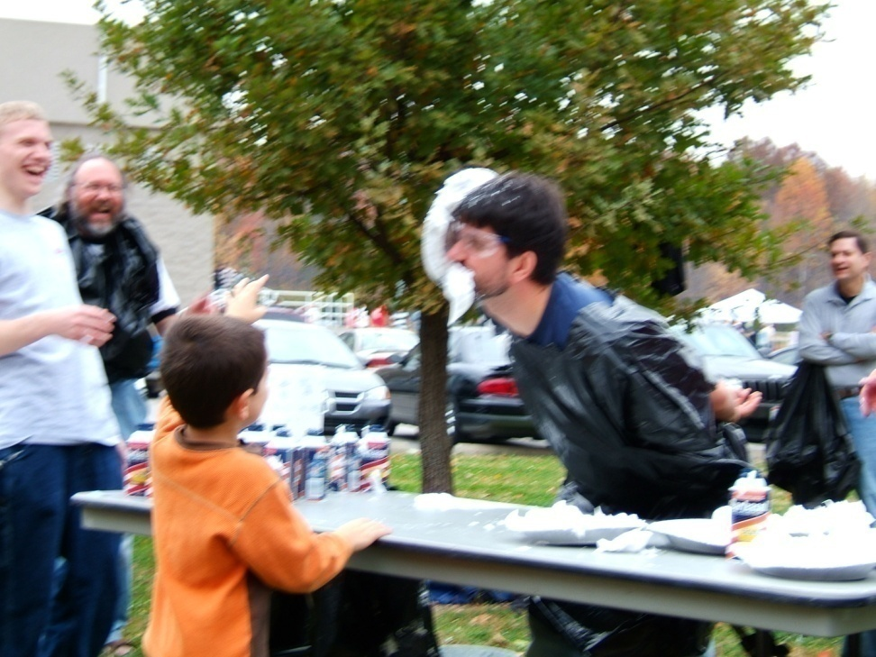
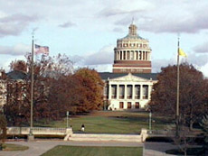

About me
Matt Boutell
U. Rochester
  PhD 2005
Kodak Research
intern 4 years
Here since 2005. CSSE120 (& Robotics), 220, 221, 230, 325, 463, 479, 483, ME430, ROBO4x0, 5 senior theses, many ind studies

Slide 6
Personal Info

Slide 7
Agenda
The players
The topic
The course structure
The course material

Slide 8
What is image recognition?
Image recognition (IR) is “Making decisions based on images and explicitly constructing the scene descriptions needed to do so” (Shapiro, Computer Vision, p. 15)
Computer vision, machine vision, image understanding, image recognition all used interchangeably
  But we won’t focus on 3D reconstruction of scenes, that’s CSSE461 with J.P. Mellor’s specialty.
IU is not image processing (IP; transforming images into images), that’s ECE480/PH437.
  But it uses it
IU isn’t machine learning; those are Dr. Shibberu’s classes
  But it uses it

Slide 9

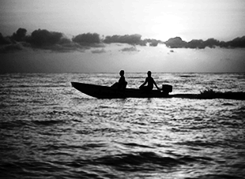
IR vs IP
Knowledge from images
  What’s in this scene?
It’s a sunset
It has a boat, people, water, sky, clouds
Enhancing images
  Sharpen the scene!
Q4

Slide 10
Why Image Rec?
A short list:
  Photo organization and retrieval
  Control robots
  Video surveillance
  Security (face and fingerprint recognition)
  Intelligent IP
Think now about other apps
  And your ears open for apps in the news and keep me posted; I love to stay current!

Slide 11
Agenda
The players
The topic
The course structure
The course material

Slide 12
What will we do?
Learn theory (lecture, written problems) and “play” with it (Friday labs)
See applications (papers)
Create applications (2 programming assignments with formal reports, big term project starting in week 4)
Learn MATLAB. (Install it asap if not installed)
  Instructions in Lab 1 (from course webpage)

Slide 13
Course Resources
Moodle for copyrighted papers, dropboxes for labs and assignments
Webpage for other. Bookmark:
https://www.rose-hulman.edu/class/csse/csse463/201930/
Schedule:
  See HW due tomorrow and Wednesday
Syllabus:
  Text optional
  Grading, attendance, academic integrity
Notes:
Course email

Slide 14
Agenda
The players
The topic
The course structure
The course material

Slide 15
Sunset detector
A system that will automatically distinguish between sunsets and non-sunset scenes
I use this as a running example of image recognition
It’s also the second major programming assignment, due at midterm
  Read the paper tonight (focus: section 2.1, skim rest, come with questions tomorrow; I’ll ask you about it on the quiz)
  We’ll discuss features in weeks 1-3
  We’ll discuss classifiers in weeks 4-5
A “warm-up” for your large term project
A chance to apply what you’ve learned to a known problem

Slide 16
Pixels to Predicates
1. Extract features from images
2. Use machine learning to cluster and classify
Color
Texture
Shape
Edges
Motion
Principal components
Neural networks
Support vector machines
Gaussian models
Q5

Slide 17


Basics of Color Images
A color image is made of red, green, and blue bands or channels.
  Additive color
    Colors formed by adding primaries to black
  RGB mimics retinal cones in eye.
  RGB used in sensors and displays
Source: Wikipedia

Slide 18
What is an image?
Grayscale image
  2D array of pixels
    (row,col), not (x,y)! Starts at top!
  Matlab demo (preview of Friday lab):
    Notice row-column indexing, 1-based, starting at top left
Color image
  3D array of pixels. Takes 3 values to describe color (e.g., RGB, HSV)
Video:
  4th dimension is time. “Stack of images”
Interesting thought:
  View grayscale image as 3D where 3rd D is pixel value
Q6-7
Notes:
Use 1 Demo prepped. If 2d->3d hangs, restart MATLAB

