Slide 1
CSSE463: Image Recognition Day 25
Today: introduction to template matching: a simple method for object detection
Questions?
Notes:
Discuss literature review, rubric, examples of student work.
http://abstrusegoose.com/288 about MATLAB: currently down.

Slide 2

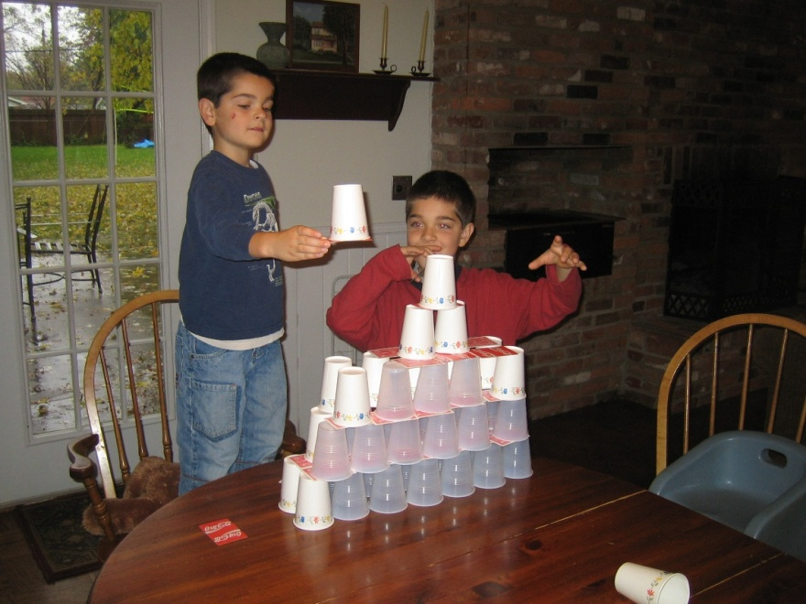
Template matching (Sonka, 6.4)
Idea: you are looking for an exact match of an object (described by a sub-image, a template) in an image
Ideal world: it matches exactly

Slide 3
Template matching (Sonka, 6.4)
Algorithm:
  Evaluate a match criterion at every image location (plus size, reflection, and rotation, if those variations are expected)
  A “match” is a local maximum of the criterion above a threshold
Q1
Notes:
Q1

Slide 4
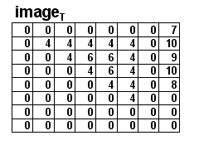
Template matching (Sonka, 6.4)
One match criterion:
  Correlation between the template and the image.
  Note: just use the template as a filter!
Simplistic implementation
Smarter implementation

Slide 5
Correlation
Just the dot product between the template and a neighborhood in the image.
Idea: high correlation when
the template matches.
Demo
Notes:
Idea: we are using the object as a filter!

Slide 6
Correlation
Just the dot product between the template and a neighborhood in the image.
Idea: high correlation when
the template matches.
Problem: always high
correlation when matching
with a plain bright region
Q2-3
Notes:
Idea: we are using the object as a filter!

Slide 7
Correlation
Just the dot product between the template and a neighborhood in the image.
Idea: high correlation when
the template matches.
Problem: always high
correlation when matching
with a plain bright region
Solution: Normalize the template and each region by subtracting each’s mean from itself before taking dot product
Q4-5

Slide 8
Other matching algorithms
Chamfering (Hausdorff distance):
  http://www.cs.cornell.edu/~dph/hausdorff/hausdorff1.html
Springs and templates (Crandall and Huttenlocher)
  http://www.cs.cornell.edu/~dph/papers/cvpr07.pdf
Even neural nets (deep or not) need to operate at various scales/patches of the image to detect objects.

Slide 9
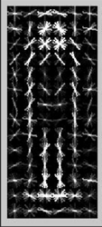
Edges are more robust features for detection than intensities
Histogram of Oriented Gradients
(HOG features)
Sources:
Guest lecture by Trenton Tabor, RHIT ‘12
Sonka, et al. text, section 10.6.3
N. Dalal and B. Triggs, "Histograms of Oriented Gradients for Human Detection", Proc. IEEE Conf. Computer Vision and Pattern Recognition, vol. 1, pp. 886-893, 2005.

Slide 10
HOG features work well for pedestrian detection
Dalal and Triggs introduced it in 2005.
Their work has been cited over 13,000 times!
Used for object classification in 2006
We’ll look at usage for digit classification
Past CSSE463 teams have used for object recognition tasks
Notes:
Add more refs

Slide 11

Matlab has clear docs and examples
Matlab HOG documentation
Matlab end-to-end digit recognition example
How?
Preprocessing by binarizing images
Extract HOG features on training and testing sets
Train an ensemble of linear SVMs for multiclass classification
Demo digit rec now
Notes:
Add more refs

Slide 12
How does HOG feature extraction work?
Notes:
Add more refs

Slide 13




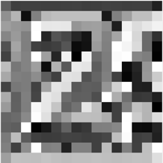
1. Calculate edge gradient magnitude and direction
-1 | 0 | 1
Orientation histogram every 20 deg (9 bins)
Compute for each cell (group of pixels)
1
0
-1
Notes:
Add more refs

Slide 14
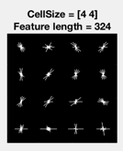
1b. Edge direction histogram visualization
Notes:
Add more refs

Slide 15

2. Repeat for each cell in block
Orientation histogram for block:
9 x 4 = 36 features
Then normalize feature vector,
$$n=\frac{v}{\sqrt{{\left\|v\right\|}^{2}+ε}}$$
For example, this gives unit length.
Notes:
Add more refs

Slide 16
3. Repeat for each block of cells in the window
etc.
36/block x 9 overlapping blocks = 324 features
Each block is normalized independently
https://www.mathworks.com/help/vision/examples/digit-classification-using-hog-features.html
Notes:
Add more refs

Slide 17
Example of pedestrian classifier using HOG features
https://www.youtube.com/watch?v=TzzJC8sOe60&feature=youtu.be
Showcasing Trenton’s work:
T. Tabor, Z. Pezzementi, C. Vallespi and C. Wellington, 'People in the Weeds: Pedestrian Detection Goes Off-road', in 2015 IEEE International Symposium on Safety, Security, and Rescue Robotics, Purdue University, West Lafayette, IN, 2015.
Notes:
Add more refs

Slide 18
Sounds great. How do I start?
Read the Matlab example.
Try it out!
Read about parameters and experiment with them as needed:
Matlab HOG documentation
Notes:
Add more refs

