Slide 1
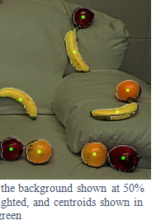
CSSE463: Image Recognition Day 6
Yesterday: Local, global, and point operators use different context, but all
  operate on entire image,
  changing one pixel at a time!!
Lab due tomorrow
Fruit-finder deadline Friday, 11:00pm
  Please leave time for a solid write-up
  Nice example of how to show results:
  See rubric online for other standards
  Questions?
Today: edge features (another local operator)
  Sonka 5.3

Slide 2
There are 2 types of programmers in the world:
    1. Those who prefer 1-based indexing
    1. Those who prefer 0-based indexing
Thanks to 463 student John Krasich for clarifying this for us.
Notes:
Thomas Root was the first one to point out…

Slide 3
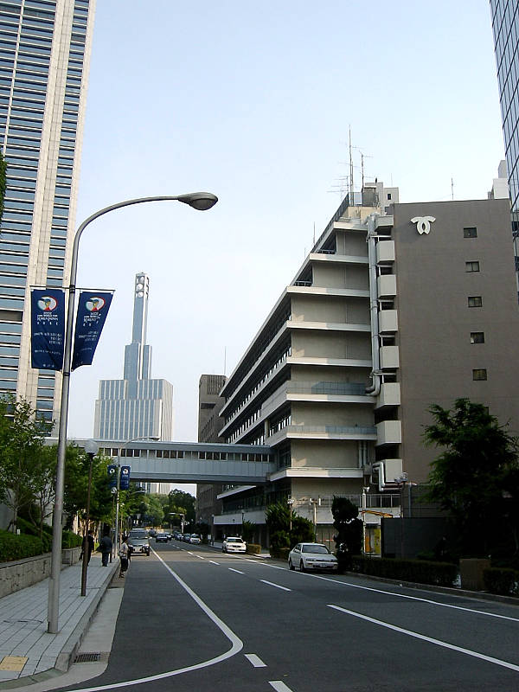
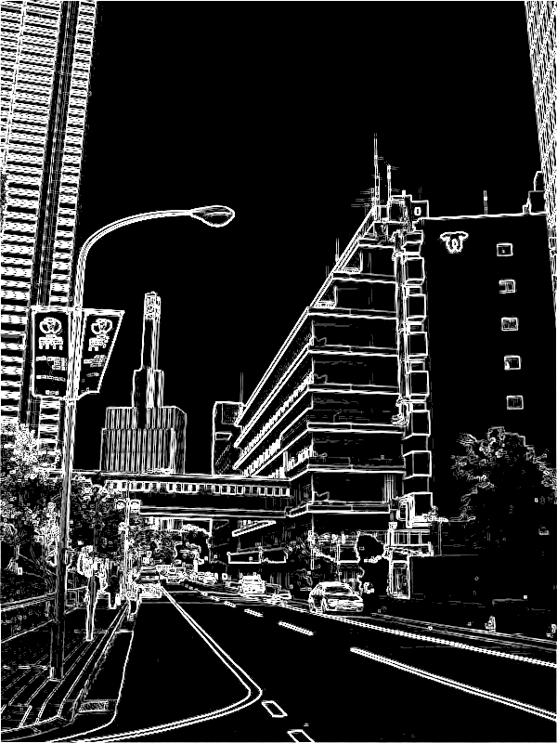
Edge Features – Why?
  “Edginess” (# edges) and their directions can give you info about the scene content
    Orientation of the image
    Natural vs. manmade images
  Edges can be used to segment the image.
    Color information is usually used as well.
    Specifically, boundaries occur where the chroma and/or luminance change (drastically).
  We could use to enhance the fruit-finder in a later assignment (not now).

Slide 4
Outline for next 2 sessions
Concept: How to find “edges” in 1D signal
Edges in 2D images
Limitations
Edges vs edgels, Canny edge detector

Slide 5
Intuition: Finding edges
Image
What’s an edge?
How to find changes in intensity?
How to find first derivative?
Intensity
First deriv.

Slide 6
Finding derivatives (1D)
Let y be intensity of point at location x
Def:
Fix Δx = 1 pixel
dy/dx = y₂-y₁
f: [0 0 0 0 0 50 50 50 50 0 0 0 0 0];
f’:[ 0 0 0 0 50 0 0 0 -50 0 0 0 0 ];
Correlate image with filter [-1,1] to find positions of change.
  Edges “between” pixels.
  What is significance of magnitude of first deriv. ?

Slide 7
Applying Filters
Example for differential with Δx = 2 pixels:
  (Better; no output “between” pixels)
Image
5 | 8 | 9 | 1 | 2 | 2 | 1 | 2 | 1 | 3 | 1 | 3
-½ | 0 | ½
-½ | 0 | ½
-½ | 0 | ½
Mask
Output
2
-3.5
-3.5
…
Could you do
  Ramps? Impulse? Step edges? (on quiz)
Properties
  If no contrast?
Q1,3

Slide 8
Why should the values in an edge filter sum to 0?
What if they didn’t?
Consider running it on a homogeneous region: 40, 40, 40, 40, 40, 40
Q2

Slide 9
2D Edges
Local operators
    Prewitt operators
    Sobel masks
    Roberts 2x2 cross-operators
Gradient: magnitude
Gradient direction

Slide 10
Edge gradient
Vector pointing in direction of greatest positive change.
We want its magnitude and direction
∇f
f_{y}
f_{x}

Slide 11
1. Find partials using filters
Note that this is 1D filter, but averaged over 3 rows (for df/dx) or 3 cols (for df/dy) and with 1/6 factored out to allow integer multiplication
Q4,Q5

Slide 12
Demo
My homemade edgefinder
  Finds vertical and horizontal edges using filters
  Combines to find edge magnitude
  Combines to find edge direction
  Re-scale for display
Similar to part of Lab 3.
  So I can’t post code

Slide 13
2. Find edge gradient magnitude
Definition: the gradient, , is the vector pointing in the direction of greatest change.
To find its magnitude:
Q2

Slide 14
3. Find edge gradient direction
tan⁻¹(y,x)
Matlab’s atan2(y,x) gives full range, [-π, π]
dir=arctan(-1,0) = -π/2
dir=arctan(0,1)= 0
dir=arctan(0,-1) = π
dir=arctan(1,0)= π/2
Direction is thus the angle formed by the x-axis and the line “pointing towards” light region.
Q3-4

Slide 15
Review: filters to reduce noise
From last slide from Day 5 class
To get the output at a single point, take cross-correlation (basically a dot-product) of filter and image at that point
To filter the whole image, shift the filter over each pixel in the original image
This is a 3x3 version of which filter?

Slide 16
Color edges
Rarely used historically
Intuition: edges occur between regions of different hue but same intensity.
One technique patented by David Cok, Eastman Kodak Co.

Slide 17
Limitations of edgel-finders
Natural variation
  Shadows and highlights can obscure edges
Internal vs. external edges
  We might want the outline of an article of clothing, but the stripes in our shirt are edges too.
Noise!
  Signal-to-noise ratio important in determining how hard it is to find edges.
Q5

Slide 18
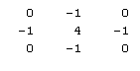
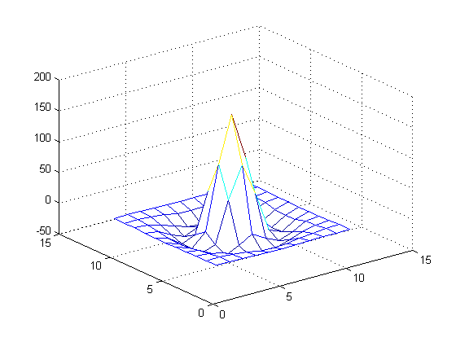
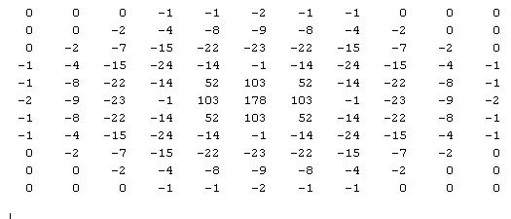
Dealing with noise by smoothing
Our goal is to combine smoothing and edgel detection.
  Smooth using Gaussian
  Find edges by finding zero-crossings of 2nd deriv. filter (1 -2 1)
Can combine by using a difference of Gaussian (DOG) filter
  Then find zero-crossings
3x3
11x11

Slide 19
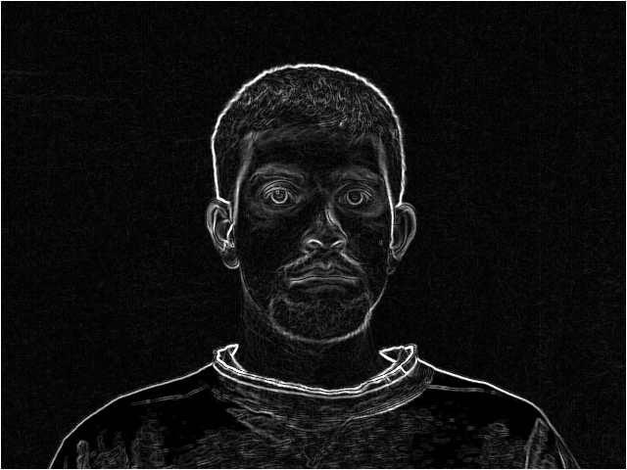
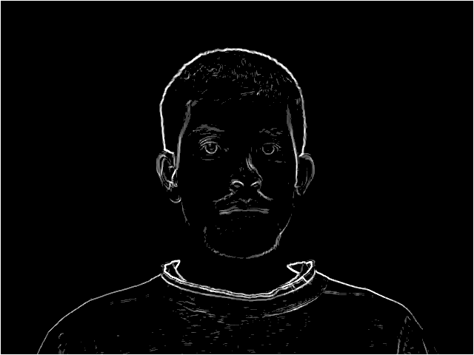
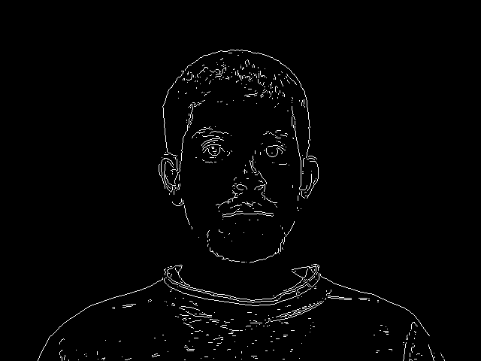
Edgels vs. Edges
Edgels are unconnected groups of pixels detected by a mask
Edges are longer segments found by grouping edgels
  Intuitively, we think of edges
Different data structure
How might you process a “raw” edge image?

Slide 20
From mask output to edgels: ideas
Threshold away “weak” output
  What threshold to use?
  Always fixed or should it vary?
“Thin” edges by nonmaximum suppression.
  Idea: If an edge is 5 pixels wide, we can replace it with only the innermost segment.
  Remove the edge response of an pixel not greater than its 2 neighbors in the direction of the gradient.
Q6

Slide 21
Canny edge detection
First smoothes the intensity image
  Parameter σ controls how many edges found
Non-maximal suppression
Uses two thresholds:
  High: to initiate contour following
  Low: to follow along a contour
  Result: segments from noise are less likely to be found (unless the noise is too strong)
Aggregates neighboring edgels into curves (“edges”)
Q7-8

Slide 22
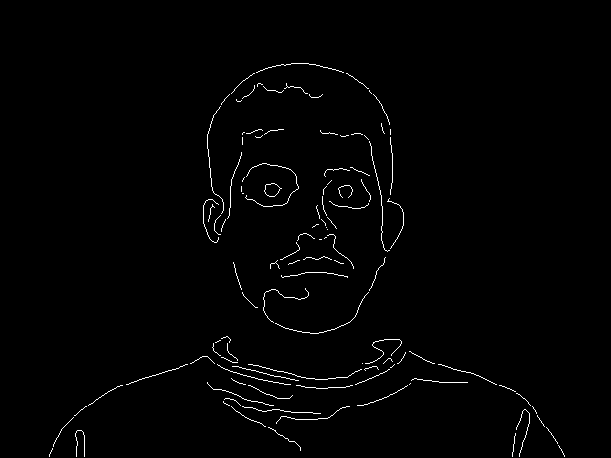
Canny edge detection
You’ll get to play with various
edgefinders in Lab 3 using
Matlab’s built-in edgedemo

Slide 23
Some neat image rec/computer vision demos using the kinect:
  http://www.youtube.com/watch?v=7QrnwoO1-8A&feature=mfu_in_order&list=UL
  http://www.engadget.com/2010/12/09/kinect-finally-fulfills-its-minority-report-destiny-video/

