Slide 1
CSSE463: Image Recognition Day 2
Roll call
Announcements:
  Moodle has drop box for Lab 1
  Next class: lots more Matlab how-to (bring your laptop)
Questions?
Today: Color and color features
  Do questions 1-2 about ICME sunset paper now
Q1-2

Slide 2

Pixels to Predicates
1. Extract features from images
2. Use machine learning to cluster and classify
Color
Texture
Shape
Edges
Motion
Principal components
Neural networks
Support vector machines
Gaussian models

Slide 3


Basics of Color Images
A color image is made of red, green, and blue bands.
  Additive color
    Colors formed by adding primaries to black
  Comments from graphics?
  RGB mimics retinal cones in eye.
  RGB used in sensors and displays
    Why “16M colors”?
    Why 32 bit?
Source: Wikipedia

Slide 4
Basics of Color Images
Each band is a 2D matrix
Each R, G, or B value typically stored in a byte.
  Range of values?
The 4th byte is typically left empty
  Allows for quicker indexing, because of alignment
  Reserved for transparency (in graphics)
How much storage, in KB, is required for a 128x192 thumbnail color image (uncompressed, including unused 4th bytes)?
Q3-4

Slide 5
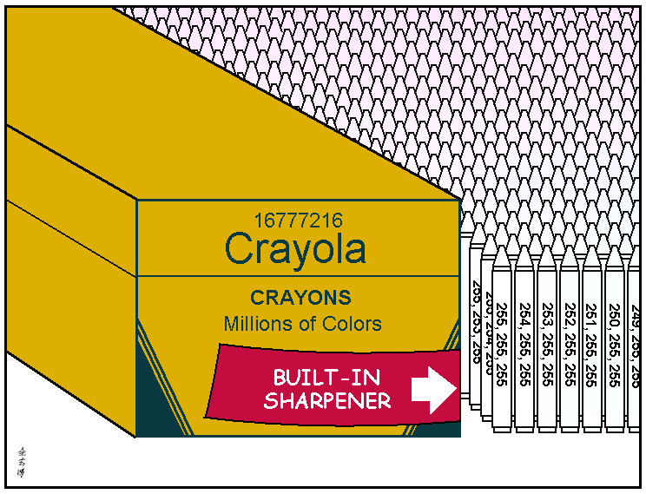
http://abstrusegoose.com/221

Slide 6
We can extract different types of color features (statistics) from images
1. Color histograms
2. Color moments
3. Color coherence vectors
Related considerations:
Some color spaces “work better”
Spatial components can help
Q5

Slide 7


Color histograms
Gives distribution of colors
Sample to left is for intensities only
Pros
  Quantizes data, but still keeps lots of info
Cons
  How to compare two images?
  Spatial info gone
  Histogram intersection (Swain and Ballard)

Slide 8

Color moments
Central moments are statistics
  1st order = mean
  2nd order = variance
  3rd order = ____
  4th order = ____
  Some have used even higher order moments, but less intuitive
For color images, take moments of each band
skew
kurtosis
m₁ = 116.3
m₂ = 1152.9
m₃ = -70078
m₄ = 7.4 million
m₁ = 132.4
m₂ = 2008.2
m₃ = 4226
m₄ =12.6 million
Q6

Slide 9
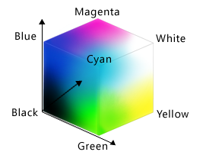
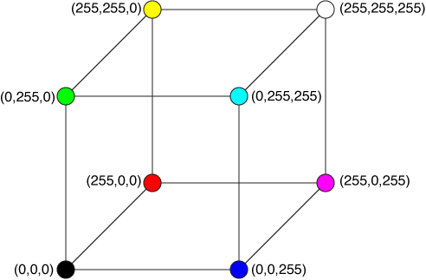
RGB color space
Red/green/blue
Rectangular axes
Simple, but non-intuitive
Source: Wikipedia
http://xstitch.zachrattner.com/Images/RGBCube.png
http://dev.bowdenweb.com/css/colors/i/rgb-color-space-visualized-as-a-cube-msdn.png
Q7

Slide 10


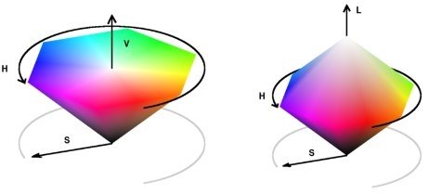
HSV color space
Hue-saturation-value (HSV) cone
  also called HSI (intensity)
  Intuitive
    H: more than “what color”: it’s wavelength; position on the spectrum!
    S: how vibrant?
    V: how light or dark
“Distance” between colors
  Must handle wraparound of hue angle correctly (0 = 2π)
Matlab has method to convert from rgb to hsv, can find formula online.
Wikipedia, http://www.getreuer.info/_/rsrc/1311740880043/home/colorspace/colorspace_01.jpg?height=209px&width=462px
Q7

Slide 11
Interactive HSV color picker
http://www.colorpicker.com/

Slide 12
Other color spaces
LST (Ohta)¹
  L = luminance: L = (R + G + B)/sqrt(3)
  S and T are chroma bands.
    S: red vs. blue: S = (R – B) / sqrt(2)
    T: green vs. magenta: T = (R – 2G + B) / sqrt(6)
  These 3 are the principal components of the RGB space (PCA and eigenvectors later in course)
  Slightly less intuitive than HSV
  No problem with wraparound
Others
  YIQ (TV signals), QUV, Lab, LUV
  http://www.scarse.org/docs/color_faq.html#graybw
  Y. I. Ohta, T. Kanade, and T. Sakai, Color information for region segmentation, Computer Graphics and Image Processing, Vol. 13, pp. 222-241, 1980. http://www.ri.cmu.edu/pub_files/pub4/ohta_y_1980_1/ohta_y_1980_1.pdf
Q8

Slide 13

Spatial component of color
Break image into parts and describe each one
  Can describe each part with moments or histograms
Regular grid
  Pros?
  Cons?
Image regions
  Pros?
  Cons?
Q9

Slide 14
Additional reading
Color gamuts
  http://en.wikipedia.org/wiki/Gamut
Color coherence vectors
  Extension of color histograms within local neighborhoods
  Used in:
    A. Vailaya, H-J Zhang, and A. Jain. On image classification: City images vs. landscapes. Pattern Recognition 31:1921-1936, Dec 1998.
  Defined in:
    G Pass, R Zabih, and J Miller. Comparing images using color coherence vectors. 4th ACM Conf. Multimedia, pp 65-73, Boston, 1996.
Q10

