Slide 1
CSSE463:
Image Recognition
Matt Boutell
F-222 x8534
boutell@rose-hulman.edu

Slide 2
Agenda: Introductions to…
The players
The topic
The course structure
The course material

Slide 3
Introductions
Roll call:
  Your name
    Pronunciations and nicknames
    Help me learn your names quickly
  Your major
  Your hometown
  Where you live in Terre Haute
  [On piazza: If you had an extra day every week, how would you spend it? Why?]
Note to do a quiz question during this slide→
Q1-2

Slide 4
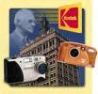
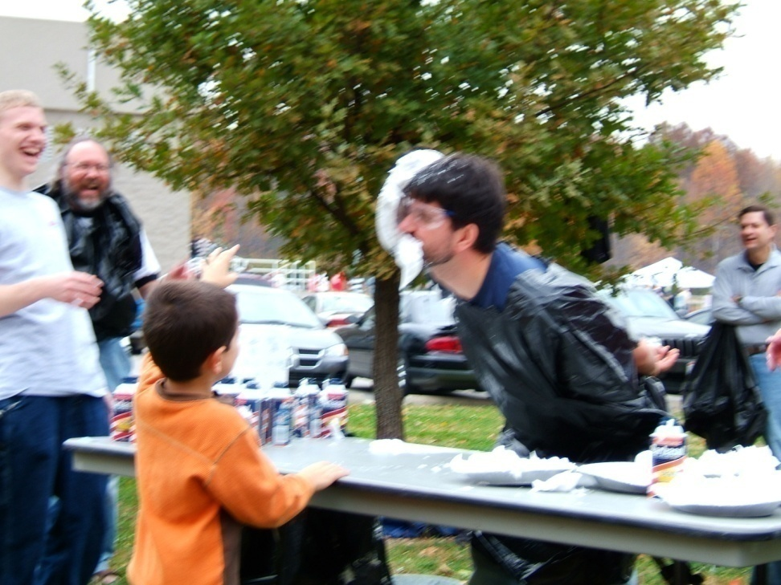
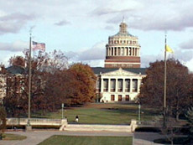

About me
Matt Boutell
U. Rochester
  PhD 2005
Kodak Research
intern 4 years
9th year here. CSSE120 (& Robotics), 220, 221, 230, 325; 479; Android, ME430, ROBO4x0, 2 Img Rec theses

Slide 5
Personal Info

Slide 6
Agenda
The players
The topic
The course structure
The course material

Slide 7
What is image recognition?
Image understanding (IU) is “Making decisions based on images and explicitly constructing the scene descriptions needed to do so” (Shapiro, Computer Vision, p. 15)
Computer vision, machine vision, image understanding, image recognition all used interchangeably
  But we won’t focus on 3D reconstruction of scenes, that’s CSSE461 with J.P. Mellor’s specialty.
IU is not image processing (IP; transforming images into images), that’s ECE480/PH437.
  But it uses it
IU isn’t pattern classification: that’s ECE597
  But it uses it
Q3

Slide 8

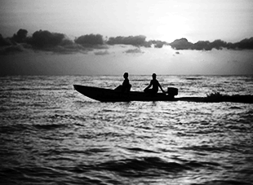
IU vs IP
Knowledge from images
  What’s in this scene?
It’s a sunset
It has a boat, people, water, sky, clouds
Enhancing images
  Sharpen the scene!

Slide 9
Why IU?
A short list:
  Photo organization and retrieval
  Control robots
  Video surveillance
  Security (face and fingerprint recognition)
  Intelligent IP
Think now about other apps
  And your ears open for apps in the news and keep me posted; I love to stay current!
Q4

Slide 10
Agenda
The players
The topic
The course structure
The course material

Slide 11
What will we do?
Learn theory (lecture, written problems) and “play” with it (Friday labs)
See applications (papers)
Create applications (2 programming assignments with formal reports, course project)
Learn MATLAB. (Install it asap if not installed)
  Tutorial Monday, 10th hour, this room.

Slide 12
Course Resources
Moodle is just a gateway to website (plus dropboxes for labs and assignments)
Bookmark now
http://www.rose-hulman.edu/class/csse/csse463/201420/
Schedule:
  See HW due tomorrow and Wednesday
Syllabus:
  Text optional
  Grading, attendance, academic integrity
Notes:
Course email

Slide 13
Agenda
The players
The topic
The course structure
The course material

Slide 14
Sunset detector
A system that will automatically distinguish between sunsets and non-sunset scenes
I use this as a running example of image recognition
It’s also the second major programming assignment, due at midterm
  Read the paper tonight (focus: section 2.1, skim rest, come with questions tomorrow; I’ll ask you about it on the quiz)
  We’ll discuss features in weeks 1-3
  We’ll discuss classifiers in weeks 4-5
A “warm-up” for your term project
A chance to apply what you’ve learned to a known problem

Slide 15
Pixels to Predicates
1. Extract features from images
2. Use machine learning to cluster and classify
Color
Texture
Shape
Edges
Motion
Principal components
Neural networks
Support vector machines
Gaussian models
Q5

Slide 16


Basics of Color Images
A color image is made of red, green, and blue bands or channels.
  Additive color
    Colors formed by adding primaries to black
  RGB mimics retinal cones in eye.
  RGB used in sensors and displays
  Comments from graphics?
Source: Wikipedia

Slide 17
What is an image?
Grayscale image
  2D array of pixels
    (row,col), not (x,y)! Starts at top!
  Matlab demo (preview of Friday lab):
    Notice row-column indexing, 1-based, starting at top left
Color image
  3D array of pixels. Takes 3 values to describe color (e.g., RGB, HSV)
Video:
  4th dimension is time. “Stack of images”
Interesting thought:
  View grayscale image as 3D where 3rd D is pixel value
Q6-7
Notes:
Use 1 Demo prepped. If 2d->3d hangs, restart MATLAB

