Slide 1


Software Construction and Evolution - CSSE 375
Software Maintenance Process
“Here’s why you need
the new wheels, too…”
Shawn and Steve
Left – Maintenance process is driven by the ongoing ability to make money at it.
Notes:
Image from http://www.visualphotos.com/image/2x4604154/mechanic_explaining_repairs_to_customer.

Slide 2

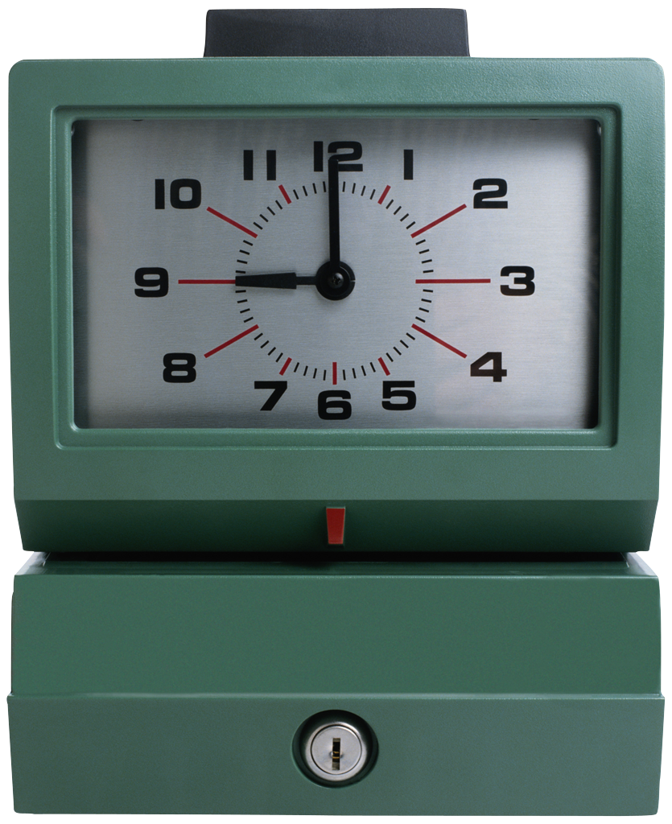
Recall Discretionary and Non-Discretionary $
Since Development and Maintenance can be somewhat ambiguous situations, money often determines the label
  Lots of money, or a little
  Out of a fixed budget, or not
Or, “when it is”
  Before or after first release
Or, whether it’s mostly fixes vs features
→

Slide 3
What’s the business case for maintenance?
Large systems, like O/S’s:
  Customers build / load a lot on top of them.
  Essentially an obligation to support for a long time.
    E.g., Windows XP supported for 10 years.
    Ubuntu has “long term releases” of Linux
May have long-term maintenance agreements.
    Paid for by customers
May have Quality of Service agreements.
    Also paid for.
Custom software products
    You may get paid “by the fix”
      Time and materials, or
      “Value pricing”
Maintaining old products retains customers
  Maybe they’ll buy new things, too?
A good final exam question: “Why is it hard to make money on customer fixes for major customers?
→

Slide 4
Development versus Maintenance Risk
Development Risks
  Technology - sometimes bleeding edge
  Personnel - sometimes high turnover
    And new people right out of school
  Budget - risk entrepreneurial investments
  Business - business case based on future customers
Maintenance Risks
  Technology - sometimes technology obsolete
  Personnel - sometimes dated skills
    Same people on the project forever?
  Budget - risk averse cost containment
  Business - business case based on existing customers
    What do they need (and will pay for)?
    What does it take to keep them?
    How to move them to new products?
Q1
→
Notes:
Q1: What is the business case based on for Software Maintenance?

Slide 5

Key Software Maintenance Factors
Software Product
User Requirements
(i.e., Change Request and Specification)
Organizational Environment
Operational Environment
Maintenance Personnel
Maintenance Process

Slide 6
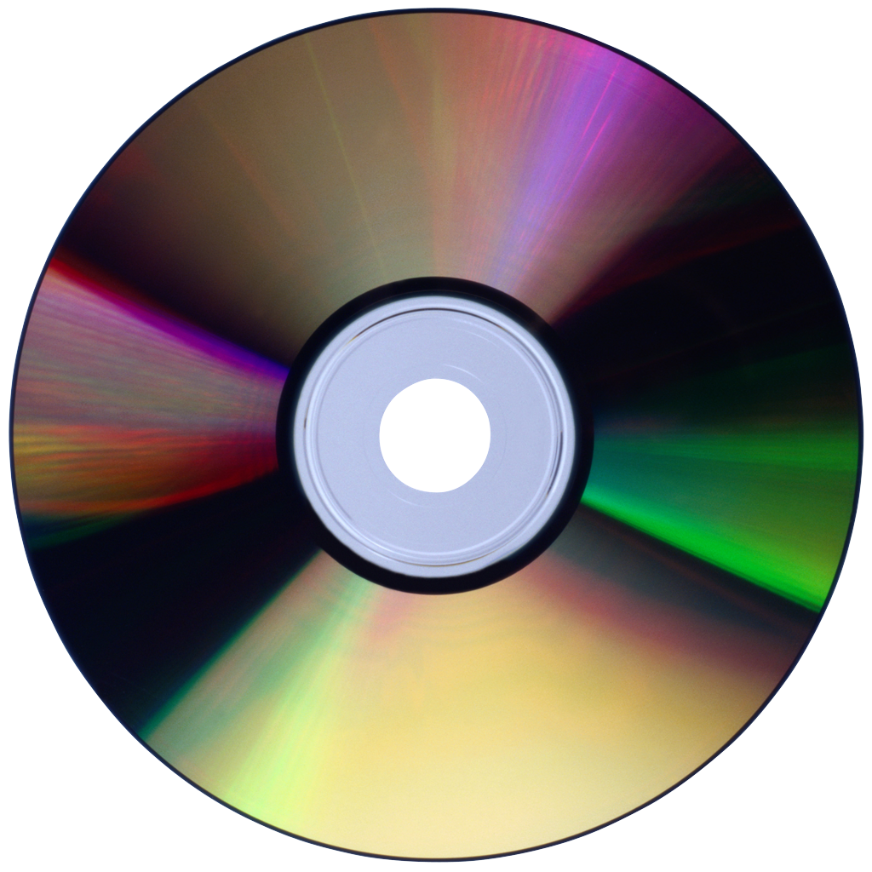
Software Product
Application domain
Documentation quality
Code flexibility
Code complexity/structure
Product quality
Q2
→
Notes:
Application Domains Mature (early 80% solution → Covering range of situations)
Code Flexibility - No clear standards for code changes (vs the rest of engineering)
Product quality – like entropy
Q2: What are the key issues with the software product with respect to maintenance?

Slide 7

User Requirements
Requests for additional features
Correction of defects (bugs)
Other support (e.g. training, help desk)
Q3
→
Notes:
Requests for additional features
Usually wait for next release
Specials for key customers or submarkets
Correction of defects (bugs)
Fix now vs. Wait for next release
Other support (e.g. training, help desk)
Should developers take a turn at the help desk?
Q3: Where do user requirements play the most direct role in software maintenance?

Slide 8

Organizational Environment
Change in Policies
  Medical – FDA 13485 Medical Device Regulation
Competition
Internal Management Changes
  Mergers and Acquisitions
→
Notes:
Policies - Banking, Insurance, Finance…
Competition - announces their product on iPad
Internal Management Changes - Your group is merged with another group, under their old management

Slide 9
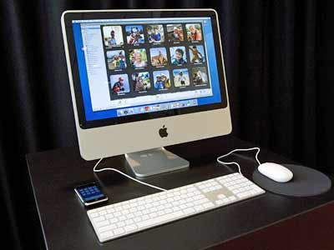
Operational Environment
Hardware
Communications
Operating Systems
Systems Software
Third Party Software
Q4
Notes:
Nasty scenario – One of the components you use forces you to do an expensive upgrade
Nastier – That upgrade won’t work with other components you have to use
Damocles' sword conflicts …
Q4: What elements of the operational environment can be effected by interoperability changes?

Slide 10
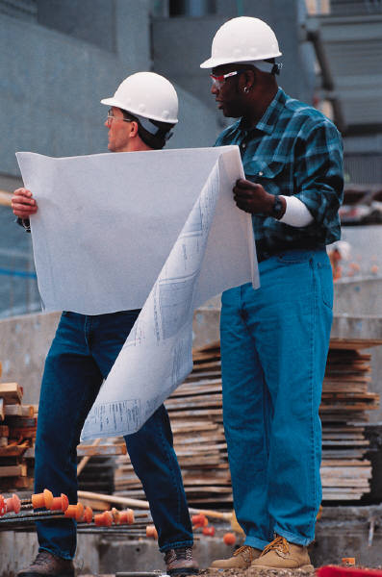
Maintenance Personnel
Staff Turnover
  What’s the “truck factor”?
Application Domain Expertise
  Anthem only wants people who “know Medicare part B”
Working Practices
  Efficiency is very important!
“Didn’t we fix that last year?”
Q5
→
Notes:
Staff Turnover – A killer of maintenance capability → Which often means, key people can never leave!
Application Domain Expertise - A critical intellectual property
Working Practices – “attitude”
A long-term focus is required of the people
Q5: What are three factors to consider when addressing software maintenance personnel issues?

Slide 11
Ingredients of a Maintenance Process (1 of 2)
Process requests before working on them:
  Capture maintenance requests
  Deal with Emergency Fixes/Priority CRs
  Investigate change requests
    Verify bugs from DRs/PRs
    Understand the impacts (1st Impact Analysis)
  Estimate the Effort / Cost
  Prioritize requests
    Competing against other requests!
  Assigning to maintenance release and team
  Scheduling the maintenance release
Q6
→
Notes:
Capture maintenance requests (Change Requests, Discrepancy / Problem Reports, etc.)
1) New versions coming out in Maintenance Releases at regular intervals
2) Ongoing Technical/Maintenance Support
1) Between or instead of releases, 2) Emergency Fixes, 3) Priority Change Requests
Q6: Before you prioritize the change requests, you must do a preliminary impact analysis to _________________ the effort and cost of the change.

Slide 12
Ingredients of a Maintenance Process (2 of 2)
Conduct detailed Impact Analysis
Update estimates
Plan the change strategies
Update Requirements (as needed)
Design the Changes
Plan the implementation
Update Design (Architecture, Logical, Physical)
Implement and Integrate the Changes
Test Changes with Various Configurations
Deciding to send it out
Special, or in a specific sub-release
Deploy the Release
Q7
→
Notes:
Q7: Why conduct a detailed impact analysis if you already did one for estimating the costs for the change request?

Slide 13
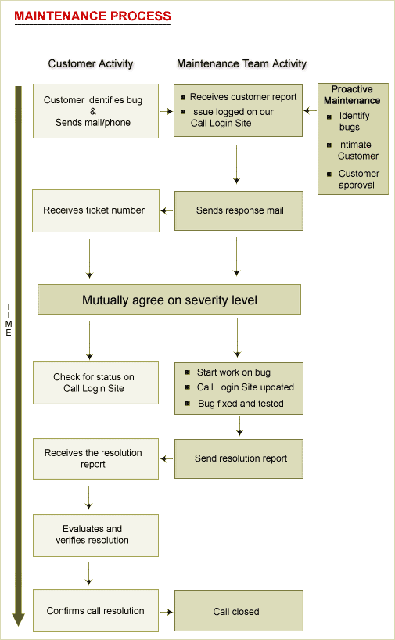
Example Maintenance Process
“Pre-fixing”
Help Desk
Technical Support
Maintenance Personnel
Customers instead of Users!
http://www.indiawebdevelopers.com/CustomerSupport/maintenance_process.asp
Notes:
Note the amount of “pre-fixing” and other communication activity!
Help Desk
Technical Support
Maintenance Personnel
Customers instead of Users!

Slide 14
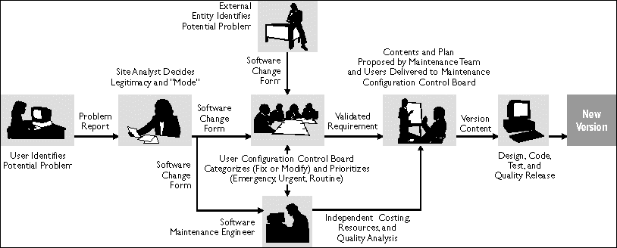
Example: Hill Air Force Base
  http://www.stsc.hill.af.mil/crosstalk/1997/07/stark1.gif.

Slide 15
Maintenance in the System Life Cycle
ISO/IEC 15288
System Life Cycle Processes
ENTERPRISE ENVIRONMENT MANAGEMENT
INVESTMENT MANAGEMENT
SYSTEM LIFE CYCLE MANAGEMENT
RESOURCE MANAGEMENT
ENTERPRISE(5)
QUALITY MANAGEMENT
SYSTEM LIFE CYCLE
ACQUISITION
AGREEMENT (2)
(25)
SUPPLY
PROJECT (7)
PROJECT PLANNING
PROJECT ASSESSMENT
PROJECT CONTROL
DECISION MAKING
RISK MANAGEMENT
CONFIGURATION MANAGEMENT
INFORMATION MANAGEMENT
TECHNICAL (11)
STAKEHOLDER REQUIREMENTS DEFINITION
TRANSITION
REQUIREMENTS ANALYSIS
VALIDATION
ARCHITECTURAL DESIGN
OPERATION
IMPLEMENTATION
MAINTENANCE
INTEGRATION
DISPOSAL
VERIFICATION

Slide 16
Maintenance in the Software Life Cycle
IEEE/EIA 12207
Software Life Cycle Processes
ACQUISITION
SUPPLY
DEVELOPMENT
OPERATION
MAINTENANCE
SOFTWARE LIFE CYCLE
PRIMARY (5)
(17+1)
SUPPORTING (8)
DOCUMENTATION
CONFIGURATION MANAGEMENT
QUALITY ASSURANCE
VERIFICATION
VALIDATION
JOINT REVIEW
AUDIT
PROBLEM RESOLUTION
ORGANIZATIONAL (4)
MANAGEMENT
INFRASTRUCTURE
IMPROVEMENT
TRAINING
Q8
TAILORING
→
Notes:
Q8: With the IEEE/EIA 12207 Software Life Cycle, what other processes are on the same leg Maintenance?

Slide 17
12207’s Maintenance Process
A Primary Life Cycle Process - 12207.0 § 5.5 (ISO/IEC 14764)
Defines the basic activities of the maintainer: managing modifications to the software product to keep it current and in operational fitness.
Activity Tasks
1 Process Implementation Document maintenance activities, problem tracking procedures, & Manage modifications to the system.
2 Problem and modification Analyze problem reports. Replicate or verify
analysis problems. Develop modifications. Document problems, analysis, fixes. Get modifications approved.
3 Modification implementation Document where changes are needed. Implement modifications and test.
4 Maintenance review/ Review integrity of modified system. Get approval for
acceptance modifications.
5 Migration Ensure products meet standard. Develop and use Migration Plan. Notify users of migration. Conduct parallel operations if needed. Notify all concerned, archive all records. Perform post-op review of changes. Keep data from old environment.
6 Software retirement Document plans for retirement. Notify all users of plans and activities. Conduct parallel operations. Notify all concerned, archive all records. Keep data from retired product per contract.

Slide 18
Maintenance Process Standards
ISO/IEC 14764
Process Implementation
Problem and modification analysis
Modification implementation
Maintenance review/acceptance
Migration
Software retirement
IEEE STD 1219
Problem identification
Analysis
Design
Implementation
System test
Acceptance test
Delivery
→

