Slide 1


Software Construction and Evolution - CSSE 375
Software Visualization Tools and Software Evolution
Shawn and Steve
Notes:
Image from http://www.thebestbrainpossible.com/category/visualization.

Slide 2
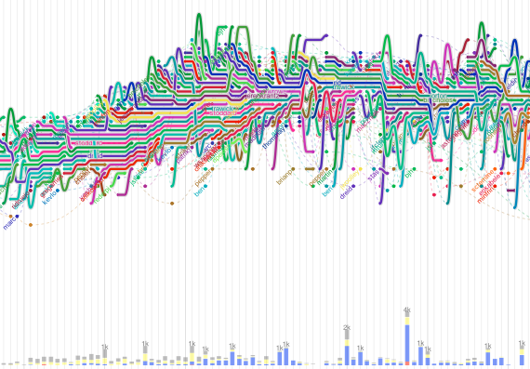
Why Do We Visualize Software & stuff?
Stuff
Above: XKCD comic characters as lines that converge in time, as they share scenes.
Q1
Notes:
Q1: Why do we visualize software
Image from http://flowingdata.com/2010/10/12/software-evolution-storylines/.

Slide 3
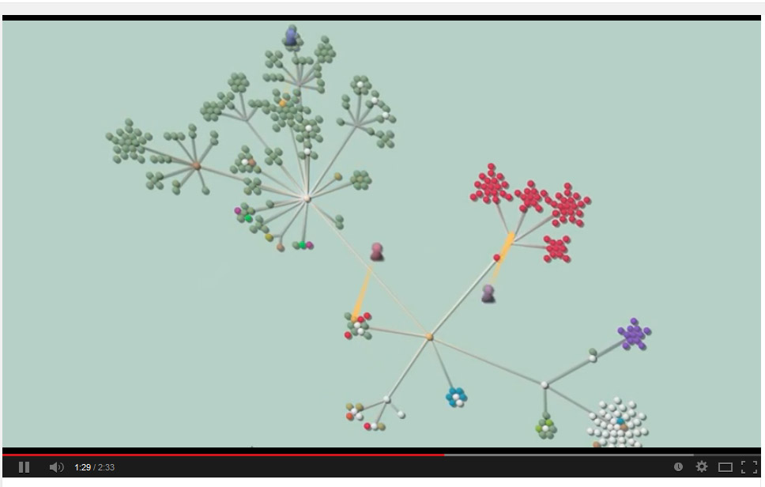
Why Do We Visualize Software & stuff?
Software
Above: Gource, from https://www.youtube.com/watch?v=E5xPMW5fg48.
Q1
Notes:
Q1: Why do we visualize software

Slide 4
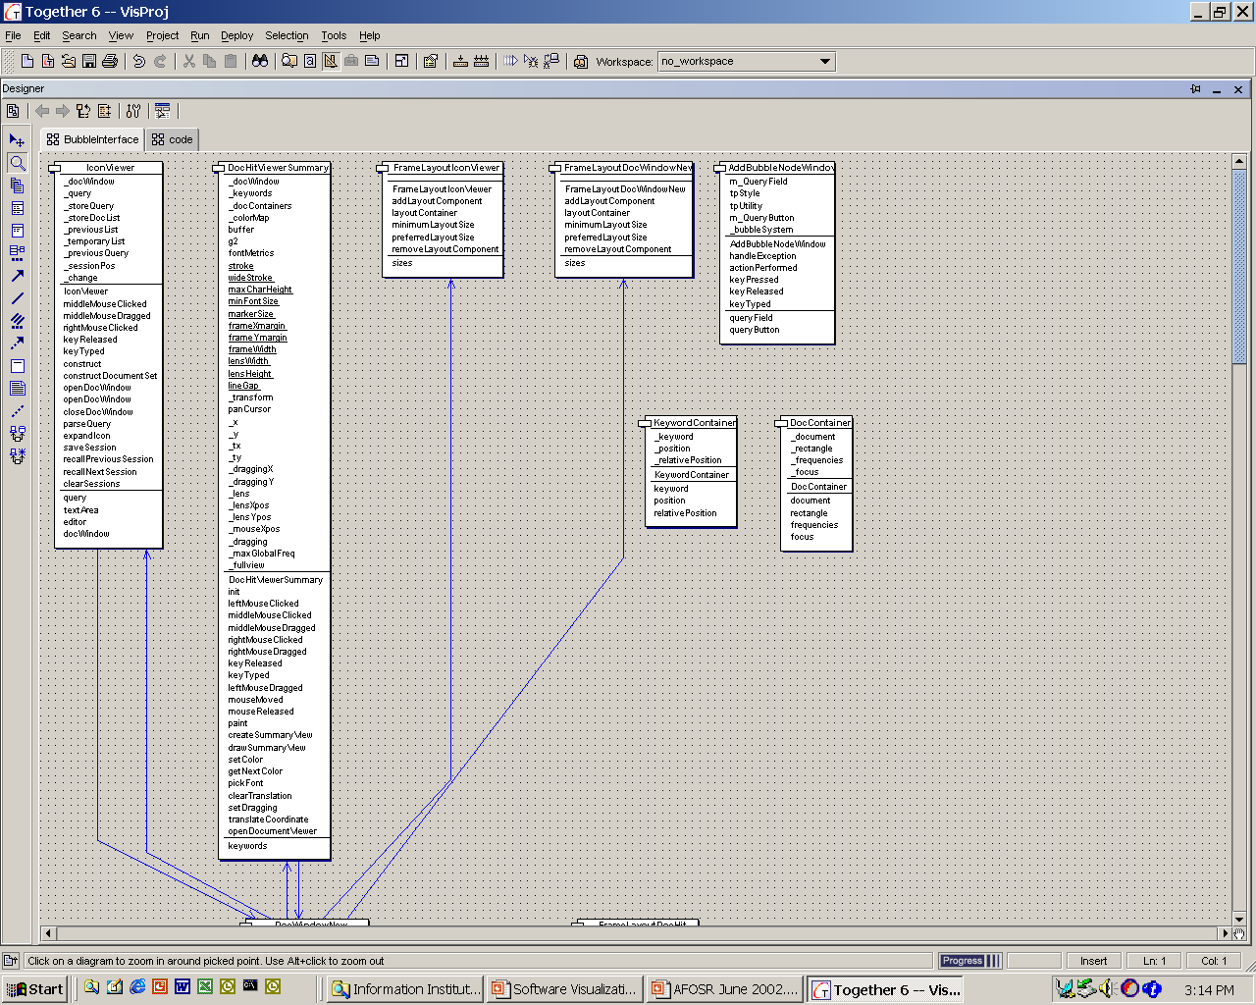
TogetherSoft
Notes:
Purpose: Program Understanding
Abstraction: code, classes, packages, relationships
Presentation
Standard UML diagrams – poor use of space and color
Code – white space and color
Strengths
Well known modeling technique
Round-trip engineering between diagrams and code
Limitations
Poor use of space – can not see the “big picture”

Slide 5
Variations - TogetherSoft
Purpose: Program Understanding
Abstraction: code, classes, packages, relationships
Presentation
  Standard UML diagrams – poor use of space and color
  Code – white space and color
Strengths
  Well known modeling technique
  Round-trip engineering between diagrams and code
Limitations
  Poor use of space – can not see the “big picture”

Slide 6
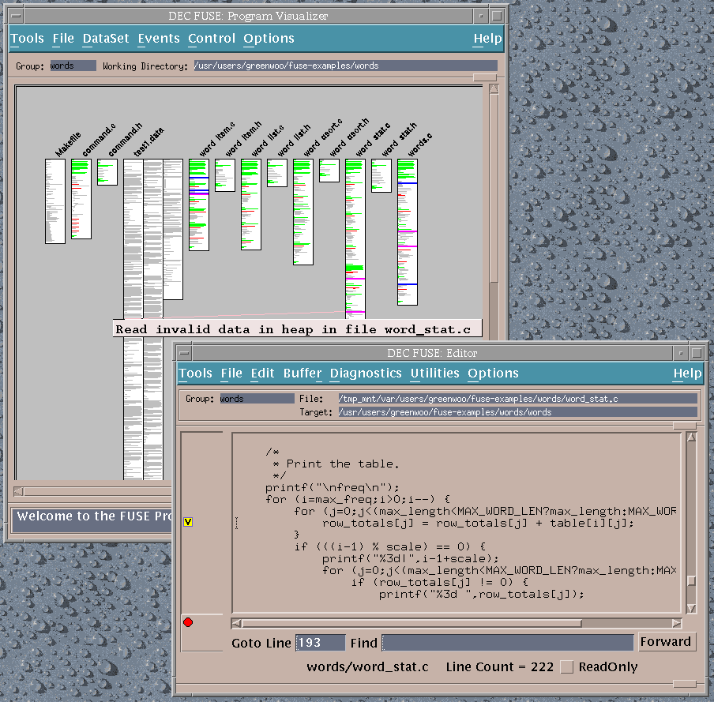
DEC FUSE Program Visualizer
Notes:
Purpose: Navigate and view large programs
Abstraction: Code
Presentation: Text, color, size
Benefits
Good use of space
Overview + detail
Drawbacks
Limited abstraction

Slide 7
DEC Fuse Program Visualizer
Purpose: Navigate and view large programs
Abstraction: Code
Presentation: Text, color, size
Benefits
  Good use of space
  Overview + detail
Drawbacks
  Limited abstraction

Slide 8
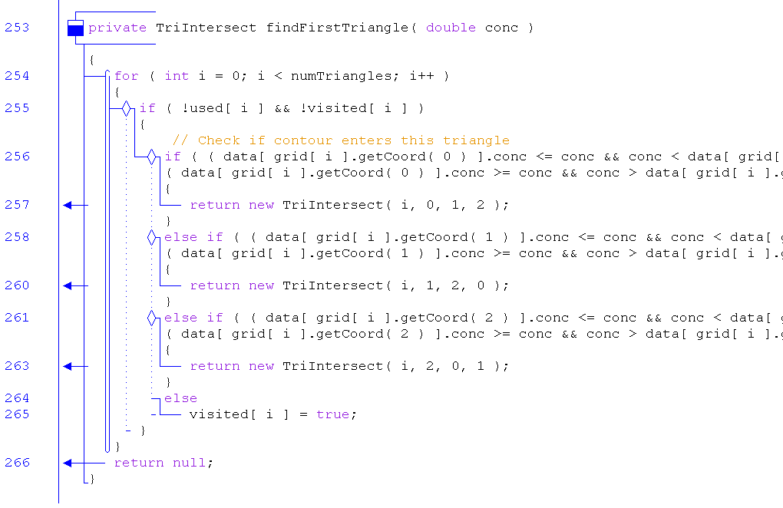
A little more on jGRASP
Q2
Control Structure Diagram shows Control in Code
Notes:
Purpose: Program specification; program understanding, program analysis
Abstraction: code, program blocks, control flow, derived statistics
Presentation
Text, color, diagrams
Color coded bar graphs
Benefits
Control diagrams integrated with code
Complexity analysis mapped to code segments
Drawbacks
Few high level abstractions
Q2: What does jGRASP Control Structure Diagram (CSD) show?

Slide 9
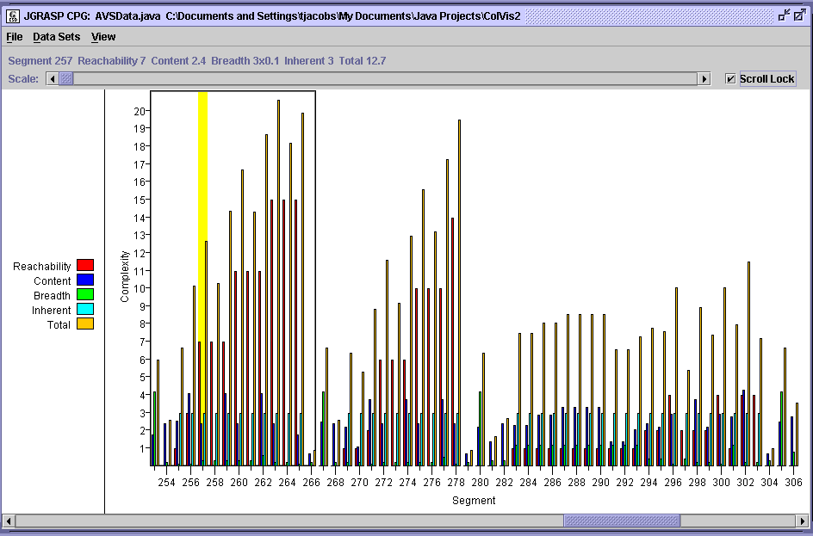
jGRASP Complexity Analysis
Notes:
Reachability - # of conditions that must be evaluated to reach the segment from outside of the enclosing method, function, or other top-level statement block.
Content - the log of the # of significant tokens in the segment.
Breadth - the number of statements, methods, etc. in the innermost block containing the segment.
Inherent - value assigned based on the inherent complexity of the innermost enclosing structure. For example, segments in switch or case statements are assigned an inherent complexity of 3.0. This reflects the view that some structure types are inherently more complex than others.

Slide 10
jGRASP
Purpose: Program specification; program understanding, program analysis
Abstraction: code, program blocks, control flow, derived statistics
Presentation
  Text, color, diagrams
  Color coded bar graphs
Benefits
  Control diagrams integrated with code
  Complexity analysis mapped to code segments
Drawbacks
  Few high level abstractions

Slide 11
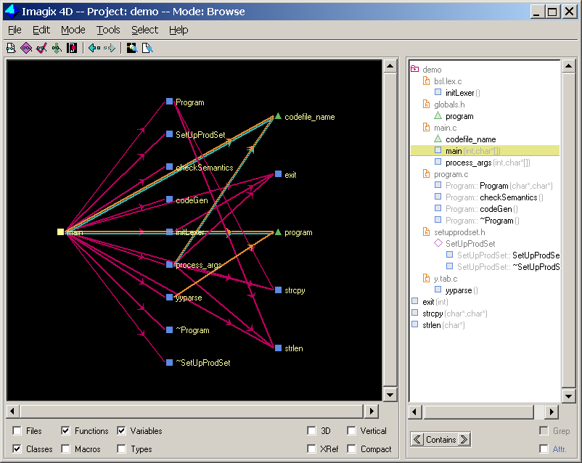
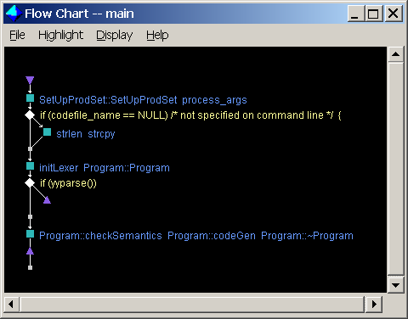
Imagix 4D
Notes:
Purpose: Program visualization
Abstraction: code, structures
Presentation: Text, color, size, graphs
Benefits
A variety of techniques for browsing code and analyzing complexity
Drawbacks
Limited abstraction

Slide 12
Imagix 4D
Purpose: Program visualization
Abstraction: code, structures
Presentation: Text, color, size, graphs
Benefits
  A variety of techniques for browsing code and analyzing complexity
Drawbacks
  Limited abstraction

Slide 13
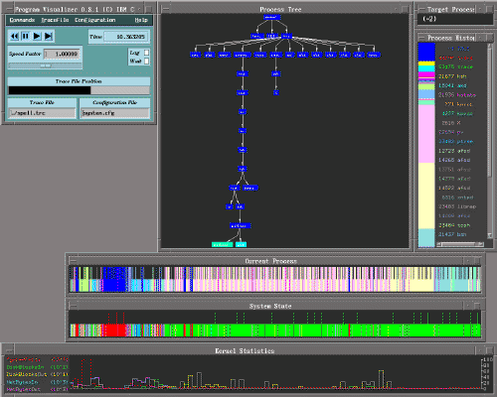
Program Execution Analysis
IBM Program
Visualizer (PV)
Notes:
Process tree – shows the process hierarchy at the current point in the trace replay
Current process – shows which process was running at each time instant
System state – shows the state of the system (idle, user mode, system call, interrupt, page fault) at each time instant
Kernel statistics – shows the rates at which a selecdted set of kernel activities were occurring at different times
Process histogram – whos the relative amounts of time that different processes have accumulated up to the current point in the trace replay
Target process – whos the name or process id of the currently selected target process

Slide 14
IBM Program Visualizer
Purpose: Analyze program execution
Abstraction: code, memory, cpu
Presentation: Text, color, size, graphs
Benefits
  Lots of relevant information
  User configurable
Drawbacks
  No high level abstraction
  No linkage between charts

Slide 15
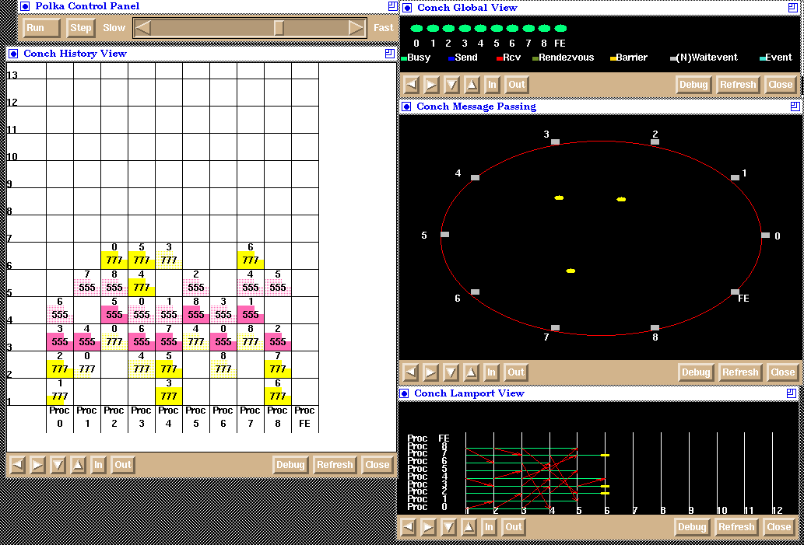
Concurrent Program Visualization
ConchViz
Notes:
History view – messages sent (dark) or received (light); time on y axis, process on x axis
Message passing view – messages sent as yellow blobs between processes in outside ring
Lamport view – message between processes over time – animated

Slide 16
ConchViz
Purpose: Animate message passing
Abstraction: messages, time
Presentation: Text, color, glyphs, lines, animation
Benefits
  Animation helps information and message flow analysis
Drawbacks
  Single level of abstraction
  Poor use of space – difficult to scale to many processes

Slide 17
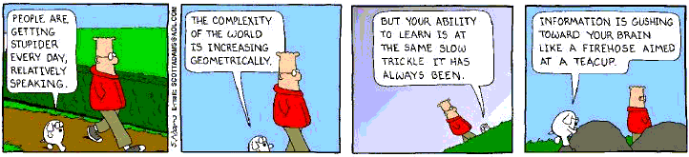
Dogbert’s Take, on Why We Visualize

Slide 18
Software Evolves in an Ecosystem
Largely based on the concept of positive and negative feedback systems existing in the software environment
Examples of feedback systems:
  Users
  Management
  Developers
  Government
Business
Change
System
Technology
Change
Cultural
Change
Q3
→
Notes:
Q3: What are three change forces that impact today’s software systems? Which one is most important, and why?

Slide 19
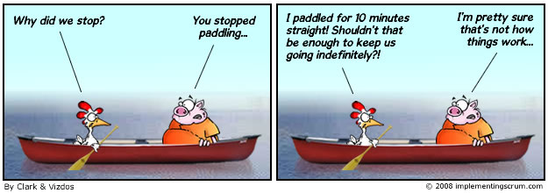
Cultural change is hard!
Change always takes longer than expected, to take hold…
This impacts acceptability of your new products.
We’d like to think better ideas win out on their own merits.
Not that easy – why?
Notes:
Cartoon from http://www.implementingscrum.com/2011/02/15/scrum-and-organizational-change-management/.

Slide 20
Enterprise Architecture Perspective
Business
Context
Business Strategies
BUSINESS
ARCHITECTURE
IT Steering
Committee
TECHNOLOGY
ARCHITECTURE
Business
Model
Domain1
Domain2
:
Domain#N
Tech-
nology
Model
Domain1
Domain2
:
Domain#N
Decision
Table
Corporate
Organization
Information
Value Chain
Information
Architecture
Business Industry Trends
IT Infrastructure
Technology Industry Trends
Program
Management
Office
Business
Processes
Application
Portfolio
Technology
Context
Technology Strategies
Notes:
Evolution is so important to large systems and the corpus of all the systems in an organization that they organize around them…

Slide 21
Software Evolution - Some History
Lazlo Balady and Manny Lehman worked for IBM studying the properties of software
Focused on software change and observed evolution patterns
Started with three “Laws” in 1968-74 and “evolved” to eight by 1997
Empirically demonstrated for 2 systems:
  OS/360 (IBM mainframe OS in the 1960’s)
  Logica FW (a financial transaction system)
Q4
→
Notes:
Q4: What was the focus of the Software Evolution Study conducted by Balady and Lehman? What was their goal?

Slide 22
Key Software Evolution Definitions (1 of 2)
Two main types of software: S and E Types
S-type software: those addressing a problem with a computational solution in an abstract and closed domain (i.e., mathematical)
  Example: floating point package may be judged correct via the IEEE standard for floating point
Q5
→
Notes:
Paper is at http://blogs.msdn.com/b/karchworld_identity/archive/2011/04/01/lehman-s-laws-of-software-evolution-and-the-staged-model.aspx.
Q5: What are the two key “types of software” that the software evolution paper discusses? What’s the third type, and which is it closest to?

Slide 23
Key Software Evolution Definitions (2 of 2)
E-type software: produced because it satisfies some real world need and so is forced to evolve as the reality changes
  Example: embedded code must fit the hardware it is placed in and must change if the hardware is changed
This represents the majority of software
Q6
→
Notes:
Q6: According to Lehman, what type of systems do most of the software systems today reflect?

Slide 24
Software Evolution
The Law of Continuing Change (1974)
The Law of Increasing Complexity (1974)
The Law of Self Regulation (1974)
The Law of Conservation of Organizational Stability (1980)
The Law of Conservation of Familiarity (1980)
The Law of Continuing Growth (1980)
The Law of Declining Quality (1996)
The Feedback System Law (1996)
Source: Lehman, M., et al, “Metrics and Laws of Software Evolution—The Nineties View,” Proceedings of the 4th International Software Metrics Symposium (METRICS '97), IEEE, 1997, can be downloaded from: http://www.ece.utexas.edu/~perry/work/papers/feast1.pdf

Slide 25
Discussion Groups
First group – Lead Laws 1 and 2
Second group – Lead Laws 3 and 4
Third group – Lead Laws 4 and 6
Fourth group – Lead Laws 7 and 8
Question 1: What does the law have to do with contemporary or traditional Software?
Question 2: Is this different for software developed using Agile approaches?

Slide 26
Law 1 - Continuing Change
An E-type (evolutionary type) program that is used must be continually adapted else it becomes progressively less satisfactory.
This is due in part to the fact that the software never exactly matches the desired operational domain (the “Software Uncertainty Principle”).
Q7
Notes:
Note: Business “law” - Things that are not growing are dying.
Q7: In your own words, what does the law 1 – Continued Change mean for today’s systems?

Slide 27
Law 2 – Increasing Complexity
As a program is evolved its complexity increases unless work is done to maintain or reduce it.
Related to the Second Law of Thermodynamics
If effort is expended to combat this (through re-engineering and other techniques) this means less effort for new functionality.
Q8
Notes:
Related to the Second Law of Thermodynamics: “In all energy exchanges, if no energy enters or leaves the system, the potential energy of the state will always be less than that of the initial state." This is also commonly referred to as entropy.
Q8: How is the Second Law of Thermodynamics related to the law of Increasing Complexity?

Slide 28
Law 3 – Self Regulation
The program evolution process is self regulating with close to normal distribution of measures of product and process attributes.
From Lehman’s paper: “Checks and balances will have been established by…management to ensure that operational rules are followed and organizational goals…are met…[This is] one example of feedback driven growth and stabilization mechanisms…[They] establish a disciplined dynamics whose parameters are, in least in part normally distributed.”
Notes:
Note: Equal and opposite reaction…

Slide 29
Law 4 – Conservation of Organizational Stability
Invariant Work Rate: The average effective global activity rate [total effort expended] on an evolving system is invariant over the product lifetime.
On the surface, it doesn’t make sense. However, various forces are at work that often counteracts attempts to increase productivity.
Notes:
[e.g. management increasing the number of people on a project increases communication overhead].
Note: first described in The Mythical Man-Month by Fred Brooks

Slide 30
Law 5 – Conservation of Familiarity
During the active life of an evolving program, the content of successive releases is statistically invariant.
From Lehman’s paper: “One of the factors that determines the progress of a software development is the familiarity of all involved with its goals. The more changes & additions [in a] particular release, the more difficult is for all concerned to be aware, to understand and to appreciate what is required of them…The larger the work package the more challenging mastery of the matter to be acquired.”

Slide 31
Law 6 – Continuing Growth
Functional content of a program must be continually increased to maintain user satisfaction over its lifetime.
Various factors mean that user demands for more functionality will increase over time, and thus the functional content must also increase
Q9
Notes:
Not the same as the first law, which refers to the fact that software never exactly matches its operational domain
Note: Customers change and grow and so do the systems that support them. Just think of your own home…
Q9: What does Law 6 “Continuing Growth” mean for software?

Slide 32
Law 7 – Declining Quality
E-type programs will be perceived as of declining quality unless rigorously maintained and adapted to a changing operational environment.
Otherwise, the system is perceived as older and less useful and less valuable.

Slide 33
Law 8 – Feedback System
E-type programming processes constitute multi-loop, multi-level feedback systems and must be treated as such to be successfully improved.
Multi-loop means that it is an iterative process
Multi-level means it occurs in more than one aspect of the software and its documentation

Slide 34
Applicability of Lehman’s Laws
Lehman’s laws seem to be generally applicable to large, tailored systems developed by large organizations
How do they pertain to:
  Shrink-wrapped software products
  Systems that incorporate a significant number of COTS components
  Small organizations
  Medium sized systems
Notes:
Confirmed in more recent work by Lehman on the FEAST project

