Slide 1


Software Construction and Evolution - CSSE 375
Software Maintenance at 30K Feet
Shawn and Steve
Left – Tibet from 30000 ft. (~9 km).
Notes:
Image from http://winterson.com/2008/04/30000-feet-over-tibet.html

Slide 2
Recall: Software Evolution
The Law of Continuing Change (1974)
The Law of Increasing Complexity (1974)
The Law of Self Regulation (1974)
The Law of Conservation of Organizational Stability (1980)
The Law of Conservation of Familiarity (1980)
The Law of Continuing Growth (1980)
The Law of Declining Quality (1996)
The Feedback System Law (1996)
Source: Lehman, M., et al, “Metrics and Laws of Software Evolution—The Nineties View,” Proceedings of the 4th International Software Metrics Symposium (METRICS '97), IEEE, 1997, can be downloaded from: http://www.ece.utexas.edu/~perry/work/papers/feast1.pdf

Slide 3
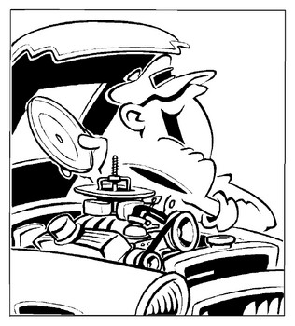
Software Maintenance Concepts
“So, you tried to do this yourself?”

Slide 4
Software Maintenance Mindset Calibration
Industry Cost Mindset:
Software Maintenance is a problem!
Maintenance activities consume 50-80% of most software budgets
  ~20% of maintenance devoted to fixing errors (Corrective)
  Perfective, Adaptive & Preventative is the rest
BETTER MINDSET:
Software Maintenance Investments Sustain and Improve Software Assets
Q10
→
Notes:
Q10: Why is software maintenance perceived as a problem?

Slide 5

Goals of Software Maintenance
Preserve and enhance
investments in software systems
  Proactive maintenance
  Reactive maintenance
Improve software maintainability
and ultimately extend software life
  e.g., Reengineering of maintenance critical software
→
Notes:
Preserve and enhance investments in large software systems
Proactive maintenance to improve software assets
Reactive maintenance to respond to emergency fixes (followed by proactive scheduled maintenance)

Slide 6

Development versus Maintenance (1 of 2)
Software Development (Initial)
  Often “from scratch” or “green field”
  Can choose process model
  Time to upgrade/update methods and tools
  Requirements and delivery driven
  Risk is often in requirements uncertainty
  Closer development project gets to delivery, the more it looks like maintenance…
Q11
→
Notes:
Maintenance is within the confines of existing system and process and tools…
E.g., “How would you change the change management system during maintenance?
Q11: The closer software development projects get to delivery, the more they look like ________________. Why?

Slide 7
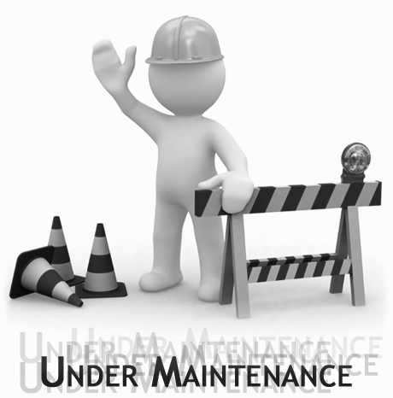
Development versus Maintenance (1 of 2)
Software Maintenance
  Must work within constraints of “existing system”
  Changes smaller scale than original development
  Manage change with multiple releases rather than functional builds
  Large part of effort is in understanding the change in the context of existing system artifacts
  Requires an “augmentation” rather than construction mindset
Q12
→
Notes:
Maintenance is within the confines of existing system and process and tools…
E.g., “How would you change the change management system during maintenance?
Impact analysis needed for estimates
Q12: A large part of the software maintenance effort is in _____________ the change in the context of ________________ system artifacts.

Slide 8
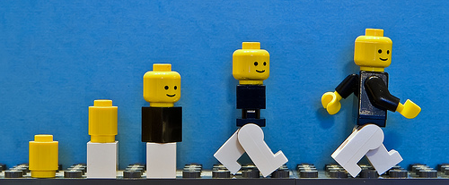
Software Maintenance versus Evolution
Maintenance and Evolution both refer to making changes to an existing system
Maintenance often refers to fixing bugs or porting a system to a new platform
Evolution is implied when making enhancements to existing software where the specifications or technology changes
Q13
→
Notes:
However, there is not strong agreement in the community…
We’ll often use “maintenance” to mean both
Q13: Software Evolution implies what types of changes are done to a system?

Slide 9
Software Systems Evolve
Software grows in size, complexity, and errors
Increased size with adding new features
Increased complexity with add-on changes
Errors complicated by continuous changes, often incomplete!
  Now that’s an insidious bug...
Q14
→
Notes:
Increased size with adding new features - Hey, I didn’t know it could do that! How about just...
Increased complexity with add-on changes - Just use the NAME field of the X1 record...it should work!?!
Errors complicated by continuous changes, often incomplete! [–> lead in for next slide]
Q14: As a software system evolves, what characteristics increase?

Slide 10
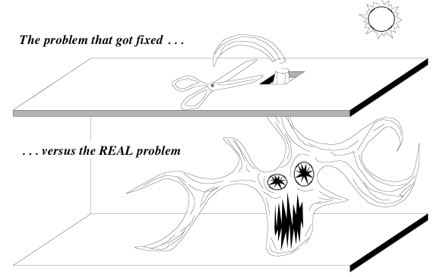
The “Hydra Effect” in Corrective Maintenance

Slide 11
Software Maintenance Challenge
Seemingly minor changes often turn out to be more extensive than expected
Consequences include:
  Incomplete changes (maybe discovered by user...)
  Poorly implemented changes
  (patches and spaghetti)
  Effort, resource, and estimate errors
  (due to low visibility)
  Difficulty augmenting software design
  Reduced maintainability and useful life of the software
Q15
→
Notes:
Q15: What are the consequences of the “Hydra-Effect” and other software maintenance challenges?

Slide 12
Proactive Versus Reactive Maintenace
Cost
Reactive
Maintenance
Proactive
Maintenance
Time
Notes:
Refactoring is a good example of Proactive Maintenance.

Slide 13
Exercise: Development and Maintenance
Is the difference really “green field?”
  These days, few project are “from scratch”
Sometimes, it’s hard to tell the difference
Let’s look at some examples – you tell me…
Notes:
Sometimes, it’s hard to tell the difference.
Distinction may be as crazy as “Which manager’s team gets to do it – the ‘development’ manager, or the ‘maintenance’ manager”

Slide 14
Example 1: Development or Maintenance?
One of our junior projects was creating a project portfolio management system. Much of the project could be done with a content management system called Joomla.
  Joomla already exists – they were building on top of that
  It has to “talk to” other existing stuff, like Rose’s AFS, maybe Angel?
  Maybe use Kerberos passwords?
  Not exactly “green field”
Q16
→
Notes:
Q16: Is Example 1 Development or Maintenance? Why?

Slide 15
Example 2: Development or Maintenance?
Same junior project was creating a CSSE project portfolio management system; found that the Joomla implementation wasn’t going to work over time.
  Redesigned system to to use Django instead.
  Again, still need to “talk to” other existing stuff, like Rose’s AFS, maybe Angel?
  Maybe use Kerberos passwords?
  But they are fixing a problem, aren’t they?
→

Slide 16
Example 3: Development or Maintenance?
A system I worked on in industry kept track of maintenance data for a very large communications network.
  For the 4th release of the same system, they were making their database “available” for other applications to access
  Most of these accesses would be ad hoc queries of large amounts of data
Q17
→
Notes:
Q17: Is Example 3 Development or Maintenance? Why?

Slide 17
Example 4: Development or Maintenance?
A system we have seen too many of…
  First release was “rush to market.”
  Few, if any, of the documentation artifacts were produced.
  Now they’re ready to do Release 2.0.

Slide 18
Example 5: Development or Maintenance?
Software system is getting too out of date and with every change, the cost seems to take too long and cost too much. They are thinking of junking the system, but have found a packaged application to replace it if we can convert all the data.
  They don’t yet know what / how much work that will be.
  The costs/effort are in the integration, transition, and testing rather than the normal requirements, design, implementation, and testing…
→

Slide 19

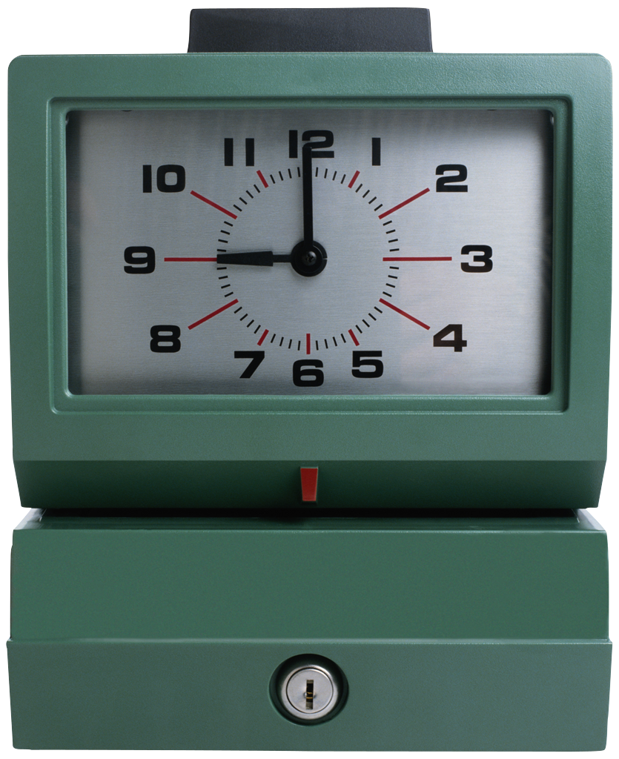
Discretionary and Non-Discretionary $
Since Development and Maintenance can be somewhat ambiguous situations, money often determines the label (see next slide)
The boundary may be like:
  Estimated cost (>$5000)
  Estimated effort
  (> 20 hours of effort)
  Above some limit, it’s “non-discretionary.”
→
Notes:
Non-discretionary means you have to get more approvals to do something, and it may be seen as “new development” versus already budgeted maintenance.

Slide 20
Often the identity relates to the funding
Development – Emphasis on doing it fast, even if it costs more.
  Willing to add people to the project, as needed.
  Given priority for additional funding.
  Anticipation is gaining new customers.
    Which is about 5x harder than keeping old customers.
  May be a known competitive battle to be “first to market.”
Maintenance – Emphasis on holding down costs.
  Usually a fixed group of people working on it.
  Documentation is important!
  Need to refactor and redesign to keep adding features.
    These are taken from “change requests,” by priority.
  “Support” is half the cost.
  Anticipation is existing customer “satisfaction.”

Slide 21
Development versus Maintenance Risk
Development Risks
  Technology - sometimes bleeding edge
  Personnel - sometimes high turnover
  Budget - risk entrepreneurial investments
  Business - business case based on future customers
Maintenance Risks
  Technology - sometimes technology obsolete
  Personnel - sometimes dated skills
  Budget - risk averse cost containment
  Business - business case based on existing customers
Q18
→
Notes:
Q18: What is the business case based on for Software Maintenance?

