Slide 1
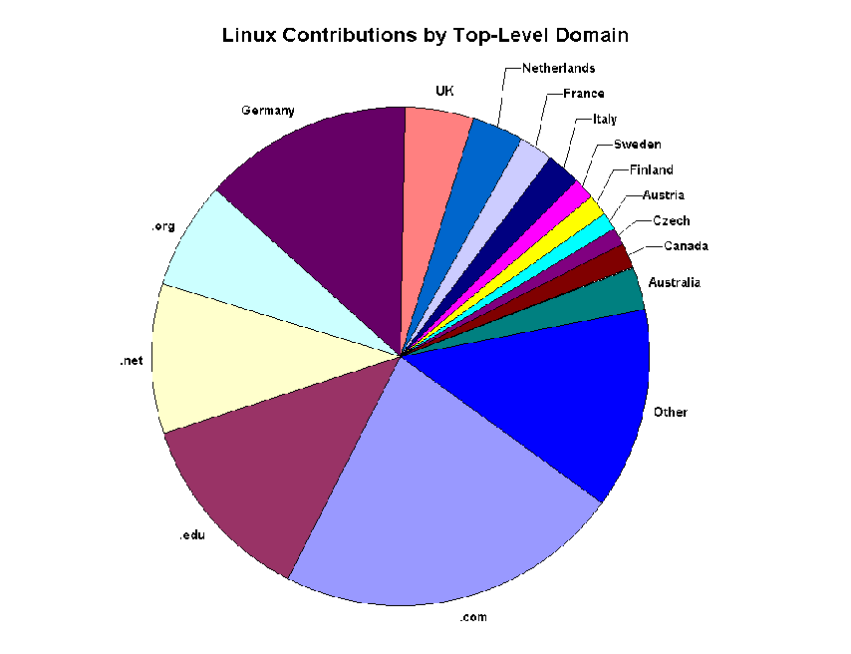

Software Construction and Evolution - CSSE 375
Open Source 2
Shawn & Steve
Notes:
Image is from your reading - http://www.stromian.com/Book/Chap1.html.

Slide 2
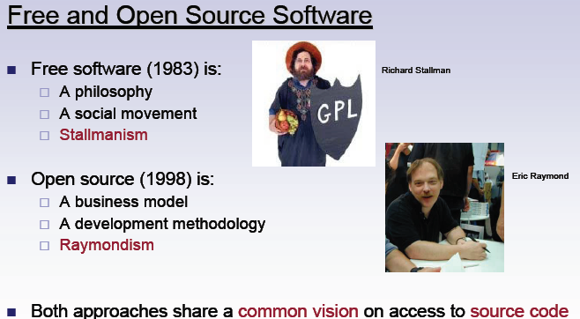

“Free” and “Open Source” Software
Free Software Foundation
  Philosophy of Software Sharing
  Social Movement
  Stallmanism
Open Source Software
  A Business Model
  A Development Approach with
  Shared Software
  Raymondism (Eric Raymond)
Both focus on access to source code
Notes:
Stallman campaigns for software to be distributed in a manner, such that a user receiving it, likewise receives with it the freedoms to use, study, distribute and modify that software: software that ensures these freedoms (on receipt) is termed free software. Example: GNU. See the Wikipedia article about Stallman.

Slide 3
Some Raymondisms…
Treating your users as co-developers
Release early… Release often!
Treat your beta-testers as if they're your most valuable resource
The next best thing to having good ideas is recognizing good ideas from your users
Q8
Notes:
Eric Raymond believes the GPL license holds back open source software, among other things!
These sayings have nothing to do with the Urban Dictionary definition of Raymondisms.

Slide 4
Open Source Advantages: Commercial
Independence – Levels the Playing Field
Access to all technical information, not only a vendor chosen subset
Any technical person has the same chance to become an expert as company employees
Competing commercial services available
Lower investment in time and money
No extra fees for advanced features like replication/free text search
Q9
Notes:
Your Independence!

Slide 5
Open Source Advantages: Community
Trains and exposes skilled developers
Find bugs faster, on more platforms
Additional testing, development, business intelligence, etc. resources
Win-Win-Win - original developers, end users, other software projects
  Linus' law: given enough eyeballs,
  all bugs are shallow
Q9, cntd

Slide 6
Some Key Issues for OSS Project
Project/Code maturity
Programming language
Type of software developed
Intended audience
Reputation of participants
Licensing issues
Organizational involvement in the project

Slide 7
Evolving Software
Open Source Software tends to grow organically based on needs & contributions
  Rather than economic games by business
Studies have found that the dependency structures of Open Source Software are similar to organisms (opportunistic)
What do you think the impact will be on a largely cost controlled software economy?
Q10

Slide 8
Cool concept, but WIIFM*?
Exemplars - systems like the one you may have in mind to construct
Reuse - anything from wholesale reuse to design salvaging
Opportunity to contribute to the body of evolving software
Opportunity to interact with some of the best software engineering professionals in the business - Learn!
*What’s in it for me?

