Slide 1
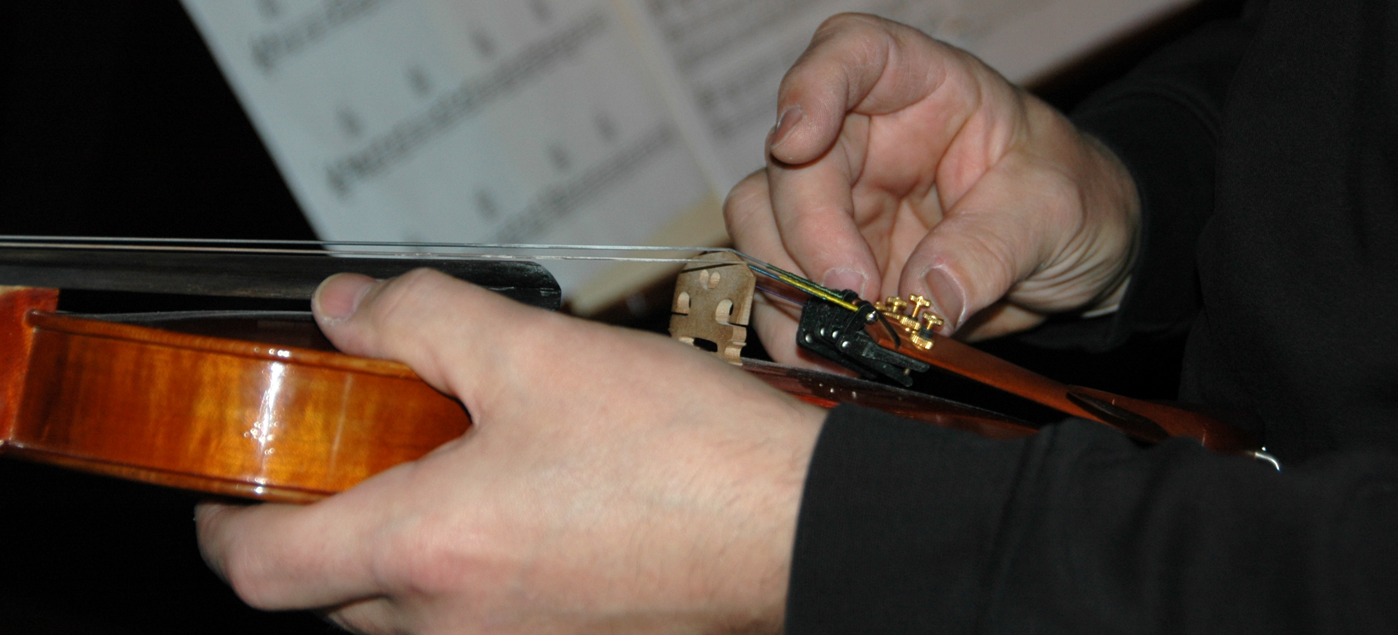

Software Construction and Evolution - CSSE 375
Code Tuning
Shawn and Steve
Left – Even tuning an ancient instrument like a violin involves multiple steps. Here is fine tuning, being done after coarse tuning has been accomplished using the pegs on the other end.
Notes:
Image from http://jillbeckerphotography.com/images/hands.

Slide 2
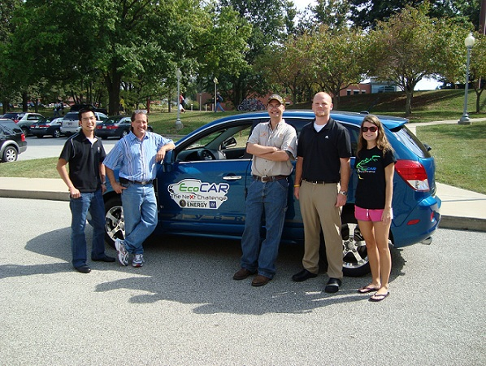

Brief Overview of Code Tuning
RHIT is all about the tuning!

Slide 3

Historical Context
1960s: When Dinosaurs Roamed the Earth :-)
  Resources decidedly limited
  Nothing more important than efficient use of resources
1970s: Dinosaurs got faster
  Computing improves
  Realizing how much it hurt readability and maintainability
1980s: Dinosaurs giving way to warm bloods
  Microcomputers brought efficiency issues back
  Waned in throughout the 1990s
2000s: Not many Dinosaurs anymore…
  Memory in embedded issues becomes the efficiency concern

Slide 4
Example: Performance Requirements
You have a system that monitors economic transactions for say Amazon.com
Critical use cases / scenarios:
  60K transactions per hour (peak)
  Each validated transaction updates status and activity information in the memory of a server
  5 displays for people watching
    Monitor exception transactions and statistics
  Screens must automatically update every 10 seconds
  Every 10 minutes the in-memory information is saved to disk, using SQL-Server

Slide 5
Example: System Performance Architecture
Trans
Input
Stream
60k/hr
Trans
validate
Update
stats
Update
displays
“Every” means “batched.”
20 ms?
20 ms?
Every 10 sec
Put in
DB
Find
exceptions
20 ms?
Every 10 min
Design looks something like this figure above
60,0000 trans/hr = 1000 trans/min = 60 ms/trans
Naïvely assume each of the 3 functions on a transaction takes equal time
So, they each have to be done in 20 ms
What are the two performance “lumps”?
Can they be tuned out?
Q1

Slide 6
Step One on this example…
Somebody had to be working the performance concerns from Day 1 of the project.
You can’t wait till it hits the test lab, then expect to tune to spec something this big!
Problem is you don’t really SEE the issues until it does hit the lab.
So, you can get lulled into thinking everything is ok.
  And focus just on writing features.
If the architecture isn’t right, you could have to start over.
See CSSE 477 for more!

Slide 7
Program Requirements Example
Initial requirement: sub-second response time
  Highly complex design
  Estimate cost: $100 million
Further analysis:
  User’s happy with four-second response time 90% of the time
  Reduced system cost by ~$70 million
Make sure you’re solving a problem that needs to be solved
Q2
Notes:
Barry Boehm’s example from TRW

Slide 8
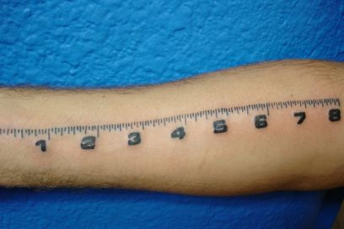
Pareto Principle – 80/20 Rule
80% of result is achieved by 20% of effort
“An Empirical Study of Fortran Programs” by Donald Knuth
  < 4% of a program accounts for more than 50% of it’s run-time
How does this relate to code tuning?
Q3
Notes:
It is mostly about flow and bottlenecks… know thy constraints.

Slide 9
Let’s consider…
Reducing the lines of code in a high-level language improves speed or the size of the resulting machine code.
(Pick which one – it matters.)

Slide 10
Which is faster?
a [ 1 ] = 1
a [ 2 ] = 2
a [ 3 ] = 3
a [ 4 ] = 4
a [ 5 ] = 5
a [ 6 ] = 6
a [ 7 ] = 7
a [ 8 ] = 8
a [ 9 ] = 9
a [ 10 ] = 10
for i = 1 to 10
a[ i ] = i
end for
Q4

Slide 11
Results…
Language | for-Loop Time | Straight-code time | Time Savings | Perform-ance Ratio
C++ | 8.47 | 3.16 | 63% | 2.5:1
Java | 12.6 | 3.23 | 74% | 4:1
You had some of this in CSSE 132, etc.

Slide 12

Common Sources of Inefficiencies
I/O Operations
Paging
System Calls
Interpreted languages
Errors

Slide 13
Good Tips on Logic
Stop testing when you know the answer
  Short circuit in conditionals and loops
  Standard with C++ and Java
Order tests by frequency
Compare performance of similar logic structures
  Some languages case is faster than if-then-else
Substitute table lookups for complicated expressions
Q5, Q7
Notes:
You do all this only if “it matters.”

Slide 14
Loops – Make Decisions outside of Loop
Putting the loop inside the conditional
Good for ~20% time savings
for ( i = 0; i < count; i++ )
{
if ( sumType == SUMTYPE_NET)
netSum = netSum + amount[ i ];
else
grossSum = grossSum + amount[ i ];
}
if ( sumType == SUMTYPE_NET)
{
for ( i = 0; i < count; i++ )
netSum = netSum + amount[ i ];
}
else
{
for ( i = 0; i < count; i++ )
grossSum = grossSum + amount[ i ];
}

Slide 15
More Loops
Jamming
  Combine loops that operate over the same elements
Unrolling
  Reduce the amount of loop housekeeping
Minimize work inside of the loop
  Assign complicated pointer expressions to a well-named variable

Slide 16
More Loops (continued)
Sentinel values
  Simplifying compound tests
Nested loops:
  Put busiest loop on the inside
Strength reduction
  Replace expensive operations (multiplication) with cheaper operations (addition)
Q6, Q8

Slide 17
Data Transformations
Use integers rather than floating-point numbers
Use the fewest array dimensions possible
Minimize array references
Use supplementary indexes
Use caching
Much more in books like Steve McConnell’s Code Complete…
Q9

Slide 18
Can Refactoring and Design Patterns coexist with Code Tuning?
Yes, but pick your battles…
Know the landscape of requirements and constraints
Balance Performance & Maintainability
  Design Performance in the large
  Tune code locally

